Slide 1

Topic: Introduction to Thermodynamics
Lecture - 2
Disclaimer:
The study materials/presentations are solely meant for academic purposes and they can be reused, reproduced, modified, and distributed by others for academic purposes only with proper acknowledgements.

Slide 2
  Property, State and Process
  To describe a system completely, the knowledge of its properties is required.
  A property is a macroscopic characteristic of a system to which a numerical value can be assigned at a given time without knowledge of the previous behavior.
  Examples of properties: Mass, volume, energy, pressure, and temperature etc.
  Thermodynamics also deals with quantities that are not properties, such as mass flow rates and energy transfers by work and heat, etc.
  The word state refers to the condition of a system as described by its properties.
  A state often can be specified by a subset of the properties. All other properties can be determined in terms of these few.

Slide 3
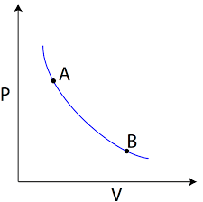
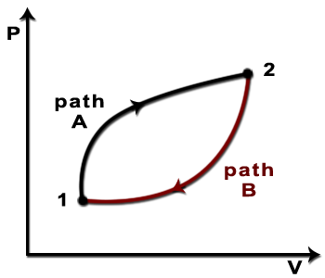
  When any of the properties of a system changes, the state changes and the system is said to undergo a process.
  In other words, a process is a transformation from one state to another.
  A system is said to be at steady state if none of its properties changes with time.
  How to determine whether a quantity is a property?
  A quantity is a property if, and only if, its change in value between two states is independent of the process, and depends solely on the end states.
  There is special kind of process, known as thermodynamic cycle.
  It is a sequence of processes that begins and ends at the same state, and the cycle is periodically repeated.

Slide 4
  Therefore, over the cycle, there is no net change in any property values.
  Example: The steam circulating through electrical power plant executes a cycle.
  Extensive and Intensive properties:
  A property is called extensive if its value for an overall system is the sum of its values for the parts into which the system is divided.
  Mass, volume, energy, and several other properties introduced later are extensive. Extensive properties depend on the size or extent of a system.
  Intensive properties are independent of the size or extent of a system and may vary from place to place within the system at any moment.
  Example: Specific volume, pressure, and temperature are important intensive properties.

Slide 5
  Intensive properties are not additive in the sense previously considered.
  Intensive properties may be functions of both position and time, whereas extensive properties can vary only with time.
  Concept of equilibrium:
  Classical thermodynamics places primary emphasis on equilibrium states and changes from one equilibrium state to another.
  The thermodynamic, or complete equilibrium refers to mechanical, thermal, phase, and chemical equilibrium.
  Isolate the system from its surroundings and if there are no changes in its observable properties, the system can be said to be at an equilibrium state.

Slide 6
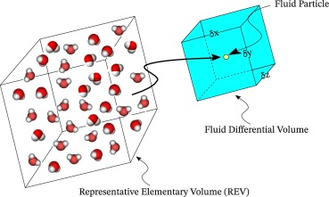
  At equilibrium, temperature is uniform throughout the system. Also, pressure is uniform throughout as long as the effect of gravity is not significant.
  Important properties in engineering thermodynamics:
  Three measurable intensive properties that are particularly important are specific volume, pressure, and temperature.
  From the macroscopic viewpoint, the description of matter is simplified by considering it to be distributed continuously throughout a region, known as the continuum hypothesis.

Slide 7
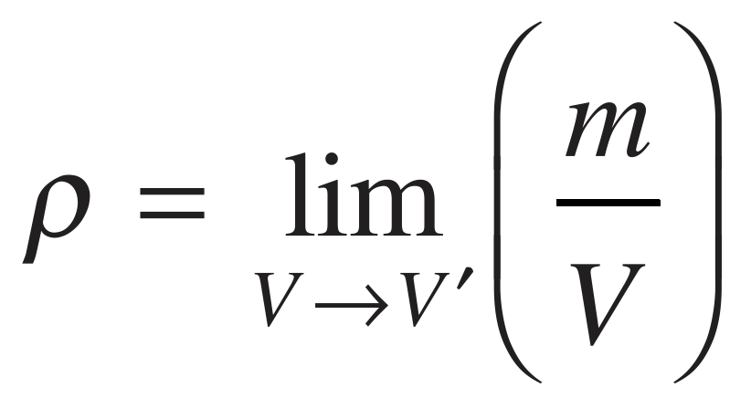
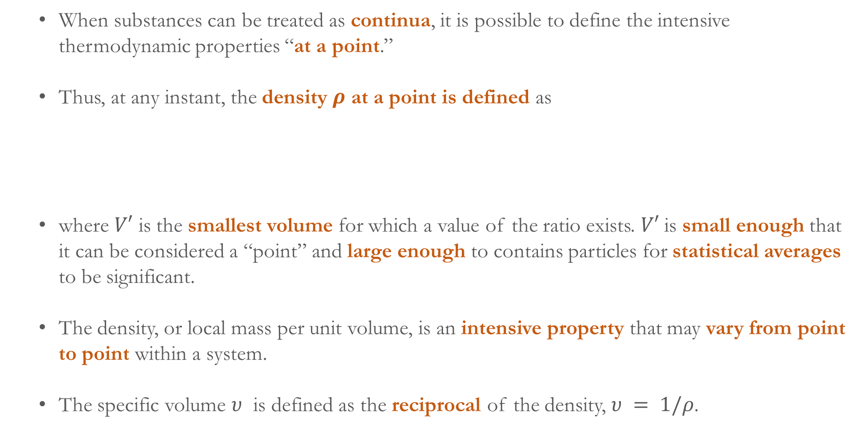
  When substances can be treated as continua, it is possible to define the intensive thermodynamic properties “at a point.”
  Thus, at any instant, the density $ρ$ at a point is defined as
  where $V′$ is the smallest volume for which a value of the ratio exists. $V′$is small enough that it can be considered a “point” and large enough to contains particles for statistical averages to be significant.
  The density, or local mass per unit volume, is an intensive property that may vary from point to point within a system.
  The specific volume $υ$ is defined as the reciprocal of the density, $υ = 1/ρ$.

Slide 8
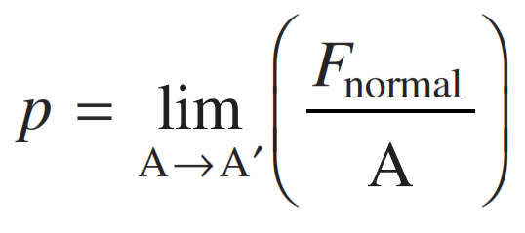
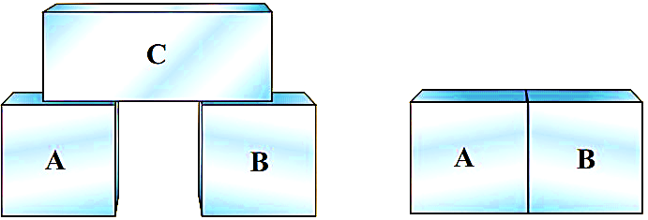
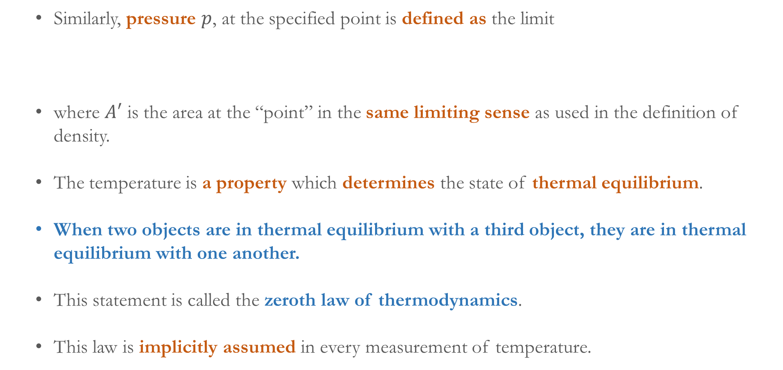
  Similarly, pressure $p$, at the specified point is defined as the limit
  where $A′$ is the area at the “point” in the same limiting sense as used in the definition of density.
  The temperature is a property which determines the state of thermal equilibrium.
  When two objects are in thermal equilibrium with a third object, they are in thermal equilibrium with one another.
  This statement is called the zeroth law of thermodynamics.
  This law is implicitly assumed in every measurement of temperature.

Slide 9
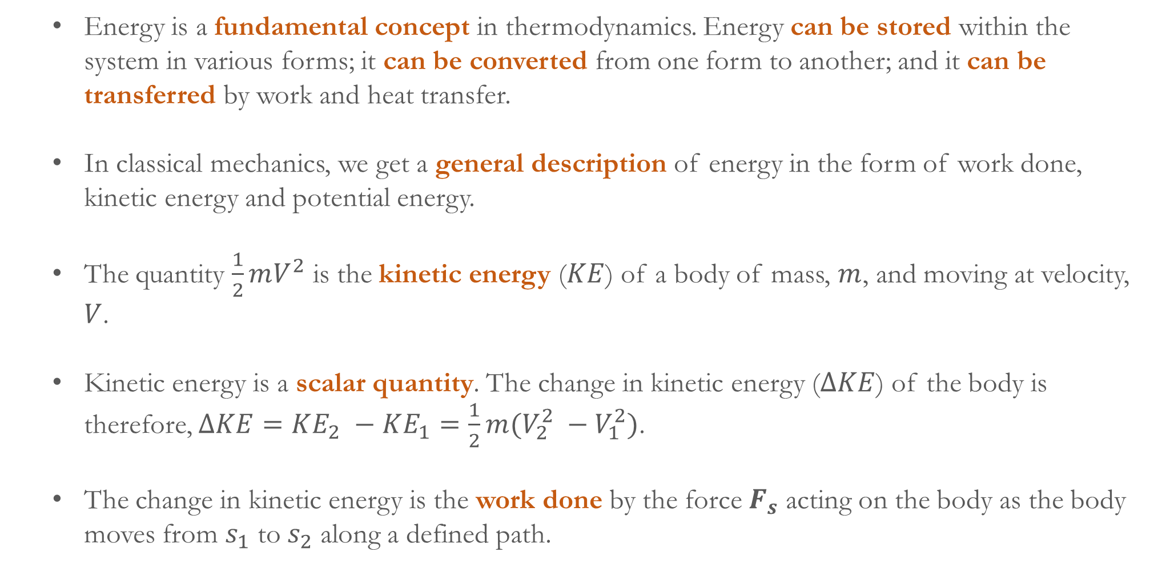
Energy is a fundamental concept in thermodynamics. Energy can be stored within the system in various forms; it can be converted from one form to another; and it can be transferred by work and heat transfer.
In classical mechanics, we get a general description of energy in the form of work done, kinetic energy and potential energy.
The quantity $\frac{1}{2}mV^{2}$ is the kinetic energy ($KE$) of a body of mass, $m$, and moving at velocity, $V$.
Kinetic energy is a scalar quantity. The change in kinetic energy ($ΔKE$) of the body is therefore, $ΔKE=KE_{2} −KE_{1}=\frac{1}{2}m(V_{2}^{2} −V_{1}^{2})$.
The change in kinetic energy is the work done by the force $F_{s}$ acting on the body as the body moves from $s_{1}$ to $s_{2}$ along a defined path.

Slide 10
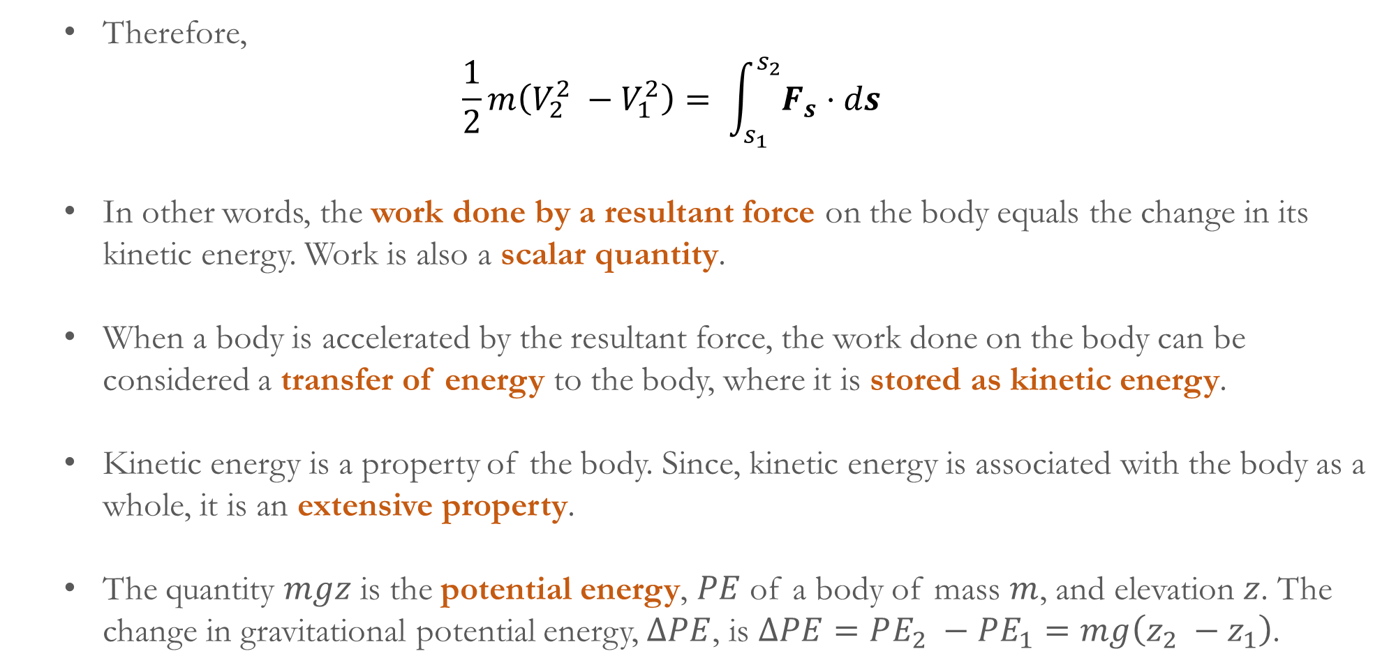
Therefore,
$$\frac{1}{2}m\left(V_{2}^{2} −V_{1}^{2}\right)= \int_{s_{1}}^{s_{2}}{F_{s}}⋅ds$$
In other words, the work done by a resultant force on the body equals the change in its kinetic energy. Work is also a scalar quantity.
When a body is accelerated by the resultant force, the work done on the body can be considered a transfer of energy to the body, where it is stored as kinetic energy.
Kinetic energy is a property of the body. Since, kinetic energy is associated with the body as a whole, it is an extensive property.
The quantity $mgz$ is the potential energy, $PE$ of a body of mass $m$, and elevation $z$. The change in gravitational potential energy, $ΔPE$, is $ΔPE=PE_{2} −PE_{1}=mg\left(z_{2} −z_{1}\right)$.

Slide 11
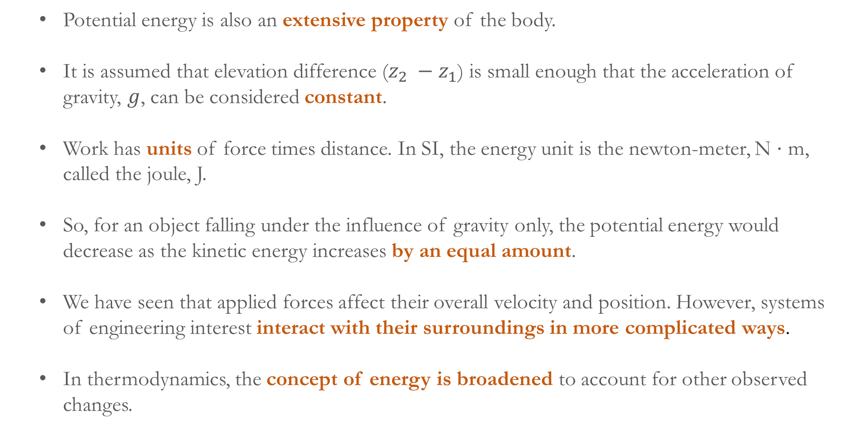
Potential energy is also an extensive property of the body.
It is assumed that elevation difference ($z_{2} −z_{1}$) is small enough that the acceleration of gravity, $g$, can be considered constant.
Work has units of force times distance. In SI, the energy unit is the newton-meter, N ⋅ m, called the joule, J.
So, for an object falling under the influence of gravity only, the potential energy would decrease as the kinetic energy increases by an equal amount.
We have seen that applied forces affect their overall velocity and position. However, systems of engineering interest interact with their surroundings in more complicated ways.
In thermodynamics, the concept of energy is broadened to account for other observed changes.

Slide 12
Definition of work broadened:
The principle of conservation of energy is extended to include a wide variety of ways in which systems interact with their surroundings.
Thermodynamics deals with phenomena which are not included within the scope of mechanics, so a broader interpretation of work is adopted.
Thermodynamic definition of work: Work is done by a system on its surroundings if the sole effect on everything external to the system could have been the raising of a weight.
The raising of a weight is, in effect, a force acting through a distance, so the concept of work in thermodynamics is a natural extension of the concept of work in mechanics.
Work is a means for transferring energy (not what is transferred). Energy is transferred and stored when work is done.

Slide 13
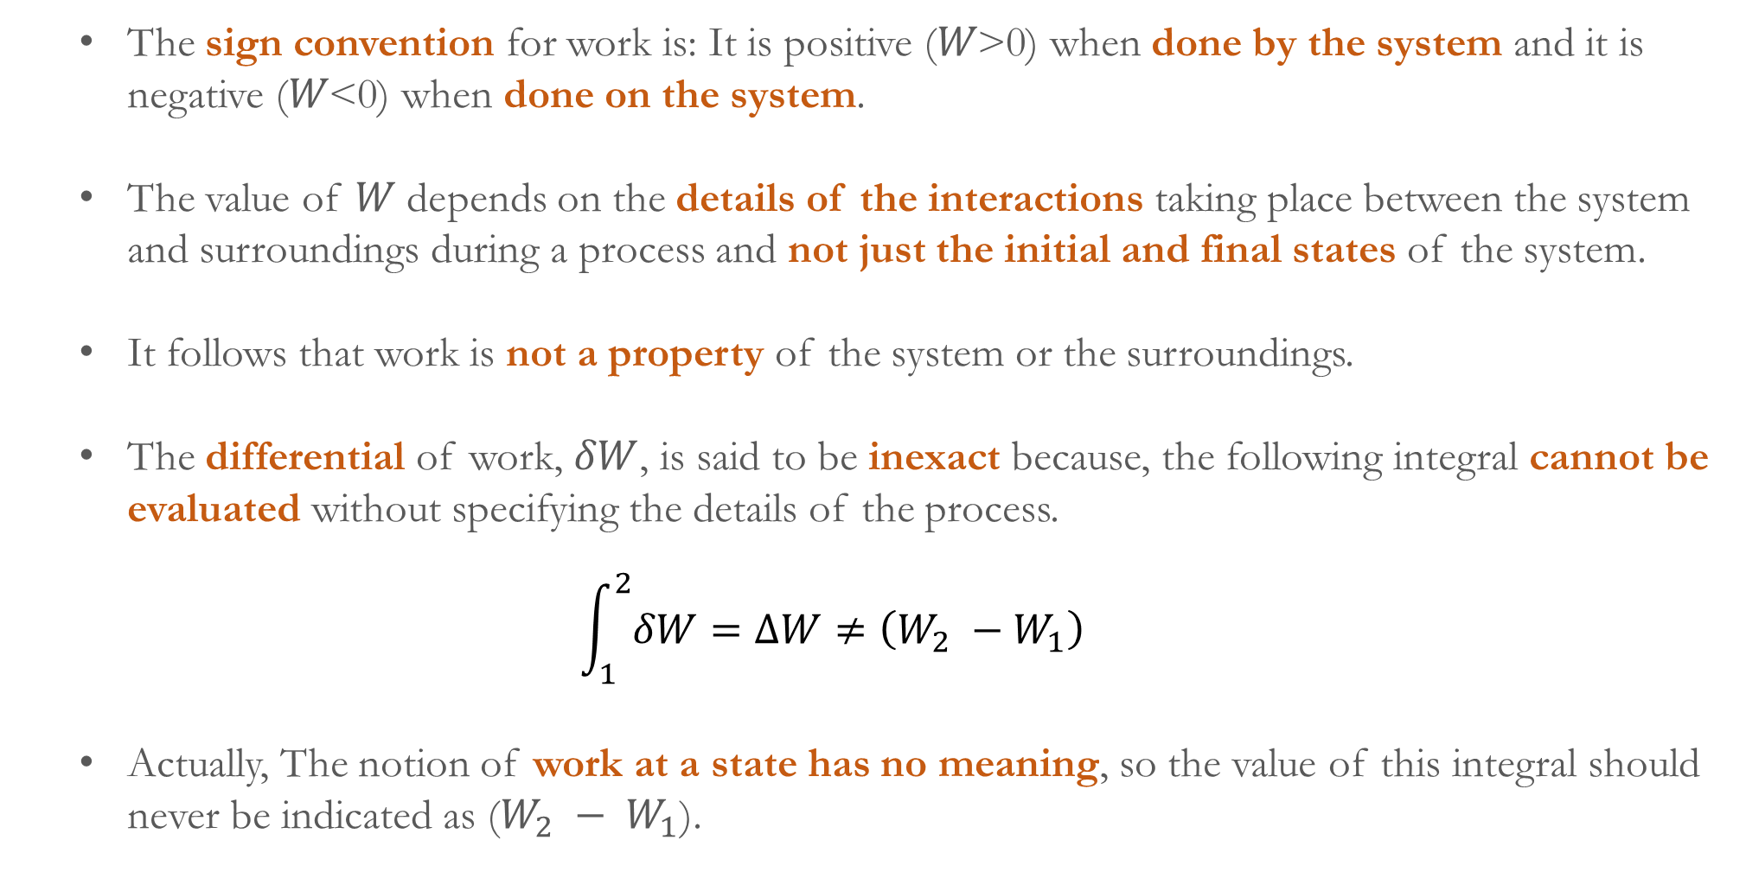
The sign convention for work is: It is positive (𝑊>0) when done by the system and it is negative (𝑊<0) when done on the system.
The value of 𝑊 depends on the details of the interactions taking place between the system and surroundings during a process and not just the initial and final states of the system.
It follows that work is not a property of the system or the surroundings.
The differential of work, $δW$, is said to be inexact because, the following integral cannot be evaluated without specifying the details of the process.
$$\int_{1}^{2}{δW}=ΔW≠\left(W_{2} −W_{1}\right)$$
Actually, The notion of work at a state has no meaning, so the value of this integral should never be indicated as ($W_{2} − W_{1}$).

Slide 14
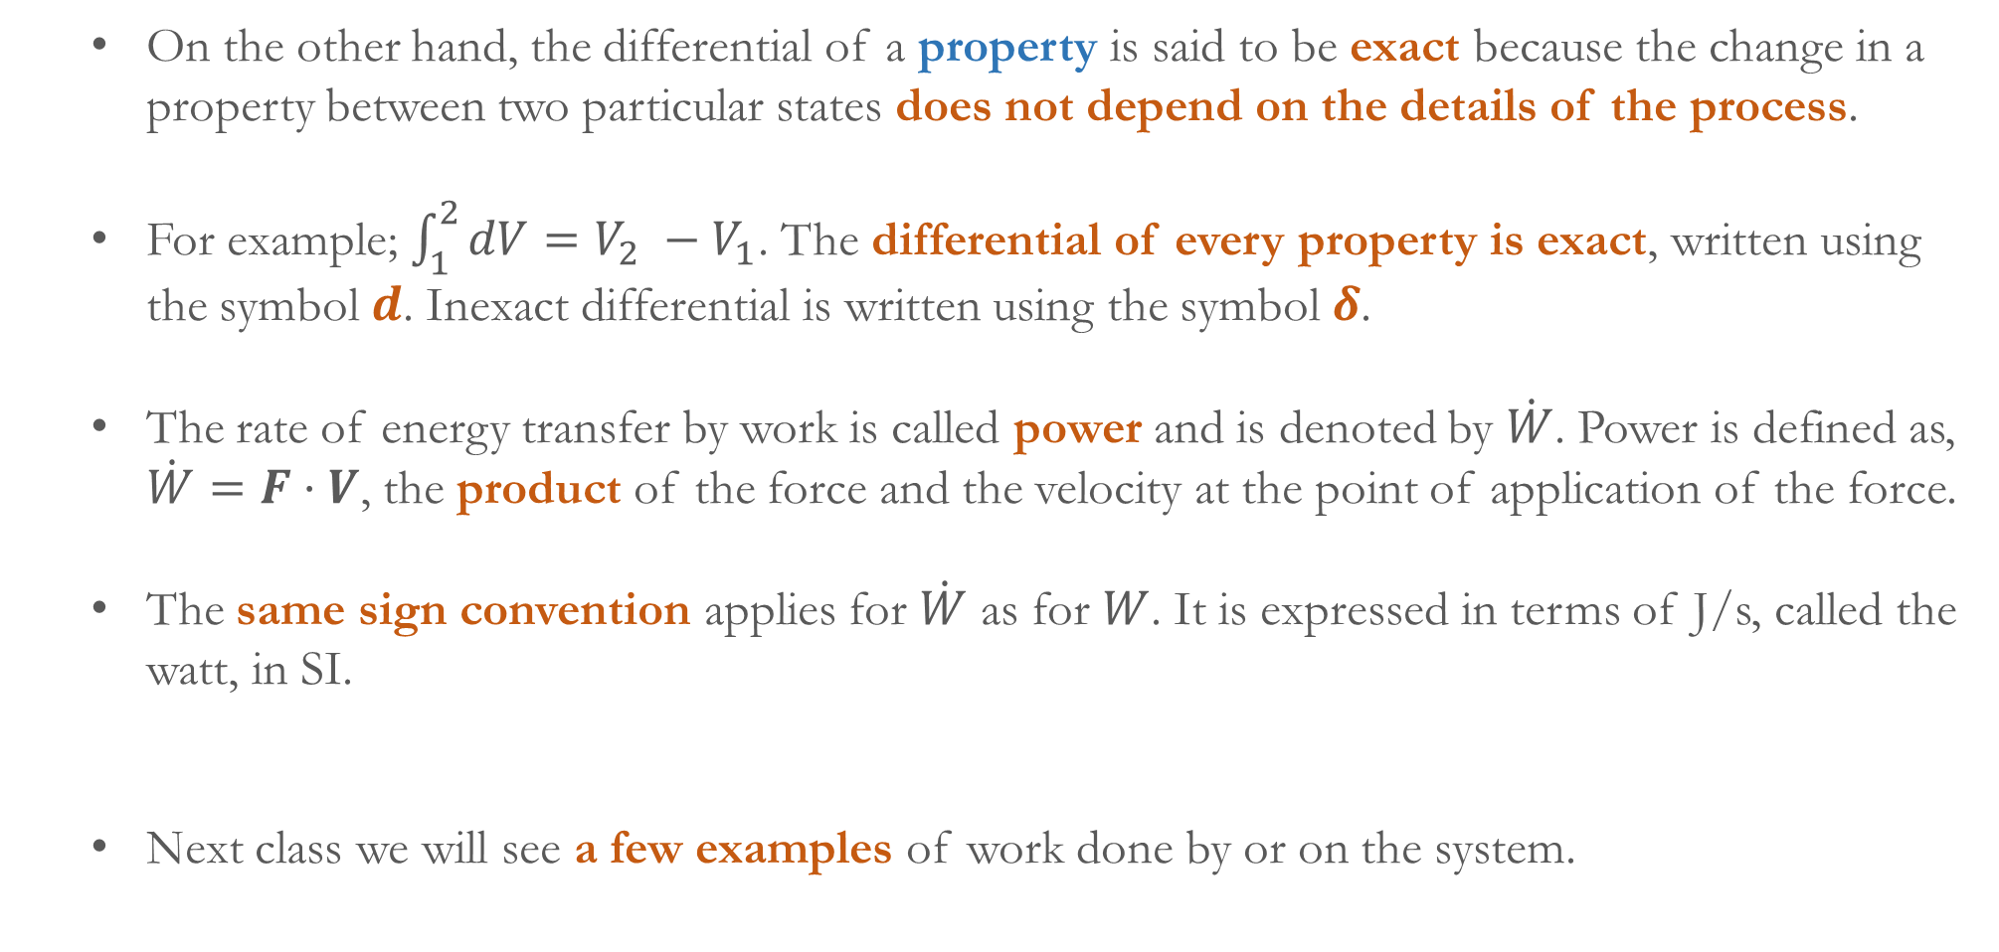
On the other hand, the differential of a property is said to be exact because the change in a property between two particular states does not depend on the details of the process.
For example; $\int_{1}^{2}{dV}=V_{2} −V_{1}$. The differential of every property is exact, written using the symbol $d$. Inexact differential is written using the symbol $δ$.
The rate of energy transfer by work is called power and is denoted by $\dot{W}$. Power is defined as, $\dot{W}=F⋅V$, the product of the force and the velocity at the point of application of the force.
The same sign convention applies for $\dot{W}$ as for $W$. It is expressed in terms of J/s, called the watt, in SI.
Next class we will see a few examples of work done by or on the system.

