Slide 1



Slide 2
Data Analysis Methods
The analysis was conducted using the following methods:
1. Data Cleaning and Preprocessing: Ensured data consistency and handled missing values across all regions.
2. Exploratory Data Analysis (EDA): Used descriptive statistics and visualizations to identify patterns and trends over the eight-year period.
3. Regional Segmentation Analysis: Analyzed sales performance across the five regions to identify high-performing and low-performing areas.
4. Visualization: Created dynamic charts and graphs to present insights clearly and regionally.
Insight Overview:
This dataset spans 8 years, covering sales data across 5 regions. Each region encompasses multiple countries, providing a comprehensive view of regional and country-level performance.
Enhanced Insight:
1. Temporal Depth:
The 8-year span enables analysis of long-term trends, seasonal patterns, and year-over-year performance, helping to identify consistent growth areas or periods of stagnation.
2. Regional Insights:
The presence of 5 distinct regions allows comparative analysis: o Highlight which regions consistently outperform others. o Identify regions with potential for growth or regions lagging in performance.
3. Country-Level Granularity:
Breaking down performance at the country level:
o Pinpoint specific countries driving regional sales.
Insight: Regional and Yearly Sales Trends
The bar charts provide a clear depiction of unit sales performance across different regions over an 8-year period. Each region showcases distinct sales patterns, highlighting variations in demand and market dynamics.
Key Observations:
1. Yearly Trends:
o Certain years show significant spikes or dips in unit sales across all regions, suggesting external factors like market conditions, promotions, or global trends. o Identify years of peak performance and analyze what contributed to these successes.
2. Regional Comparisons:
o Top-Performing Regions: Some regions consistently outperform others, contributing a larger share of total unit sales.
o Underperforming Regions: Highlight regions with stagnating or declining sales and analyze potential causes such as market saturation, competition, or lack of localized strategies.

Slide 3
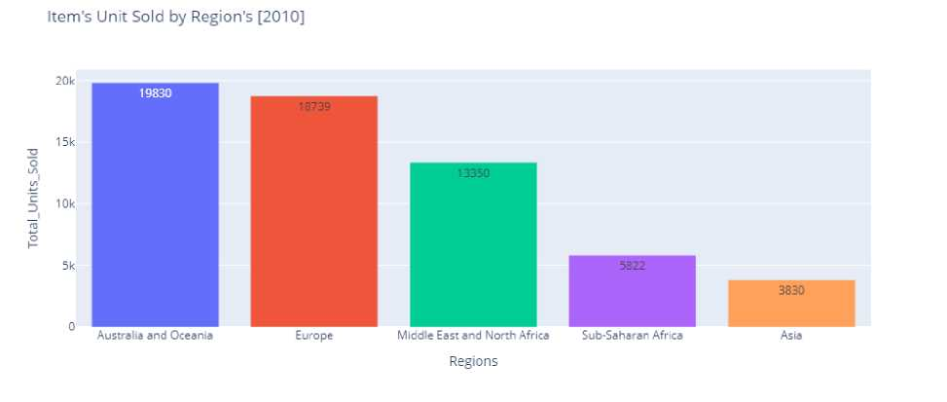
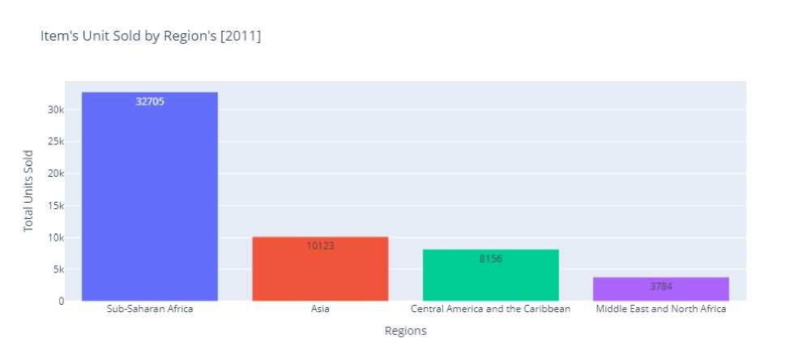
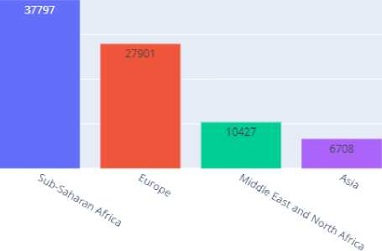
In 2010, Australia and Oceania is the most selling region.
In 2011, Sub-Saharan Africa is most selling region. Other regions has least selling. Item's Unit Sold by Region's [2012]
20 k
10k
6422 | 5908
V
2804
;:'V.
Regions

Slide 4
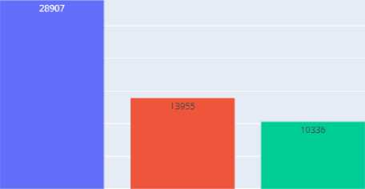

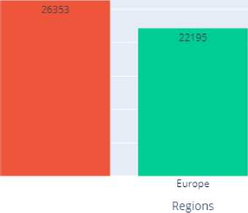

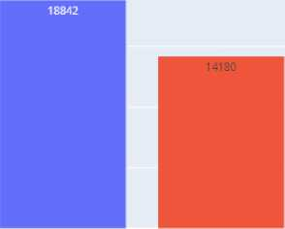
In 2012, Sub-Saharan Africa again most selling region also by year 2011. But other regions has again least selling.
Item’s Unit Sold by Region s [2013]
Sub-Saharan Africa Middle East and North Africa Australia and Oceania
⁴⁷⁵⁰ 1705
Regions
Europe Central America and the Caribbean
In 2013, Sub-Saharan Africa is most selling region but this year it has less sales as compare previous years. Other reason are not giving good profit.
Item's Unit Sold by Region's [2014]
 | 30k
 | 25k
TD
O 1/1 | 20k
i/i
£Z
D | 15k
O
 | 10k
 | 5k
 | 0
4901
Asia
Sub-Saharan Africa Australia and Oceania
North America
In 2014, Sub-Saharan Africa is most selling region and also Australia and Oceania nearby it.
Item’s Unit Sold by Region’s [2015]
5898 |  | 5767
 |  |  | 4120
Australia and Oceania |  | North America | Europe
Sub-Saharan Africa
Regions
Middle East and North Africa

Slide 5


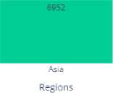


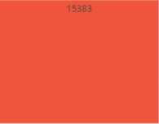

In 2015, Sub-Saharan Africa is most selling region but less sales by previous years and Asia is nearby it by selling.
Item’s Unit Sold by Region’s [2016]
Europe
Central America and the Caribbean
Middle East and North Africa
Sub-Saharan Africa
In 2016, Europe is most selling region but not by previous years and, Sub-Saharan Africa is most least selling region.
Item’s Unit Sold by Region’s [2017]
"jo 10k
Sub-Saharan Africa
Central America and the Caribbean
Regions
Europe
In 2017, Sub-Saharan Africa is most selling region again.

Slide 6
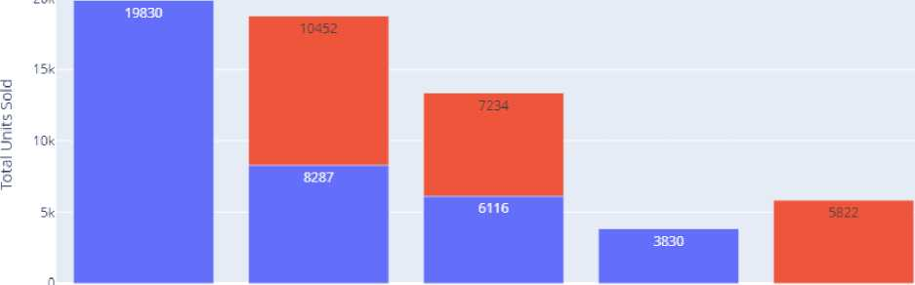
Sales Channel's
1. Online Sales Channels
These involve digital platforms where customers purchase products via the internet:
• E-commerce Websites: Amazon, eBay, Flipkart, etc.
• Brand Websites: Direct purchases from company-owned websites.
• Social Media: Facebook Marketplace, Instagram Shops, or Pinterest Buyable Pins.
• Mobile Apps: Apps like amazon or specialized brand apps.
• Online Marketplaces: Platforms hosting multiple sellers.
• Subscriptions: Online recurring delivery services.
Advantages:
• Global reach and 24/7 availability.
• Data-driven insights on customer behavior.
• Cost-effective for marketing and operations.
2. Offline Sales Channels
These involve physical locations where customers make purchases directly:
• Retail Stores: Brick-and-mortar outlets, supermarkets, and department stores.
• Franchises: Chains operating under a brand (e.g., Domino's, Pizza Hut).
• Direct Sales: Door-to-door, kiosks, or sales through company representatives.
• Pop-Up Shops: Temporary setups for promotions or seasonal sales.
• Events and Expos: Sales during fairs, exhibitions, or industry events.
Advantages:
• Personal interaction with customers, improving trust.
• Immediate product availability without shipping delays.
• Enables physical inspection of products before purchase.
Sales Channels Used in Region [2010]
20k
Sales Channel
■ Offline | Online
0
Australia and Oceania
Europe
Middle East and North Africa
Asia
Sub-Saharan Africa
Region

Slide 7
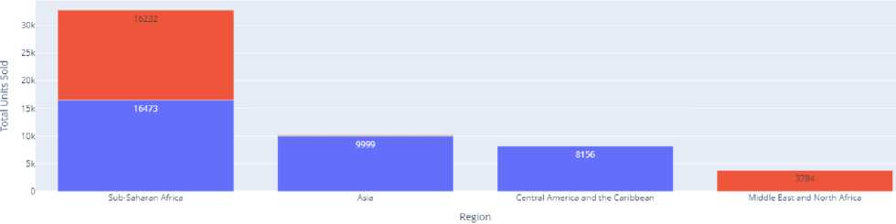
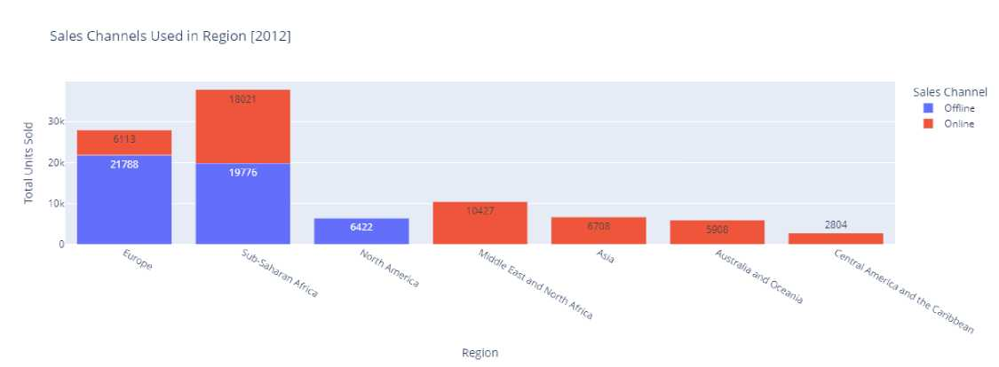
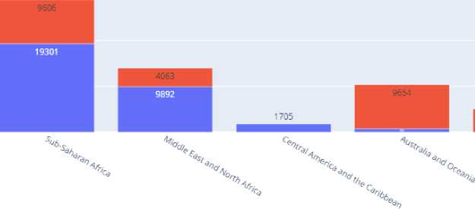
In 2010, Australia and Oceania use only offline channel but Europe and Middle East and North Africa use the both channels.
Sales Channels Used in Region [2011]
Sales Channel
■ Offline
■ Online
In 2011, only single region use both channels.
In 2012, two regions are use the both, but other are use only one which attract the less people.
Sales Channels Used in Region [2013]
Sales Channel ■ Offline I Online
Total Units Sold
Region
In 2013, two regions are use the both, But other are use only one which attract the less people.

Slide 8
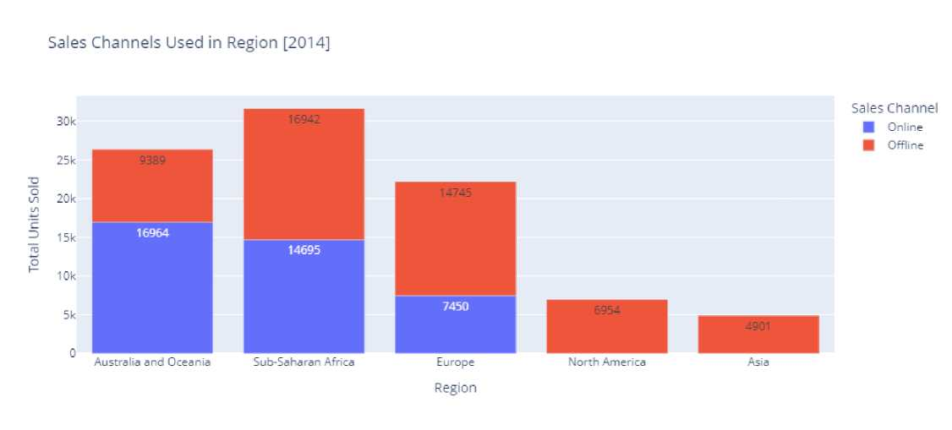
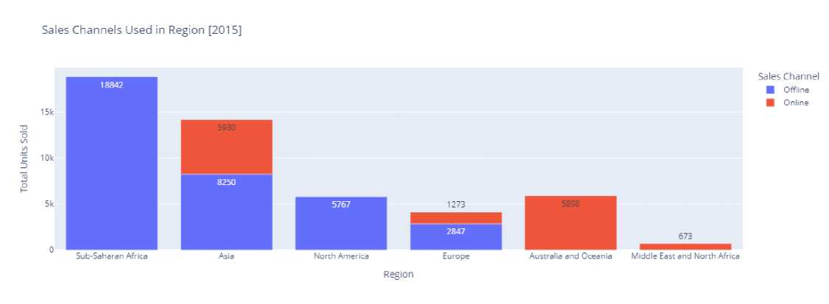

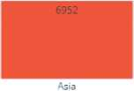

In 2014, three regions are use the both, But other are use only one which attract the less people.
In 2015, Here Sub-Saharan Africa region is most popular but use single channel, on the other side other region use the both channels.
Sales Channels Used in Region [2016]
Sales Channel
■ Online
■ Offline
13937
6489
Europe
Middle East and North Africa
2225
Sub-Saharan Africa
Central America and the Caribbean
Region

Slide 9
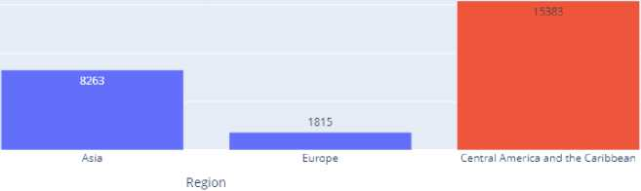

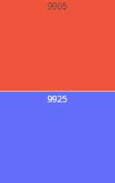
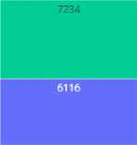
In 2016, Europe use both channels and it's the most popular but other are least.
Sales Channels Used in Region [2017]
25k
23765
Sales Channel | Online ■ Offline
20k
15k
E
2 10k
£
5k
Sub-Saharan Africa
In 2017, Sub-Saharan Africa is most popular region but in this year each region user the single channel.
Order Priority
Order priority refers to the level of importance or urgency assigned to an order in a sales or fulfillment system. It helps businesses determine the sequence in which orders should be processed, packed, and shipped.
Order Priority in Each Region [2010]
Order Priority
■ H
■ c
■ M
■
Europe
Australia and Oceania
Middle East and North Africa Region
Sub-Saharan Africa
In 2010, Europe and Australia has High, Medium, critical order priority and has less as compare to them.

Slide 10
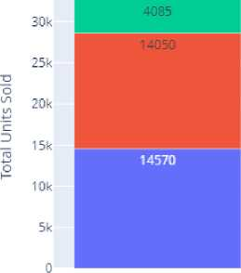



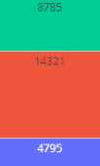
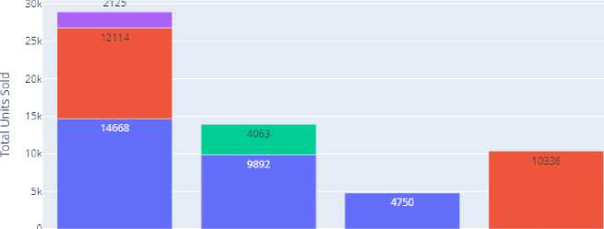
Order Priority in Each Region [2011]
Order Priority
■ c
■ M
■ L
■ -
Sub-Saharan Africa
Central America and the Caribbean
Mis
Middle East and North Africa
Region
In 2011, Sub-Saharan Africa hast three type of order priority and maximum sales.
Order Priority in Each Region [2012]
Order Priority ■ -
■ M
■ H
■ C
7884 | 1
 |  | 6708 | ■ | 6422 | ■ | 5908
2804
Sub-Saharar Africa Middle East and North Africa
North America
Region
Australia and Oceania
Europe Central America and the Caribbean
In 2012, Sub-Saharan Africa and Europe has three types of priorities and has maximum sales.
Order Priority in Each Region [201 3]
Order Priority ■ -
■ H
■ M
■ C
Sub-Saharan Africa Middle East and North Africa
Europe
Region
Australia and Oceania Central America and the Caribbean

Slide 11
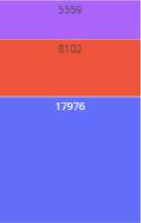
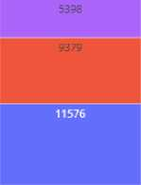
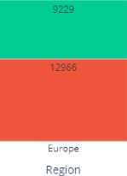
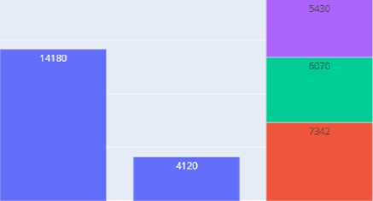




In 2013, Sub-Saharan Africa has three priorities and also has maximum sales.
Order Priority in Each Region [2014]
 | 30 k
 | 25 k
T3
O on | 20k
id
"c
Z> | 15k
 | 10k
 | 5 k
 | 0
Order Priority
■ H
■ c
■ -■ M
Sub-Saharan Africa
Australia and Oceania
North America
In 2014, Sub-Saharan Africa again has three priorities and also Australia and Oceania has same priority.
Order Priority in Each Region [201 5]
Order Priority
■ H
■ -
■ M
■ C
Europe
Sub-Saharan Africa Middle East and North Africa
Region
North America Australia and Oceania
In 2015, Asia has the highest total units sold with high-priority orders dominating, while the Middle East and North Africa have the lowest sales volume
Order Priority in Each Region [2016]
Order Priority
■ c
■ M
■ H
■ L
Europe
Sub-Saharan Africa
Region
Central America and the Caribbean Middle East and North Africa

Slide 12
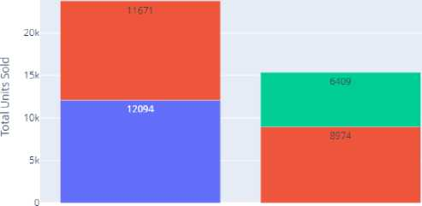

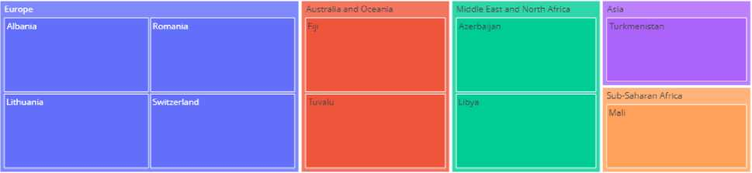
In 2016, Europe has highest total unit sold with high and low priority order, while the Sub-Saharan Africa have the lowest sales volume.
Order Priority in Each Region [2017]
25k
Order Priority
■ M
■ H
■
Sub-Saharan Africa Central America and the Caribbean
Region
Europe Asia
In 2017, Sub-Saharan Africa has highest total unit sold with high and medium priority order, while the Europe have the lowest sales volume.
Countries under Each Region
A region refers to a geographical area or a group of countries grouped together for analytical or operational purposes. In your visualizations, regions like Europe, Asia, Sub-Saharan Africa, Middle East and North Africa, and Australia and Oceania represent clusters of countries categorized based on location.
Countries under Each Region[2010]
In 2010, the visualization categorizes countries into regions, showing distinct regional segmentation, with Europe having
more countries represented compared to other regions like Asia and Sub-Saharan Africa.

Slide 13
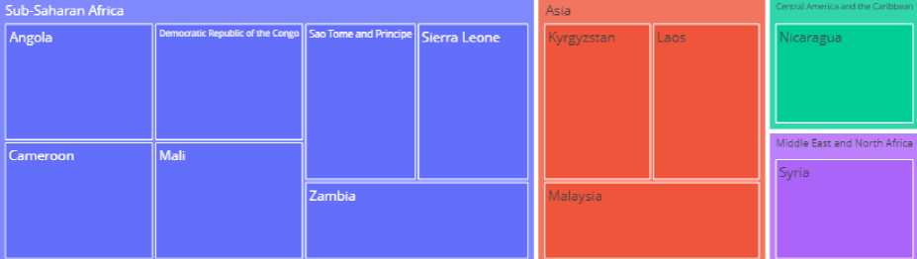
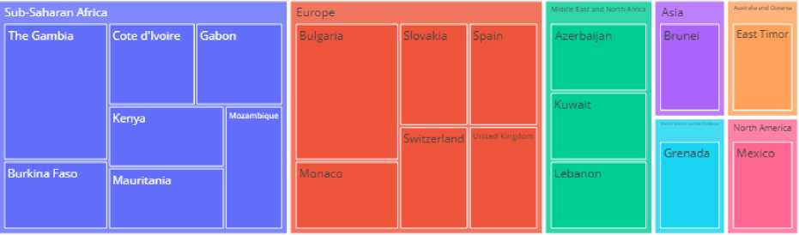
Countries under Each Region[2011]
In 2011, The categorizes countries into regions, showing distinct regional segmentation, with Sub-Saharan Africa having more countries represented compared to other regions like Middle East and North Africa.
Countries under Each Region[2012]
In 2012, The categorizes countries into regions, showing distinct regional segmentation, with Sub-Saharan Africa Europe having more countries represented compared to other regions like Asia North America.

Slide 14
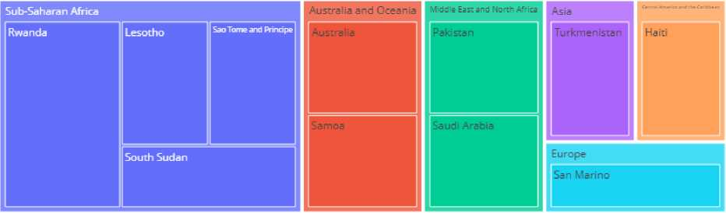
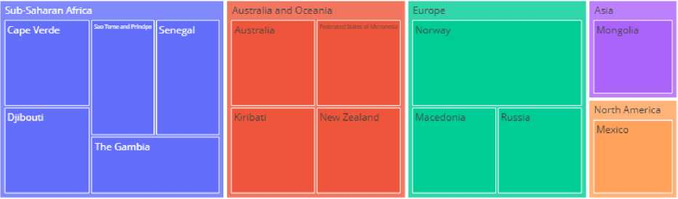
Countries under Each Region[2013]
In 2013, the categorizes countries into regions, showing distinct regional segmentation, with Europe having more countries represented compared to other regions like Asia and Sub-Saharan Africa.
Countries under Each Region[2014]
In 2014, The categorizes countries into regions, showing distinct regional segmentation, with Sub-Saharan Africa, Australia and Oceania, Europe having more countries represented compared to other regions like Asia and North America.

Slide 15
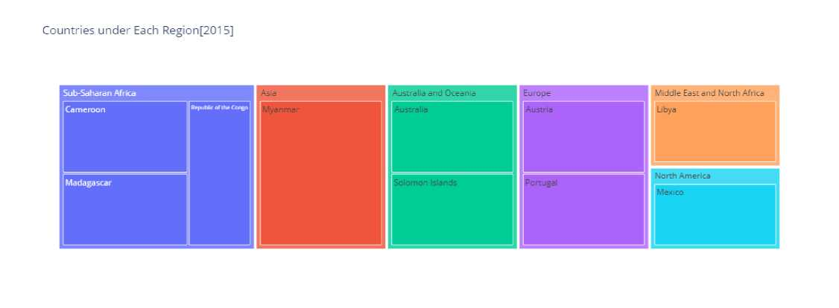
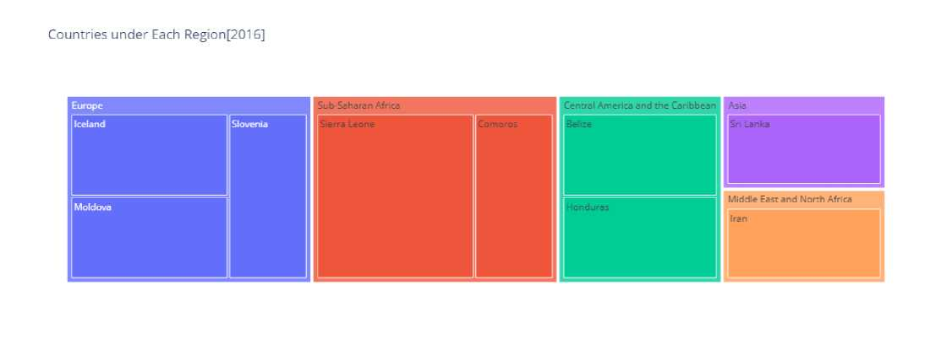
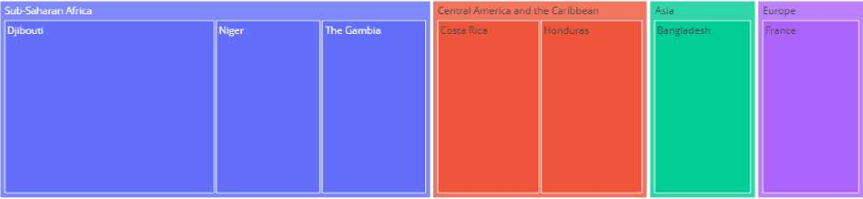
In 2015, the categorizes countries into regions, showing distinct regional segmentation, with Sub-Saharan Africa having more countries represented compared to other regions like Asia and others.
In 2016, The Categorizes countries into regions, showing distinct regional segmentation, with Europe and Sub-Saharan Africa having more countries represented compared to other regions like Asia and Middle East and North Africa.
Countries under Each Region[2017]

Slide 16
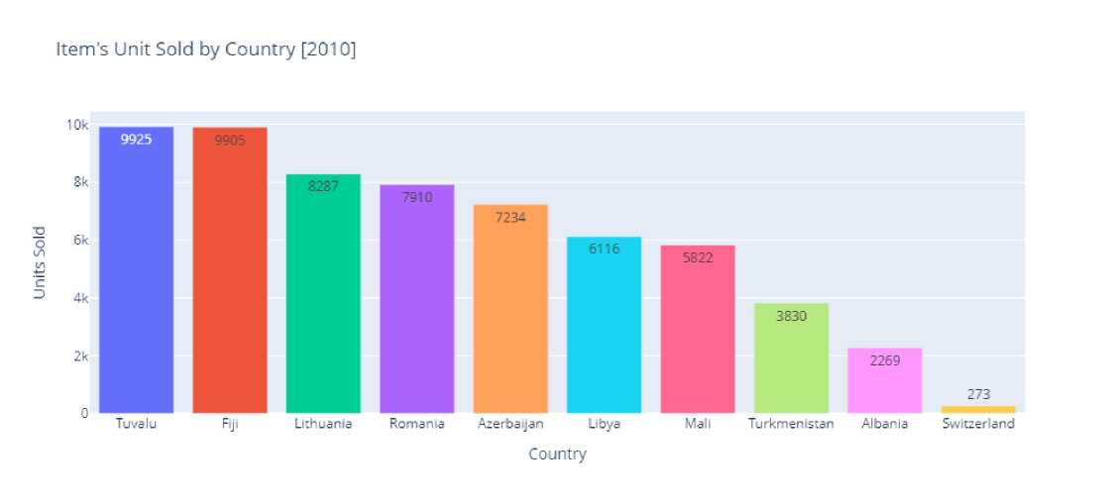
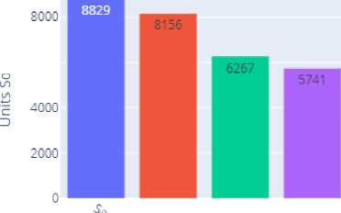

In 2017, The Categorizes countries into regions, showing distinct regional segmentation, with Sub-Saharan Africa having more countries represented compared to other regions like Asia and Europe.
Unit Sold
Unit Sold refers to the total quantity of individual items or products sold during a specific period. It is a key metric in sales analysis used to measure the demand and performance of products across regions, countries, or categories.
In 2010, Tuvalu and Fiji lead in the number of units sold, while Albania and Switzerland report the lowest sales, indicating strong regional demand in Oceania compared to Europe.
Item’s Unit Sold by Country [2011]
■o 6000
5518
4187 4085
3784 3732
3457
888
124
v x
H S,
%■
Country

Slide 17
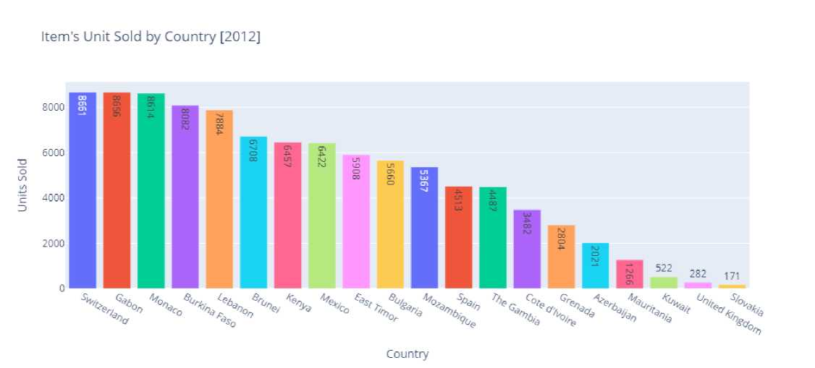
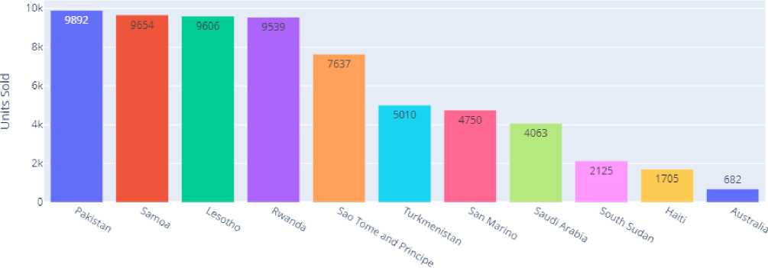
Sao Tome and Principle, Nicaragua lead in the number of units sold, while Mali and Kyrgyzstan report the lowest sales,
indicating strong regional demand in Sub-Saharan Africa compared to Asia.
In 2012, Switzerland, Gabon and Monaco lead in the number of units sold, while Kuwait, United Kingdom and Slovakia report the lowest sales, indicating strong regional demand in Sub-Saharan Africa, Europe both regions has good lead and demand.
Item's Unit Sold by Country [2013]
Country
In 2013, Pakistan, Samoa, Lesotho and Rwanda lead in the number of units sold, while Australia report the lowest sales, indicating strong regional demand in Australia and Oceania compared to Middle east and North Africa.

Slide 18
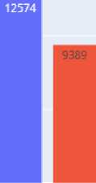

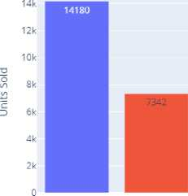
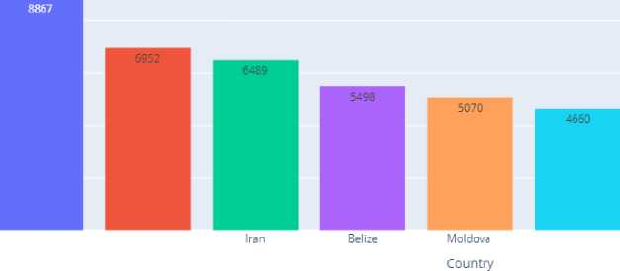
Item's Unit Sold by Country [2014]
o
10k
9379
8102
7842
721
6954
6593
8 5k
5559 5398
21S7
1779
V X \\\%
^{0j}%,„ V„ V- *"
"% 'H,
V
Of. 'o_{c}.
%_{r} X
Country
In 2014, Norway lead in the number of units sold, while Russia report the lowest sales, both countries are under Europe, Russia indicating strong regional demand.
Item’s Unit Sold by Country [201S]
Myanmar Madagascar Republic of the Congo Mexico
Cameroon Solomon Islands Australia Country
1273
Portugal
673
Libya
In 2015, Myanmar lead in the number of units sold, while Libya report the lowest sales, indicating strong regional demand in Middle East and North Africa compare to Asia.
Item’s Unit Sold by Country [2016]
Iceland Sri Lanka
Slovenia Sierra Leone Honduras
962
Comoros

Slide 19
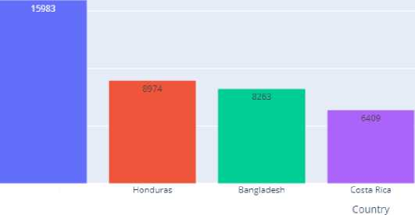
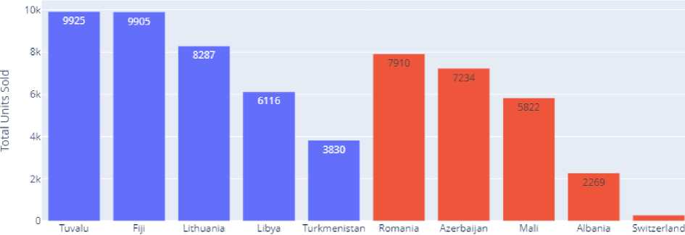
In 2016, Iceland lead in the number of units sold, while Comoros report the lowest sales, indicating strong regional
demand in Sub-Saharan Africa compared to Europe.
Item’s Unit Sold by Country [2017]
2 10k
Djibouti
Niger
1815
France
In 2017, Djibouti lead in the number of units sold, while France report the lowest sales, indicating strong regional demand in Europe compared to Sub-Saharan Africa.
Sales Channels
Sales Channel refers to the platform or method through which products or services are sold to customers. It represents the path a business uses to reach its customers and complete sales transactions.
Sales Channels Used in Each Country [2010]
Sales Channel
■ Offline
■ Online
Country
In 2010, Tuvalu and Fiji dominated offline sales, while Romania and Azerbaijan led online sales, with Switzerland showing the lowest overall activity in both channels.

Slide 20
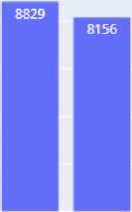
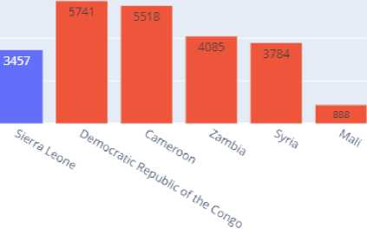
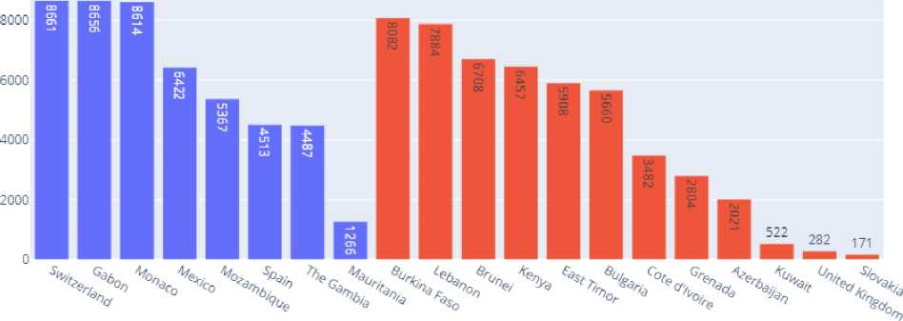
Sales Channels Used in Each Country [2011]
8000
6000
4000
2000
0
Sales Channel
■ Offline | Online
Total Units Sold
6267
4187
3732
X X
'Vo
X
%
X
Country
In 2011, Sao Tome and principle dominated offline sales, while Democratic Republic of the Congo led online sales, with Kyrgyzstan showing the lowest overall activity in both channels.
Sales Channels Used in Each Country [2012]
Sales Channel
■ Offline | Online
O
tel
Country
In 2012, Switzerland, Gabon and Monaco dominated offline sales, while Burkina Faso, Lebanon led online sales, Mauritania, Slovakia showing the lowest overall activity in both channels.

Slide 21
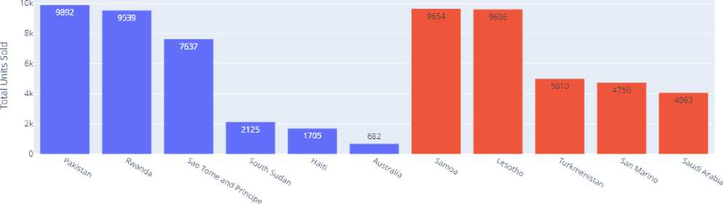
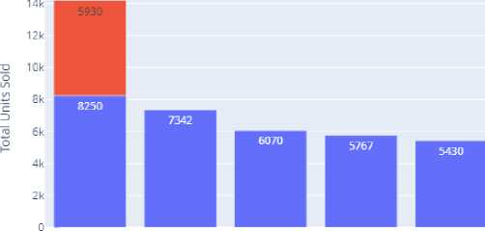

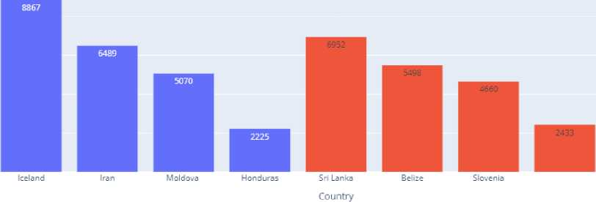
Sales Channels Used in Each Country [2013]
Sales Channel ■ Offline | Online
Country
In 2013, Pakistan and Rwanda dominated offline sales, while Samoa and Lesotho led online sales, with Australia and Saudi Arabia showing the lowest overall activity in both channels.
Sales Channels Used in Each Country [2015]
Sales Channel ■ Offline I Online
Myanmar Madagascar Republic of the Congo Mexico
Cameroon Austria
Country
Solomon Islands Australia Portugal
673
Libya
In 2015, Myanmar dominated offline and Online sales, while Solomon Island led online sales, with Libya showing the lowest overall activity in both channels.
Sales Channels Used in Each Country [2016]
Sales Channel
■ Online
■ Offline
Sierra Leone Comoros

Slide 22
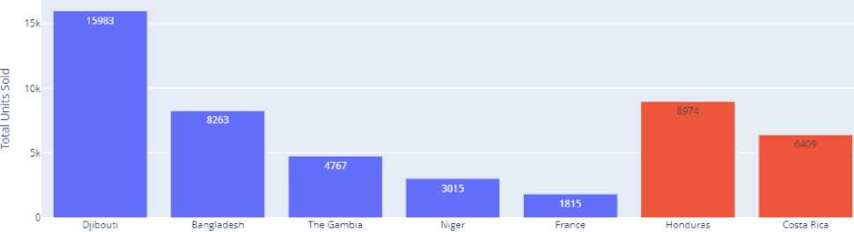

In 2016, Iceland dominated offline sales, Srilanka led online sales, with Honduras and Comoros showing the lowest overall activity in both channels.
Sales Channels Used in Each Country [2017]
Sales Channel | Online ■ Offline
Country
In 2017, Djibouti dominated offline sales, Honduras led online sales, with France showing the lowest overall activity in sales channel.
Order Priority
Order priority refers to the level of urgency or importance assigned to processing and fulfilling a specific order. In this chart, the order priorities are likely categorized as:
• C (Critical): Orders that need immediate attention and processing.
• H (High): Orders that are important but not as urgent as critical ones.
• M (Medium): Orders with moderate urgency and importance.
• L (Low): Orders with the least urgency and importance.
Order Priority of Item's by Country [2010]
992
Order Priority
■ c
■ M
■ H
■ L
8287
c
D
6116
5822
3830
% | X x
'Q₀
% \ \ % | % X
%
%
%
Country-Item Type

Slide 23


In 2010, countries prioritized items differently based on order type: Tuvalu and Fiji emphasized high-priority cosmetics
and clothes, while Albania showed the lowest priority for clothes, and Switzerland had minimal activity in personal care.
Order Priority of Item's by Country [2011]
Units Sold o' Units Sold
Country - Item Type
rity Beverages, while Kyrgyzstan showed the lowest priority for vegetables, and Syria had minimal activity in Fruits.
Order Priority of Item's by Country [2012]
Country - Item's
In 2012, countries prioritized items differently based on order type: Switzerland emphasized high-priority cosmetics, while Kuwait, United Kingdom and Slovak showed the lowest priority for fruits, Household.

Slide 24


Order Priority of Item's by Country [2013]
Country - Item's
In 2013, countries prioritized items differently based on order type: Pakistan and Lesotho emphasized high-priority cosmetics and Fruits, while Australia and showed the lowest priority for Cereal.
In 2014, countries prioritized items differently based on order type: Australia, Federated States of Micronesia emphasized high-priority Beverages, while Russia showed the lowest priority for Office Supplies.

Slide 25




Order Priority of Item's by Country [2015]
Order Priority
■ H
■ L
■ M
■ C
Country - Item's
In 2015, countries prioritized items differently based on order type: Myanmar emphasized high-priority Household, while Libya showed the lowest priority for Cereal.
Order Priority of Item's by Country [2016]
Country - Item's
In 2016, countries prioritized items differently based on order type: Iceland emphasized high-priority cosmetics, while Sierra Leone showed the lowest priority for office Supplies.
Order Priority of Item's by Country [2017]
3015
 | ■ | 1815
V
Country - Item's

Slide 26


In 2017, countries prioritized items differently based on order type: Honduras, Djibouti and Bangladesh emphasized
high-priority Household, Cereal and Cloths, while France showed the lowest priority for Cosmetic.
Units Sold
Units sold" refers to the total quantity of individual items purchased or distributed within a specific period. Each unit represents one item sold, regardless of its size or value.
Items Sold by units [2010]
Clothes Cosmetics Baby Food Office Supplies Fruits Household Personal Care
Items
In 2010, clothes were the most sold item, with 18,290 units, followed by cosmetics with 15,144 units. Personal care items had the lowest sales, with just 273 units sold.
Items Sold by units [2011 ]
20k
2Z7Z6
2
O
1/1
tn
C
D
15k
10k
5k
4085
Snacks
3856
Beverages
Fruits
Office Supplies
Vegetables
888
Household
Clothes
Items

Slide 27


In 2011, Beverage were the most sold item, with 22,726 units. Clothes items had the lowest sales, with just 888 units
sold.
In 2012, clothes were the most sold item, with 15,078 units, followed by Vegetables with 14,710 units. Fruits items had the lowest sales, with just 522 units sold.
Items Sold by units [2013]
Cosmetics Fruits Office Supplies Baby Food Cereal Personal Care
Item's
In 2013, Cosmetic were the most sold item, with 25,728 units, followed by Fruits with 17,243 units. Personal care items had the lowest sales, with just 2125 units sold.

Slide 28



In 2014, Beverage were the most sold item, with 23,892 units, followed by Fruits with 15,687 units. Office Supplies items had the lowest sales, with just 1,779 units sold.
Items Sold by units [2015]
Clothes Personal Care Household Beverages Baby Food Office Supplies Cosmetics Fruits
Item's
In 2015, clothes were the most sold item, with 13,272 units, followed by Personal Care with 11,837 units. Fruits items had the lowest sales, with just 673 units sold.
Items Sold by units [2016]
5070 |  | 4660
 |  |  | 2225
Personal Care |  | Beverages | Snacks
14B5
Vegetables
952
Cereal
94-8
Office Supplies
Cosmetics Clothes
Item's

Slide 29




In 2016, cosmetic were the most sold item, with units 22,308. Office Supplies items had the lowest sales, with just 948
units sold.
Items Sold by units [2017]
Personal Care Household Cereal Clothes Snacks Meat Cosmetics
Items
In 2017, Personal Care were the most sold item, with 9424 units, followed by Household with 8974 units. Cosmetics items had the lowest sales, with just 1815 units sold.
Item Types Ordered in Each Month [2010]
15k
5822
Item Type
82S7
■ | Clothes
■ | Cosmetics
■ | Baby Food
■ | Fruits
■ | Office Supplies
■ | Household
■ | Personal Care
10k
9925
o
3830
6 8 Order Month
12
In 2010, Clothes recorded the highest sales volume, dominating June with over 9,000 units sold.

Slide 30



Item Sold in Each Month [2011]
20k
Item Type
■ Beverages | Snacks
I Household
■ Vegetables
■ Clothes I Fruits
I Office Supplies
Total Units Sold o Total Units Sold
15k
10k
Order Month
11,
Beverages recorded the highest sales volume, dominating January with over 8,000 units sold.
Item Sold in Each Month [2012]
Item Type I Household I Office Supplies I Personal Care
■ Vegetables | Clothes
| Fruits
■ Baby Food I Cereal
I Meat Cosmetics
Order Month
In 2012, Personal Care recorded the highest sales volume, dominating July with over 8,000 units sold.

Slide 31





Item Sold in Each Month [2013]
20 k
19546
Item Type I Office Supplies I Cereal I Baby Food I Cosmetics I Fruits | Personal Care
15k
10k
9606
5k
4750
7637
6 8
Order Month
12
"In 2013, Cosmetics recorded the highest sales volume, dominating July with over 19,000 units sold."
Item Sold in Each Month [2014]
20k
7842
Item Type
■ Baby Food
| Personal Care
■ Cereal
I Cosmetics I Office Supplies I Fruits I Beverages
■ Clothes Household
Total Units Sold
15k
14513
9379
7215
1779
10k
6593
8102
5398
6954
4168
2187
Order Month
10
In 2014, Household recorded the highest sales volume, dominating July with over 14,000 units sold.

Slide 32




Item Sold in Each Month [201S]
12k
Item Type
H Household
■ Baby Food
■ Cosmetics H Beverages
■ Clothes
H Personal Care H Fruits
Office Supplies
"In 2015, Personal Care recorded the highest sales volume, dominating July with over 11,000 units sold."
Item Type | Cereal I Personal Care I Snacks H Vegetables
■ Clothes
■ Beverages H Cosmetics
Office Supplies
"In 2016, Cosmetics recorded the highest sales volume, dominating November with over 13,000 units sold.
Item Type
■ Clothes
■ Meat
■ Household H Snacks
I Personal Care | Cereal H Cosmetics
In 2017, Personal Care recorded the highest sales volume, dominating May with over 6,000 units sold.

Slide 33



lead time of order shipment by Item [2010]
40
30
30
20
10
Personal Care
Clothes
Baby Food Cosmetics Office Supplies Household
Item Type
Fruits
In 2010, Personal Care items experienced the highest lead time for order shipment, averaging 39 days, indicating potential delays in processing or supply chain inefficiencies
lead time of order shipment by Item [2011 ]
In 2011, Clothes experienced the highest lead time for order shipment, averaging 39 days, indicating potential delays in processing or supply chain inefficiencies

Slide 34




lead time of order shipment by Item [2012]
23
18
16.5
Meat
Cosmetics
Clothes Household Office Supplies Vegetables
Item's
Fruits Personal Care Cereal Baby Food
In 2012, Meat items experienced the highest lead time for order shipment, averaging 42 days, indicating potential delays in processing or supply chain inefficiencies
lead time of order shipment by Item [2013]
35
Cosmetics Fruits Personal Care Office Supplies Cereal Baby Food
Item's
In 2013, Cosmetic and Fruits items experienced the highest lead time for order shipment, averaging 34 days, indicating potential delays in processing or supply chain inefficiencies

Slide 35


lead time of order shipment by Item [2014]
Baby Food Cereal Household Clothes Fruits Cosmetics Beverages Office Supplies Personal Care
Item's
In 2014, Baby Food and Cereal items experienced the highest lead time for order shipment, averaging 45 days, indicating potential delays in processing or supply chain inefficiencies
lead time of order shipment by Item [2015]
Fruits Household Office Supplies Baby Food Personal Care Clothes Beverages Cosmetics
Item's
In 2015, Fruits and Household items experienced the highest lead time for order shipment, averaging 47 days, indicating potential delays in processing or supply chain inefficiencies

Slide 36



lead time of order shipment by Item [2016]
Beverages
Vegetables Snacks
Item's
Office Supplies
Personal Care
In 2016, Clothes items experienced the highest lead time for order shipment, averaging 44 days, indicating potential delays in processing or supply chain inefficiencies
lead time of order shipment by Item [2017]
Personal Care
Cosmetics
Item's
In 2017, Clothes items experienced the highest lead time for order shipment, averaging 47 days, indicating potential delays in processing or supply chain inefficiencies

Slide 37


Unit Price V/S Unit Cost by Item Type [2010]
 | 700
 | 600
 | 500
tS-
<12 | 400
Cl
-i-j | 300
3 | 200
 | 100
 | 0
500
400
300
200
100
0
Metrics
• Unit Price
* Unit Cost
o
u
"c
Item Type
In 2011, Household items and Office Supplies had the highest unit prices of $668 and $651, respectively, significantly exceeding their unit costs, indicating strong profitability potential compared to other categories.
Unit Price V/S Unit Cost by Item Type [2011]
Metrics
—•— Unit Price
* Unit Cost
In 2011, Household items and Office Supplies had the highest unit prices of $668 and $651, respectively, significantly exceeding their unit costs, indicating strong profitability potential compared to other categories.

Slide 38


Unit Price V/S Unit Cost by Item Type [2012]
663
 | 500 |  | Metrics —Unit Price
 |  |  | —•— Unit Cost
 | 400 | y*
 | 300 | ~- o u
 | 200 | "c
154
91 | 100
57 | 0
600
oj 400
200
255
Item's
In 2012, Household items and Office Supplies had the highest unit prices of $668 and $651, respectively, significantly exceeding their unit costs, indicating strong profitability potential compared to other categories.
In 2013, Office Supplies had the highest unit prices of $651, respectively, significantly exceeding their unit costs, indicating strong profitability potential compared to other categories.

Slide 39


In 2014, Household items and Office Supplies had the highest unit prices of $668 and $651, respectively, significantly exceeding their unit costs, indicating strong profitability potential compared to other categories.
Unit Price V/S Unit Cost by Item Type [2015]
Metrics
—•— Jnrt Price —•— Unit Cost
In 2015, Household items and Office Supplies had the highest unit prices of $668 and $651, respectively, significantly exceeding their unit costs, indicating strong profitability potential compared to other categories.
Unit Price V/S Unit Cost by Item Type [2016]
Metrics
—•— Unit Price —•— Unit Cost
In 2011, Office Supplies had the highest unit prices of the $651, respectively, significantly exceeding their unit costs, indicating strong profitability potential compared to other categories.

Slide 40


Unit Price V/S Unit Cost by Item Type [2017]
700
600
500
400
300
200
100
668
500
Metrics
—•— Jnit Price
—•— Unit Cost
UJ
Q_
400
t/i
300
o
u
"E
200 13
100
In 2017, Household items Supplies had the highest unit prices of $668, respectively, significantly exceeding their unit costs, indicating strong profitability potential compared to other categories.
Total Revenue V/S Total Cost by Item Type [2010]
5396577
Metrics
—•— Total Revenue —•— Total Cost
Total Revenue
In 2010, Office Supplies generated the highest total revenue of $5.39M, significantly exceeding its total cost of $3.35M highlighting it as the most profitable item type

Slide 41



Total Revenue V/S Total Cost by Item Type [2011]
Metrics
—•— Total Revenue
■ Total Cost
In 2011, Office Supplies generated the highest total revenue of $2.92M, significantly exceeding its total cost of $2.35M, highlighting it as the most profitable item type
Total Revenue V/S Total Cost by Item Type [2012]
Metrics
• Total Revenue
• Total Cost
Item's
In 2012, Clothes generated the highest total revenue of $3.78M, significantly exceeding its total cost of $2.28M, highlighting it as the most profitable item type
Item's

Slide 42



In 2013, Office Supplies generated the highest total revenue of $3.27M, significantly exceeding its total cost of $2.64M
highlighting it as the most profitable item type
Total Revenue V/S Total Cost by Item Type [2014]
Metrics
—•— Total Revenue —•— Total Cost
iTl
O
u
To
O
In 2014, Household generated the highest total revenue of $4.64M, significantly exceeding its total cost of $3.49M, highlighting it as the most profitable item type
Total Revenue V/S Total Cost by Item Type [2015]
Metrics
—•— Total Revenue —•— Total Cost
In 2015, Household generated the highest total revenue of $5.51M, significantly exceeding its total cost of $4.41M, highlighting it as the most profitable item type
Total Revenue V/S Total Cost by Item Type [2016]
3M 2.5M 2M 1.5M 1M 0.5M 0
Metrics
—•— Total Revenue —•— Total Cost
Item's

Slide 43


In 2016, Cosmetic generated the highest total revenue of $3.25M, significantly exceeding its total cost of $1.95M,
highlighting it as the most profitable item type
Total Revenue V/S Total Cost by Item Type [2017]
Metrics
—•— Total Revenue —•— Total Cost
In 2017, Office Supplies generated the highest total revenue of $5.99M, significantly exceeding its total cost of $4.50M, highlighting it as the most profitable item type
Total Revenue V/S Total Cost by Country [2010]
Item Type
In 2010, Lithuania generated the highest total revenue of $5.39M, significantly surpassing its total cost of $4.35M, making it the most profitable country for sales.

Slide 44


Total Revenue V/S Total Cost by Country [2011]
4M
4368317
Metrics
• Total Revenue
• Total Cost
£ 314
3
c
CLl
I
U
"fD
1M
*>0 ^{r}<? ° " '«? o(X
%
Country
In 2011, Azerbaijan generated the highest total revenue of $4.36M, significantly surpassing its total cost of $3.52M, making it the most profitable country for sales.
Total Revenue V/S Total Cost by Country [2012]
4368317
Metrics
• ~ Total Revenue
• ~ Total Cost
In 2012, Azerbaijan generated the highest total revenue of $4.36M, significantly surpassing its total cost of $3.52M, making it the most profitable country for sales.

Slide 45



Total Revenue V/S Total Cost by Country [2013]
Metrics
—•— Total Revenue
—•— Total Cost
Country
In 2013, Pakistan generated the highest total revenue of $4.32M, significantly surpassing its total cost of $2.60M, making it the most profitable country for sales and Samoa generated the highest total revenue of $4.22M, significantly surpassing its total cost of $2.54M, making it the most profitable country for sales.
Total Revenue V/S Total Cost by Country [2014]
5M 4MD4/13U
Metrics
• Total Revenue —•— Total Cost
In 2014, Mexico generated the highest total revenue of $4.64M, significantly surpassing its total cost of $3.49M, making it the most profitable country for sales.
Total Revenue V/S Total Cost by Item Type [2015]
Metrics
—•— Total Revenue —•— Total Cost
Item's

Slide 46


In 2015, Household generated the highest total revenue of $5.55M, significantly surpassing its total cost of $4.14M
making it the most profitable country for sales.
Total Revenue V/S Total Cost by Country [2016]
Metrics
—•— Total Revenue —•— Total Cost
Country
In 2016, Iceland generated the highest total revenue of $3.87M, significantly surpassing its total cost of $2.33M, making it the most profitable country for sales.
Total Revenue V/S Total Cost by Country [2017]
Metrics
—*— Total Revenue —•— Total Cost
^{,M} 9029E1
363198
Bangladesh
Costa Rica
Niger
170860
In 2017, Hondurans generated the highest total revenue of $5.99M, significantly surpassing its total cost of $4.550M, making it the most profitable country for sales.

Slide 47

Total Profit by Year's
9M 8M w 7M
9,213,010.12
o
Cl
3
6M 5M 4M 3M
Year
Conclusion
Total profit peaked in 2012 at $9.21M, marking the most profitable year, but showed a declining trend afterward, reaching $4.09M by 2017
Based on the analysis of Amazon's sales data, Sub-Saharan Africa emerged as the region with the highest number of units sold. This region utilized both sales channels; however, one channel was used twice as much as the other. All types of order priorities were observed across the regions.
In terms of countries, 13 countries recorded maximum unit sales, while 8 countries had the least sales. Among them, 15 countries predominantly used offline sales channels, 13 relied on online channels, and the
rest utilized both.
The analysis spanned 8 years, showing variations in order priorities across different countries. Among product categories, Baby Food and Personal Care consistently held the highest order priorities. Over the years, items like Clothes, Beverages, Personal Care, and Cosmetics stood out as top-selling categories. Key sales months varied by year but included January, June, July, and November.
The average shipment time ranged between 34 to 48 days, reflecting the typical delivery period. Products were priced strategically to ensure profitability, with notable contributions from countries like Lithuania, Brunei, Pakistan, Samoa, Mexico, Iceland, and Honduras, which generated profits in different years.
Lastly, the year 2012 recorded the highest profit, whereas 2011 had the least, highlighting annual performance fluctuations over the analysis period.
Recommendation
1. Focus on Underperforming Countries
Identify the 8 countries with the least sales and analyze reasons for low performance (e.g., lack of demand, poor marketing, or limited product availability).
Develop localized marketing campaigns to promote awareness and demand for products in these regions.
Partner with local distributors to improve reach and accessibility.
2. Optimize Sales Channels
For regions relying on a single sales channel, explore strategies to introduce or strengthen the other channel (e.g., investing in online platforms in offline-focused regions).
Offer promotions or discounts on sales channels with lower usage to encourage customer adoption.

Slide 48
3. Product Prioritization
Promote high-priority items like Baby Food and Personal Care in underperforming regions through targeted ads or bundle offers.
Introduce region-specific products to cater to the local tastes and preferences of countries with low sales.
4. Improve Shipment Efficiency
Reduce shipment time (currently 34-48 days) to improve customer satisfaction and encourage repeat purchases. Collaborate with logistics partners to optimize supply chain processes in regions with low profit or high delivery times.
5. Seasonal Promotions
Leverage high-performing months like January, June, July, and November by introducing sales and discounts in low-performing regions during these months.
Create targeted seasonal campaigns for products that match regional demand trends.
6. Increase Customer Retention
Introduce loyalty programs or exclusive discounts for customers in underperforming regions to build brand loyalty and drive sales.
Offer personalized product recommendations based on customer browsing and purchase history.
7. Address Profit Margins
Review the pricing strategy for low-profit regions and adjust unit prices to ensure better margins without alienating customers.
Focus on promoting higher-margin products in these regions while minimizing the cost of goods sold.
8. Invest in Market Research
Conduct surveys and gather customer feedback in regions with low sales and profit to understand barriers and challenges.
Use insights to adapt product offerings, pricing, and marketing strategies to better suit local needs.
9. Expand Advertising
Increase ad spending in regions with low sales and highlight unique product features to attract customers.
Utilize social media platforms, influencers, and local channels to raise awareness about available products.
10. Monitor and Evaluate Progress
Continuously track the performance of low-performing regions and adjust strategies as needed.
Use predictive analytics to identify trends and preemptively address potential declines in sales or profits.

Slide 49

r Google Play Store |  | ■
 | Prepared By: Hussain Akhta

Slide 50





Most Popular Categories by installs
Total Installs
COMMUNICATION
PHOTOGRAPHY
Game category stands out as the most popular on the Google Play Store, highlighting a high level of user interest and engagement. This category serves as a primary source of entertainment, offering users an opportunity to have fun, connect with friends through multiplayer games, and spend leisure time productively. Additionally, games have expanded their influence beyond casual play, with many players live-streaming their gaming experiences on platforms like YouTube, creating a thriving ecosystem of content creators and viewers.
Recommendation: Game developers should focus on this high-performing category by creating innovative, engaging, and socially interactive games. Features like multiplayer modes, competitive events, and streaming-friendly designs can further attract and retain users while capitalizing on the growing live-streaming trend.
Top 5 Game Genres by total Installs
1567000000
 |  | 1181646020
Casual
Game Genres
Racing
Based on total installs, the Arcade genre stands out as the most popular, captivating users with its frantic, addictive gameplay. Arcade games are designed to focus on reflexes and quick decision-making, often requiring minimal puzzle-solving or complex strategy skills. These games offer players an immersive experience, serving as more than just childhood pastimes— they evoke a sense of joy and nostalgia while providing entertainment rooted in simplicity.
Key Benefits: Arcade games improve hand-eye coordination, as they demand quick reactions and precise movements. Popular examples like "Air Hockey" or "Whack-a-Mole" not only enhance gaming skills but also benefit everyday tasks requiring fine motor abilities.

Slide 51
Action games follow closely as the second most popular genre, attracting players who seek adrenaline-pumping, dynamic experiences. Both genres dominate the gaming landscape, highlighting their universal appeal across various user demographics.
Recommendation: Developers should focus on innovating within these top-performing genres, leveraging their addictive gameplay mechanics while incorporating new elements to sustain user interest. Adding features like leaderboards, challenges, and multiplayer options can further boost engagement and installs.
Top 5 Game Genres by total reviews
120M
100M
130866243
Total Reviews
98498417
o '
Action Arcade
81270583
 |  | 72157418
46670095
Strategy Casual
Genres
Racing
The Action genre stands out as the most reviewed category, making it the most popular and engaging genre among users. The large volume of reviews indicates that users are highly active and involved with Action games. This could be attributed to the genre's immersive gameplay, engaging mechanics, and broad appeal across various demographics.
The significant number of reviews reflects a diverse range of feedback, both positive and negative:
• Positive reviews may highlight aspects like "thrillinggameplay," "high-qualitygraphics," or "challenging missions."
• Negative reviews might address concerns such as "frequent ads," "bugs or crashes," or "monotony in levels."
Interpretation:
The high review volume signifies that players feel strongly about Action games—whether they love or dislike them—which reinforces the genre’s ability to draw attention and elicit emotional responses. This makes it a critical category for developers to invest in, ensuring that user feedback is addressed effectively to maintain its dominance.

Slide 52





Top 5 Game genres by Rating
The Action genre once again leads the way with the highest total rating score, solidifying its position as the most favored genre among users. This indicates that Action games not only attract a large audience but are also able to deliver quality experiences that resonate positively with players.
Top 5 Game genres by Size
Maximum Size in mb
Card
Game Genres
Sports
• Board Games:
The large size indicates that these games often feature detailed graphics, complex mechanics, or offline content that requires significant storage.
Board games may target users with high-performing devices, offering premium features or rich multiplayer experiences.
• Action Games:
Action games also have a large size, likely due to high-resolution graphics, detailed environments, and intense gameplay mechanics.
• Their popularity despite the size suggests users are willing to allocate significant storage for a high-quality experience.
Conclusion

Slide 53
The gaming landscape on Google Play is thriving, with the Games category standing out as the most popular and engaging, driving significant user interest and interaction. Among the various genres, Arcade and Action games are the front-runners, capturing a large user base due to their addictive, fast-paced gameplay and broad appeal. The Arcade genre excels in reflex-based challenges, while Action games provide immersive, adrenaline-fueled experiences that generate high volumes of both positive and critical feedback.
For developers, focusing on these high-performing genres is essential. By innovating within these spaces and integrating features like multiplayer modes, competitive events, and streaming-friendly elements, developers can enhance user engagement and retention. Additionally, addressing user feedback—especially in genres like Action, which generates a significant number of reviews—can help maintain high ratings and user satisfaction.
As gaming continues to expand beyond casual play into a content-creation ecosystem (e.g., live streaming), developers should also consider the growing influence of platforms like YouTube, ensuring their games are optimized for social interaction and sharing.
In summary, the gaming category's dominance on Google Play presents a rich opportunity for developers to create engaging, interactive, and high-quality experiences that resonate with a broad audience, while also capitalizing on the live-streaming trend and user feedback.

Slide 55



All Over Sale
Total Sales by Pizza Category
Pizza Category
| Classic I Supreme
■ Chicken
■ Veggie
The "Classic" pizza category achieved the highest total sales, followed closely by "Supreme," while "Chicken" and "Veggie" had slightly lower but comparable sales figures.
Monthly Sales
Each Pizza category sale by Month
2 4 6 8 10 12
Month
The "Classic" pizza consistently achieved the highest sales each month, with relatively stable contributions from the other categories.
Sale of Each Pizza category byjanuary
pizza.category
| Classic
■ Supreme
■ Veggie | Chicken

Slide 56



Pizza sales in January peaked on Fridays and gradually declined through the week, with "Classic" pizzas leading sales
across all days. The least pizza sales occurred on Sundays, with the "Chicken" category consistently contributing the
smallest share across all days.
Pizza sales in February peaked on Fridays and gradually declined through the week, with "Classic" pizzas leading sales across all days. The least pizza sales occurred on Sundays, with the "Chicken" category consistently contributing the smallest share across all days.
Sale of Pizza Category by March
pizza_category | Chicken
■ Classic H Supreme
■ Veggie
Pizza sales in March peaked on Tuesday and gradually declined through the week, with "Classic" pizzas leading sales across all days. The least pizza sales occurred on Sundays, with the "Supreme" category consistently contributing the smallest share across all days.
Sale of Pizza Category by May
pizza_category
■ Chicken
■ Classic
| Supreme
■ Veggie
■
1 | 23
Monday
Tuesday
Wednesday

Slide 57




Pizza sales in May peaked on Fridays and gradually declined through the week, with "Classic" pizzas leading sales across
all days. The least pizza sales occurred on Tuesday, with the "Chicken" category consistently contributing the smallest
share across all days.
Sale of Pizza Category byjune
pizza_category | Chicken
■ Classic H Supreme
■ Veggie
Wednesday
Pizza sales in June peaked on Fridays and gradually declined through the week, with "Classic" pizzas leading sales across all days. The least pizza sales occurred on Sundays, with the "Chicken" category consistently contributing the smallest share across all days.
Pizza sales in July peaked on Fridays and gradually declined through the week, with "Classic" pizzas leading sales across all days. The least pizza sales occurred on Sundays, with the "Chicken" category consistently contributing the smallest share across all days.
Sale of Pizza Category by August
700
600
500
jy 400
ra
i/i
300
200
100
pizzajzategory
■ Chicken | Classic H Supreme
■ Veggie
 | 123
 | 136
 | 158
 | 119
0
Friday
Monday
Saturday
Wednesday

Slide 58




Pizza sales in August peaked on Fridays and gradually declined through the week, with "Classic" pizzas leading sales
across all days. The least pizza sales occurred on Thursday, with the "Chicken" category consistently contributing the
smallest share across all days.
Pizza sales in June peaked on Tuesday and gradually declined through the week, with "Classic" pizzas leading sales across all days. The least pizza sales occurred on Thursday, with the "Supreme" category consistently contributing the smallest share across all days.
Sale of Pizza categor by October
pizza_category H Chicken
■ Classic
| Supreme
■ Veggie
127
148
Friday Saturday Sunday Thursday
Days
Tuesday
Wednesday
Pizza sales in October peaked on Fridays and gradually declined through the week, with "Classic" pizzas leading sales across all days. The least pizza sales occurred on Tuesday, with the "Chicken" category consistently contributing the smallest share across all days.

Slide 59




Sales of Pizza Category by November
700
600
500
400
300
200
100
0
pizza_category | Chicken
■ Classic
| Supreme
■ Veggie
JL)
HD
l/l
Friday Monday Saturday Sunday Thursday Tuesday Wednesday
Days
Pizza sales in November peaked on Fridays and gradually declined through the week, with "Classic" pizzas leading sales across all days. The least pizza sales occurred on Wednesday, with the "Chicken" category consistently contributing the smallest share across all days.
Sale of Pizza Category by December
pizzajzategory
■ Chicken | Classic
■ Supreme
■ Veggie
Friday Monday Saturday Sunday Thursday
Days
Tuesday Wednesday
Pizza sales in December peaked on Wednesday and gradually declined through the week, with "Classic" pizzas leading sales across all days. The least pizza sales occurred on Sundays, with the "Veggie" category consistently contributing the smallest share across all days.
Sales by Weekend's Hours
Sale of Pizza Category byjanuary's Saturday & Sunday hours
pizza_category
I Chicken H Classic
■ Supreme
■ Veggie
Hours
January weekends, pizza sales were highest around the evening hours 18:00 and 20:00), Sales were lowest at 12:00.

Slide 60





Sale of Pizza Category by February’s Saturday & Sunday hours
pizza_category
■ Classic
■ Chicken
■ Veggie
| Supreme
Hours
February weekends, pizza sales were highest around the evening hours 17:00 and 18:00), Sales were lowest at 01:00.
Sale of Pizza Category by March's Saturday & Sunday hours
Pizza Category
■ Chicken | Classic
■ Supreme
■ Veggie
Hours
March weekends, pizza sales were highest around the hours 12:00 and 16:00, Sales were lowest at 14:00.
Pizza Category | Classic H Supreme
■ Chicken
■ Veggie
April weekends, pizza sales were highest around the hours 13:00 and 17:00, Sales were lowest at 15:00.

Slide 61



Sale of Pizza Category by May's Saturday & Sunday hours
150
Pizza Category
■ Chicken
■ Classic H Supreme
■ Veggie
100
50
o
Hours
May weekends, pizza sales were highest around the hours 13:00 and 17:00, Sales were lowest at 14:00.
Sale of Pizza Category byjune’s Saturday & Sunday hours
Pizza Category
■ Chicken
■ Classic
| Supreme
■ Veggie
Hours
June weekends, pizza sales were highest around the hours 16:00, Sales were lowest at 15:00.
Sale of Pizza Category byjuly's Saturday & Sunday hours
Pizza Category | Chicken
■ Classic
| Supreme
■ Veggie
July weekends, pizza sales were highest around the hours 18:00 and 19:00, Sales were lowest at 14:00.

Slide 62



Sale of Pizza Category by August Saturday & Sunday hours
150
Pizza Category
■ Chicken | Classic
■ Supreme
■ Veggie
100
50
o
Hours
August weekends, pizza sales were highest around the hours 18:00, Sales were lowest at 15:00.
Pizza Category H Chicken
■ Classic H Supreme
■ Veggie
September weekends, pizza sales were highest around the hours 17:00 - 19:00, Sales were lowest at 16:00.
Sales of Pizza Category by October's Saturday & Sunday hours
Pizza Category
■ Chicken
■ Supreme H Classic
■ Veggie
Hours
March weekends, pizza sales were highest around the hours 13:00 and 19:00, Sales were lowest at 16:00.

Slide 63



Sales of Pizza Category by November's Saturday & Sunday hours
Pizza Category
■ Chicken
■ Classic H Supreme
■ Veggie
Hours
November weekends, pizza sales were highest around the hours 13:00 and 18:00, Sales were lowest at 14:00.
Sale of Pizza Category by Saturday & Sunday hours
Pizza Category
■ Chicken
■ Classic
| Supreme
■ Veggie
Hours
December weekends, pizza sales were highest around the hours 13:00 and 18:00, Sales were lowest at 17:00.
Clasic pizza Unit Prices of XXL size Pizzas
Unit Price($)
36.4
36.2
36
35.8
35.6
0 5 10 15 20 25 30 35
Unit Price($)
Classic XXL-size pizzas show a consistent unit price of $35.95 for premium options the Greek.

Slide 64





Clasic Pizza unit prices of XI size pizza
Unit Price($)
26
The Greek Pizza
Unit Price($)
Classic XL-size pizzas show a consistent unit price of $25.5 for premium options the Greek.
Classic Pizzas Unit Prices of Large Size Pizzas
The Classic Deluxe Pizza 20.5
The Italian Capocollo Pizza 20.5
oj The Greek Pizza 20.5
E
ns
^{z} The Napolitana Pizza 20.5
re ^{r}
NJ
T"e Peppe-'Z!' , Mur^{,-}::n, arc Pepper;- - ' ~.c
The Hawaiian 16.5
The Peppe'c - i :; " 5,25
0 5 10 15 20
Unit Price {$)
Classic L-size pizzas show a consistent unit price of $20.5 for premium options, while more basic options Pizza lower at $15.25.
Chicken Pizza's Unit prices of L size pizzas
Unit Price ($) 20
are priced
The Southwest Chicken Pizza
Unit Price{$) 21.2
The Barbecue Chicken Pizza
E The Chicken Alfredo Pizz;
The Chicken Pesto Pizza
The California Chicken Pizza
The Thai Chicken Pizza
Chicken L-size pizzas show a consistent unit price of $20.75 for all premium options.

Slide 65

Supreme L-size pizzas show a consistent unit price of $20.75 for premium, while more basic options Pizza are priced lower at $20.25.
Veggie Pizza's unint price of L size Pizza
The Italian Vegetables Pizza The Spinach Pesto Pizza 1 The Spinach and Feta Pizza I The Mediterranean Pizza I The Mexicana Pizza I The Vegetables + Vegetables Pizzal The Green Garden Pizzal The Five Cheese Pizzal The Four Cheese Pizza|
21
20.75 I 20.25 I 20.25 | 20.25
120.25
120.25
Unit Price 21
~i 20.5 120
119.5 119
H ¹⁵
117.95
118.5 11S
Veggie L-size pizzas show a consistent unit price of $21 for premium options , while more basic options like Pizza are priced lower at $17.95
Clasic Pizza unit prices of M size pizza
The Greek Pizza The Napolitana Pizza The Classic Deluxe Pizza The Italian Capocollo Pizza The Pepperoni, Mushroom, and Peppers Pizzal The Hawaiian Pizzal The Pepperoni Pizzal
16
16
Unit Price($) 16
gM i: :
12 14
Unit Price{$)
Classics M-size pizzas show a consistent unit price of $16 for premium options , while more basic options like Pizza are
priced lower at $12.5

Slide 66



Chicken Pizza's unint price of M size Pizza
The Barbecue Chicken Pizza The Southwest Chicken Pizza
(LI
E The Chicken Pesto Pizza
z:
IT3
The Thai Chicken Pizza
CL
The Chicken Alfredo Pizza The California Chicken Pizza
Unit Price
_17.2
Unit Price
Chicken M-size pizzas show a consistent unit price of $16.75 for all premium options.
Supreme M-size pizzas show a consistent unit price of $16.5 for premium options, while more basic options like Pizza are priced lower at $16.25
Veggie M-size pizzas show a consistent unit price of $16.75 for premium options , while more basic options like Pizza are
priced lower at $14.75

Slide 67

Clasic Pizza unit prices of S size pizza
The Classic Deluxe Pizza The Big Meat Pizza The Napolitana Pizza The Italian Capocollo Pizza The Greek Pizza
The Pepperoni, Mushroom, and Peppers PizzaB The Hawaiian PizzaB The Pepperoni PizzaB
12
Unit Price($)
12
12
12
12
12
Unit Price($)
Classic S-size pizzas show a consistent unit price of $12 for premium options, while more basic options like Pizza are priced lower at $9.75
Unit Price
Chicken S-size pizzas show a consistent unit price of $12.75 for all premium options.
Supreme Pizza's unint price of S size Pizza
The Brie Carre Pizza The Soppressata Pizza I T ne Prosciutto and Arugula Pizza I The Spicy Italian Pizza I The Pepper Salami Pizza I The Italian Supreme Pizza I The Spinach Supreme Pizzal The Sicilian Pizzal The Calabrese Pizzal
112.5
112.5
112.5
112.5
112.5
112.5
²³*⁶⁵ Unit Price
122 I20 118
112.25
1112.25
Veggie S-size pizzas show a consistent unit price of $23.65 for premium options , while more basic options like Pizza are
priced lower at $12.25

Slide 68







Supreme Pizza’s unit price of S size Pizza
The Italian Vegetables Pizza The Spinach Pesto Pizza The Spinach and Feta Pizza The Vegetables + Vegetables Pizza The Mediterranean Pizza The Mexicana Pizza The Green Garden Pizza
12.75 Unit Price
Supreme S-size pizzas show a consistent unit price of $12.75 for premium options, while more basic options like Pizza are priced lower at $12
Top 3 Pizzas of Each Size (January Weekends)
Pizza Name
H The Barbecue Chicken Pizza H The Thai Chicken Pizza H The California Chicken Pizza I The Italian Supreme Pizza
■ The Big Meat Pizza H The Brie Carre Pizza H The Sicilian Pizza
■ The Greek Pizza
S
XL
Each pizza size category (L, M, S, and XL) has distinct top three pizzas in January weekend, with notable high sales for larger sizes, particularly in the 'Large' category.
Least 3 Pizza's of Each Size (January Weakends)
Pizza Name
■ The Green Garden Pizza
■ The Pepperoni, Mushroom, and Peppers Pizza
■ The Greek Pizza
■ The Chicken Pesto Pizza
■ The Italian Capocollo Pizza
■ The Mediterranean Pizza
■ The Chicken Alfredo Pizza The Calabrese Pizza
■ The Southwest Chicken Pizza
M
Pizza Size
The Popular least sizes (XL and XXL) dominate sales across all months, especially S, show consistently lower demand..

Slide 69



Top 3 Pizza's of Each Size (Febuary Weakends)
600
500
is>
400
H3
0/1
3 300
p
200
100
0
Pizza Name
■ The Spicy Italian Pizza
■ The Five Cheese Pizza
■ The Four Cheese Pizza
■ The Barbecue Chicken Pizza
■ The California Chicken Pizza
■ The Classic Deluxe Pizza
■ The Big Meat Pizza
■ The Brie Carre Pizza
■ The Green Garden Pizza The Greek Pizza
Pizza Size
Each pizza size category (L, M, S, and XL) has distinct top three pizzas in February weekend, with notable high sales for larger sizes, particularly in the 'Large' category.
Least 3 Pizza's of Each Size (February Weakends)
Pizza Name
■ The Green Garden Pizza
■ The Spinach Supreme Pizza
■ The Pepperoni Pizza
■ The Chicken Pesto Pizza
■ The Pepperoni, Mushroom, and Peppers Pizza
■ The Mediterranean Pizza
■ The Calabrese Pizza
■ The Greek Pizza
■ The Italian Supreme Pizza
L M S XL
Pizza Size
The Popular least sizes (XL and XXL) dominate sales across all months, especially S, show consistently lower demand.
Least 3 Pizza's of Each Size (March Weakends)
Pizza Name
■ The Green Garden Pizza
■ The Spinach Supreme Pizza
■ The Calabrese Pizza
■ The Mediterranean Pizza
■ The Chicken Pesto Pizza
■ The Chicken Alfredo Pizza
■ The Mexican a Pizza
■ The Greek Pizza
L M S XL XXL
Pizza Size

Slide 70


The Popular least sizes (XL and XXL) dominate sales across all months, especially S, show consistently lower demand.
Top 3 Pizza's of Each Size (April Weakends)
700
600
500
1/1
_0J
£ 40D
£ 300
200 100
Pizza Name
H The Thai Chicken Pizza
■ The Southwest Chicken Pizza
■ The Five Cheese Pizza
■ The Barbecue Chicken Pizza
■ The Classic Deluxe Pizza
■ The Italian Supreme Pizza
■ The Big Meat Pizza
■ The Hawaiian Pizza
■ The Sicilian Pizza The Greek Pizza
L M S XL XXL
Pizza Size
Each pizza size category (L, M, S, and XL) has distinct top three pizzas in March weekend, with notable high sales for larger sizes, particularly in the 'Large' category.
Least 3 Pizza's of Each Size (April Weakends)
Pizza Name
■ The Spinach Pesto Pizza
■ The Italian Vegetables Pizza
■ Th e Ca la b rese P izza
■ The Soppressata Pizza
■ The Chicken Pesto Pizza
■ The Mediterranean Pizza H The Italian Supreme Pizza
■ The Greek Pizza
L M S XL XXL
Pizza Size
The Popular least sizes (XL and XXL) dominate sales across all months, especially S, M, show consistently lower demand.
Top 3 Pizza's of Each Size (May Weakends)
Pizza Name
■ The Thai Chicken Pizza
■ The Spicy Italian Pizza
■ The Four Cheese Pizza
■ The Classic Deluxe Pizza
■ The Italian Supreme Pizza
■ The California Chicken Pizza
■ The Big Meat Pizza
■ The Brie Carre Pizza
■ The Greek Pizza
L M S XL XXL
Pizza Size

Slide 71



Each pizza size category (L, M, S, XL) has distinct top three pizzas in May weekend, with notable high sales for larger and Smaller sizes, particularly in the 'Small' category.
Least 3 Pizza's of Each Size (May Weakends)
Pizza Name
■ The Green Garden Pizza
■ The Italian Vegetables Pizza
■ The Greek Pizza
■ The Spinach Supreme Pizza
■ The Chicken Alfredo Pizza
■ The Ca la b rese P izza
■ The I ta lia n Su p re m e Pizza
Pizza Size
The Popular least sizes (XL and XXL) dominate sales across all months, especially S, M, show consistently lower demand.
Top 3 Pizza's of Each Size {June Weakends)
Pizza Name
■ The Five Cheese Pizza
■ The Thai Chicken Pizza
■ The Spicy Italian Pizza
■ The Classic Deluxe Pizza
■ The Italian Supreme Pizza
■ The Barbecue Chicken Pizza
■ The Big Meat Pizza The Napolitana Pizza
□ The Greek Pizza
L M S XL XXL
Pizza Size
Each pizza size category (L, M, S, and XL) has distinct top three pizzas in June weekend, with notable high sales for larger
sizes, particularly in the 'Large' category.
Least 3 Pizza's of Each Size (June Weakends)
250
200
Pizza Name
■ The Chicken Alfredo Pizza
■ The Italian Vegetables Pizza
■ The Green Garden Pizza
■ The Spinach Supreme Pizza
■ The Mediterranean Pizza
■ The Pepperoni, Mushroom, and Peppers Pizza
■ The Greek Pizza
The Italian Supreme Pizza
ra
^2 150
rtJ
g
XL XXL
Pizza Size

Slide 72



The Popular least sizes (XL) dominate sales across all months, especially S, L show consistently lower demand.
Top 3 Pizza's of Each Size {July Weakends)
Pizza Name
■ The Five Cheese Pizza
■ The Thai Chicken Pizza
■ The Four Cheese Pizza
■ The Classic Deluxe Pizza
■ The Barbecue Chicken Pizza
■ The Prosciutto and Arugula Pizza
■ The Big Meat Pizza The Brie Carre Pizza
■ The Greek Pizza
Total Sales
Pizza Size
Each pizza size category (L, M, S, and XL) has distinct top three pizzas in July weekend, with notable high sales for larger sizes, particularly in the 'Large' category.
Least 3 Pizza's of Each Size (July Weakends)
■too
Pizza Name
■ The Chicken Alfredo Pizza
■ The Green Garden Pizza
■ The Spinach Pesto Pizza
■ The Italian Capocollo Pizza
■ The Greek Pizza
■ The Calabrese Pizza
■ The Italian Vegetables Pizza
300
ro
L S M
Pizza Size
The Popular least sizes (XL) dominate sales across all months, especially S, show consistently lower demand.
Top 3 Pizza's of Each Size (August Weakends)
Pizza Name
■ The Rve Cheese Pizza H The Barbecue Chicken Pizza
■ The Thai Chicken Pizza
■ The California Chicken Pizza
■ The Classic Deluxe Pizza
■ The Italian Supreme Pizza
■ The Big Meat Pizza
■ The Brie Carre Pizza
■ The Hawaiian Pizza H The Greek Pizza
L M S XL
Pizza Size
Each pizza size category (L, M, S, and XL) has distinct top three pizzas in August weekend, with notable high sales for larger sizes, particularly in the 'Large' category.

Slide 73



Least 3 Pizza's of Each Size (August Weakends)
 | 350
 | 300
Vi 0) | 250
m CO | 200
ro £ | 150
 | too
 | 50
 | 0
Pizza Name
■ The Green Garden Pizza
■ The Vegetables + Vegetables Pizza
■ The Spinach Supreme Pizza H The Chicken Pesto Pizza
I The Greek Pizza
■ The Mediterranean Pizza
■ The Chicken Alfredo Pizza The Mexicana Pizza
81 S3
60 60 25.5 ■
Pizza Size
The Popular least sizes (XL) dominate sales across all months, especially S, show consistently lower demand.
Top 3 Pizza's of Each Size (September Weakends)
izza Name
■ The Thai Chicken Pizza
■ The Barbecue Chicken Pizza
■ The Five Cheese Pizza
■ The Italian Supreme Pizza
■ The California Chicken Pizza
I The Prosciutto and Arugula Pizza
■ The Big Meat Pizza The Hawaiian Pizza
■ The Brie Carre Pizza The Greek Pizza
CO
Pizza Size
Each pizza size category (L, M, S, and XL) has distinct top three pizzas in September weekend, larger sizes, particularly in the 'Large' category.
Least 3 Pizza's of Each Size (September Weakends)
with notable high sales for
 | 120
 | 100
V) 0) ns on | 80
ro £ | 60
 | 40
 | 20
 | 0
Pizza Name
■ The Green Garden Pizza
■ The Prosciutto and Arugula Pizza
■ The Spinach Supreme Pizza
■ The Spicy Italian Pizza
I The Mediterranean Pizza I The Chicken Alfredo Pizza
■ The Calabrese Pizza The Pepper Salami Pizza
■ The Greek Pizza
Pizza Size
The Popular least sizes (XL) dominate sales across all months, especially S, show consistently lower demand.

Slide 74



Top 3 Pizza's of Each Size {October Weakends)
500
500
(A
J“ 400
03
on
3 300
£
200
100
0
Pizza Name
■ The Spicy Italian Pizza
■ The Five Cheese Pizza
■ The Four Cheese Pizza
H The Barbecue Chicken Pizza
■ The California Chicken Pizza
■ The Classic Deluxe Pizza
■ The Big Meat Pizza
■ The Brie Carre Pizza
■ The Green Garden Pizza H The Greek Pizza
Pizza Size
Each pizza size category (L, M, S, and XL) has distinct top three pizzas in October weekend, with notable high sales for larger sizes, particularly in the 'Large' and 'Small' category.
Least 3 Pizza's of Each Size (October Weakends)
Pizza Name
■ The Green Garden Pizza
■ The Greek Pizza
■ The Chicken Alfredo Pizza
■ The Soppressata Pizza
■ The Spinach Supreme Pizza
■ The Mediterranean Pizza
■ The Mexicana Pizza
Pizza Size
The Popular least sizes (XL) dominate sales across all months, especially S, show consistently lower demand.
Top 3 Pizza's of Each Size (November Weakends)
Pizza Name
■ The Four Cheese Pizza
■ The Barbecue Chicken Pizza
■ The Southwest Chicken Pizza
■ The Classic Deluxe Pizza
■ The Chicken Alfredo Pizza
■ The Pepperoni Pizza
■ The Big Meat Pizza
■ The Hawaiian Pizza
■ The Brie Carre Pizza The Greek Pizza
L M S XL
Pizza Size
Each pizza size category (L, M, S, XL) has distinct top three pizzas in November weekend, with notable high sales for larger, Medium, Small sizes, particularly in the 'Large', 'Medium', 'Small' category.

Slide 75




The Popular least sizes (XL and XXL) dominate sales across all months, especially M, show consistently lower demand.
Top 3 Pizza's of Each Size (December Weakends)
Pizza Name
■ The Thai Chicken Pizza
■ The Barbecue Chicken Pizza fl The Hawaiian Pizza
■ The Classic Deluxe Pizza
■ The California Chicken Pizza I The Vegetables + Vegetables Pizza
■ The Big Meat Pizza The Brie Carre Pizza
■ The Sicilian Pizza
■ The Greek Pizza
L M S XL XXL
Pizza Size
Each pizza size category (L, M, S, XL, and XXL) has distinct top three pizzas in December weekend, with notable high sales for larger sizes, particularly in the 'Large' category.
Peek Time of Each Month
Peak Sales Time on Weekends for Each Month
18
2210.15 | 2200.1 | 2420.S | 2151,45 | 2697.7 | 2453.3 2516.05 | 2511.6 | 2119.4
 |  |  |  |  |  |  |  |  | • | •
 | 2 |  | 4 |  | 6 Month | 8 |  | 10 |  | 12
17
14
13
Peak sales on weekends across months consistently occur during evening hours, with the highest sales observed in January, June, July and August around 18:00

Slide 76
Least Sales Time on Weekends for Each Month
24
22
20
18
16
14
12
10
101.5 40.75 20.75
70 137.75
50 67.7
Hour of Day
22 20 18 16 14 12 10
♦
3*5
10
Month
Least sales on weekends across months consistently occur during late mornings and early afternoons, particularly around 22:00 - 22:00
Insights from Pizza Sales Analysis:
• Category Sales Performance:
• Across all months, the Classic category consistently achieves the highest sales, while the Chicken category experiences comparatively lower demand.
• Weekend sales also follow a similar trend, with Classic pizzas dominating and Chicken pizzas being less popular.
• Day-wise Sales Trends:
• Fridays are the peak sales day each week, consistently recording the highest sales across all months.
• Saturdays and Sundays, while not as strong as Fridays, still maintain solid sales figures and contribute significantly to overall performance.
• Peak and Low Sales Hours:
• Analyzing weekend sales by hour reveals specific peak hours of high activity, as well as less active hours, providing a clearer understanding of customer behavior and demand patterns.
• Price Analysis:
• Certain pizzas and categories are positioned as premium-priced offerings, while others are basic-priced, showcasing a range of pricing strategies catering to different customer segments.
• Size-Specific Trends:
• Large-sized pizzas consistently account for the highest sales volume, highlighting strong customer preference for this size.
• Small-sized pizzas, on the other hand, exhibit the lowest demand and lag behind other sizes in sales performance.
• Top and Least-Selling Pizzas:
• A review of the top 3 pizzas for each size highlights customer favorites, while the least 3 pizzas for each size indicate products that may need attention or adjustment.
• Month-wise Peak Hours:
• Sales activity varies by month, with distinct peak hours emerging, providing valuable insights for optimizing operational strategies and staffing.
Recommendations:

Slide 77
• Capitalize on the Classic Category:
• Invest in promoting the Classic category further through targeted marketing campaigns, especially on Fridays and weekends.
• Boost Chicken Category Sales:
• Explore strategies to enhance the appeal of the Chicken category, such as limited-time offers, new flavors, or combo deals.
• Optimize Friday Operations:
• Allocate additional resources and staff on Fridays to accommodate peak sales, ensuring smooth operations and customer satisfaction.
• Focus on Peak Sales Hours:
• Schedule promotions and deals during the identified peak hours to maximize sales, and consider strategies to drive traffic during off-peak hours.
• Price Differentiation:
• Leverage premium-priced pizzas for profitability, while promoting basic-priced options to attract budgetconscious customers.
• Reevaluate Small-Sized Pizzas:
• Investigate why small-sized pizzas have lower demand and consider adjustments such as revising pricing, improving product offerings, or bundling options.
• Tailor Marketing by Month:
• Use the month-wise peak hour insights to design time-specific marketing campaigns and optimize operational efficiency.
• Address Low-Performing Pizzas:
• For the least-selling pizzas, analyze customer feedback and identify whether adjustments to ingredients, pricing, or marketing could improve performance.

