Slide 1
A practical introduction to Deep Learning
BIOF509 – 04/12/18
Nicolas Fiorini

Slide 2
Machine learning
Note: please ask questions!
What is machine learning?
Essentially, learning a model
What is a model?
A set of parameters such that when you provide an input, it processes it and gives a prediction

Slide 3
Deep learning
So what is new in deep learning?
Not much. You will see approaches similar to those used in machine learning.
The main difference is in the number of trained parameters;
And most of them are not manually designed. For deep learning, these parameters are represented by neurons.

Slide 4
An intuitive example
Identify people’s last names in text.
Machine learning – for each word in the text, have a gold standard and the features:
Is the previous word “Mr”, “Ms”, “Mr.”, … E.g. Mr. Doe
Does it start with a capital letter? E.g. [...] Doe
Is the previous word capitalized too? E.g. John Doe
Deep Learning – for each word in the text, have a gold standard and pass it to the network. With an appropriate network, it will design the features itself to fit the gold standard.

Slide 5
A vast world
There are tons of learning methods/tasks and this course is not about covering all of them.
Instead, I will try to give an intuitive introduction to how it works.
Particularly, we will focus on
Feedforward Neural Networks
Convolutional Neural Networks (CNNs)
Recurrent Neural Networks (RNNs)

Slide 6
(Almost) single layer perceptron
Inputs |  | Output
0 | 0 | 0
1 | 1 | 1
1 | 0 | 1
0 | 1 | 0
x₁
w₁
w₂
y = 1 if ∑x_{i} w_{i} > 1;
y = 0 otherwise
Weights set
randomly
y
x₂
Input layer
Output layer

Slide 7
Ideas?
Inputs |  | Output
0 | 0 | 0
1 | 1 | 1
1 | 0 | 1
0 | 1 | 0
y = 1 if ∑x_{i} w_{i} > 1;
y = 0 otherwise
Inputs |  | Output
0 | 0 | 0
0 | 1 | 1
1 | 0 | 1
1 | 1 | 0
We need a nonlinear activation function
??

Slide 8
Multiple layer perceptron
More parameters = more modelling freedom
Non-linear activation function (e.g. sigmoid) gives sense to multilayer (deep) networks
σ
x₁
h₁
σ
x₂
h₂
y
x₃
h₃
Input layer
Hidden layer
Output layer

Slide 9
When do we learn?
Two critical concepts
Loss function: a way to evaluate how the network currently performs
Backpropagation: updating the weights based on the current loss value
PREDICT
x₁
h₁
x₂
h₂
y
Loss
x₃
h₃
Input layer
Hidden layer
Output layer
LEARN

Slide 10
Loss and backpropagation
Many loss functions - you can design your own to fit a particular problem
Backpropagation mainly relies on the chain rule:
Loss = L(A(B((WX)))
A and B are activation functions. W is the weight matrix, X is the input matrix.
We can recursively derive the cost for each cell and update their weights (e.g. with gradient descent)
B A
x₁
h₁
y
L

Slide 11
Let’s code it!
Open the notebook.

Slide 12
Convolutional Neural Networks
Huge domain
Inspired from human vision
Neuron response to horizontal edges, or vertical edges – features
Gained a lot of popularity for its efficiency on image processing
Applications:
Handwriting recognition
Face recognition
Tumor detection
Even sequencing and alignments based on colored pictures of DNA sequences

Slide 13
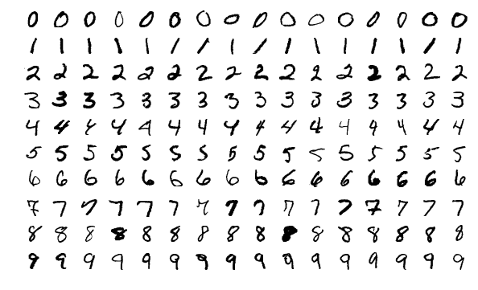
Handwritten digit recognition
MNIST: standard dataset – all novelties are compared on this dataset
10 classes
Best accuracy in literature: 99.79%
Perfect example where CNNs work well

Slide 14
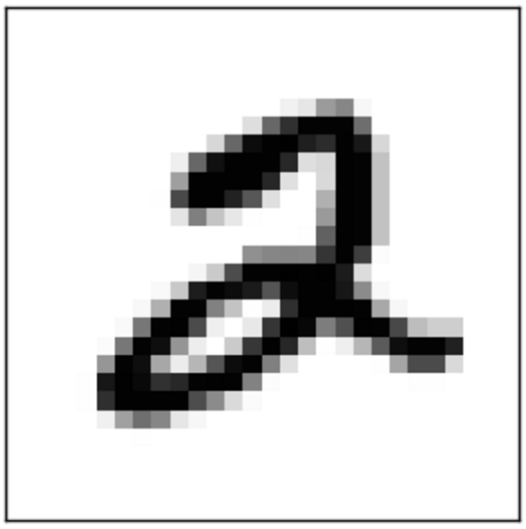
Desired pipeline
Probability distribution:
[
[ 0 ],
[ 0 ],
[ 1 ],
[ 0 ],
[ 0 ],
[ 0 ],
[ 0 ],
[ 0 ],
[ 0 ],
[ 0 ]
]

Slide 15
What is an image?
0 | 0 | 0 | 0 | 0 | 0 | 0 | 0 | 0 | 0 | 0 | 0 | 0 | 0
0 | 0 | 0 | 0 | 0 | 0 | 0 | 0 | 0 | 0 | 0 | 0 | 0 | 0
0 | 0 | 0 | 0 | 0 | 0 | 1 | 1 | 0 | 0 | 0 | 0 | 0 | 0
0 | 0 | 0 | 0 | 0 | 0 | 1 | 1 | 0 | 0 | 0 | 0 | 0 | 0
0 | 0 | 0 | 0 | 0 | 0 | 1 | 1 | 1 | 0 | 0 | 0 | 0 | 0
0 | 0 | 0 | 0 | 0 | 0 | 0 | 1 | 1 | 0 | 0 | 0 | 0 | 0
0 | 0 | 0 | 0 | 0 | 0 | 0 | 1 | 1 | 0 | 0 | 0 | 0 | 0
0 | 0 | 0 | 0 | 0 | 0 | 0 | 1 | 1 | 0 | 0 | 0 | 0 | 0
0 | 0 | 0 | 0 | 0 | 0 | 0 | 1 | 1 | 1 | 0 | 0 | 0 | 0
0 | 0 | 0 | 0 | 0 | 0 | 0 | 0 | 1 | 1 | 0 | 0 | 0 | 0
0 | 0 | 0 | 0 | 0 | 0 | 0 | 0 | 1 | 1 | 0 | 0 | 0 | 0
0 | 0 | 0 | 0 | 0 | 0 | 0 | 0 | 1 | 1 | 0 | 0 | 0 | 0
0 | 0 | 0 | 0 | 0 | 0 | 0 | 0 | 0 | 0 | 0 | 0 | 0 | 0
0 | 0 | 0 | 0 | 0 | 0 | 0 | 0 | 0 | 0 | 0 | 0 | 0 | 0

Slide 16
Let’s use filters
0 | 1 | 0
0 | 1 | 0
0 | 1 | 0
Detects vertical lines
Detects horizontal lines
Detects diagonals
0 | 0 | 0 | 0 | 0 | 0 | 0 | 0 | 0 | 0 | 0 | 0 | 0 | 0
0 | 0 | 0 | 0 | 0 | 0 | 0 | 0 | 0 | 0 | 0 | 0 | 0 | 0
0 | 0 | 0 | 0 | 0 | 0 | 1 | 1 | 0 | 0 | 0 | 0 | 0 | 0
0 | 0 | 0 | 0 | 0 | 0 | 1 | 1 | 0 | 0 | 0 | 0 | 0 | 0
0 | 0 | 0 | 0 | 0 | 0 | 1 | 1 | 1 | 0 | 0 | 0 | 0 | 0
0 | 0 | 0 | 0 | 0 | 0 | 0 | 1 | 1 | 0 | 0 | 0 | 0 | 0
0 | 0 | 0 | 0 | 0 | 0 | 0 | 1 | 1 | 0 | 0 | 0 | 0 | 0
0 | 0 | 0 | 0 | 0 | 0 | 0 | 1 | 1 | 0 | 0 | 0 | 0 | 0
0 | 0 | 0 | 0 | 0 | 0 | 0 | 1 | 1 | 1 | 0 | 0 | 0 | 0
0 | 0 | 0 | 0 | 0 | 0 | 0 | 0 | 1 | 1 | 0 | 0 | 0 | 0
0 | 0 | 0 | 0 | 0 | 0 | 0 | 0 | 1 | 1 | 0 | 0 | 0 | 0
0 | 0 | 0 | 0 | 0 | 0 | 0 | 0 | 1 | 1 | 0 | 0 | 0 | 0
0 | 0 | 0 | 0 | 0 | 0 | 0 | 0 | 0 | 0 | 0 | 0 | 0 | 0
0 | 0 | 0 | 0 | 0 | 0 | 0 | 0 | 0 | 0 | 0 | 0 | 0 | 0
0 | 0 | 0
1 | 1 | 1
0 | 0 | 0
1 | 0 | 0
0 | 1 | 0
0 | 0 | 1

Slide 17
And convolve
0 | 0 | 0 | 0 | 0 | 0 | 0 | 0 | 0 | 0 | 0 | 0 | 0 | 0
0 | 0 | 0 | 0 | 0 | 0 | 0 | 0 | 0 | 0 | 0 | 0 | 0 | 0
0 | 0 | 0 | 0 | 0 | 0 | 1 | 1 | 0 | 0 | 0 | 0 | 0 | 0
0 | 0 | 0 | 0 | 0 | 0 | 1 | 1 | 0 | 0 | 0 | 0 | 0 | 0
0 | 0 | 0 | 0 | 0 | 0 | 1 | 1 | 1 | 0 | 0 | 0 | 0 | 0
0 | 0 | 0 | 0 | 0 | 0 | 0 | 1 | 1 | 0 | 0 | 0 | 0 | 0
0 | 0 | 0 | 0 | 0 | 0 | 0 | 1 | 1 | 0 | 0 | 0 | 0 | 0
0 | 0 | 0 | 0 | 0 | 0 | 0 | 1 | 1 | 0 | 0 | 0 | 0 | 0
0 | 0 | 0 | 0 | 0 | 0 | 0 | 1 | 1 | 1 | 0 | 0 | 0 | 0
0 | 0 | 0 | 0 | 0 | 0 | 0 | 0 | 1 | 1 | 0 | 0 | 0 | 0
0 | 0 | 0 | 0 | 0 | 0 | 0 | 0 | 1 | 1 | 0 | 0 | 0 | 0
0 | 0 | 0 | 0 | 0 | 0 | 0 | 0 | 1 | 1 | 0 | 0 | 0 | 0
0 | 0 | 0 | 0 | 0 | 0 | 0 | 0 | 0 | 0 | 0 | 0 | 0 | 0
0 | 0 | 0 | 0 | 0 | 0 | 0 | 0 | 0 | 0 | 0 | 0 | 0 | 0
0 | 0 | 0
0 | 0 | 0
0 | 0 | 0
0 | 1 | 0
0 | 1 | 0
0 | 1 | 0
x
∑
0

Slide 18
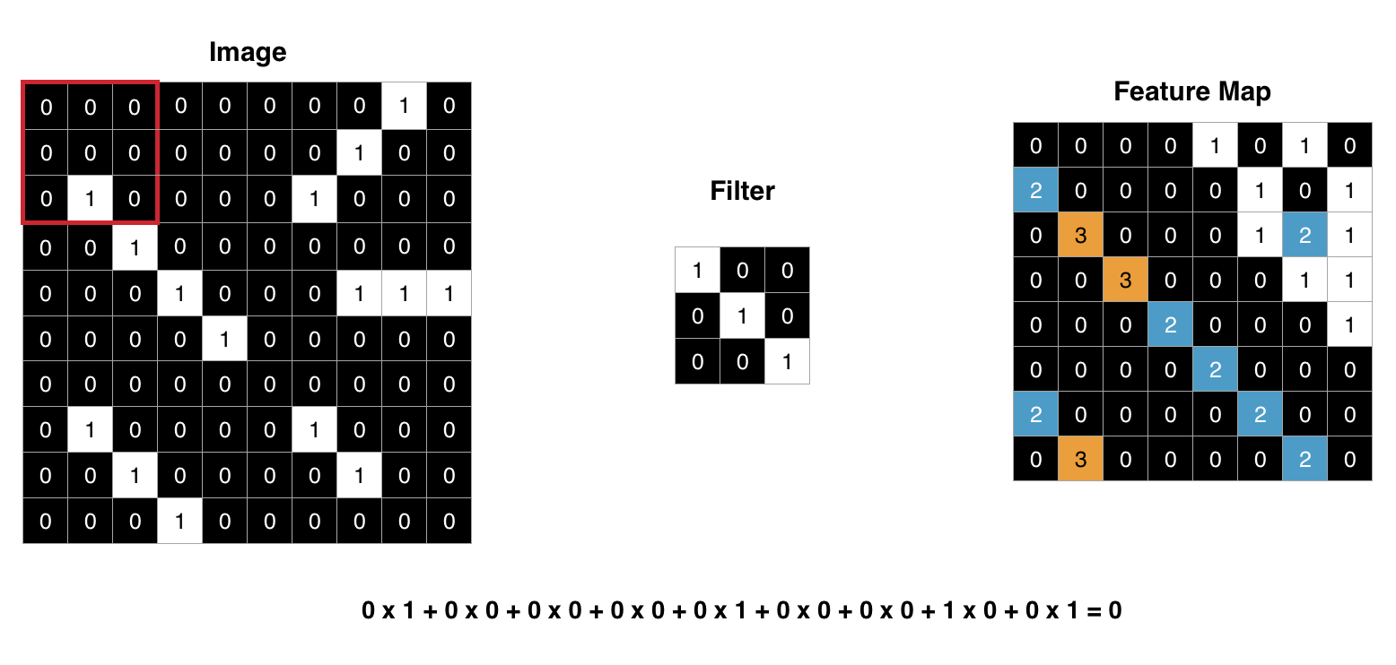
And convolve

Slide 19
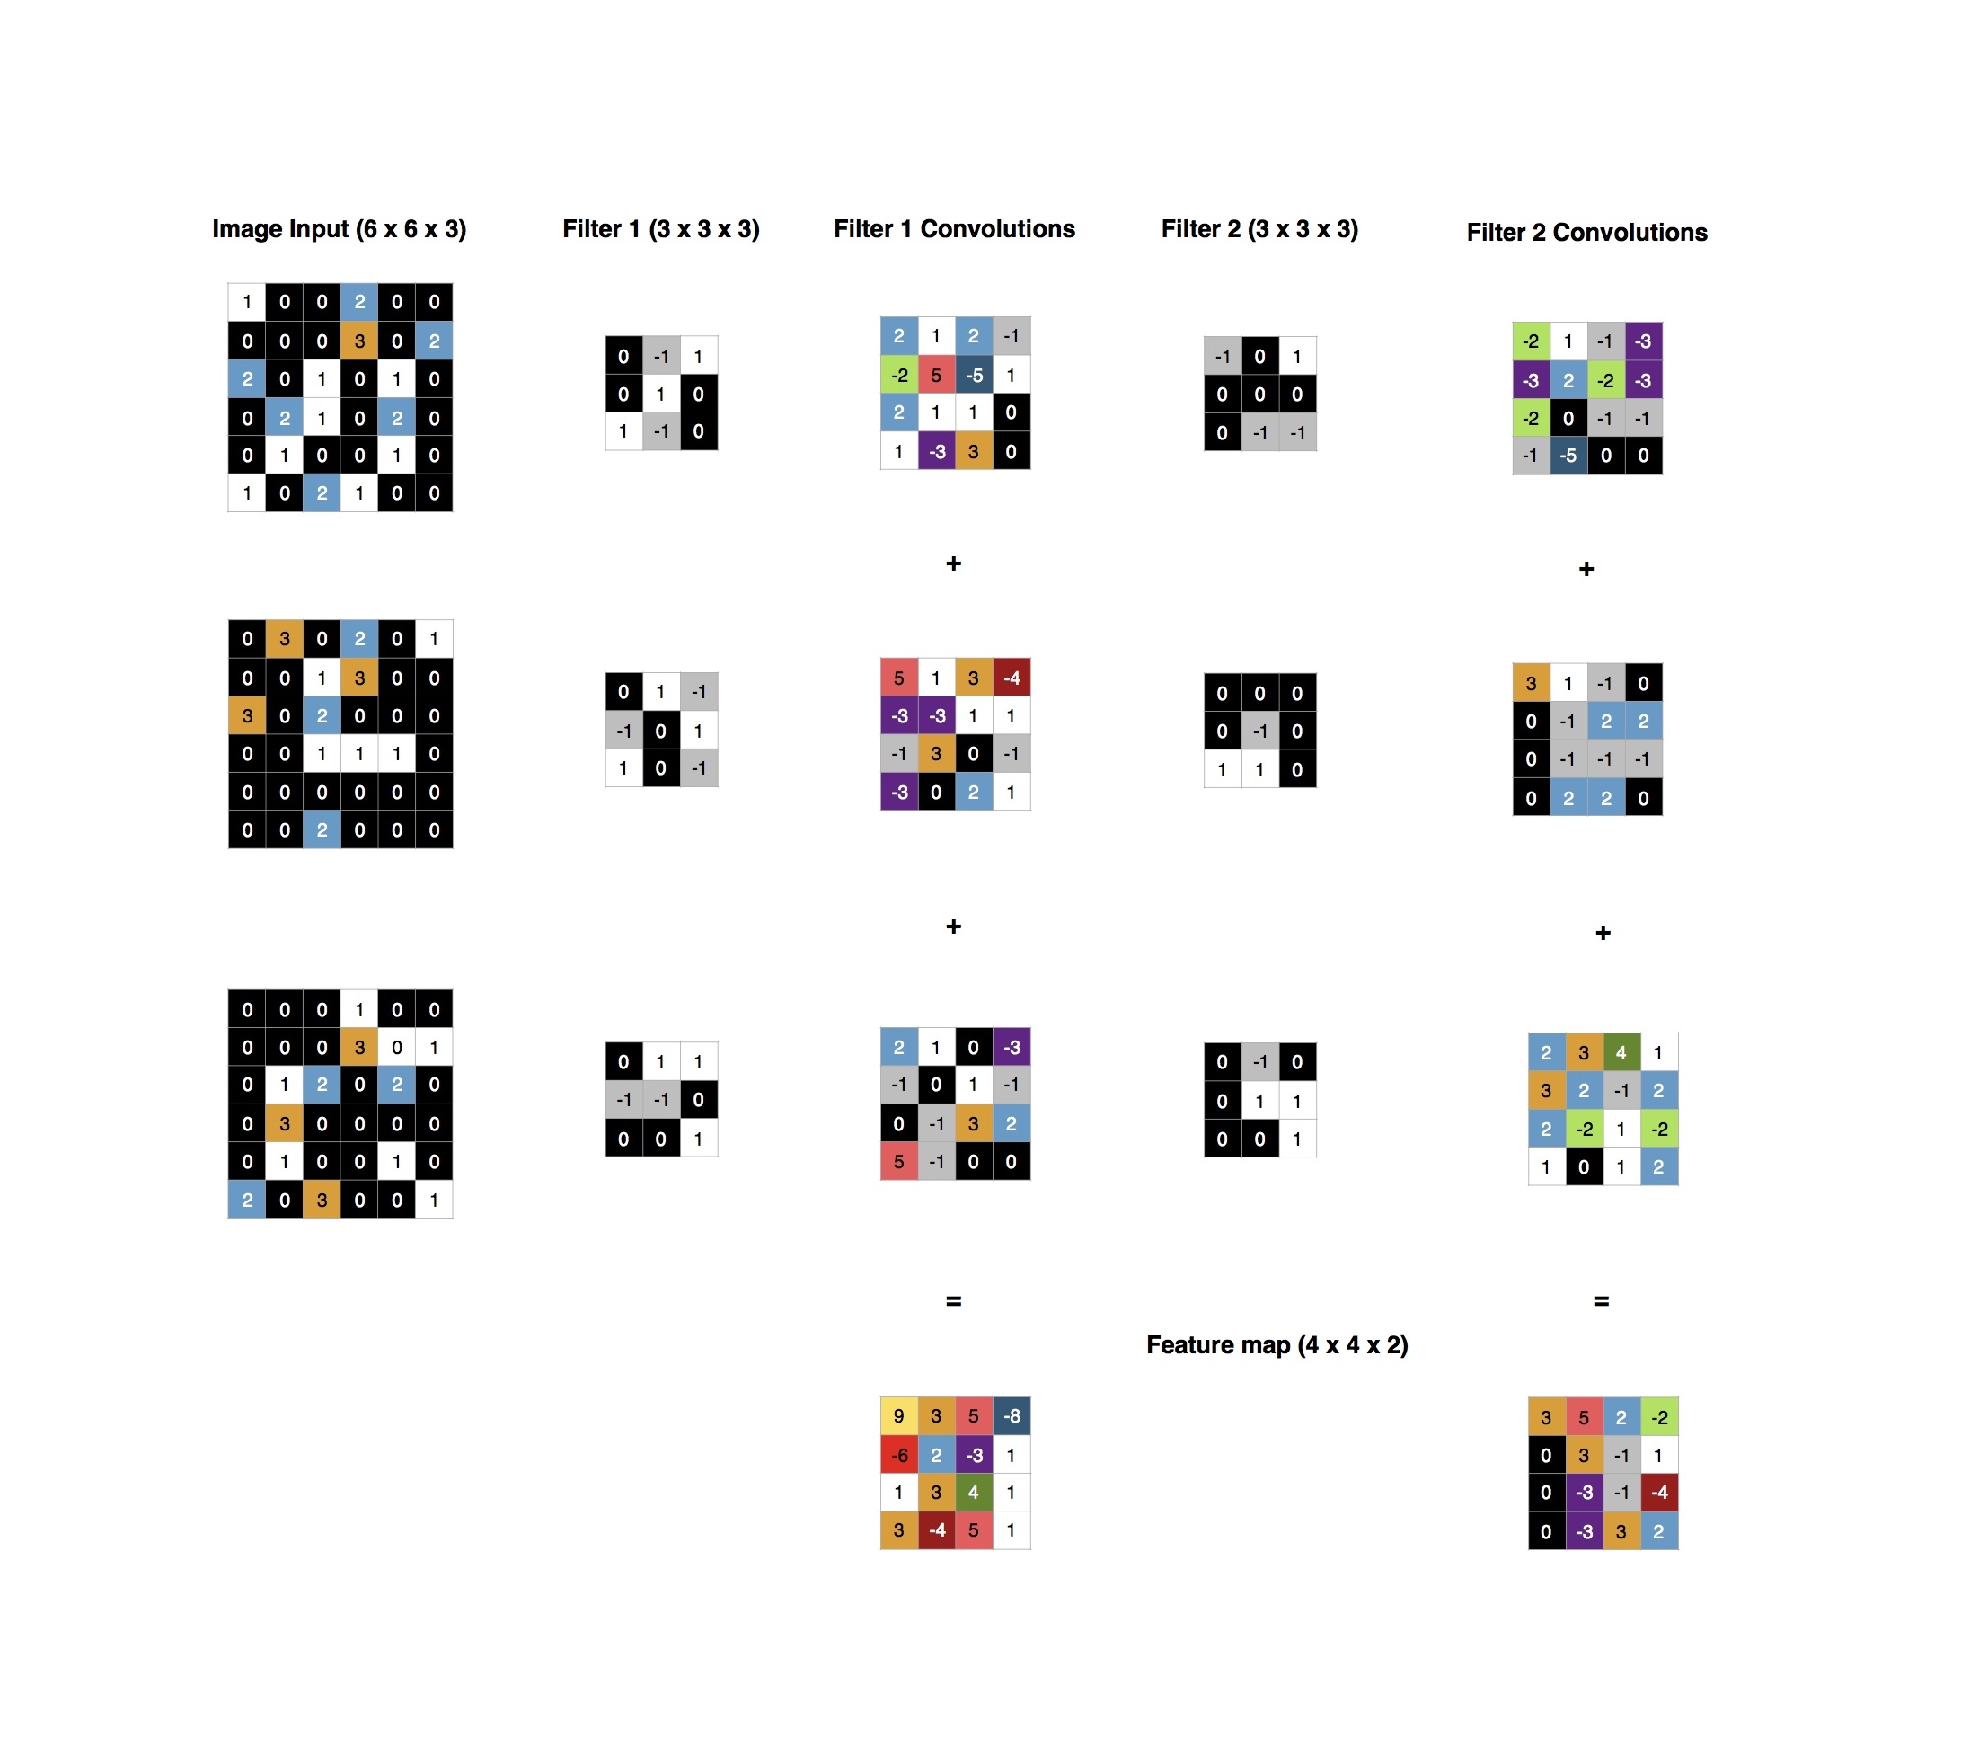
And stack layers – but hold on
Note:
filters in reality are set randomly, as usual
They will converge individually (hopefully) to more complex shapes
Real values are used
Color images have 3 dimensions: R, G and B
Activation
What will happen?

Slide 20
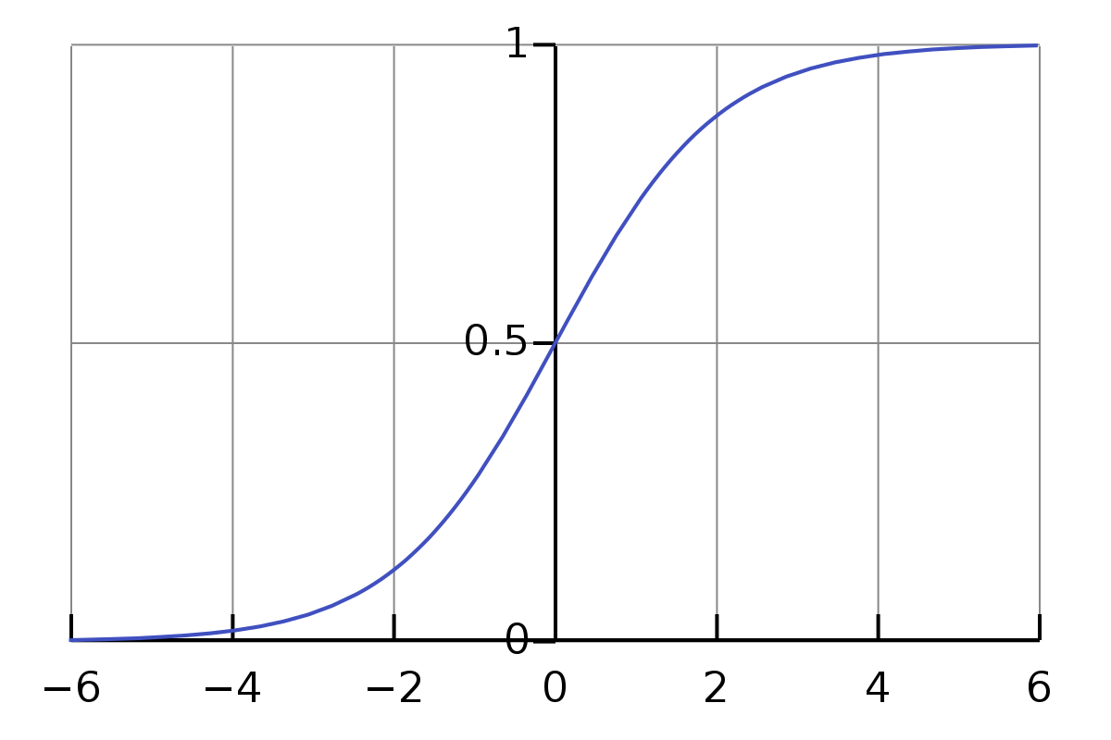
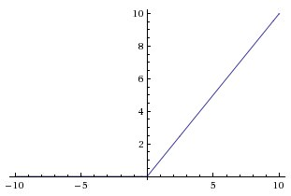
Gradient vanishing
The sigmoid activation works well in general
But as the network grows, gradients become smaller and smaller => poor training
Solution: ReLU

Slide 21
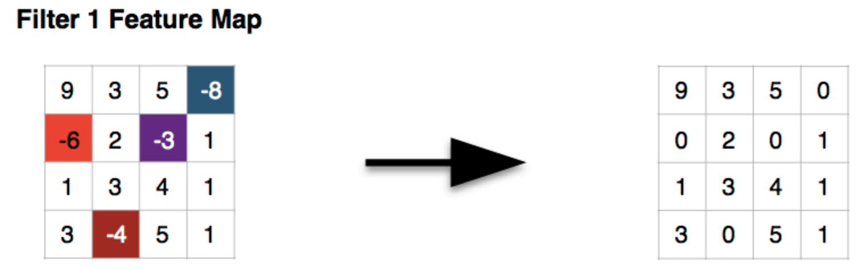
ReLU activation

Slide 22
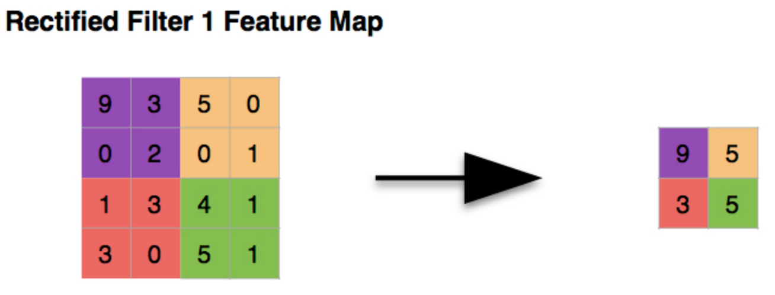
(Max) pooling
Aggregates features = makes the network more robust to small changes

Slide 23
Fully connected layer
All neurons are connected as in the multilayer perceptron we saw
Acts like a vote:
Input: high-level features from rectified filters of convolutions
Each feature can “vote” for a class
But some features can have more than one voice (e.g. one that identifies the cross in an “x”)
This layer is also part of training!

Slide 24
Let’s code it!
I know this is a lot of concepts, but they’re important.
Let’s see how it works in practice.
Open the notebook at the CNN section.

Slide 25
Recurrent Neural Networks
Another large class of networks
Intuition: like in hidden Markov models, better understand sequences
Particularly useful for text (e.g. sentiment analysis), or anything where each input can depend on the previous one(s).

Slide 26
Intuition of RNNs
Predict the blank word:
Last week I visited the capital of France. ______ really is a nice city!
How did you guess?

Slide 27
Recurrences
RNNs are less deep in the number of layers (usually 2-3 is enough)
They are deep in the number of states (memory)
Last week I visited the capital
x¹_{t-5}
x¹_{t-4}
x¹_{t-3}
x¹_{t-2}
x¹_{t-1}
x¹_{t}

Slide 28
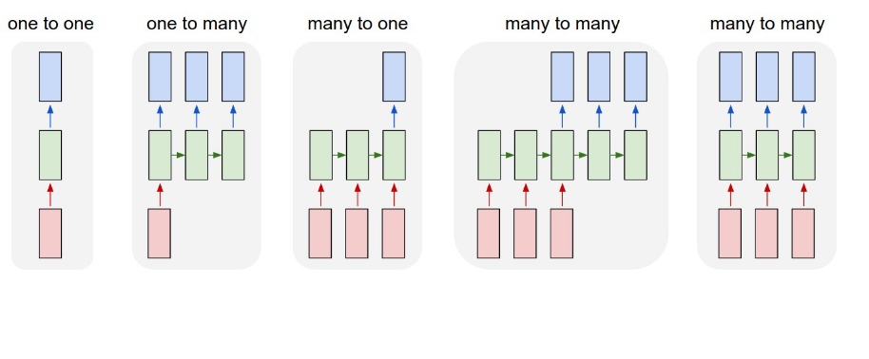
Many applications

Slide 29
Different cells
LSTM: Long Short Term Memory
GRU: Gated Recurrent Unit
Bi-directional RNN
Etc.
But overall, despite their (theoretical) better modelling power, RNNs are slower than CNN.
Yet some applications seem magical.

Slide 30
Let’s code it!
Open the notebook to the RNN section.

Slide 31
What we haven’t seen today
Mathematical details
Optimization algorithms
Loss function details
Scalability (& GPU processing)
MANY other networks
But hopefully you’ll have enjoyed practicing with NNs and it got you enthusiastic about applying them to other tasks.

Slide 32
Resources
Used for this course:
http://iamtrask.github.io/2015/07/12/basic-python-network/
https://hashrocket.com/blog/posts/a-friendly-introduction-to-convolutional-neural-networks
Further reading:
http://neuralnetworksanddeeplearning.com/
https://www.deeplearning.ai/
Wikipedia has a ton of resources too

