Slide 1
Making an xml/asn.1 to FHIR compliant JSON converter for genomic data
Hale Kpetigo
Syed Hussain Ather
Rob Guthridge
Blythe Hospelhorn
Luli Zou

Slide 2
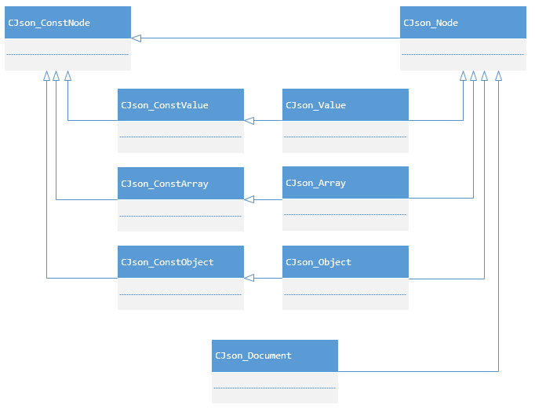
Motivation
Existing tools to convert from XML to JSON
C++ Toolkit (JSONWRAPP)
Eutils
Not made for Bioinformaticians
Not user-friendly
Issues with being FHIR compliant
Make output FHIR compliant JSON
Use case examples
Find all gene positions for Candida albicans
Find all Clean variants and their positions
JsonWrapp library class relationship
diagram.
Source NCBI C++ Toolkit
Notes:
JSON object is an unordered collection of zero or more name/value pairs, where name is a string and value is a string, number, boolean, null, object, or array. JsonWrapp object classes - CJson_ConstObject, CJson_Object - resemble STL map. Unlike STL map though, pair elements are called name and value here. Object classes implement bidirectional iterators to access object elements.
First thing to note is that most classes here act like pointers. That is, creating or copying them does not create any data; destroying them does not destroy any data either. There is only one data storage class – Document. All others are simply pointers to different parts of the document. Once so, it is impossible to create a standalone JSON value object. To create a value, one should add it into a document and get a proper adapter object.

Slide 3
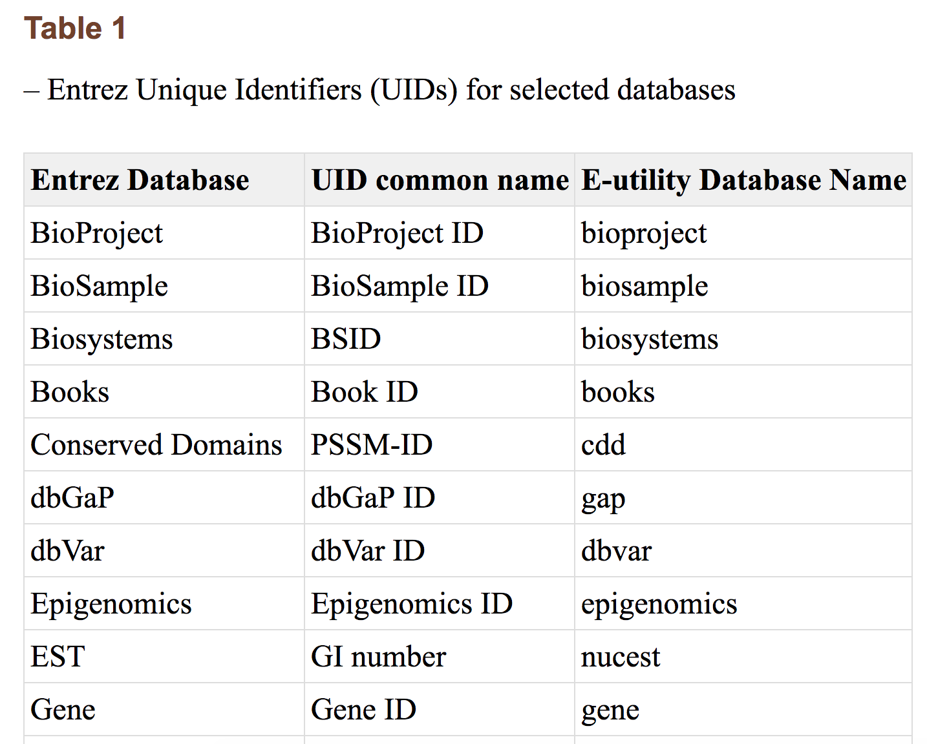
Motivation
Existing tools to convert from XML to JSON
C++ Toolkit (JSONWRAPP)
Eutils
Not made for Bioinformaticians
Not user-friendly
Issues with being FHIR compliant
Make output FHIR compliant JSON
Use case examples
Find all gene positions for Candida albicans
Find all Clean variants and their positions
(Entrez Programming Utilities)
Notes:
JSON object is an unordered collection of zero or more name/value pairs, where name is a string and value is a string, number, boolean, null, object, or array. JsonWrapp object classes - CJson_ConstObject, CJson_Object - resemble STL map. Unlike STL map though, pair elements are called name and value here. Object classes implement bidirectional iterators to access object elements.
First thing to note is that most classes here act like pointers. That is, creating or copying them does not create any data; destroying them does not destroy any data either. There is only one data storage class – Document. All others are simply pointers to different parts of the document. Once so, it is impossible to create a standalone JSON value object. To create a value, one should add it into a document and get a proper adapter object.

Slide 4
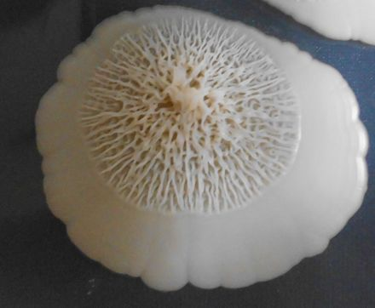
Motivation
Existing tools to convert from XML to JSON
C++ Toolkit (JSONWRAPP)
Eutils
Not made for Bioinformaticians
Not user-friendly
Issues with being FHIR compliant
Make output FHIR compliant JSON
Use case examples
Find all gene positions for Candida albicans
Find all Clean variants and their positions
Candida albicans
Notes:
JSON object is an unordered collection of zero or more name/value pairs, where name is a string and value is a string, number, boolean, null, object, or array. JsonWrapp object classes - CJson_ConstObject, CJson_Object - resemble STL map. Unlike STL map though, pair elements are called name and value here. Object classes implement bidirectional iterators to access object elements.
First thing to note is that most classes here act like pointers. That is, creating or copying them does not create any data; destroying them does not destroy any data either. There is only one data storage class – Document. All others are simply pointers to different parts of the document. Once so, it is impossible to create a standalone JSON value object. To create a value, one should add it into a document and get a proper adapter object.

Slide 5


Pipeline
Web API
User query:
Taxonomy / NCBI accession number
Genes of interest
C++ Toolkit
xml/asn.1 file
FHIR-compliant JSON output
Notes:
Assume we have a sequence and input sequence. Output result in JSON FHIR-compliant format. We’re going to search candida albicans and what we’ve sequenced (input data). Apply taxonomy. The C++ Toolkit provides hook mechanisms, whereby the needed functionality can be installed with the object’s static class type information object. Local hooks apply to a selected stream whereas global hooks apply to all streams. Note: global skip hooks are not supported.

Slide 6
Precision Medicine Toolkit
EMR with variants (JSON format)
SNPEFF and Annovar
“Useful” (i.e. deleterious?) variants
Search SRA, dbGaP, TOPMED, GWAS
Associated genotypes and phenotypes
Convert to FHIR-compliant JSON
EMR with variants and associated genotypes and phenotypes learned

Slide 7
Annovar
SNPEff
Input: Annovar formatted text table, OR VCF file
Output: Input table with additional columns, OR VCF file with annotations as INFO fields.
Input: chromosome, position, ref. allele, alt. allele OR vcf
Output: JSON file with alternate allele frequency

Slide 8
TOPMED (via Bravo API)
GWAS
Input: chromosome, position, ref. allele, alt. allele OR vcf
Output: JSON file with alternate allele frequency
Input: GWAS catalog (a .tsv file, each line is a variant)
Output: Name of study/disease trait, pubmed link

Slide 9
SRA (SRR)
dbGaP
Input: fasta, fastq, sff
Output: sra
Input:
Output:

