Slide 1
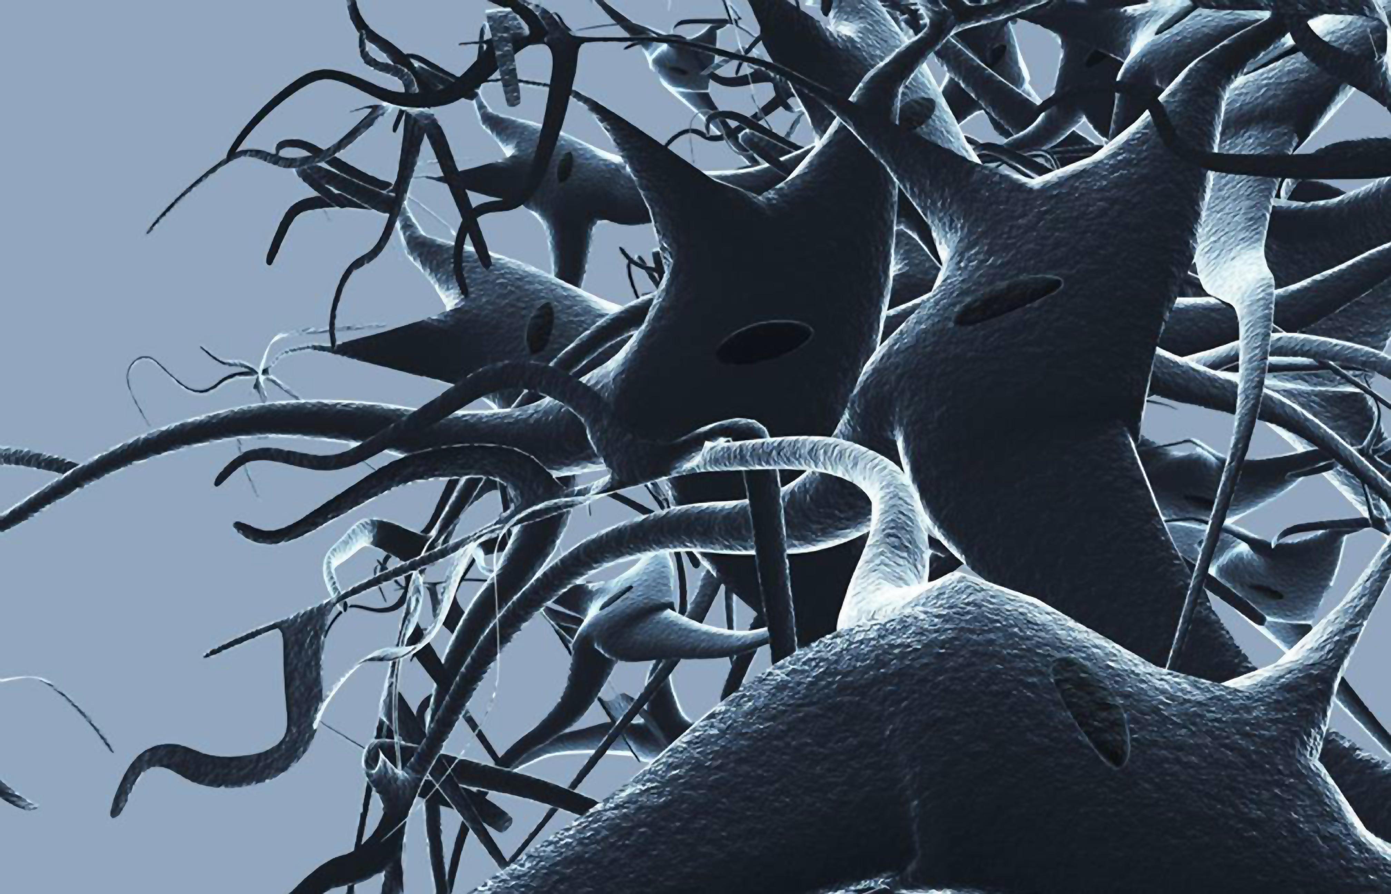
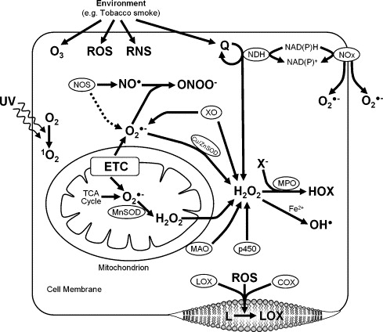
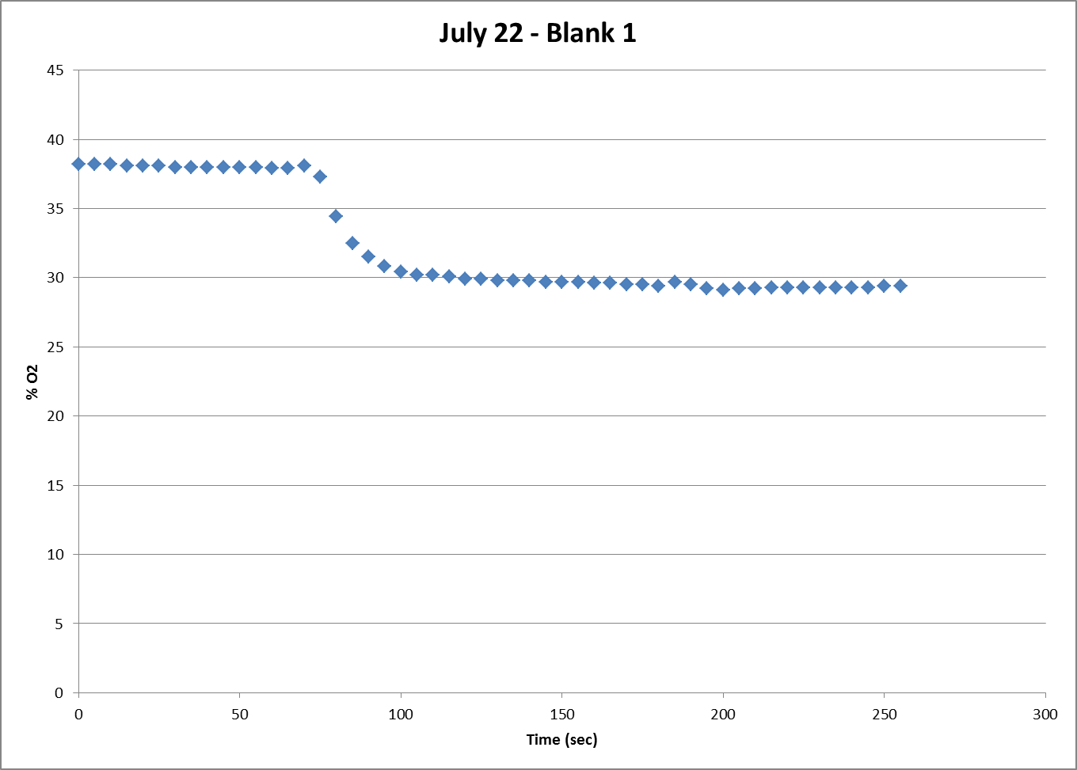
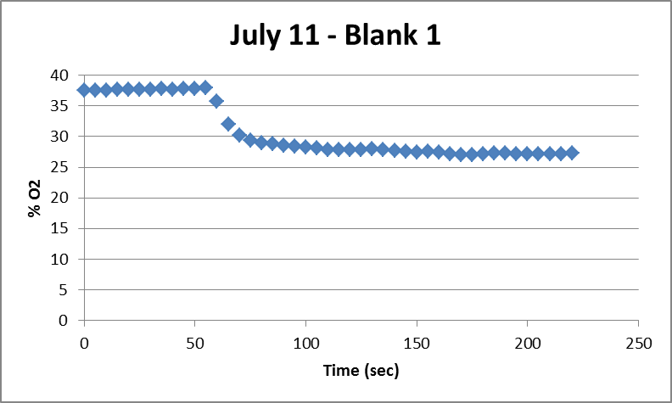
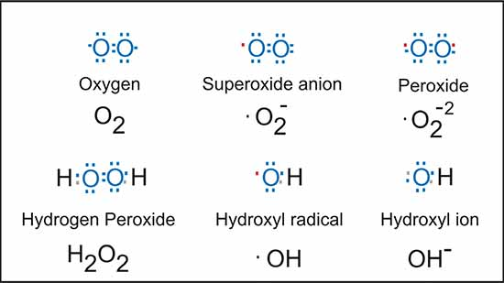
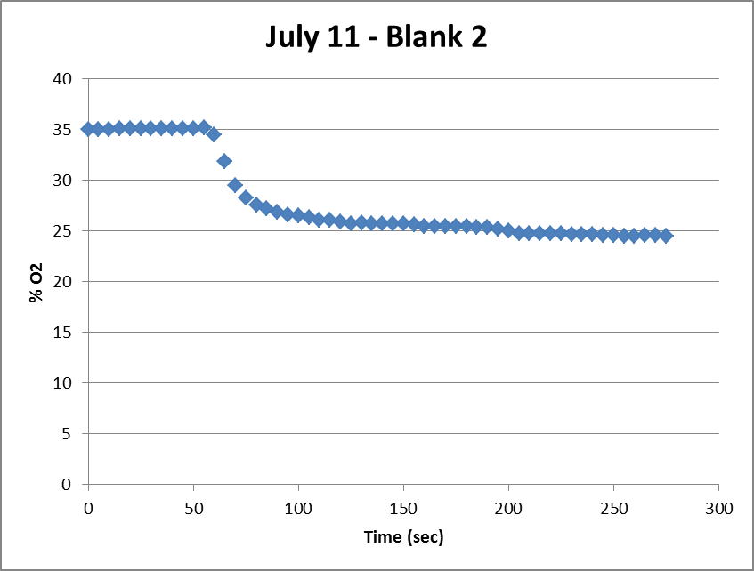
Oxygen consumption of yeast cell mitochondria in the presence of antioxidants to determine the role of reactive oxygen species and superoxidase dismutase
Syed Hussain Ather
Marian University
Introduction
Antioxidants play an important role in mitochondrial function in the presence of reactive oxygen species (ROS). For example deficiency of the antioxidant glutathione has been shown to cause oxidative stress in different types of dialysis patients (Ross). ROS are naturally produced as byproducts of various cellular processes such as respiration and develop in greater amounts under situations of environmental stress. Common ROS are shown below (Fig. 1) The dot represents an unpaired electron in various formulas (Held). This experiment was performed to determine the role of reactive oxygen species, specifically quercetin, in the mitochondria of yeast cells.
Results
Discussion
These results of the blank trials used for practice demonstrate the stage IV and stage III oxygen consumption of mitochondrial with the addition of ADP at the end of each plateau. Two distinct curves shuold be seen that separate three plateaus. These trials were simply tests to understand and maintain the technique of the protocol.
Fig. 2 (up) . Cellular sources of reactive oxygen species. Aside from the ETC, TCA (Citric Acid) Cycle, and monoamine oxidase (MAO). ROS can be generated from NADPH oxidases (NOX), UV light, and smoke. Other sources, including the Cu/Zn superoxidative species (Cu/Zn SOD) and nitric oxide synthase (NOS) catalysis of NO are shown to produce H₂O₂ and peroxynitrite (ONOO ), respectively. Further, H₂O₂ can react with metals, such as Fe²⁺, to generate the hydroxyl radical ( OH), myeloperoxidase (MPO) uses H₂O₂ and halides (X) to make hypohalous acids (HOX), and quinones (Q) may cyclically react with NAD(P)H dehydrogenases to generate ROS (Sheu).
Figure 2 shows various sources of ROS. This experiment will mainly examine sources of ROS from the first cytochrome complex of the ETC.
References
Held, Paul. "An Introduction to Reactive Oxygen Species - Measurement of ROS in Cells."BioTek. BioTek Instruments, 23 Feb. 2010. Web. 23 July 2013.
Qiagen. (2010) Protocol: Purification of Total RNA from Yeast. RNeasy Mini Handbook.
Ross, Edward A., Lilia C. Koo, and James B. Moberly. "Low whole blood and erythrocyte levels of glutathione in hemodialysis and peritoneal dialysis patients." American journal of kidney diseases 30.4 (1997): 489-494.
Sheu, Shey-Shing, Dhananjaya Nauduri, and M. W. Anders. "Targeting antioxidants to mitochondria: a new therapeutic direction." Biochimica et Biophysica Acta (BBA)-Molecular Basis of Disease 1762.2 (2006): 256-265.
Sohal, Rajindal S., Hung-Hai Ku, Sanjiv Agarwal, Michael J. Forster, and Harbans Lal. "Oxidative Damage, Mitochondrial Oxidant Generation and Antioxidant Defenses during Aging and in Response to Food Restriction in the Mouse." Mechanisms of Ageing and Development 74.1-2 (1994): 121-33. Print.
Figure 1 (up). Common ROS.
Methods
Mitochondria were isolated from yeast cells that were mixed, some of which contained quercetin. Through two different methods: mechanical isolation and enzymatic breaking down of the cell membranes, the process involved a series of centrifugation and homogenization (Qiagen). The mitochondria were immersed in a mitochondrial suspension solution with a pyruvate-malate solution and their oxygen consumption rate was measured with and without the presence of ADP

