Slide 1
Information Security (CSNC3413)
Lecture 1

Slide 2
Contents
Introduction of Information Security
  Basics of Information Security
  Basic terminologies
  CIA Model
  Solution of CIA related Issues?
  Social Engineering

Slide 3
WHAT IS DATA?

Slide 4
WHAT IS DATA?
Data is a collection of raw facts, figures, images, audio, video, and multimedia that can be stored, processed, and analyzed.
Data is often unorganized and lacks context, but it can be used to generate information.
Notes:
The collection referred to is typically known as "data." Data can be broadly categorized into several types, including:
Text data: Raw textual information that can be stored and processed.
Numeric data: Data in the form of numbers that can be used for various calculations and analysis.
Image data: Visual information stored in the form of images.
Audio data: Sound information stored in the form of audio files.
Video data: Moving visual information stored in the form of video files.
Multimedia data: Data that combines different forms of media, such as text, images, audio, and video, into a single integrated package.
When this data is organized, stored, and managed, it can be used for various purposes, including analysis, decision-making, research, and many other applications. Data processing and analysis often involve using various techniques and tools to extract meaningful insights from the data.

Slide 5
WHAT IS INFORMATION?
Information is processed and contextualized data that has meaning and relevance to a specific context or situation. Information is often structured and organized in a way that makes it easier to understand and use.

Slide 6
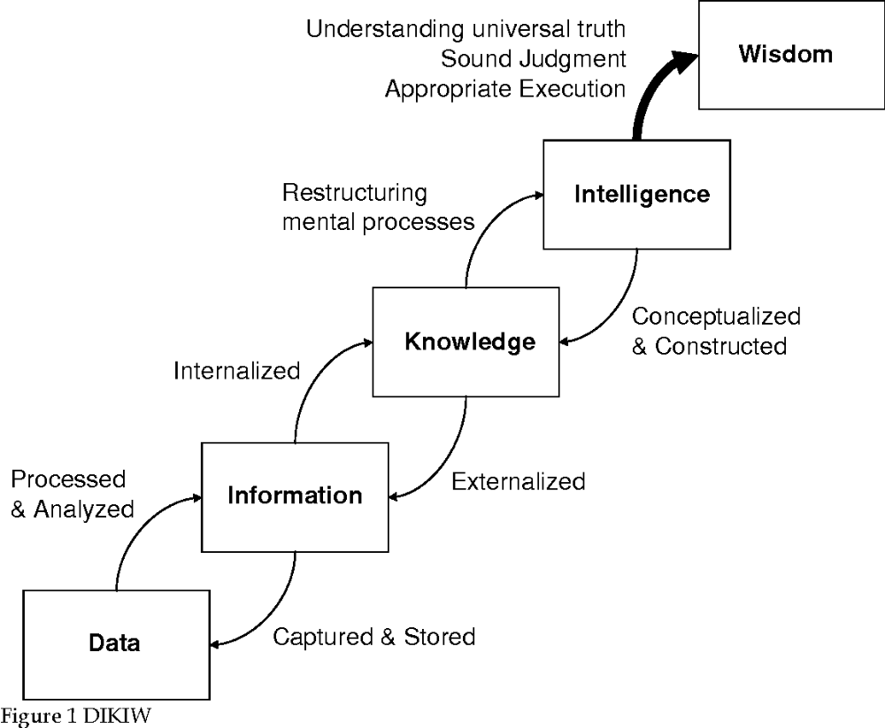
DIKIW - MODEL

Slide 7
DIKIW - MODEL
The DIKIW model is a framework that describes the relationship between data, information, knowledge, intelligence, and wisdom.
The model suggests that data is the most basic form of information, which is then processed and contextualized to form knowledge.
Intelligence is the ability to use knowledge to solve problems or make decisions, while wisdom is the ability to apply intelligence to achieve long-term goals and benefits.
The DIKIW model is often used in information management and knowledge management to help organizations manage and leverage their data, information, and knowledge assets.
Notes:
A brief description of each component of the DIKIW model:
Data: Data refers to the raw facts, figures, or statistics that are collected and processed. Data is often unorganized and lacks context, but it can be used to generate information.
Information: Information is processed and contextualized data that has meaning and relevance to a specific context or situation. Information is often structured and organized in a way that makes it easier to understand and use.
Knowledge: Knowledge is the result of analyzing and synthesizing information to create insights and understanding. Knowledge is often subjective and depends on the individual's perspective and experience.
Intelligence: Intelligence is the ability to apply knowledge to solve problems or make decisions. Intelligence requires critical thinking, reasoning, and problem-solving skills.
Wisdom: Wisdom is the ability to apply intelligence to achieve long-term goals and benefits. Wisdom requires an understanding of the broader context and consequences of decisions.

Slide 8
WHAT IS AN ASSET?
An asset is what we are trying to protect.
Anything that is valuable for an organization
  Information
  Property
  Software
  Hardware
  Human
Notes:
"An asset is a person, structure, facility, information, and technology throughout its lifecycle. It includes the management, operational, and technical controls that are put in place, including measures to prevent unauthorized access, use, disclosure, disruption, modification, or destruction of information.“ ~ NIST

Slide 9
WHAT IS A THREAT?
Any thing that can cause harm
  From someone else
A threat is a potential danger to an asset (information)
Threat Agent:
  The entity which causes threat to happen
  Example: An intruder in a system, Malware, Nature

Slide 10
WHAT IS A VULNERABILITY?
A weakness or gap in our protection efforts.
It makes an attack possible.
Vulnerability is weakness or gap in a security program that can be exploited by threats to gain unauthorized access to an asset.

Slide 11
WHAT IS RISK?
The potential for loss, damage or destruction of an asset as a result of a threat exploiting a vulnerability.
  A risk is a possible event which could cause a loss
  Own perception
  Risk = F(Threat, Vulnerability, Asset)

Slide 12
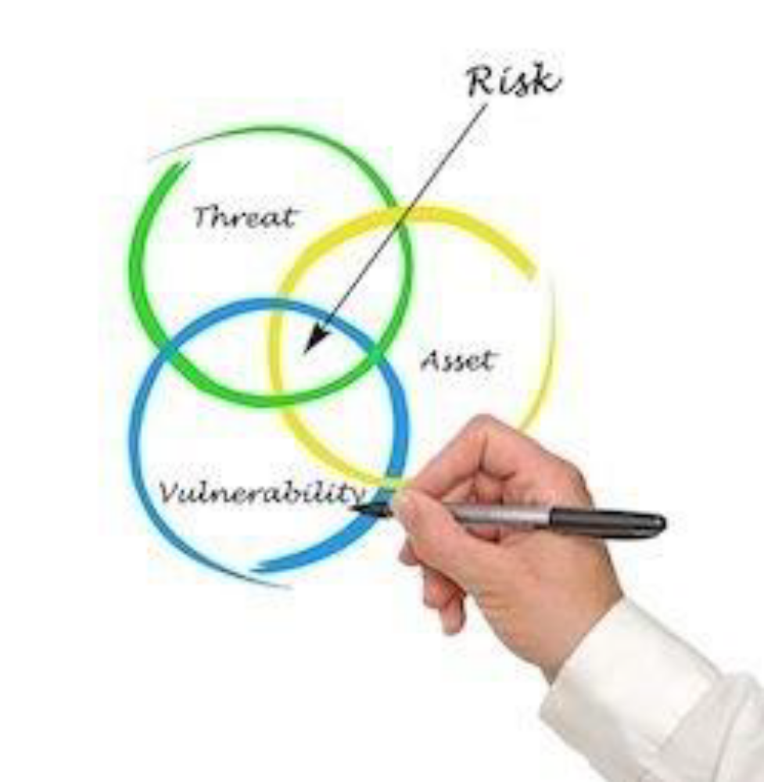

Slide 13
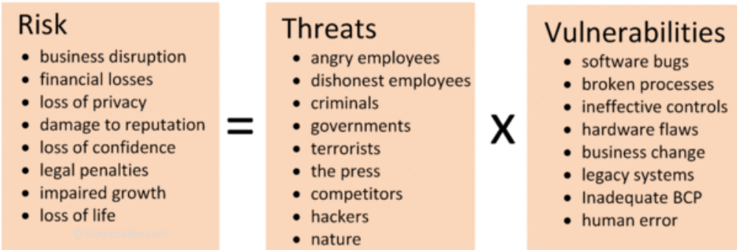
Risk is the intersection of assets, threats, and vulnerabilities.

Slide 14
EXPOSURE FACTOR AND IMPACT
Exposure Factor and Impact are two terms that are commonly used in the field of risk management.
Exposure Factor refers to the percentage of loss that an asset may experience due to a specific threat.
In other words, it represents the potential damage that a threat can cause to an asset.
This percentage is usually estimated based on the asset's value, the likelihood of the threat occurring, and the vulnerability of the asset to the threat.

Slide 15
EXPOSURE FACTOR AND IMPACT (Cont.)
Impact, on the other hand, refers to the extent of damage that a threat can cause.
It takes into account the Exposure Factor, as well as other factors such as the duration of the impact and the availability of backup resources.
Impact is usually expressed in terms of a range of values, such as low, medium, or high, based on the severity of the potential damage.

Slide 16
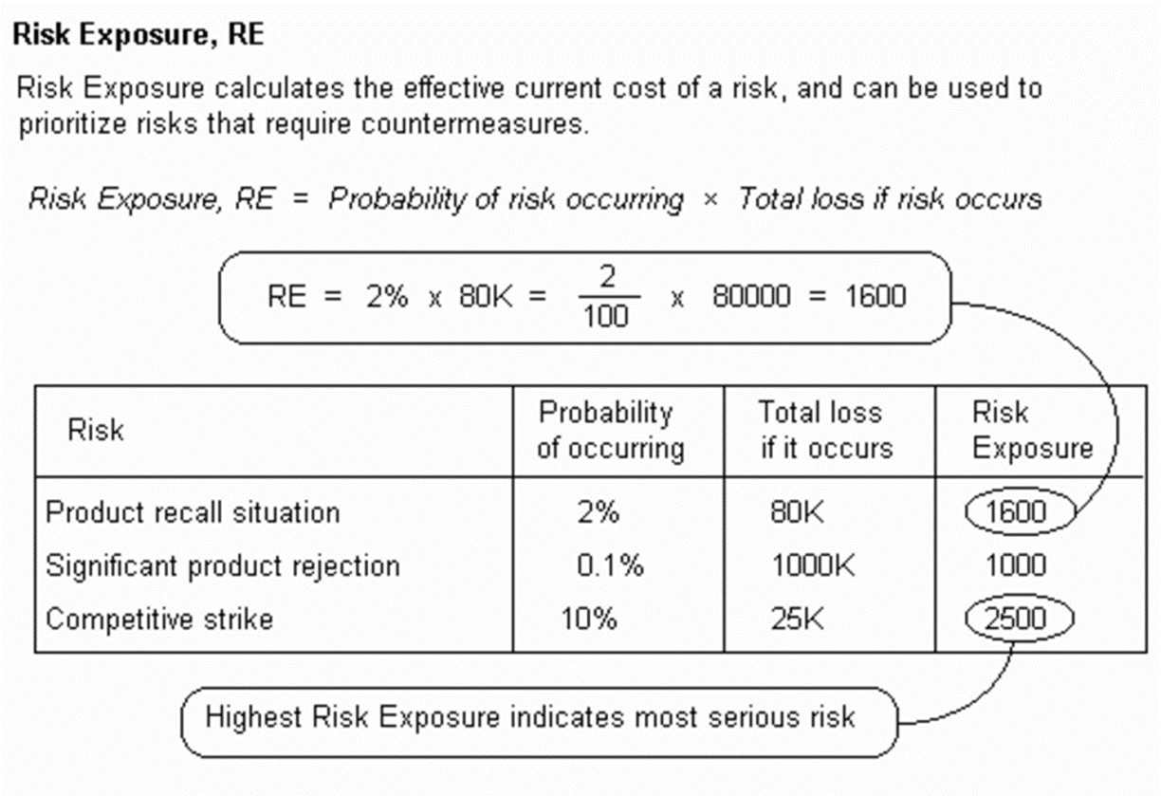

Slide 17
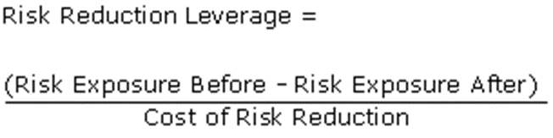
RISK REDUCTION LEVERAGE
Risk Reduction Leverage is another Quantitative means of assessing how Risks are being managed.
Since Risk Exposure is not absolute but relative, we can compare different exposures to one another. One of the ways we can compare such exposures is to compare the Exposure of a single event BEFORE and AFTER managing the risk. We need a simple measure to assess Risk Reduction.
20.8.1 Example of Risk Reduction Leverage
Let us consider a Server with some data on it. The probability of losing the data is 20%. The cost of losing such data is measured in terms of the cost of rebuilding it. This is estimated at $20,000:
Probability of loss 0.2 BEFORE Resolution
Loss $20,000
Exposure to data loss 0.2 x $20,000 = $4,000

Slide 18
(Note that the $4000 is simply the average impact: if we have 100 days then since the probability of data loss is 20%, we expect to lose data on 20 of them. In each case, we will have a damage or impact of $20,000. Therefore, the total expected impact would be 20 x $20,000 or $400,000. Divide this over 100 days to get the average impact and you will get $4000).
Now we provide a method of reducing the possibility of data loss (Say frequent backup or replication on another database, etc). This reduces the risk to 5%. The impact on losing the data is the same since we still need to rebuild the data. However, the cost of introducing the loss reduction is $2000.
Probability of loss 0.05 AFTER Resolution
Loss $20,000 (Same loss in this example)
Exposure 0.05 x $20,000 = $1000
Cost of Risk Reduction $2000
So using the above formula, the Risk Reduction Leverage is:
Leverage ($4000 - $1000) / $2000 = 1.5
The higher the Leverage, the better the solution.
The Risk Reduction Leverage gives us the following benefits:
We can now compare different ways of reducing data loss to each other by comparing the Reduction Leverage
We can increase Leverage by Increasing the difference between Exposure (Before) and Exposure (After), that is by improving the solution and reducing the probability.
We can also increase Leverage by reducing the cost of risk reduction or by selecting better solutions.
In conclusion, use Risk Reduction Leverage to assess different solutions to a risky event.

Slide 19
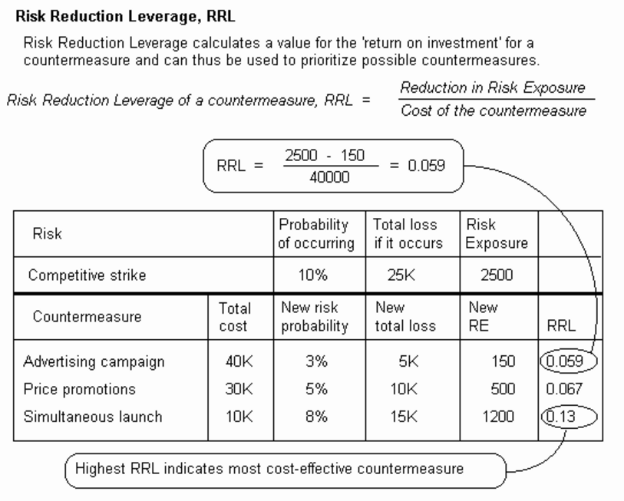

Slide 20
Exercise
A company owns an asset with a total cost of 50,000 PKR. The probability of a risk associated with the asset occurring is 70%. Total Loss if the risk occurs is 10,000 PKR. The company is evaluating two potential countermeasures: Countermeasure X, which reduces the probability of the risk occurring to 30% and the total loss if the risk occurs to 2,000 PKR, and Countermeasure Y, which reduces the probability to 15% and the total loss if the risk occurs to 2,510 PKR. Calculate the Risk Exposure (R.E) before and after implementing the countermeasures. Determine which countermeasure is more cost-effective, considering that Countermeasure X costs 25,000 PKR and Countermeasure Y costs 10,000 PKR. Which countermeasure would you recommend the company to implement based on cost-effectiveness?

Slide 21
Solution??
Countermeasure Y is more cost effective (0.66235)

Slide 22
SECURITY CONCEPTS
Assurance:
  The level of guarantee that a security system will behave as expected
Countermeasure/safeguard/control:
  A countermeasure is a way to stop a threat
Defense in depth:
  Never rely on one single security measure alone
  Take (maximum) steps to protect the system

Slide 23
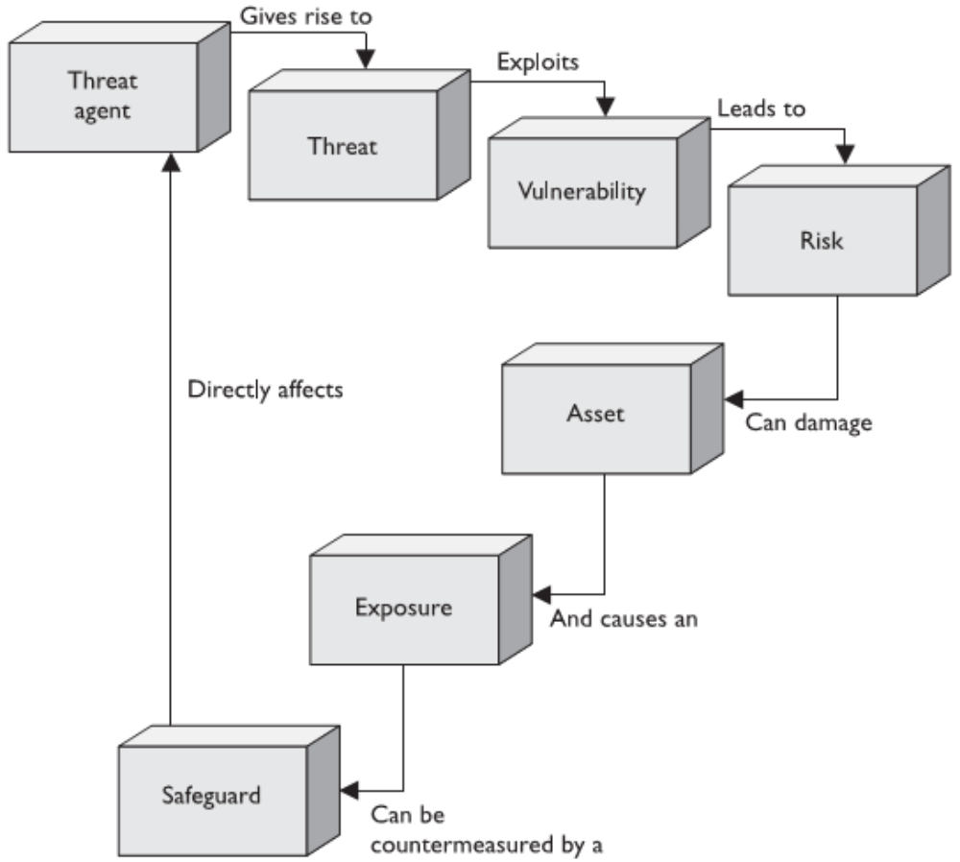
Notes:
Relationships among risk, vulnerabilities, threats, and countermeasures (Figure)

Slide 24
SECURITY
The art of war teaches us to rely:
  Not on the likelihood of the enemy is not coming, but on our own readiness to receive him;
  Not on the chance of his not attacking, but rather on the fact that we have made our position unassailable (impossible to challenge).
                —The Art of War, Sun Tzu

Slide 25
SECURITY
Security is the degree of protection against danger, loss, and criminals.
The condition that prevents unauthorized persons from having access (to official information).
The National Institute of Standards and Technology (NIST) defines security as:
“The preservation of confidentiality, integrity, and availability of information.”

Slide 26
SECURITY CONCEPTS
Security Attack: Any action that compromises the security of information owned by an organization.
Security Mechanism: A mechanism designed to detect, prevent, or recover from a security attack

Slide 27
CIA MODEL / CIAA MODEL
Confidentiality (privacy) :
  Protection of data from unauthorized disclosure
Integrity (has not been altered) :
  Assurance that data received is as sent by an authorized entity
Availability (permanence, non-erasure) :
  Denial of Service Attacks
  Virus that deletes files
Authentication (who created or sent the data):
  Assurance that the communicating entity is the one claimed
Non-repudiation :
   The ability to verify that an action or communication has been performed by a specific individual or entity and that it cannot be denied later.
Notes:
The CIAA model is a framework used in information security to ensure the confidentiality, integrity, and availability of information assets. The model expands on the CIA (Confidentiality, Integrity, and Availability) triad to include two additional elements, authenticity and non-repudiation. The five elements are:
Confidentiality: The protection of information from unauthorized access, disclosure, or exposure. Confidentiality ensures that sensitive information is only accessible to authorized parties and is kept secure from unauthorized individuals or entities.
Integrity: The assurance that information is accurate and has not been altered or tampered with in any way. Integrity ensures that data remains consistent and trustworthy throughout its lifecycle, and that it can be relied upon for decision-making and other critical purposes.
Availability: The guarantee that information is accessible and usable by authorized parties when and where it is needed. Availability ensures that systems and networks are reliable and resilient, and that users can access the resources they need to perform their jobs.
Authenticity: The assurance that information has been created or modified by an authorized source and that it has not been forged or altered in transit. Authenticity ensures that data can be trusted to be genuine and reliable, and that it has not been tampered with or manipulated.
Non-repudiation: The ability to verify that an action or communication has been performed by a specific individual or entity and that it cannot be denied later. Non-repudiation ensures that parties cannot deny their involvement in a transaction or communication, and that there is evidence of all actions taken.
The CIAA model is a useful tool for organizations to assess and manage their information security risks and to ensure that their information assets are protected from a range of threats and vulnerabilities.

Slide 28
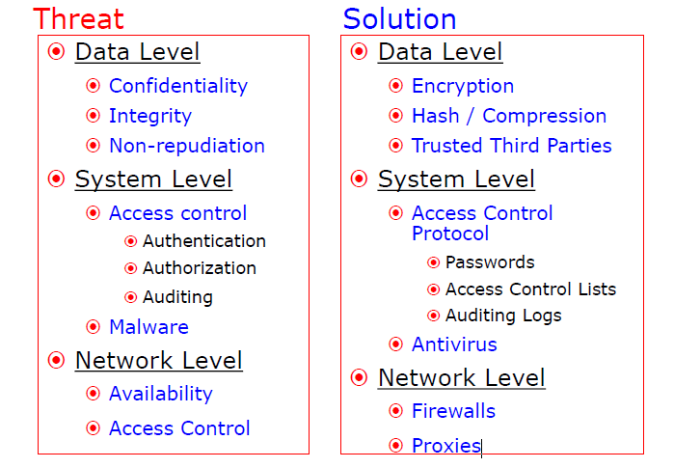
SECURITY LEVELS

Slide 29
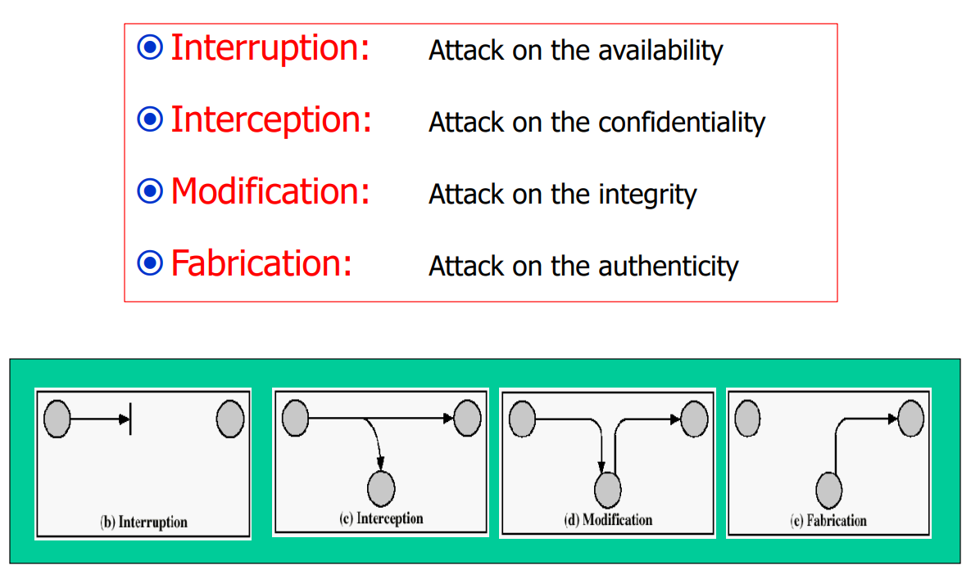
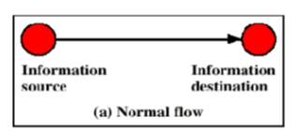
SECURITY ATTACKS
Notes:
Interruption, delay, denial of receipt, or denial of service: System assets or information may become unavailable or rendered inaccessible.
Interception or snooping: An unauthorized party gains access to information by browsing through files or reading communications.
Modification or alteration: An unauthorized party changes information in transit or information stored for subsequent access.
Fabrication, masquerade, or spoofing: Spurious information is inserted into the system or network to make it appear as if it is from a legitimate entity.
Repudiation of origin: False denial that an entity created something.

Slide 30
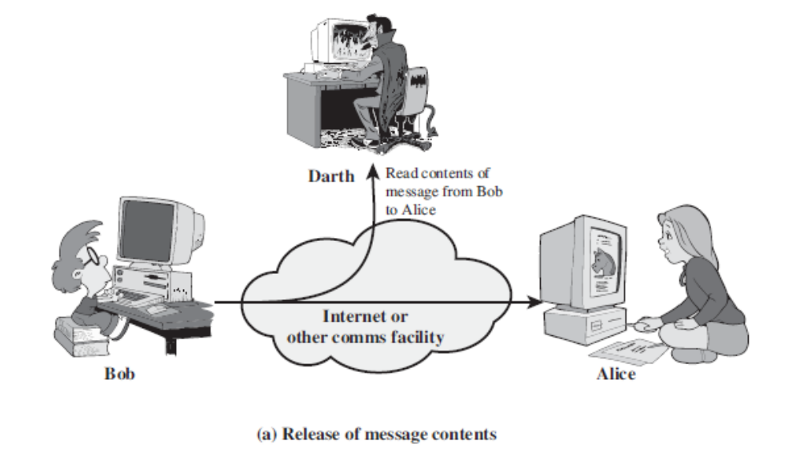
SECURITY ATTACKS
Passive attacks involve:
  Eavesdropping on or monitoring transmissions to obtain message contents or monitor traffic flows.

Slide 31
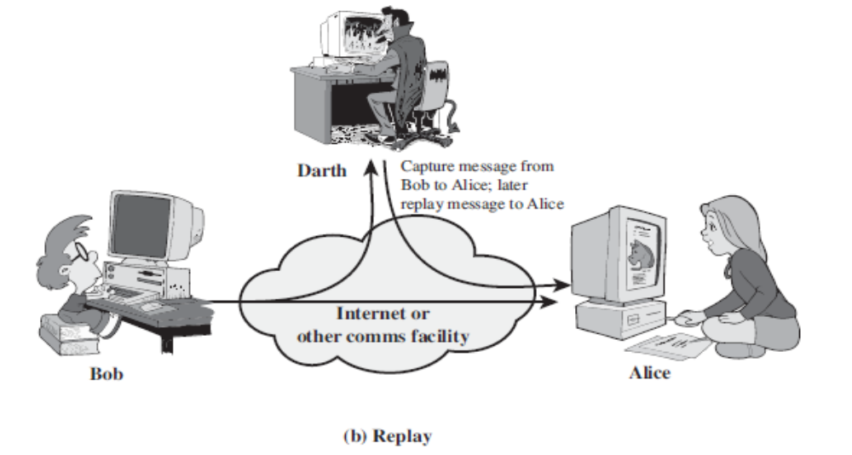
SECURITY ATTACKS
Active attacks include:
  Modification of the data stream to masquerade as one entity, replay previous messages, modify messages in transit, or deny service. Additionally, fabrication may occur.

Slide 32
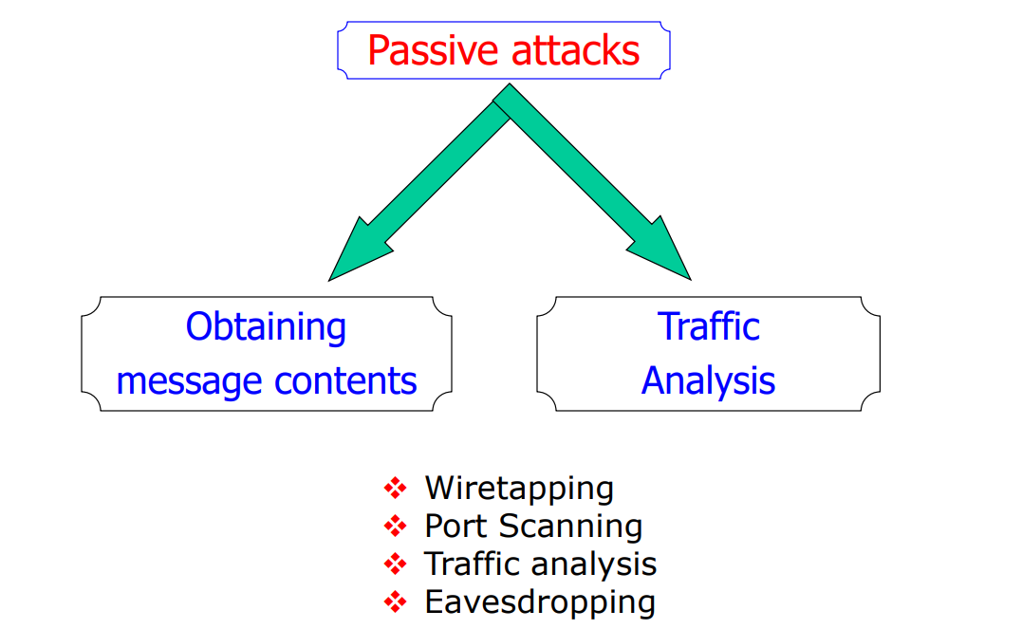
SECURITY ATTACKS

Slide 33
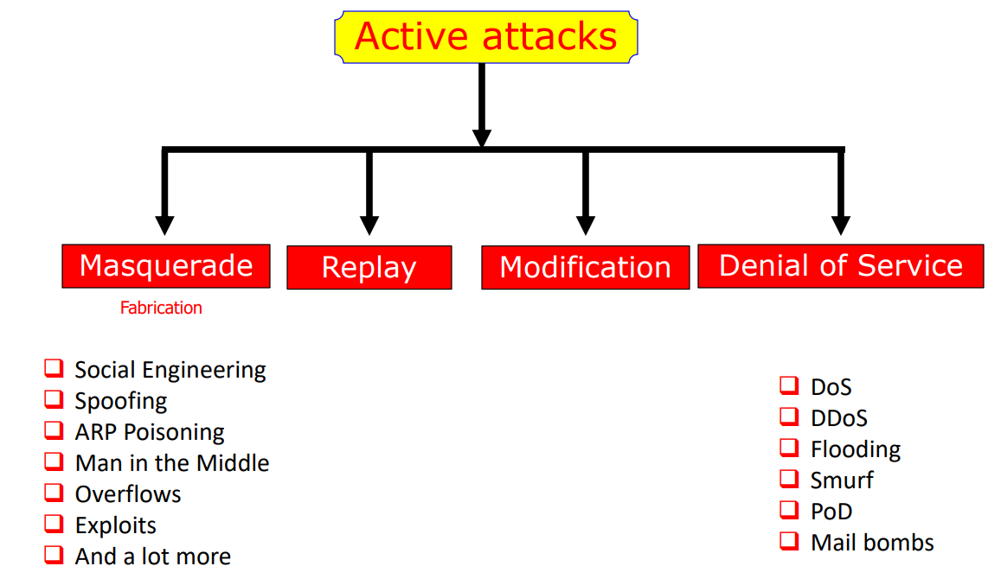
SECURITY ATTACKS

Slide 34
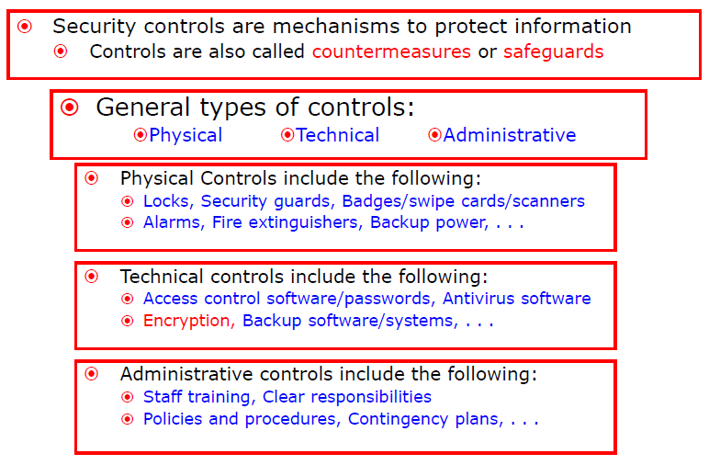
SECURITY CONTROLS

Slide 35
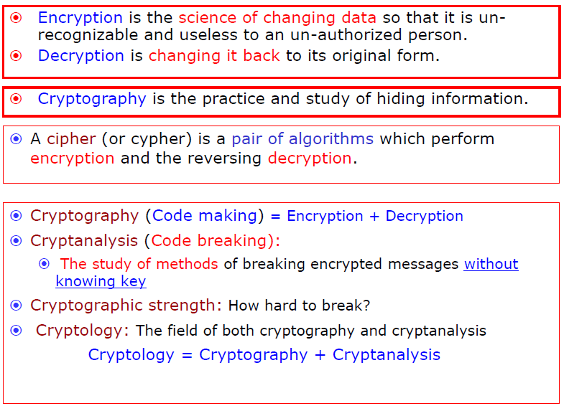

Slide 36
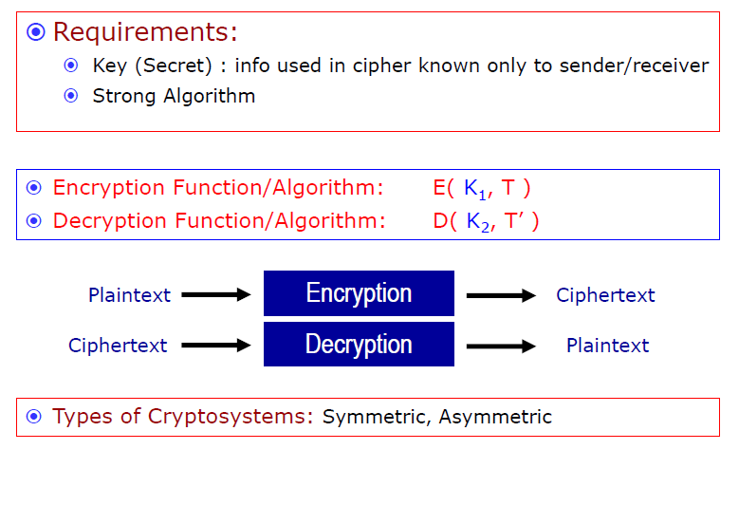

Slide 37
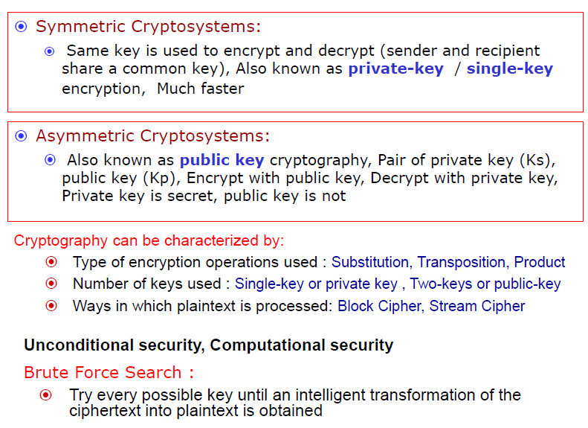

Slide 38
SOCIAL ENGINEERING
Malicious activities accomplished through human interaction.
“Cyber criminals use social engineering to heck our minds”.
They use our emotions - To make us stop thinking rationally.

Slide 39
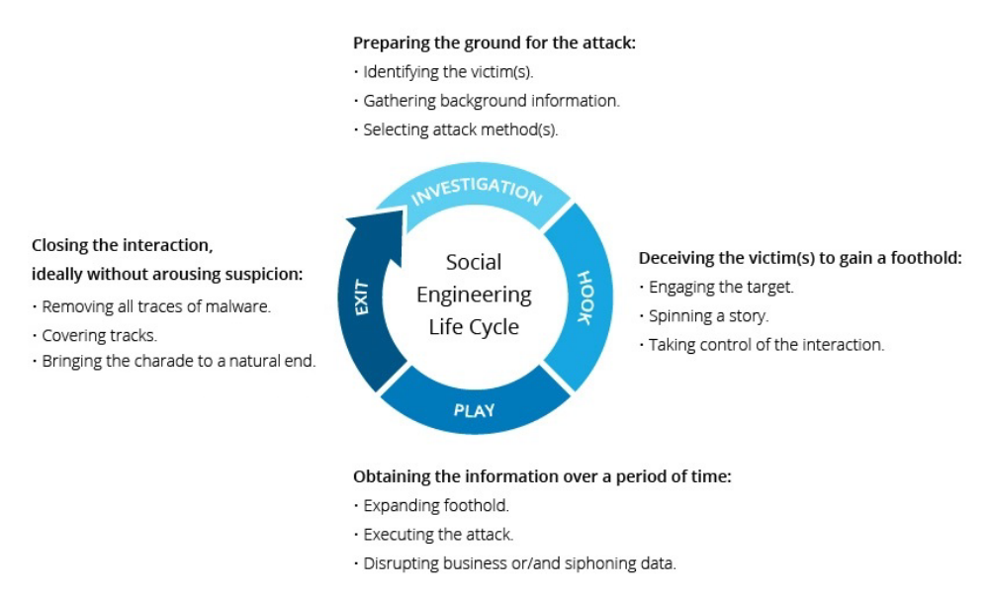

Slide 40
EXAMPLES
Giving up username, password or pin.
Sending money via electronic funds.
Unintentionally acting as a money mule for purpose of laundering.
Nigerian Prince Fraud (early 2000s).
  Linked to human greed.

Slide 41
PRINCIPLES ON WHICH SOCIAL ENGINEERING TECHNIQUES ARE BASED:
Dr. Robert Cialdini breaks the techniques of social engineering down in to six principles:
  RECIPROCITY
  SCARCITY
  AUTHORITY
  CONSISTENCY
  LIKING
  CONSENSUS
Notes:
Reciprocity: If someone gives you a gift, however small it may be, you’re more likely to respond in kind with a gift of your own. With the Nigerian scam, the scammer has all but given you millions of dollars, the least you can do is help pay the nominal processing fee.
Scarcity: In 2019 Americans caught a glimpse of the end times when Popeyes sold out of their popular chicken sandwiches. People fought over the sandwiches. One man threatened Popeyes employees with a gun. Another man sued the fast food chain for deceptive business practices. People killed for the sandwiches. Literally. That, in a nutshell, is scarcity. If consumers can’t have something, they just want more of it.
Authority: Pretending to be royalty is just one way criminals can employ authority to manipulate their victims. Malwarebytes Labs has reported on a number of different scam calls in which callers purport to be from some United States government agency. The victims, callers allege, owe money on back taxes or fines and if they don’t settle up with the government immediately, they’re going to jail.
Consistency: Generally speaking, no one wants to come off as indecisive. When we say we’re going to do something we try to follow through. And if you can get someone to agree to something small first, then they’ll feel pressured to agree to something bigger. Take, for example, money mule scams. Working on behalf of the scammers, money mules accept illicit funds from one account then transfer it to the scammer. Even when the legality of the operations comes into question, victims tend to follow through, not wanting to go back on their word.
Liking: The Ellen DeGeneres scam is a great example of liking. In social media posts supposedly from Ellen herself, scammers cut together videos of the popular daytime talk show speaking about her favorite charities along with a request to share the posts. Because the victims like Ellen, they’re more inclined to share. “Ellen” then reaches out directly to those who shared the post and asks them to download one of her films for a chance at winning a million dollars. Of course, there is no million dollars and all victims have to show for their effort is a subscription to an illegal streaming site and a pirated copy of Mr. Wrong.
Consensus: You’ve probably heard the expression: “If everyone else jumped off a bridge, would you?” If you have, then you’re familiar with the concept of consensus. People are more inclined to respond affirmatively if they think everyone else is doing it. As it applies to online scams, Malwarebytes Labs has reported on fake charitable organizations emerging in the aftermath of a natural disaster. Criminals use the groundswell of support that typically follows to pressure people in to donating money.

Slide 42
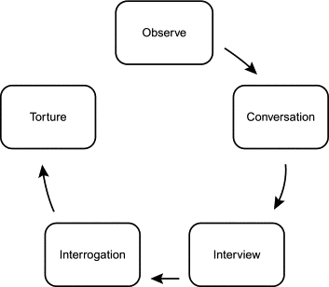
SOCIAL ENGINEERING ATTACKS
BAITING (Deceptive Promises)
SCAREWARE
PRETEXTING
PHISHING (BeEF, Vishing, Smishing)
SPEAR PHISHING
Pretexting

Slide 43
PREVENTION
DON’T OPEN EMAILS & ATTACHMENTS FROM SUSPICIOUS SOURCES.
USE MULTIFACTOR AUTHENTICATION.
BEWARY OF TEMPTING OFFERS.
KEEP ANTIVIRUS/ANTIMALWARE RUNNING AND UP-TO-DATE.

