Slide 1

Operating systems
Lecture #1

Slide 2
Content Lecture#1
01
What is an Operating System?
02
Why do we need an OS?
03
System Boot
04
Computer-System Architecture
05
Operating System Concepts
06
Multitasking, Multiprogramming, Multiprocessing
07
Protection
08
Dual-mode of Operation
09
Operating Systems around us

Slide 3

Lets take a Break
Silberschatz, Galvin and Gagne, Operating System Concepts, 9th Edition.
Operating Systems Internals and Design Principles by Willam Stallings 5th edition
Tanenbaum, Andrew S., Modern Operating Systems, 3rd Edition, Prentice Hall.

Slide 4

Operating System
An operating system is a program that manages a computer’s hardware. It also provides a basis for application programs and acts as an intermediary between the computer user and the computer hardware.

Slide 5
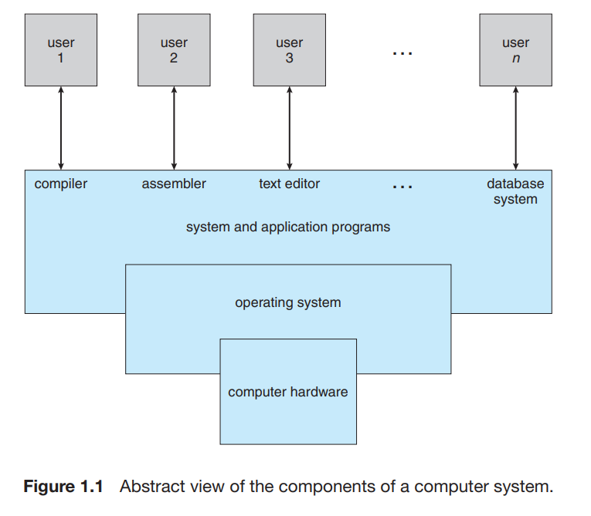
What is Operating System
Application programs
Hardware
You can simply impress your audience and add a unique zing.
the central processing unit (CPU), the memory, and the input/output (I/O) devices
Resource allocator
Moore’s Law
A computer system has many resources that may be required to solve a problem:
the number of transistors on an integrated circuit would double every eighteen months,.
Control program
manages the execution of user programs to prevent errors and improper use of the computer.

Slide 6
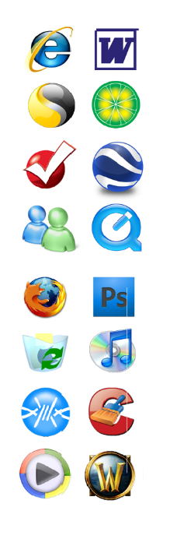
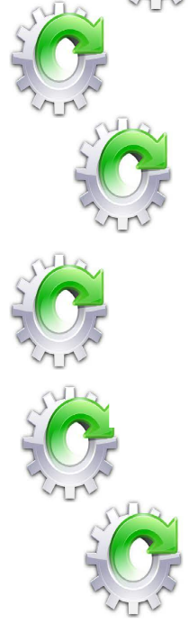
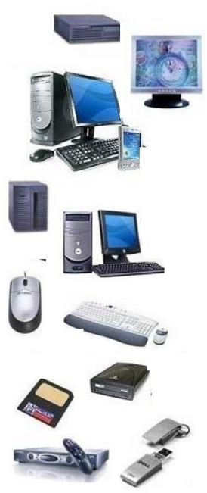
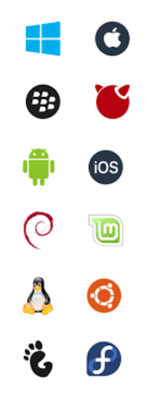

What/Why/How of Operating System
System Users
Operating System
Hardware
Application Software
System Program

Slide 7
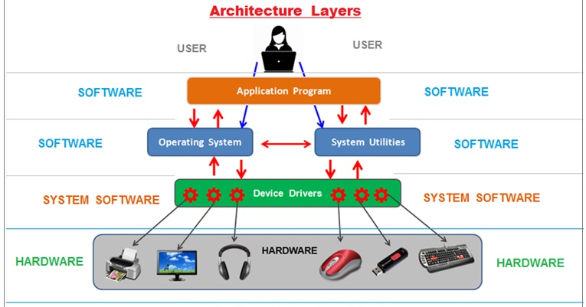
What/Why/How of Operating System

Slide 8
What/Why/How of Operating System
System Programs
  They are used to manage operations of computer and to control its resources
  Oriented to the needs of hardware and facilitate the development and running of applications
  Examples:
    Compilers (C Language Compiler)
    Editors (DOS Editor)
    Shell (C Shell)
    Interpreter (VB Interpreter)
Application Programs
  They are used to solve user’s problems
  AP have specific processing’s capabilities required for user’s applications
  Examples:
    Word processor (Microsoft Word, Abi Word)
    Spread sheet (Microsoft Excel)
    Presentation tools (MS PowerPoint, KPresenter)
    Inventory control system
    Library management system
Operating Systems
  OS is an integrated set of programs used to manage the computer resources and its overall operations
  Provide a layer of services which manage the resources of the hardware and permit the user to drive the system
  Provide special hardware services in absence of hardware facility using special software routines

Slide 9
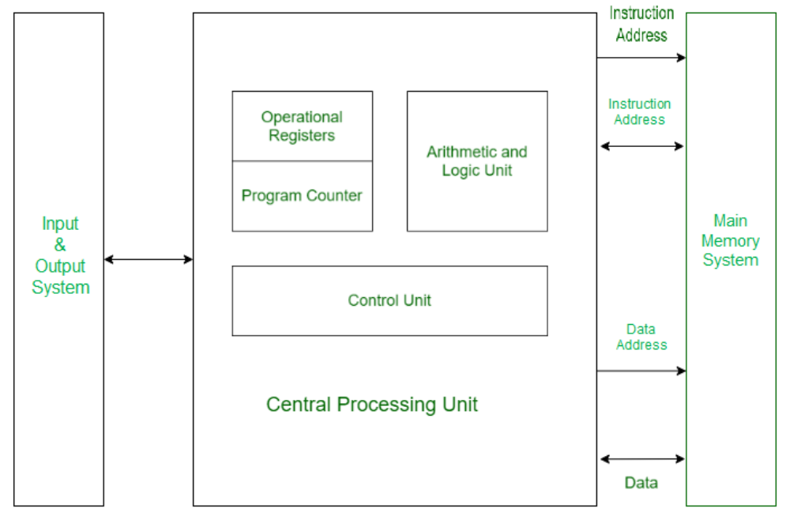
Computer Architecture

Slide 10
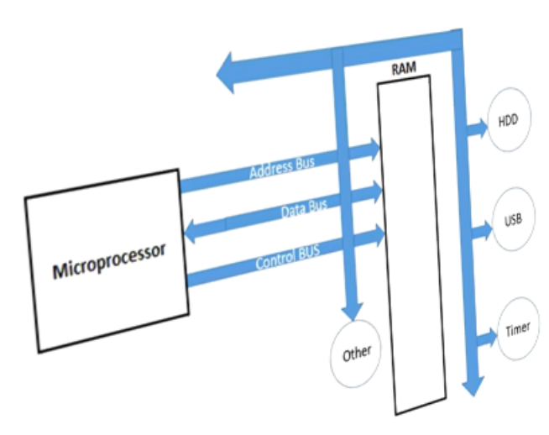
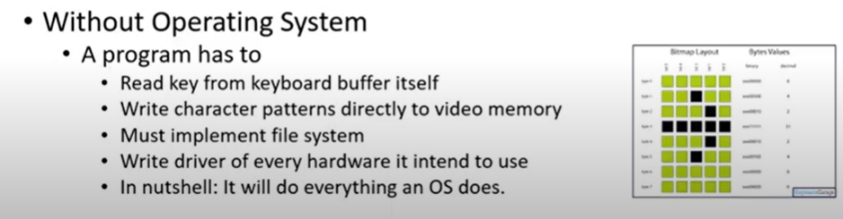
Computer Organization
CPU reads all instructions from RAM
RAM is empty initially
Programs are residing on Hard disk
So initial instructions are read from
RESET Address which is the address of ROM
ROM stores the program known as BIOS
This program loads the first sector of bootable device to 0x07C00(intel)(512 Bytes)
So after the first sector there is utility to load other programs
  Provide user interface
  Provide Programmer interface
RESET Address
For intel Processor 0xFFFF0
ROM
BIOS proceeds to load the MBR (Master Boot Record) from the bootable device into RAM. The MBR consists of 512 or more bytes located at the very beginning sector of the bootable device (which can be an HDD, an SSD, or a flash drive).

Slide 11
Boot Process
Bootstrap program is loaded at power-up or reboot
  Typically stored in ROM or EEPROM, generally known as firmware
  Initializes all aspects of system
  Locates and loads operating system kernel into memory and starts execution
  Sometimes two-step process where boot block at fixed location loaded by ROM code, which loads bootstrap loader from disk
Kernel loads and system is then running
The power button is pressed = sends power to the motherboard and other components
The computer displays a splash screen of the manufacturer's logo, or alternatively text-base specifications of the computer.
The BIOS access the boot disk, which is typically the same hard disk drive (HDD) or solid-state drive (SSD) that contains the operating system (OS).
The BIOS loads the bootstrap loader from ROM into the random access memory (RAM). The bootstrap loader is a small program which is used to search for and launch the computer's operating system.
The BIOS then passes on the work to the boot loader and beings launching the OS.
Once the boot loader has finished, the operating system takes control of the computer, which is now ready for use.

Slide 12
Evolution of Operating Systems
In early systems the programs were entered by using a set of switches to define memory address value
The program was started by setting the program counter to the first instruction word and pressing a start button
The execution was progressed by displaying light on console
The first step towards improvement was to reduce human involvement in this process
Offline input devices like cards or paper tape reader were introduced later
A program loader was established in Computer memory to read program from input device and setup it in memory
New input/output technologies were applied to assist in improving system performance

Slide 13
Evolution of Operating Systems
Around 1960, a new computer called Atlas was developed with the requirements of an operating system in mind
Batch processing was applied to submit jobs in batches to the computer
Multiprogramming was introduced to run several programs at the same time
  The processor should be kept busy for most of the time by switching its attention from one program to another
Fist time sharing system (support multiple interactive users) was developed at MIT
Mini Computer took place having multi-user OS
Spooling (Simultaneous Peripheral Operation On-line) technique was introduced
  it is used to absorb surplus processor time by performing I/O transfers for other jobs

Slide 14
Types of Operating Systems
With the passage of time operating systems are divided into different categories. They can be categories as follows
  Single User OS
  Distributed OS
  Network OS
  Multiprocessor OS
  Real-time OS
  Embedded OS

Slide 15
Types of Operating Systems
Single User Operating Systems
These types of OS were commonly used with computer systems referred as Personal Computers in 1980s, 1990s and early 2000s
Cheaper OS
Easy to use
May run several different types of operating systems (Windows, MacOS, UNIX, Linux)
Supports multiple applications
  not dedicated for one type of application
Have centralized resources
Supports multimedia (images, text, graphics and audio/video)
Example:
  Windows 98,ME
  Linux
Network Operating Systems are used to connect more than one computer
  User can login to a remote computer, to share its resources
Network OS does not follow any transparency (e.g. location, migration)
  Every operation has to be explicitly specified by the user
User knows where his job is processing
Examples:
  Windows NT
  Sun Solaris
Distribute computation among several physical processors
Follows the transparencies
Requires networking infrastructure
  Local area networks(LAN) & Wide area networks(WAN)
May be either client-server or peer-to-peer systems
Main features of Distributed System
  Resource sharing
  Computation speed up
  Reliability
  Communication

Slide 16
Types of Operating Systems
Embedded OS
These operating systems are dedicated for devices
These are normally built-in with devices
Example:
  Mobile set OS
  PDA OS ( personal digital assistant, a handheld device that combines computing, telephone/fax, Internet and networking features.)
Issues:
  Limited memory
  Slow processors
  Small display screens
Two types of Distributed OS
  Tightly coupled DOS
    Multiprocessor system
    Processor share memory
      Communication takes place through memory
  Loosely coupled DOS
    Single processor system
    Clusters of workstations
      Do not communicate via memory
      Communicate via high speed buses, telephone lines
Examples:
  Windows 2000
  Linux
  Unix
Multiprocessor Operating system
These are actually distributed operating systems which run on machines having more than one processor
Communication is done via shared memory through message passing, pipes etc.

Slide 17
Types of Operating Systems
These OS run on Real-time systems
Very fast operating system
Normally designed for a set of specific applications
A real-time system is any information processing system which has to respond to externally generated input stimuli within a finite and specified period
  the correctness depends not only on the logical result but also the time it was delivered
  failure to respond is as bad as the wrong response
In a real time system emphasis is on timely execution of tasks than speed of execution
Often used as a control device in a dedicated application such as controlling scientific experiments, medical imaging systems, industrial control systems, and some display systems
Real-Time systems may be either hard or soft real-time
Hard real-time system
  systems where it is absolutely imperative that responses occur within the required deadline
  E.g. Flight control systems
  Secondary storage limited or absent, data stored in short term memory, or read-only memory (ROM)
Soft real-time system
  systems where deadlines are important but which will still function correctly if deadlines are occasionally missed
  E.g. Data acquisition system
  Limited utility in industrial control of robotics
  Useful in applications (multimedia, virtual reality) requiring advanced operating-system features

Slide 18
Computing Environment
Traditional: Stand-alone general purpose machines
But blurred as most systems interconnect with others (i.e. the Internet)
Portals provide web access to internal systems
Network computers (thin clients) are like Web terminals
Mobile computers interconnect via wireless networks
Networking becoming ubiquitous – even home systems use firewalls to protect home computers from Internet attacks
Mobile: Handheld smartphones, tablets, etc
What is the functional difference between them and a “traditional” laptop?
Extra feature – more OS features (GPS, gyroscope)
Allows new types of apps like augmented reality
Use IEEE 802.11 wireless, or cellular data networks for connectivity
Leaders are Apple iOS and Google Android
Distributed
  Collection of separate, possibly heterogeneous, systems networked together
    Network is a communications path, TCP/IP most common
      Local Area Network (LAN)
      Wide Area Network (WAN)
      Metropolitan Area Network (MAN)
      Personal Area Network (PAN)
  Network Operating System provides features between systems across network
    Communication scheme allows systems to exchange messages
    Illusion of a single system

Slide 19
Computing Environment
Client-Server Computing
  Dumb terminals supplanted by smart PCs
  Many systems now servers, responding to requests generated by clients
    Compute-server system provides an interface to client to request services (i.e., database)
    File-server system provides interface for clients to store and retrieve files
Peer-to-Peer
Another model of distributed system
P2P does not distinguish clients and servers
  Instead all nodes are considered peers
  May each act as client, server or both
  Node must join P2P network
    Registers its service with central lookup service on network, or
    Broadcast request for service and respond to requests for service via discovery protocol
  Examples include Napster and Gnutella, Voice over IP (VoIP) such as Skype

Slide 20
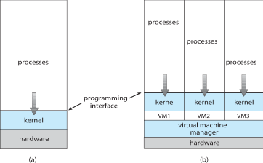
Computing Environment
Virtualization
Allows operating systems to run applications within other OSes
  Vast and growing industry
Emulation used when source CPU type different from target type (i.e. PowerPC to Intel x86)
  Generally slowest method
  When computer language not compiled to native code – Interpretation
Virtualization – OS natively compiled for CPU, running guest OSes also natively compiled
  Consider VMware running WinXP guests, each running applications, all on native WinXP host OS
  VMM provides virtualization services
  Use cases involve laptops and desktops running multiple OSes for exploration or compatibility
  Apple laptop running Mac OS X host, Windows as a guest
  Developing apps for multiple OSes without having multiple systems
  QA testing applications without having multiple systems
  Executing and managing compute environments within data centers
  VMM can run natively, in which case they are also the host
  There is no general purpose host then (VMware ESX and Citrix XenServer)

Slide 21
Operating System Services
Operating systems provide an environment for execution of programs and services to programs and users
A set of operating-system services provides functions that are helpful to the user
User interface
  Almost all operating systems have a user interface (UI)
    Varies between Command-Line (CLI), Graphics User Interface (GUI), Batch
Program execution
  The system must be able to load a program into memory and to run that program, end execution, either normally or abnormally (indicating error)
I/O operations
  since user programs cannot execute I/O operations directly, the operating system must provide some means to perform I/O
File-system manipulation
  Programs need to read and write files and directories, create and delete them, search them, list file Information, permission management
  Operating system helps the programs to achieve that
Communications
  Processes may exchange information, on the same computer or between computers over a network
  Communications may be via shared memory or through message passing (packets moved by the OS)

Slide 22
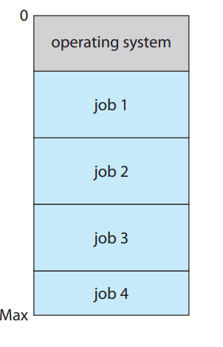
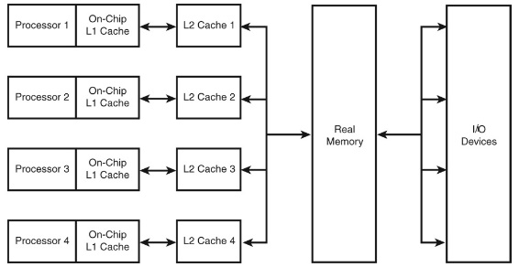
Operating-System approach
Multiprogramming
The idea is as follows: The operating system keeps several jobs in memory simultaneously Since, in general, main memory is too small to accommodate all jobs, the jobs are kept initially on the disk in the job pool. This pool consists of all processes residing on disk awaiting allocation of main memory.
Multiprocessing
There are several different strategies for designing a computer system. Single-processor systems have only one processor, while multiprocessor systems contain two or more processors that share physical memory and peripheral devices.
Multitasking
Multitasking is when multiple jobs are executed by the CPU simultaneously by switching between them. Switches occur so frequently that the users may interact with each program while it is running. Multitasking about time sharing
Multithreading
Multitasking is when multiple jobs are executed by the CPU simultaneously by switching between them. Switches occur so frequently that the users may interact with each program while it is running. An OS does the following activities related to multitasking
Problems because of Multiprogramming
Memory Protection
I/O Protection
CPU Protection

Slide 23
Solution of Multiprogramming Problems
Memory Protection (Solution)
Every Program residing in memory is assigned a limit
If a program exceed its limit in user mode, it is trapped
I/O Protection Solution
I/O instructions can’t be used in user mode
Issuing I/O instructions in user-mode generate a trap
CPU Protection (Solution)
Time, a controller, generates interrupts at fixed intervals.
Interrupts transfer control to kernel in kernel mode.

Slide 24
Operating System Services
Error detection
  OS needs to be constantly aware of possible errors
    May occur in the CPU and memory hardware, in I/O devices, in user program
    For each type of error, OS should take the appropriate action to ensure correct and consistent computing
    Debugging facilities can greatly enhance the user’s and programmer’s abilities to efficiently use the system
Resource allocation
  When multiple users or multiple jobs running concurrently, resources must be allocated to each of them
    Many types of resources - Some (such as CPU cycles, main memory, and file storage) may have special allocation code, others (such as I/O devices) may have general request and release code
Accounting
  To keep track of which users use how much and what kinds of computer resources
Protection and security
  The owners of information stored in a multiuser or networked computer system may want to control use of that information, concurrent processes should not interfere with each other
  Protection
    involves ensuring that all access to system resources is controlled
  Security
    of the system from outsiders requires user authentication, extends to defending external I/O devices from invalid access attempts
      If a system is to be protected and secure, precautions must be instituted throughout it. A chain is only as strong as its weakest link

Slide 25
OS Management
Process Management
A process is a program in execution
A process needs certain resources, including CPU time, memory, files, and I/O devices, to accomplish its task
The operating system is responsible for the following activities in connection with process manager
  Process creation and termination
  Process suspension and resumption
  Provision of mechanisms for:
    process synchronization
    process communication
Memory Management
Memory is a large array of words or bytes, each with its own address
It is a repository of quickly accessible data shared by the CPU and I/O devices.
Main memory is a volatile storage device
  It looses its contents in the case of system failure
The operating system is responsible for the following activities in connections with memory management:
  Keep track of which parts of memory are currently being used and by whom
  Decide which processes to load when memory space becomes available
  Allocate and deallocate memory space as needed
I/O System Management
Operating system is responsible for I/O system management The I/O system consists of:
  A buffer-caching system
  A general device-driver interface
  Drivers for specific hardware devices
File Management
file is a collection of related information defined by its creator
Commonly, files represent programs (both source and object forms) and data
The operating system is responsible for the following activities in connections with file management:
  File creation and deletion
  Directory creation and deletion
  Support of primitives for manipulating files and directories
  Mapping files onto secondary storage
  File backup on stable (nonvolatile) storage media
Protection refers to a mechanism for controlling access by programs, processes, or users to both system and user resources
The protection mechanism must:
  distinguish between authorized and unauthorized access
  specify the controls to be imposed
  provide a means of enforcement

Slide 26
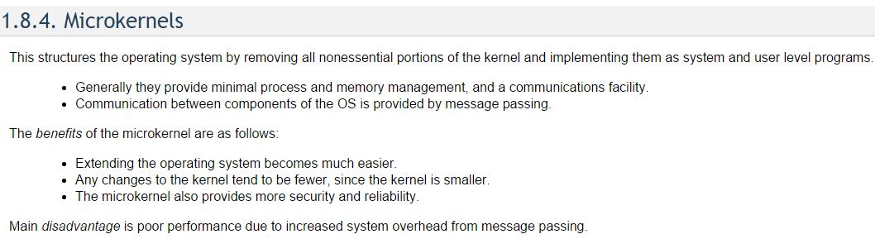
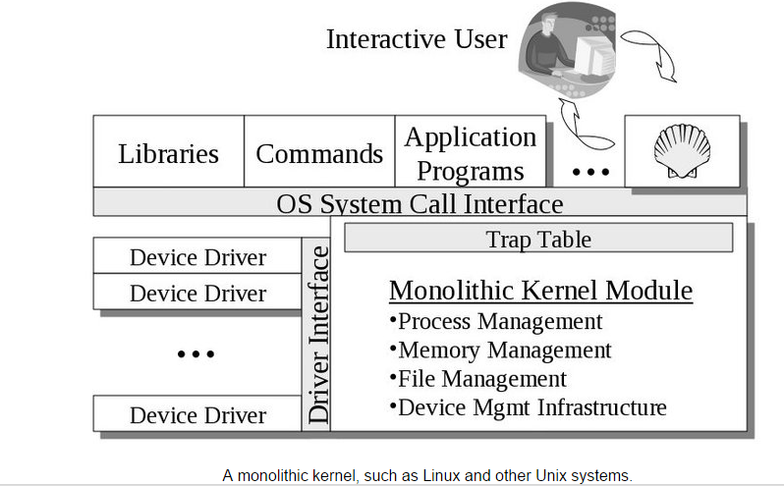
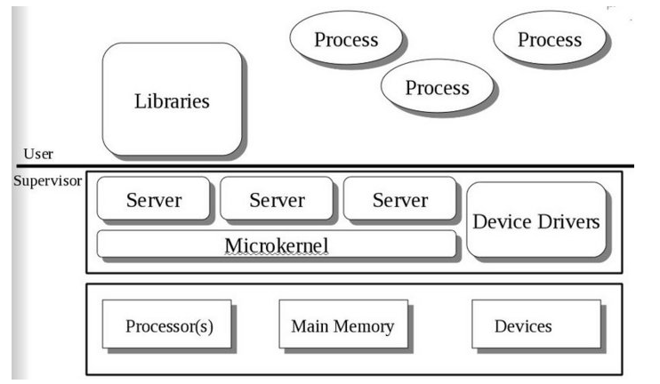
OS Structure
Kernel is part of operating system that includes most heavily used functions
Generally kernel is permanently in main memory
A privileged, nucleus or supervisory mode into which the machine switches when the OS is running
Enables the execution of such privileged instructions
  Such as in the area of I/O operations, which are not available to user mode
Monolithic Approach
Functionality of OS is invoked through simple function call which is one large program
Device drivers are loaded into kernel and become part of Operating system

Slide 27
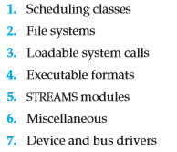
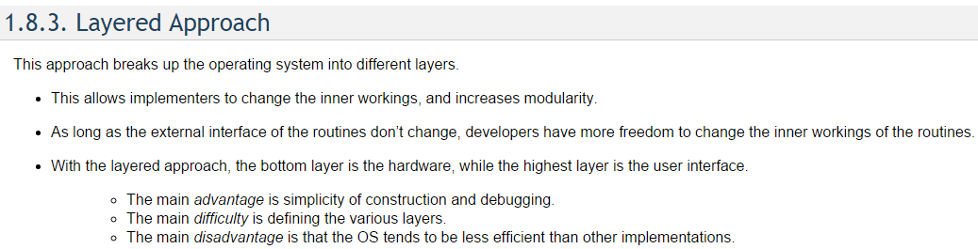
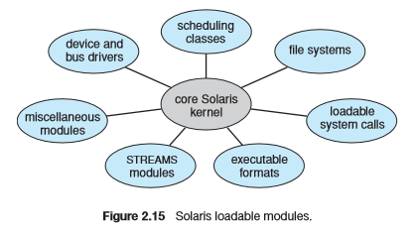
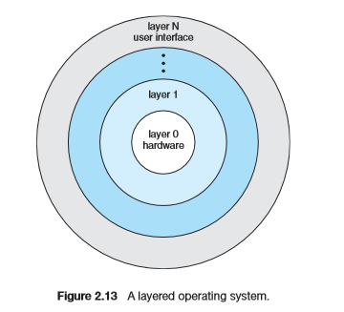
OS Structure
Hybrid Systems
Linux and Solaris are monolithic and modular (Loadable kernel modules)
Windows are primarily monolithic but supports microkernel approach with loadable kernel modules.

Slide 28
Dual Mode
At the very least, we need two separate modes of operation:
user mode
kernel mode (also called supervisor mode, system mode, or privileged mode).
A bit, called the mode bit, is added to the hardware of the computer to indicate the current mode: kernel (0) or user (1).

Slide 29
Kernel Mode
The techniques by which a user program requests the kernel’s services are;
  System calls
  Message passing
The process can only be switched into kernel mode by the above actions
No other way that a user program can execute kernel instructions
This facility is not given to user program in order to enforce system security
User space
User process
Supervisor process
Supervisor
space
Supervisor & user memory

Slide 30
System Calls
User program communicate with OS and request its services by making system calls
Corresponding to each system call is a library procedure that user program can call
System calls provide the interface between a running program and the OS
These calls are generally available as assembly language instruction
All instruction with the hardware is implemented by system calls
OS provides an additional layer of subroutines called an API (application programming interface), between programmer and system call interface
To compile a program, a process calls the command interpreter or shell, reads command from the terminal
Shell will create a new process to compile the program
When the process has completed compilation, it executes a system call to terminate itself
Other process system calls are also available to;
  Request for more memory
  Released unused/extra memory
  Process and memory management
System calls related to file systems;
  System calls are needed to create, read, move and write a file
  A file should be opened before read it
  Similarly, after reading file must be closed which is done by system calls
  System calls are required to
    create and remove a directory
    manipulate file with in different directories
System V Unix provides about 64 system calls e.g.
  create(name, amode)
  open(name, oflag, amode)
  close(fd)
MS-DOS uses software interrupts similar to system calls

Slide 31
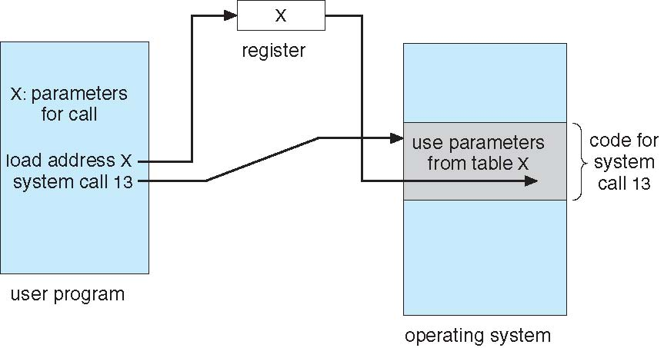
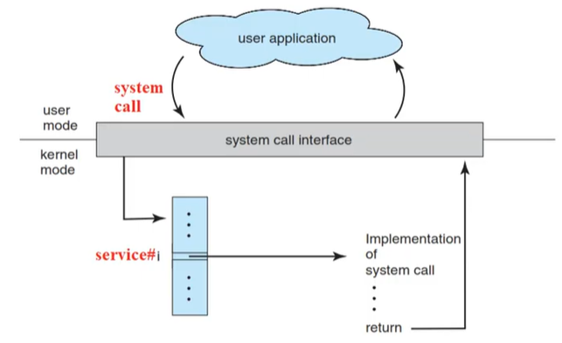
System Call
Three general methods are used to pass parameters between a running program and the operating system
  Pass parameters in registers
  Store the parameters in a table in memory, and the table address is passed as a parameter in a register
  Push (store) the parameters onto the stack by the program, and pop off the stack by operating system
Types of System Calls
Process control
File management
Device management
Information maintenance
Communications

Slide 32
Lab
Virtual Machine Installation
Ubuntu installation
Commands of Ubuntu

Slide 33
Thank you

