Slide 1
CLASSICAL CRYPTOGRAPHY
Classical Ciphers
Monoalphabetic • Polyalphabetic • Vernam & One-Time Pad
Frequency Analysis • Playfair Cipher
Lecture slides with worked examples and practice

Slide 2
Learning outcomes
OVERVIEW
Explain substitution ciphers and distinguish monoalphabetic from polyalphabetic systems.
Encrypt and decrypt messages using Caesar, general substitution, Vigenère, auto-key Vigenère, Vernam, one-time pad, and Playfair.
Apply modular arithmetic and alphabet-number mappings correctly.
Use frequency analysis to reason about likely plaintext in a monoalphabetic cipher.
Evaluate the strengths, weaknesses, and assumptions of classical ciphers.
Cryptography • Classical Ciphers
2

Slide 3
Road map
OVERVIEW
1. Core vocabulary and mathematical notation
2. Monoalphabetic ciphers: Caesar and general substitution
3. Polyalphabetic ciphers: Vigenère and auto-key Vigenère
4. Vernam cipher and the one-time pad
5. Frequency analysis
6. Playfair cipher
7. Comparison, worked practice, and review
Cryptography • Classical Ciphers
3

Slide 4
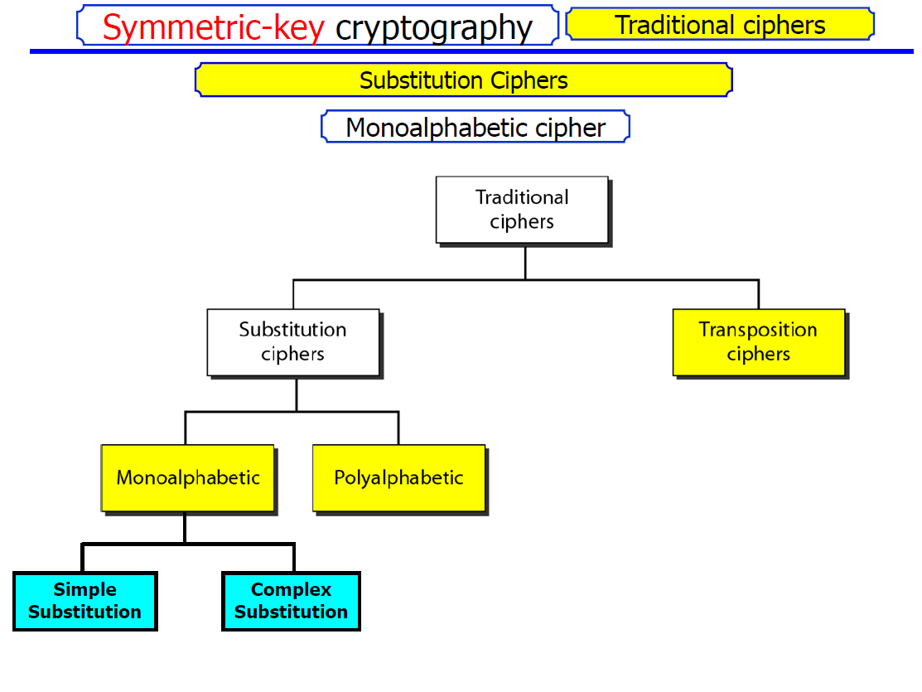

Slide 5
Core vocabulary: how encryption works
FOUNDATIONS
Plaintext (P): the original readable message.
Ciphertext (C): the transformed message sent over a channel.
Encryption: converts plaintext into ciphertext using an algorithm and key.
Decryption: uses the key and algorithm to recover plaintext.
A substitution cipher replaces symbols; a transposition cipher rearranges their positions.
Kerckhoffs’s principle: security should depend on the key, not on keeping the algorithm secret.
Cryptography • Classical Ciphers
4

Slide 6
Alphabet and modular arithmetic
FOUNDATIONS
For hand calculations, map A–Z to numbers 0–25: A=0, B=1, …, Z=25.
Addition is performed modulo 26: wrap around after Z.
Caesar encryption: C = (P + k) mod 26.
Caesar decryption: P = (C − k) mod 26.
Example: X=23, shift k=5 → (23+5) mod 26 = 2 → C.
Always state the convention used; some materials number A–Z from 1 to 26.
Cryptography • Classical Ciphers
5

Slide 7
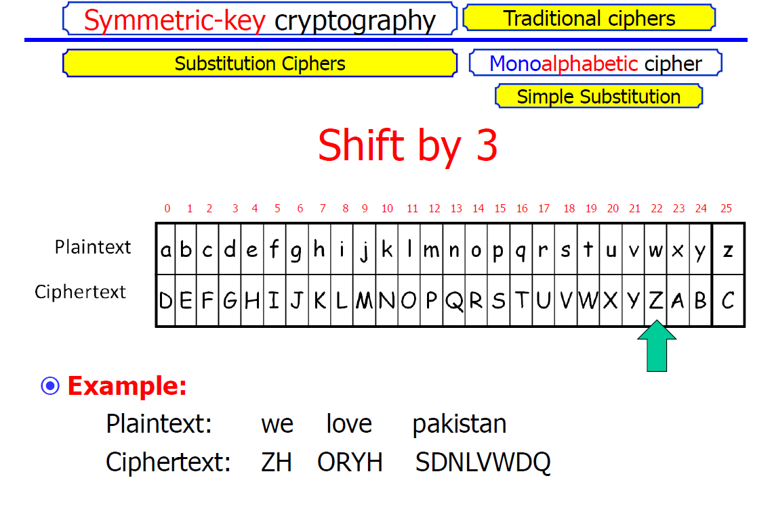

Slide 8
Monoalphabetic substitution: big idea
MONOALPHABETIC
One fixed mapping replaces each plaintext letter with one ciphertext letter.
The mapping is a permutation of the alphabet: each plaintext letter maps to exactly one ciphertext letter, and mappings are one-to-one.
The same plaintext letter always produces the same ciphertext letter.
Spaces and punctuation are often left unchanged in classroom examples.
Key space for a full 26-letter substitution: 26! possible mappings (about 4 × 10²⁶).
Despite the large key space, patterns in natural language make it vulnerable to statistical analysis.
Cryptography • Classical Ciphers
6

Slide 9
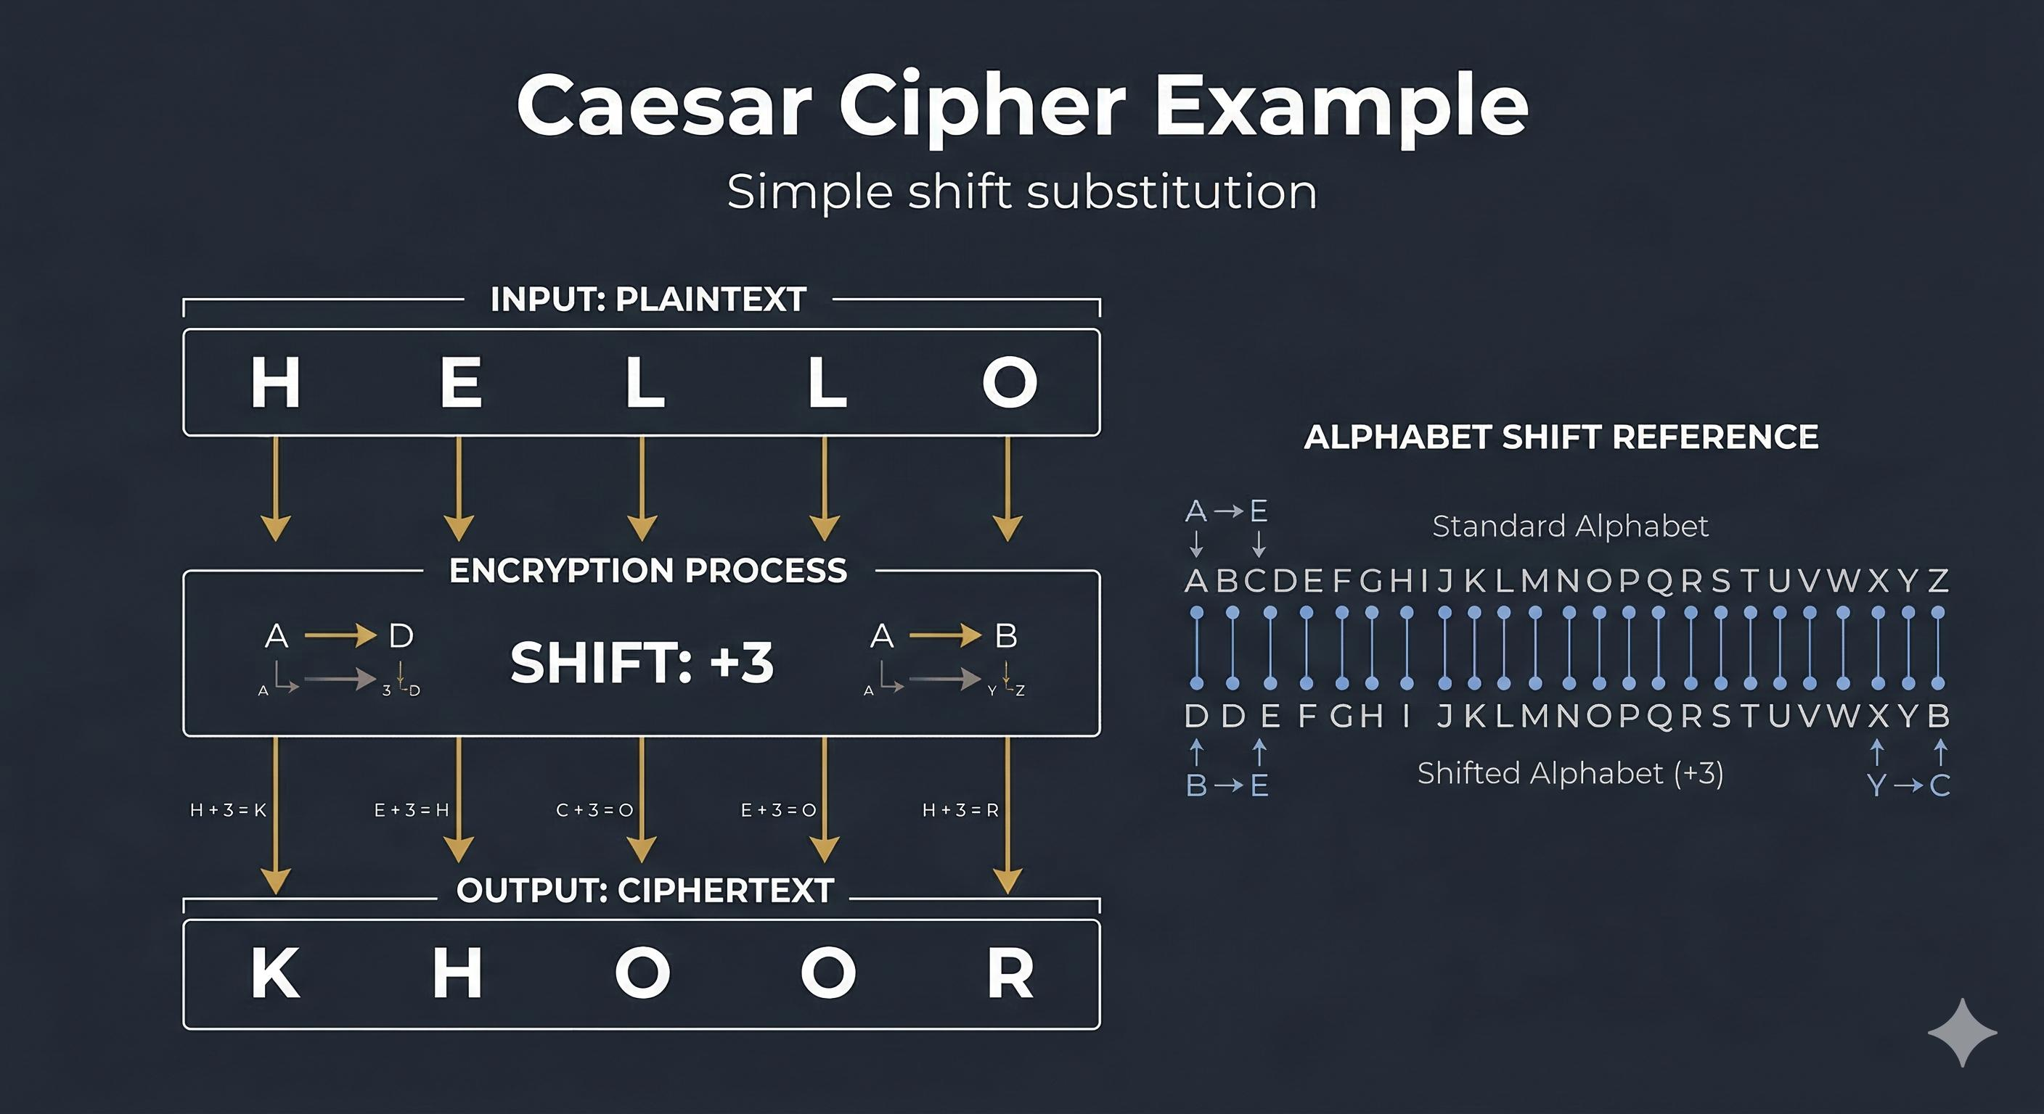

Slide 10
Caesar cipher: encryption
MONOALPHABETIC
A Caesar cipher shifts every letter by the same fixed amount k.
Encryption: C = (P + k) mod 26.
Example with k = 3: ATTACK AT DAWN → DWWDFN DW GDZQ.
A→D, T→W, C→F, K→N; spaces remain spaces.
The shift value is the key. There are only 26 possible shifts, including the no-shift case.
Use case: a simple teaching model—not suitable for protecting real information.
Cryptography • Classical Ciphers
7
Notes:
Worked example: A(0)+3=D(3); T(19)+3=W(22); C(2)+3=F(5); K(10)+3=N(13). DAWN maps D->G, A->D, W->Z, N->Q.

Slide 11
Caesar cipher: decryption example
MONOALPHABETIC
Ciphertext: KHOOR. Key: k = 3.
Decrypt by shifting each ciphertext letter backward by 3.
K→H, H→E, O→L, O→L, R→O.
Recovered plaintext: HELLO.
Quick check: encrypt HELLO with k=3 and you should get KHOOR.
Common error: shifting forward during decryption instead of backward.
Cryptography • Classical Ciphers
8

Slide 12
Caesar cipher: brute-force attack
MONOALPHABETIC
Because there are only 26 shifts, an attacker can try every possible key.
Example ciphertext: FDHVDU.
Try k=3 backward: F→C, D→A, H→E, V→S, D→A, U→R → CAESAR.
A computer can test all shifts almost instantly and score outputs for likely language.
Security lesson: a key can be easy to enumerate even when the encryption steps are correct.
Cryptography • Classical Ciphers
9

Slide 13
General monoalphabetic substitution
MONOALPHABETIC
Instead of a uniform shift, choose any permutation of the alphabet.
Example key fragment: Plain A B C D E F … → Cipher Q W E R T Y …
If A→Q, then every A in the message becomes Q; the mapping never changes.
Encryption uses the forward mapping; decryption uses the inverse mapping.
The number of possible keys is 26!, far more than Caesar’s 26 shifts.
Yet repeated-letter patterns, word lengths, and letter frequencies remain visible.
Cryptography • Classical Ciphers
10

Slide 14
Substitution cipher: worked mini-example
MONOALPHABETIC
Illustrative mapping: A→Q, B→W, C→E, D→R, E→T, H→U, I→I, L→O, O→P.
Encrypt: HELLO → U T O O P → UTOOP.
Decrypt UTOOP by reversing the mapping: U→H, T→E, O→L, O→L, P→O → HELLO.
A full key must specify all 26 letters and be one-to-one; this partial key is only for demonstration.
Do not confuse a substitution key with a rule that shifts all letters by the same amount.
Cryptography • Classical Ciphers
11

Slide 15
Why monoalphabetic ciphers leak patterns
CRYPTANALYSIS
Letter identities change, but repetition patterns do not.
A repeated plaintext letter always becomes the same ciphertext letter.
A plaintext double letter such as LL remains a repeated ciphertext pair.
Word-length patterns are usually preserved when spaces are retained.
Common English letters include E, T, A, O, I, and N; common short words include THE, OF, TO, and AND.
These clues motivate frequency analysis.
Cryptography • Classical Ciphers
12

Slide 16
Polyalphabetic ciphers: big idea
POLYALPHABETIC
A polyalphabetic cipher uses multiple substitution alphabets rather than one fixed mapping.
The substitution applied to a letter depends on key position or another evolving state.
The same plaintext letter can encrypt to different ciphertext letters at different positions.
This can flatten simple single-letter frequency patterns compared with monoalphabetic substitution.
Vigenère is the standard classroom example; its repeating keyword still creates exploitable structure.
Cryptography • Classical Ciphers
13

Slide 17
Vigenère cipher: rule
POLYALPHABETIC
Represent letters as numbers 0–25, with A=0.
Repeat the keyword until it matches the plaintext length.
Encryption: Cᵢ = (Pᵢ + Kᵢ) mod 26.
Decryption: Pᵢ = (Cᵢ − Kᵢ) mod 26.
Example keyword: KEY. Repeat KEYKEY… under the message.
Use the same alphabet convention consistently; omit spaces for the arithmetic, then restore them for readability.
Cryptography • Classical Ciphers
14

Slide 18
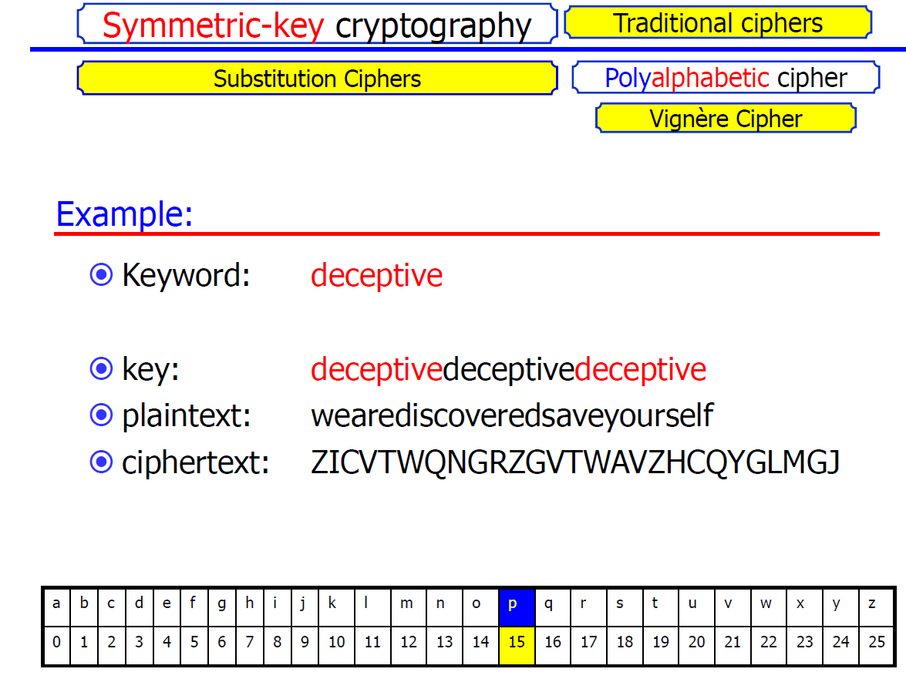

Slide 19
Vigenère: worked encryption
POLYALPHABETIC
Plaintext: ATTACKATDAWN
Key: LEMONLEMONLE
A(0)+L(11)=L(11); T(19)+E(4)=X(23); T(19)+M(12)=F(5).
Continue position by position using Cᵢ=(Pᵢ+Kᵢ) mod 26.
Ciphertext: LXFOPVEFRNHR.
Check: decrypting the ciphertext with LEMON returns ATTACKATDAWN.
Cryptography • Classical Ciphers
15

Slide 20
Vigenère: worked decryption
POLYALPHABETIC
Ciphertext: LXFOPVEFRNHR; keyword: LEMON.
Repeat key: LEMONLEMONLE.
At each position, subtract the key value from the ciphertext value modulo 26.
Example: L(11)−L(11)=A(0); X(23)−E(4)=T(19); F(5)−M(12)=T(19).
Continue to recover ATTACKATDAWN.
Common error: adding the key during decryption instead of subtracting it.
Cryptography • Classical Ciphers
16

Slide 21
Vigenère: strengths and weaknesses
POLYALPHABETIC
Strength: repeated plaintext letters can encrypt differently when their key positions differ.
Weakness: a repeating keyword repeats the keystream.
Repeated ciphertext patterns can help estimate the key length (e.g., Kasiski examination).
Once a likely key length is known, positions can be grouped by key column and analyzed statistically.
Longer keys do not automatically make a cipher secure if they repeat or are predictable.
Cryptography • Classical Ciphers
17

Slide 22
Auto-key Vigenère: concept
POLYALPHABETIC
Auto-key Vigenère extends a short primer key with plaintext characters rather than repeating the primer forever.
Example convention: keystream = primer + plaintext (excluding spaces), truncated to message length.
Encryption remains Cᵢ = (Pᵢ + Kᵢ) mod 26.
Decryption starts with the primer; recovered plaintext characters are then used to reconstruct the remaining keystream.
Different textbooks use different auto-key variants—always state which convention is being used.
This reduces simple repeating-key patterns, but it is not a modern secure encryption method.
Cryptography • Classical Ciphers
18

Slide 23
Auto-key Vigenère: worked example
POLYALPHABETIC
Convention: append plaintext to the primer; use A=0…Z=25.
Plaintext: ATTACKATDAWN. Primer: QUEEN.
Keystream: QUEENATTACKA (primer + plaintext, truncated to 12 letters).
Encrypt position by position with Cᵢ=(Pᵢ+Kᵢ) mod 26.
Example first letter: A(0)+Q(16)=Q; second: T(19)+U(20)=N (mod 26).
The key stream depends on the plaintext; decryption must recover characters in order to rebuild it.
Cryptography • Classical Ciphers
19
Notes:
This example uses the plaintext-autokey convention. Verify the stream and arithmetic carefully: ATTACKATDAWN + QUEENATTACKA yields QNXT… by modular addition. Students should calculate the full result in class.

Slide 24
Vernam cipher: core idea
VERNAM / OTP
The Vernam cipher combines each plaintext symbol with a key symbol.
In the binary form, encryption is bitwise XOR: C = P ⊕ K.
Decryption uses the same operation: P = C ⊕ K, because XOR reverses itself.
For alphabetic classroom versions, letters may be combined modulo 26; this is not identical to binary XOR.
Security depends strongly on how the key is generated, used, and protected.
The one-time pad is a special Vernam-style construction with strict key requirements.
Cryptography • Classical Ciphers
20

Slide 25
Vernam: binary XOR example
VERNAM / OTP
XOR rule: equal bits produce 0; different bits produce 1.
Plaintext bits P = 10110010
Key bits K = 01101100
Ciphertext C = P ⊕ K = 11011110
Decrypt: C ⊕ K = 11011110 ⊕ 01101100 = 10110010 = P.
Reusing the same key stream across messages can expose relationships between plaintexts.
Cryptography • Classical Ciphers
21

Slide 26
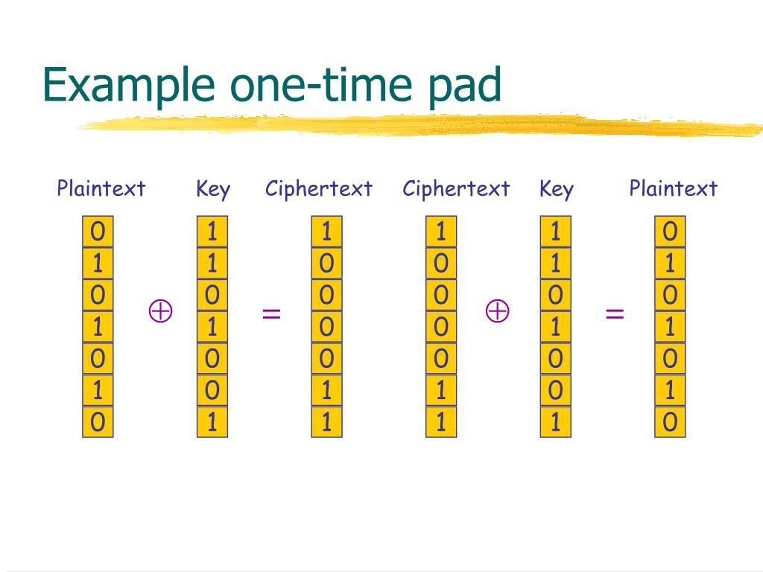

Slide 27
One-time pad (OTP): the strict conditions
VERNAM / OTP
The key must be truly random and at least as long as the plaintext.
The key must remain secret and be securely delivered to the communicating parties.
Every key must be used once only—never reused for another message.
Encryption combines plaintext and key symbols (e.g., XOR for bits or addition mod 26 for letters).
When all conditions hold, the OTP provides perfect secrecy in the information-theoretic sense.
Practical challenges: generating, distributing, storing, and securely destroying long keys.
Cryptography • Classical Ciphers
22

Slide 28
One-time pad: alphabetic example
VERNAM / OTP
Use A=0…Z=25 and C=(P+K) mod 26.
Plaintext: CAT → C=2, A=0, T=19.
Random key: XMCK → use the first 3 letters X=23, M=12, C=2.
Ciphertext: (2+23)=25=Z; (0+12)=12=M; (19+2)=21=V → ZMV.
Decrypt by subtraction: Z−X=C, M−M=A, V−C=T.
Teaching note: this is a valid toy illustration only if the key is genuinely random, secret, message-length, and never reused.
Cryptography • Classical Ciphers
23

Slide 29
OTP: what goes wrong if a key is reused?
VERNAM / OTP
If two messages use the same key stream, their ciphertexts share a mathematical relationship.
For binary OTP: C₁=P₁⊕K and C₂=P₂⊕K.
XOR the ciphertexts: C₁⊕C₂ = P₁⊕P₂ because K⊕K=0.
This can reveal information about both messages, especially when plaintexts contain predictable language.
A key must be used once—not once per user, session, or day, but once per message/key stream.
Cryptography • Classical Ciphers
24

Slide 30
Frequency analysis: purpose
CRYPTANALYSIS
Frequency analysis studies how often symbols or symbol groups appear in ciphertext.
It is especially useful against monoalphabetic substitution because frequency rankings are preserved under a fixed mapping.
Single-letter counts: E, T, A, O, I, N are often frequent in English.
Digraphs (two-letter groups): TH, HE, IN, ER, AN are common.
Trigraphs (three-letter groups): THE, AND, ING are common.
These are clues, not guarantees; topic, message length, and writing style affect the distribution.
Cryptography • Classical Ciphers
25

Slide 31
Frequency analysis: a method
CRYPTANALYSIS
1. Count ciphertext letters and calculate their relative frequencies.
2. Compare the ranking with expected language frequencies.
3. Inspect repeated patterns, double letters, and word lengths.
4. Make tentative substitutions; test whether several words become plausible at once.
5. Use common digraphs/trigraphs and grammar to refine the mapping.
6. Verify the complete proposed plaintext by applying the inverse substitution.
Cryptography • Classical Ciphers
26

Slide 32
Frequency analysis: miniature example
CRYPTANALYSIS
Ciphertext sample: GSRH RH Z HVXIVG NVHHZTV.
Repeated short words and repeated letters can help form hypotheses.
Suppose a Caesar-style shift is suspected: try shifting letters backward by 25 (equivalent to forward by 1).
GSRH → THIS; RH → IS; Z → A; HVXIVG → SECRET; NVHHZTV → MESSAGE.
Recovered plaintext: THIS IS A SECRET MESSAGE.
Lesson: frequency clues suggest possibilities; testing a candidate transformation confirms it.
Cryptography • Classical Ciphers
27

Slide 33
Playfair cipher: overview
PLAYFAIR
Playfair is a digraph substitution cipher: it encrypts pairs of letters rather than individual letters.
A 5×5 key square is built from a keyword; I and J are usually combined to fit 25 cells.
Split plaintext into letter pairs (digraphs).
If a pair contains the same letter, insert a filler (often X) between them.
If one letter remains at the end, append a filler.
Playfair hides simple single-letter frequencies better than monoalphabetic substitution, but it is not secure by modern standards.
Cryptography • Classical Ciphers
28

Slide 34
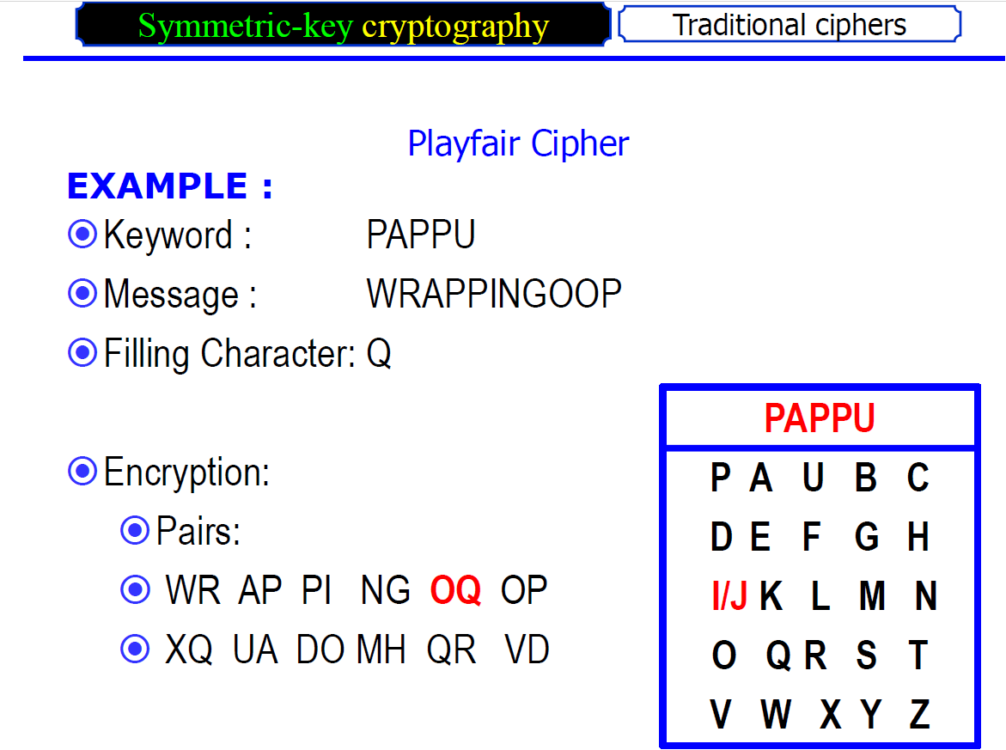

Slide 35
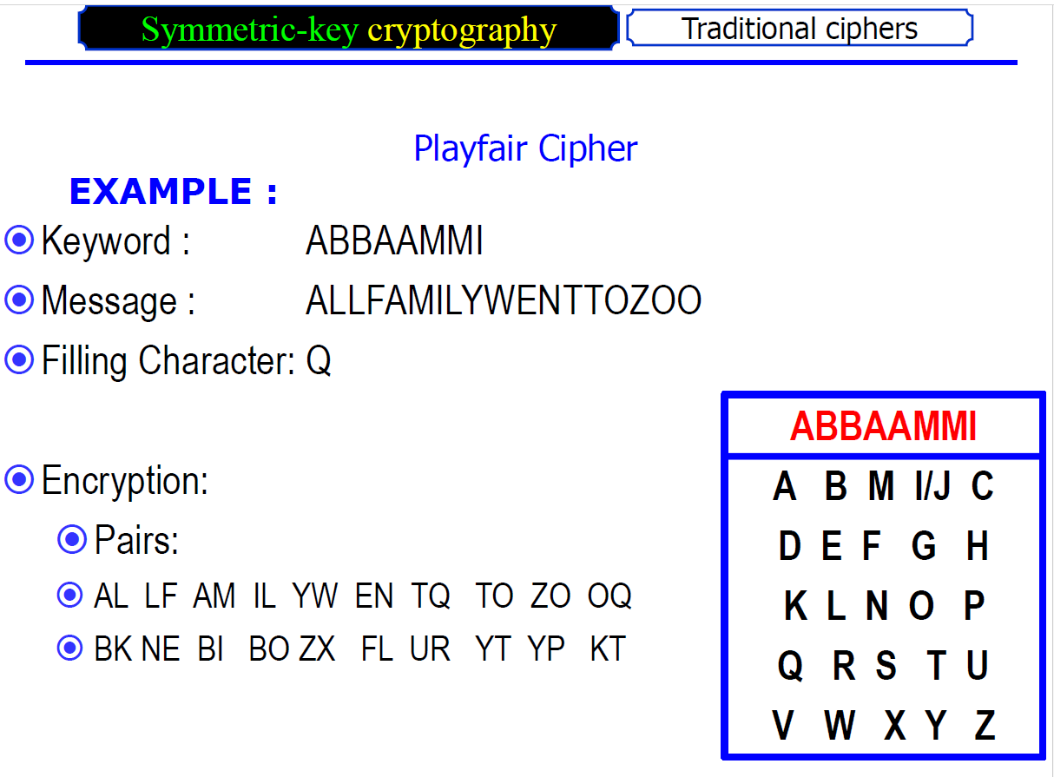

Slide 36
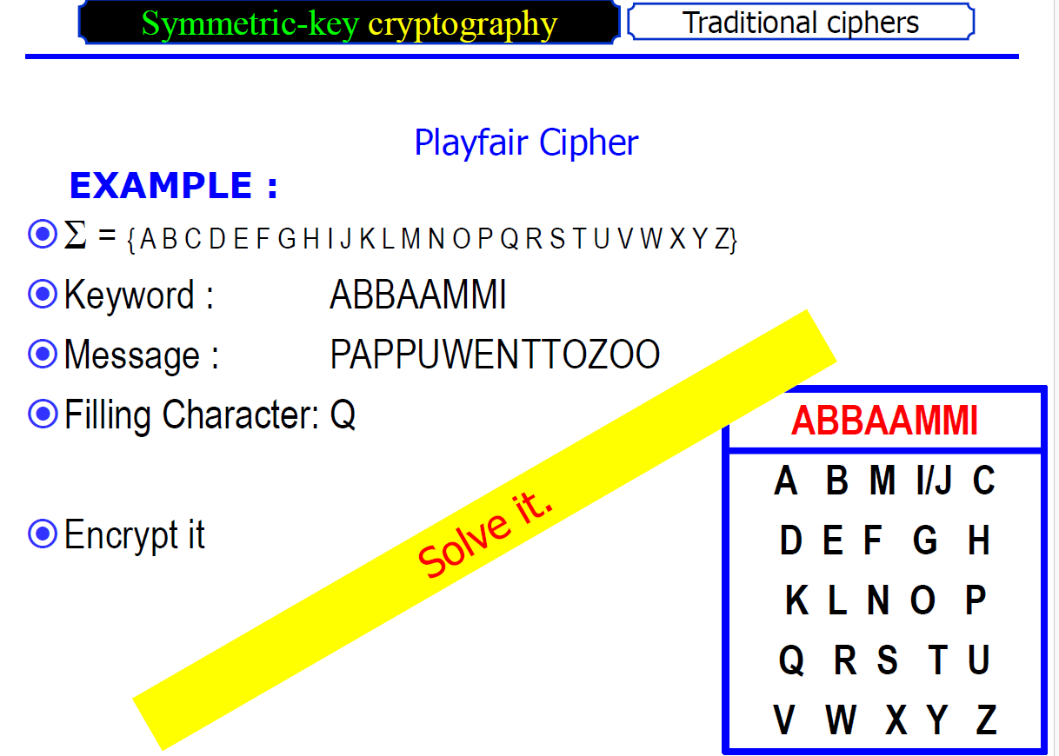

Slide 37
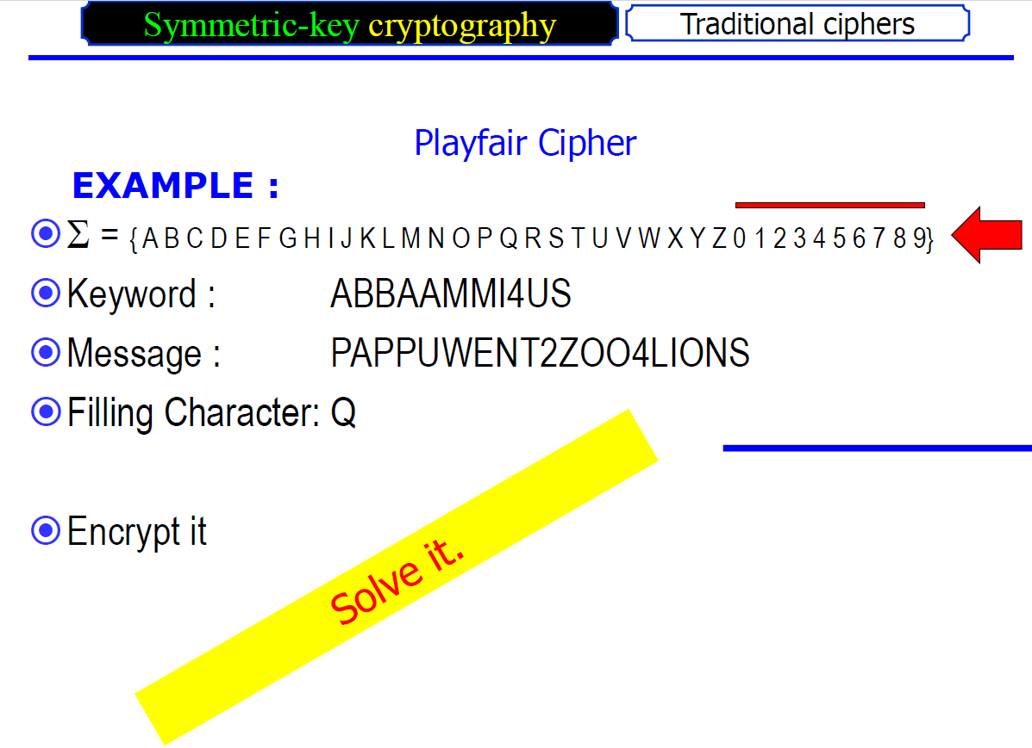

Slide 38
Playfair: build the key square
PLAYFAIR
Keyword: MONARCHY. Remove repeated letters: M O N A R C H Y.
Write the keyword first, then append unused letters of the alphabet in order.
Combine I/J; omit J from the square.
Key square:
M O N A R
C H Y B D
E F G I K
L P Q S T
U V W X Z
Cryptography • Classical Ciphers
29

Slide 39
Playfair: the three encryption rules
PLAYFAIR
Same row: replace each letter with the letter immediately to its right; wrap around at row end.
Same column: replace each letter with the letter immediately below; wrap around at column bottom.
Rectangle: replace each letter with the letter in its own row and the other letter’s column.
For a rectangle, keep the original order of the two letters.
Decryption reverses the row/column direction; rectangle rule is applied the same way.
Always process digraphs using the same key square.
Cryptography • Classical Ciphers
30

Slide 40
Playfair: prepare the plaintext
PLAYFAIR
Example plaintext: INSTRUMENTS.
Split into pairs: IN ST RU ME NT S.
Append a filler to the final single letter: IN ST RU ME NT SX.
If a pair repeats a letter, separate them with a filler: BALLOON → BA LX LO ON (one common preparation approach).
If X itself creates a repeated pair or conflicts with the message, choose another agreed filler such as Q.
Different teaching materials may vary in filler handling; document the convention.
Cryptography • Classical Ciphers
31

Slide 41
Playfair: worked digraph example
PLAYFAIR
Use the MONARCHY square shown earlier.
Pair IN: I is row 3, col 4; N is row 1, col 3 → rectangle gives A and G → AG.
Pair ST: S is row 4, col 4; T is row 4, col 5 → same row, shift right → T L.
Pair RU: R is row 1, col 5; U is row 5, col 1 → rectangle gives M and Z → MZ.
Continue the remaining pairs using the same rules.
Important: coordinates are counted from 1 in this example; use consistent row/column indexing.
Cryptography • Classical Ciphers
32

Slide 42
Playfair: decryption and limitations
PLAYFAIR
Same row: move left; same column: move up; rectangle: use the same rectangle corners.
After decryption, remove filler characters carefully to reconstruct the likely original message.
Ambiguity can remain because a filler may also be a genuine plaintext letter.
Digraph frequencies can be analyzed, so Playfair is not immune to cryptanalysis.
Its historical importance is educational; use modern authenticated encryption for real systems.
Cryptography • Classical Ciphers
33

Slide 43
Compare the ciphers
REVIEW
Caesar: one fixed shift; tiny key space; trivially brute-forced.
Monoalphabetic substitution: one fixed permutation; large key space but frequency leakage.
Vigenère: multiple alphabets controlled by a repeating key; vulnerable to key-length and statistical attacks.
Auto-key Vigenère: extends the key with plaintext; reduces repeating-key pattern but remains classical and insecure.
Vernam / OTP: XOR or modular combination; OTP can provide perfect secrecy only with strict key discipline.
Playfair: digraph substitution; hides some single-letter statistics but remains breakable.
Cryptography • Classical Ciphers
34

Slide 44
Common mistakes to avoid
REVIEW
Mixing A=0 with A=1 numbering conventions.
Forgetting to apply modulo 26 when a sum exceeds 25 or a subtraction becomes negative.
Repeating the Vigenère key incorrectly or aligning it with spaces inconsistently.
Calling any Vernam cipher a one-time pad without checking randomness, key length, secrecy, and non-reuse.
In Playfair, forgetting to combine I/J, split repeated letters, or apply wraparound.
Treating frequency counts as proof rather than hypotheses that must be tested.
Cryptography • Classical Ciphers
35

Slide 45
In-class practice: solve in pairs
PRACTICE
Q1 — Caesar: Encrypt NETWORK using k=4.
Q2 — Caesar: Decrypt XLMW using k=4.
Q3 — Vigenère: Encrypt ATTACK using key KEYKEY.
Q4 — Vernam/XOR: P=11001010, K=10110101. Find C.
Q5 — Frequency analysis: Why does a fixed substitution preserve letter-frequency rankings?
Q6 — Playfair: Explain how you would prepare BALLOON before encryption.
Be ready to show each intermediate step, not only the final answer.
Cryptography • Classical Ciphers
36

Slide 46
Practice answer key
PRACTICE
Q1: NETWORK + 4 → RIXASVO (N→R, E→I, T→X, W→A, O→S, R→V, K→O).
Q2: XLMW − 4 → THIS.
Q3: ATTACK + KEYKEY → KXRKGI.
Q4: 11001010 ⊕ 10110101 = 01111111.
Q5: Each plaintext letter always maps to the same ciphertext letter, so counts are relabeled but not redistributed.
Q6: Insert a filler between the repeated Ls, then regroup into pairs; for example BA LX LO ON.
Cryptography • Classical Ciphers
37

Slide 47
Exit ticket
ASSESSMENT
1. State one structural difference between monoalphabetic and polyalphabetic substitution.
2. Encrypt one letter using Caesar k=7 and show the modulo operation.
3. Give all four strict requirements for a one-time pad.
4. Name two clues used in frequency analysis.
5. State the Playfair rule for a pair in the same column.
6. Which of these techniques would you trust for protecting modern sensitive data? Explain why.
Cryptography • Classical Ciphers
38

