Slide 1
Computer Organization & Assembly Language
Lecture 11-VIDEO MEMORY

Slide 2
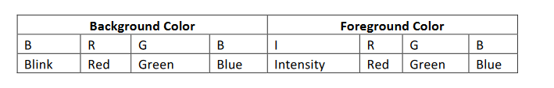
Video Memory
The text screen video memory for color monitors resides at 0xB8000.
The text screen resolution is 80x25.
25 Rows and 80 Columns
2 Bytes each character. One for ascii code and 1 for color.
1B Color bit represents : First nibble for Foreground Text Color and Second Nibble for background Color.

Slide 3
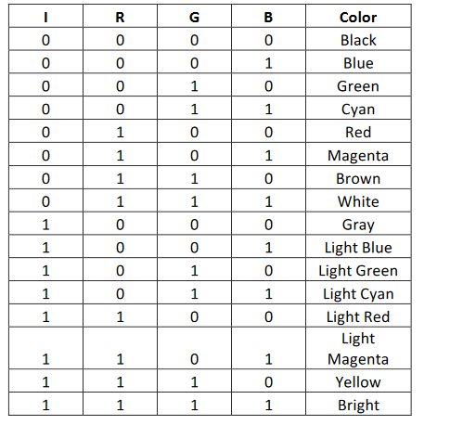

Slide 4
Print A with some random Color
.model small
.code
Mov ax,0xb800
Mov es,ax
Mov si,0
Mov es:[si], 'A'
Inc si
Mov byte ptr es:[si],01010110b
.exit

Slide 5
Calculate Screen Coordinates
Linear Address (ASCII) = (Row address x Columns per Row x 2 + Column address x 2) (eq. 1)
Linear Address (Attributes) = (Row address x Columns per Row x 2+ Column address x 2) + 1 (eq. 2)

Slide 6
Example
To display a text on the middle of the screen, we need to know its screen coordinates which are (12,40).
To translate it into physical address,
Memory address = 12 * 80 * 2 + 40 *2 = 2000
N 2001 for the offset address of the attributes of character

Slide 7
To display text on center of the screen
.model small
.stack 100h
.data
.code
Mov ax,0xb800
Mov es,ax
Mov si,2000
Mov es:[si], 'H'
add si,2
Mov es:[si], 'E'
add si,2
Mov es:[si], 'L'
add si,2
Mov es:[si], 'L'
add si,2
Mov es:[si], 'O'
.exi

Slide 8
Class activity
Initialize a string in data segment and display it in video memory using loop and jumps

Slide 9
