Slide 1
Computer Organization & Assembly Language
Lecture 11

Slide 2
Interrupt Vector Table (IVT)
The processor uses the interrupt number to index the Interrupt Vector Table (IVT) to get the address of a special type of procedure called an Interrupt Service Routine (ISR).
There are 256 entries in IVT.
VT resides in memory at physical address 0x00000.
Each entry stores the logical address, which is 4 bytes; the total size of the IVT is 256 x 4B = 1 KB
Total Size is 1024B

Slide 3
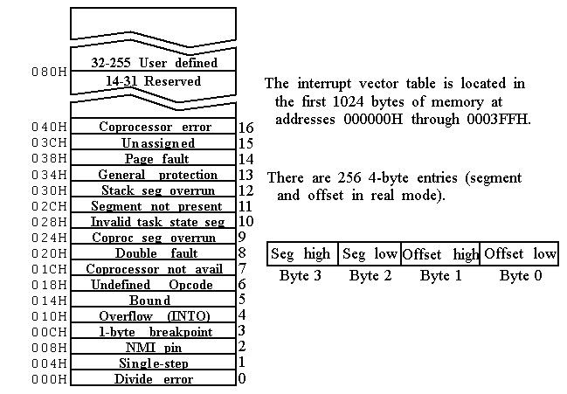

Slide 4
INT 00 (divide error)
Invoked by the microprocessor whenever there are conditions(exception) that CPU is unable to handle
i.e divide a no. by zero
If the quotient is too large to fit into the assigned register when executing a DIV instruction
MOV AL,92
SUB CL,CL
DIV CL
MOV AX, 0FFFFH
MOV BL,2
DIV BL

Slide 5
INTERRUPT HOOKING
.model small
.data
.code
mov ax,@data
mov ds,ax
mov ax,0
mov es,ax
mov word ptr es:[0 * 4 + 0],isr0 ; offset address of ISR0
mov word ptr es:[ 0 * 4 + 2],cs ; Segment address of ISR0
mov ax,100
mov bl,0
div bl ;Dividing a number by zero to check if the hooking
.exit
ISR0 proc
jmp l@1
msg: db "Divide by Zero Exception!$"
l@1:
mov dx,offset msg
mov ah,9
int 0x21
IRET
ISR0 endp

Slide 6
INT 04(signed number overflow)
Invoked by signed number overflow
INTO instruction ; CPU will activate INT 04 if OF=1
If OF=0 ; INTO acts as NOP
Mov AL, DATA1 ; DATA1=64
MOV BL DATA2 ;DATA2=64
ADD AL, BL
INTO ;processor jump to physical location 00010h

