Slide 1
COAL
Lecture 13

Slide 2
32-bit Registers
Intel 80386 was the first 32-bit processor of the Intel family of microprocessors.
It has 32-bit addresses and data buses.
The protected mode was also introduced in this processor that limits the operation of user programs.
It doesn’t allow user programs to go beyond their memory limits assign to them and directly access IO devices.
The size of existing registers, except the segment registers, were extended to 32-bit.

Slide 3
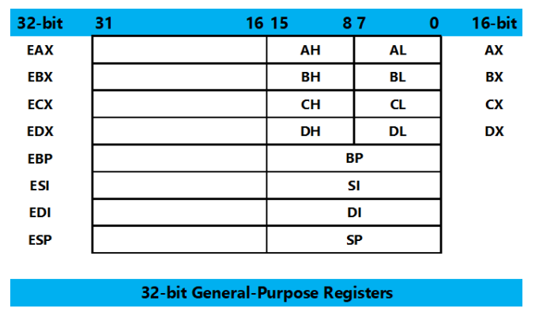
32-bit Registers

Slide 4
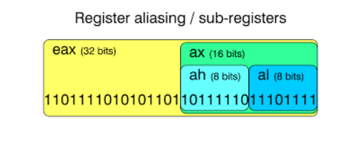
Register Aliasing

Slide 5
32-bit Addressing Modes
The addressing modes are the same.
In 80386 and above, any 32-bit register may be used in register indirect addressing mode.
The MOV [EDX], CL instruction copies the byte sized contents of register CL into the data segment memory location addressed by EDX
Any two registers from the above may be combined to generate the memory address.
The MOV [EAX+EBX], CL instruction copies the byte sized contents of register CL into the data segment memory location addressed by EAX plus EBX.
Use any 32-bit register except ESP to address memory

Slide 6
32-bit Addressing Modes
Register Direct Addressing (EAX, EBX)
Register Indirect Addressing ([EBX], [EAX +4])
Register Offset Addressing ([EBX + EAX], [EDX + ECX * 4])
Base + Offset Addressing ([EBX + 10], [EAX + 0x20])
Immediate Addressing (32-bit immediate value)
Segment : Offset Addressing ([CS:1234], [DS:2000])

Slide 7
Inline Assembly Language
Assembly language serves many purposes:
Improving program speed
Reducing memory needs
Controlling hardware when writing kernel modules
You can use the inline assembler to embed assembly-language instructions directly in your C and C++ source programs without extra assembly and link steps.

Slide 8
Inline Assembly Language
The inline assembler is built into the compiler, so you don't need a separate assembler
Because the inline assembler doesn't require separate assembly and link steps, it is more convenient than a separate assembler
Inline assembly code can use any C or C++ variable or function name that is in scope, so it is easy to integrate it with your program's C and C++ code.

Slide 9
__asm Keyword
The__asm keyword invokes the inline assembler and can appear wherever a C or C++ statement is legal.
It cannot appear by itself.
It must be followed by an assembly instruction, a group of instructions enclosed in braces, or, at the very least, an empty pair of braces.

Slide 10
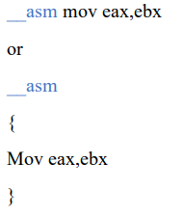
Example

Slide 11
Using and Preserving Registers in Inline Assembly
A register will not have a given value when an __asm block begins.
Register values are not guaranteed to be preserved across separate __asm blocks.
If you end a block of inline code and begin another, you cannot rely on the registers in the second block to retain their values from the first block.

Slide 12
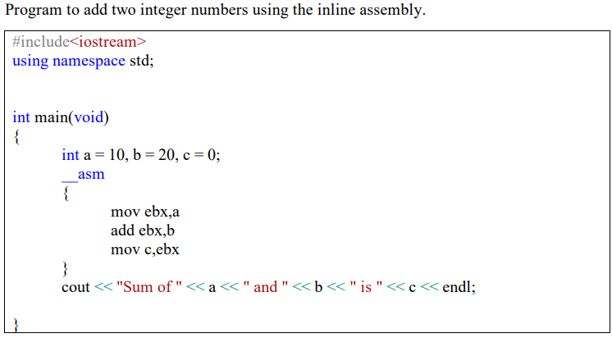
Example
Notes:
#include<iostream>
using namespace std;
int main(void)
{
int a = 10, b = 20, c = 0;
__asm
{
mov ebx,a
add ebx,b
mov c,ebx
}
cout << "Sum of " << a << " and " << b << " is " << c << endl;
}

Slide 13
Example – Array
#include<iostream>
using namespace std;
int array1[] = { 1, 2, 3, 4, 5 };
int main(void)
{
__asm
{
push ebp
mov ebp, offset array1
mov esi, 0
mov ecx, 5
l1:
inc dword ptr[ebp + esi]
add esi, 4
loop l1
pop ebp
}
for (int i = 0; i < 5; i++)
cout << array1[i];
cout << endl;
system("pause");
return 0;
}
Notes:
#include<iostream>
using namespace std;
int array1[] = { 1,2,3,4,5 };
int main(void)
{
__asm
{
push ebp
mov ebp, offset array1
mov esi, 0
mov ecx, 5
l1:
inc dword ptr[ebp + esi]
add esi, 4
loop l1
pop ebp
}
for (int i = 0; i < 5; i++)
cout << array1[i-1];
}

Slide 14
Example – Array
#include<iostream>
using namespace std;
int array1[] = { 1, 2, 3, 4, 5 };
int main(void)
{
for (int i = 0; i < 20; i = i + 4)
{
__asm
{
mov esi, i
inc dword ptr[array1 + esi]
}
}
for (int i = 0; i < 5; i++)
cout << array1[i]<<" ";
cout << endl;
system("pause");
return 0;
}
Notes:
#include<iostream>
using namespace std;
int array1[] = { 1,2,3,4,5 };
int main(void)
{
for (int i = 0; i < 20; i = i + 4)
{
__asm
{
mov esi, i
inc dword ptr[array1 + esi]
}
}
for (int i = 0; i < 5; i++)
cout << array1[i-1];
}

Slide 15
Example – Rotate Left
#include<iostream>
using namespace std;
int main(void)
{
int array1[] = { 1, 2, 3, 4, 5 };
for (int i = 0; i < 20; i = i + 4)
{
__asm
{
mov eax, i
rol dword ptr[array1 + eax], 1
}
}
for (int i = 0; i < 5; i++)
{
cout << array1[i] <<endl;
}
system("pause");
return 0;
}
Notes:
#include<iostream>
using namespace std;
int main(void)
{
int array1[] = { 1,2,3,4,5 };
for (int i = 0; i < 20; i = i + 4)
{
__asm
{
mov eax, i
rol dword ptr[array1 + eax], 1
}
}
for (int i = 0; i < 5; i++)
{
cout << array1[i] <<
endl;
}
}

Slide 16
Example – 2D Array
#include<iostream>
using namespace std;
int main(void)
{
int array1[3][4] = { { 1, 2, 3, 1 }, { 4, 5, 6, 1 }, { 7, 8, 9, 1 } };
int index = 0;
for (int i = 0; i < 3; i++)
for (int j = 0; j < 4; j++)
{
index = (i * 4 + j) * sizeof(int);
__asm
{
mov eax, index
add dword ptr[array1 + eax], 1
}
cout << "(" << i << "," << j << ")" << "->" << array1[i][j] << endl;
}
system("pause");
return 0;
}
Notes:
#include<iostream>
using namespace std;
int main(void)
{
int array1[3][4] = { {1,2,3,1},{4,5,6,1},{7,8,9,1} };
int index = 0;
for (int i = 0; i < 3; i++)
for (int j = 0; j < 4; j++)
{
index = (i * 4 + j) * sizeof(int);
__asm
{
mov eax, index
add dword ptr[array1 + eax], 1
}
cout << "(" << i << "," << j << ")" << "->" << array1[i][j] << endl;
}
}

Slide 17
To Call Function Written in Assembly
#include<iostream>
using namespace std;
extern "C" int sum1(int a, int b);
int main()
{
int x, y;
cin >> x >> y;
cout << "sum is " << sum1(x, y);
system("pause");
return 0;
}
.model flat
.code
_sum1 PROC
push ebp
mov ebp,esp
mov eax, [ebp+8]
add eax,[ebp+12]
pop ebp
ret
_sum1 endp
END

Slide 18
Convention
Flat model means a single linear address space (used in modern 32-bit systems,
unlike segmented memory in older architectures like 16-bit mode).
.CODE tells MASM that the following code belongs to the code segment.
_sum declares the function as a procedure (PROC). The leading underscore (_)
suggests it follows stdcall conventions, typically for calling from C/C++. The
caller will call this function as sum( ) without ( _ ) underscore.
Assembly functions (written in TASM, MASM, NASM) follow C-style calling
conventions. extern "C" ensures the function name remains unaltered, so it can
be called from C++

Slide 19
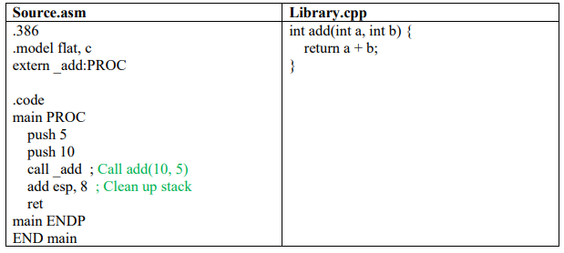
To Call Function Written in C/C++

Slide 20
Conventions
.386 directive tells the assembler that the code is for Intel 80386 and later processors.
It enables 32-bit instructions and registers.
▪ .model flat specifies a flat memory model, meaning there's a single continuous
memory space (used in 32-bit applications).
▪ C specifies that the C calling convention is used.
▪ extern declares that _add is an external function, meaning it is defined in another file
(likely a C file).
▪ _add In MSVC, C function names are prefixed with _ in stdcall calling convention.
▪ :PROC indicates that _add is a procedure

