Slide 1
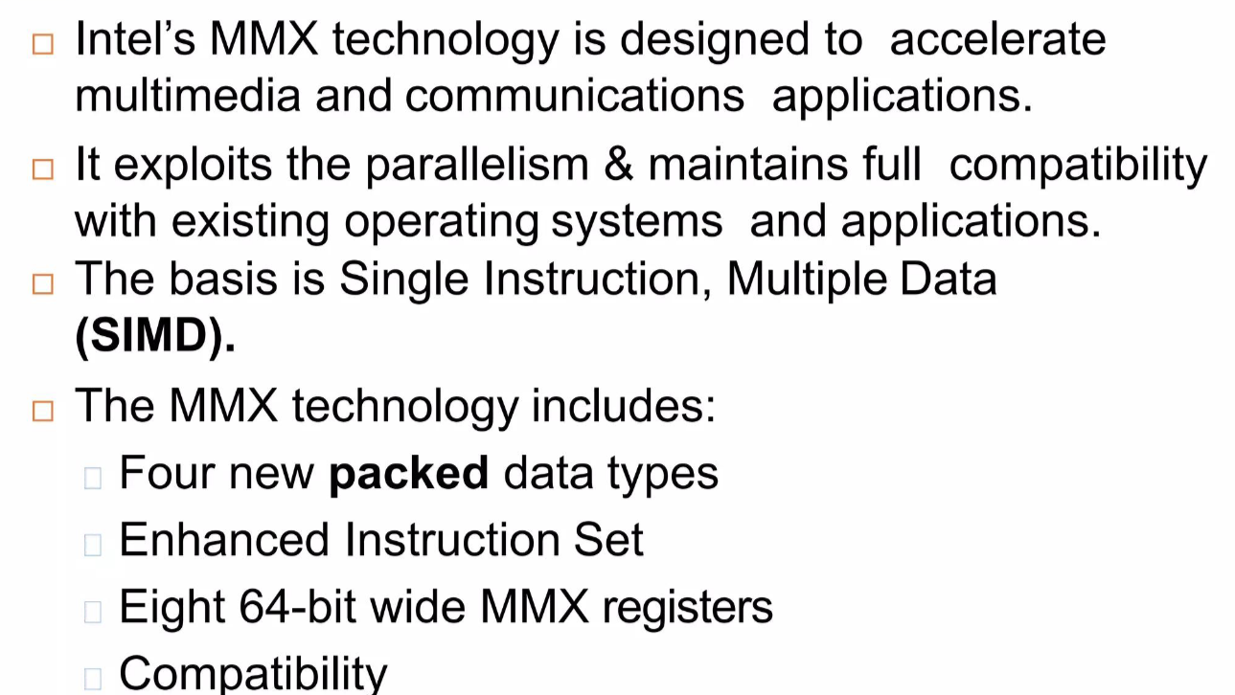
MMX Programming

Slide 2
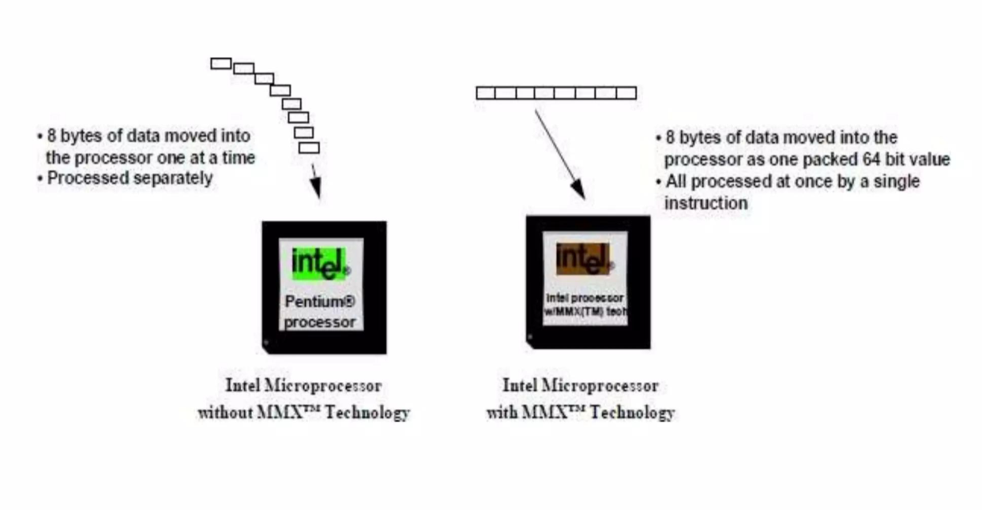

Slide 3
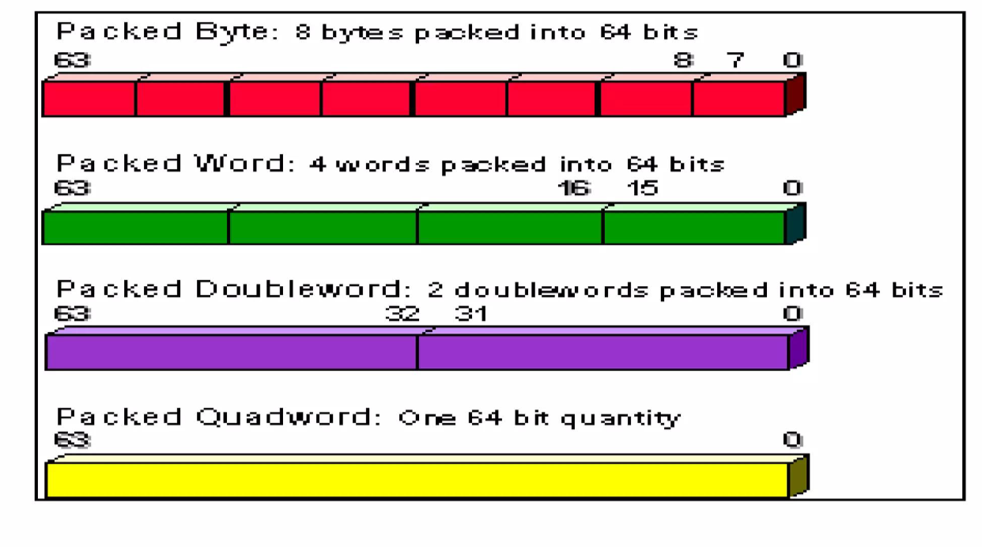
Data Types

Slide 4
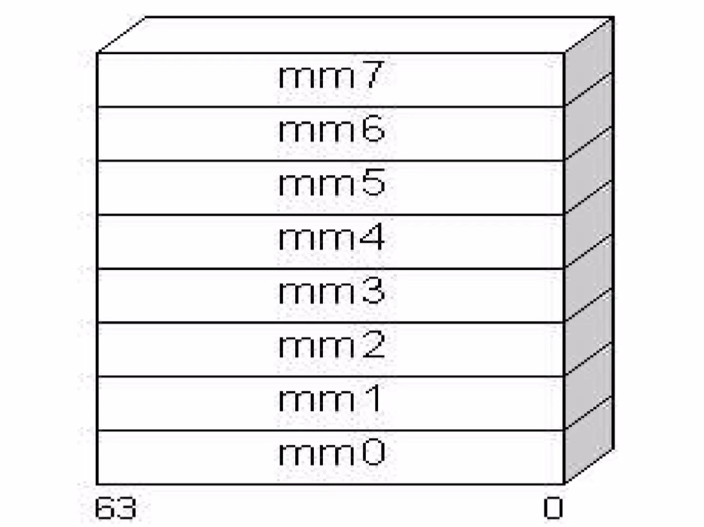
Registers

Slide 5
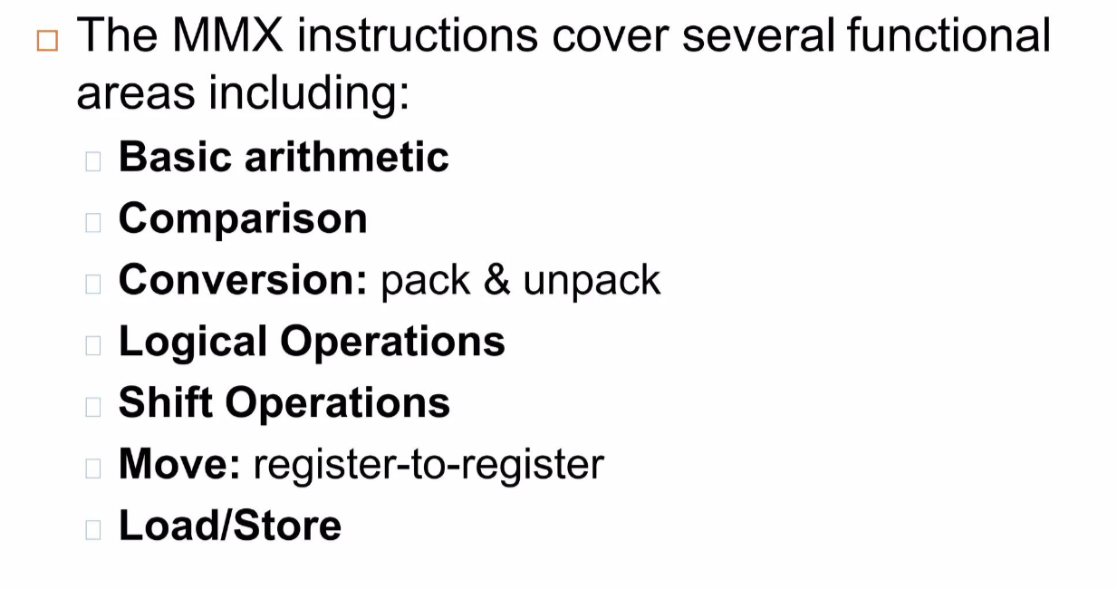
Instructions

Slide 6
Specific Forms of MMX Instructions are:
mmxInstr( mmi, mmi ); // i=0..7
mmxInstr( mem, mmi ); // i=0..7
A few instructions require a small immediate value (or constant) like shift

Slide 7
Move Data
movd( reg32, mmi );
movd( mem32, mmi );
movd( mmi, reg32 );
movd( mmi, mem32 );
movq( mem64, mmi );
movq( mmi, mem64 );
movq( mmi, mmi );
Movd for double Word and movq for quad Word
Char array1[8] = { 1,2,3,4,5,6,7,8 };
movq mm0,[array1]

Slide 8
Saturation
Saturation ensures that values that go beyond the representable range are "clamped" to the maximum or minimum representable value.
For example, if you're packing signed words into signed bytes, and a value is too large to fit in a signed byte (which has a range of -128 to 127), saturation ensures that values exceeding this range are set to the maximum or minimum value, avoiding overflow.
If a result is greater than 127, it will be saturated to 127. (0x7fff)
If a result is less than -128, it will be saturated to -128. (0x8000)
For Unsigned
If a result is greater than 255, it will be saturated to 255. (0xffff)
If a result is less than 0, it will be saturated to 0. (0x0000)

Slide 9
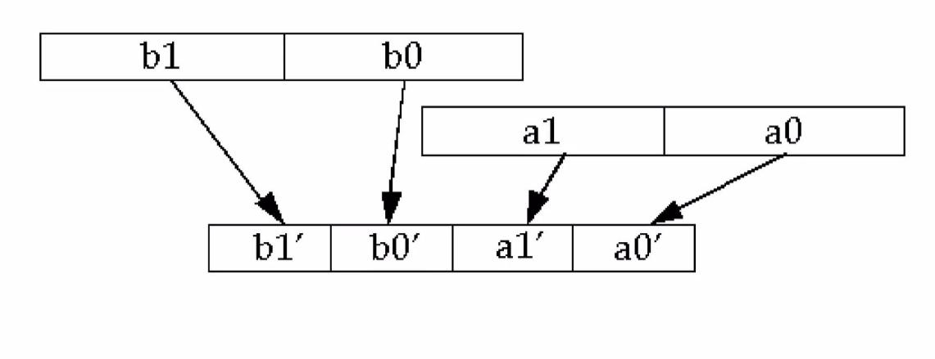
Pack : The PACK instructions in MMX are used to pack data elements from two MMX registers into a single MMX register

Slide 10
The PACKSSxx instructions pack and saturate signed values. They convert a sequence of larger values to a sequence of smaller values via saturation.
The PACKSSDW instruction takes the two double words in the source operand and the two double words in the destination operand and converts these to four signed words via saturation.
The PACKSSWB instruction takes the four words from the source operand and the four signed words from the destination operand and converts, via signed saturation, these values to eight signed bytes.
Practical : UNICODE(16bit) to ASCII Code (8bit)
Translate 16bit audio to 8 bit

Slide 11
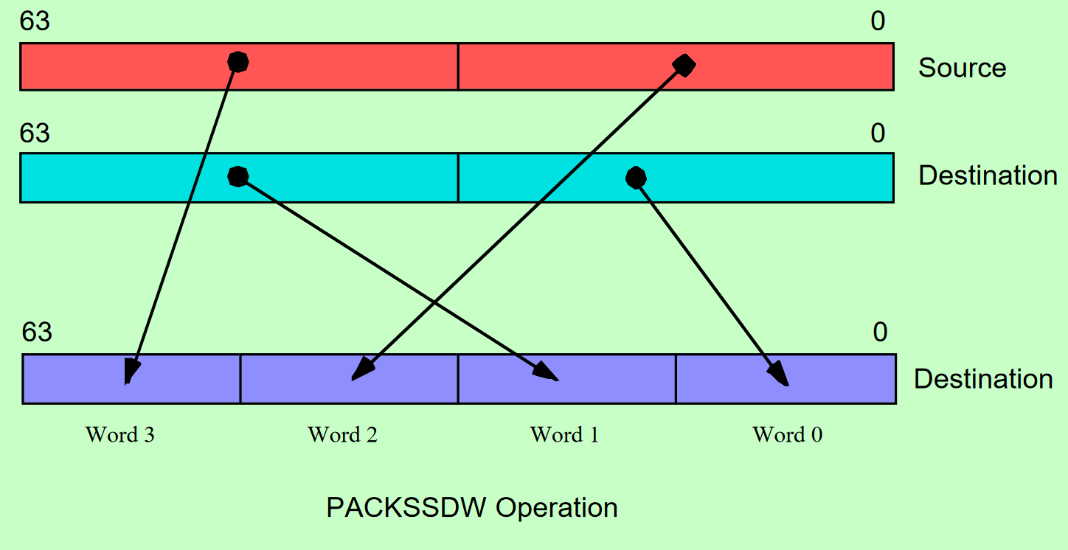

Slide 12
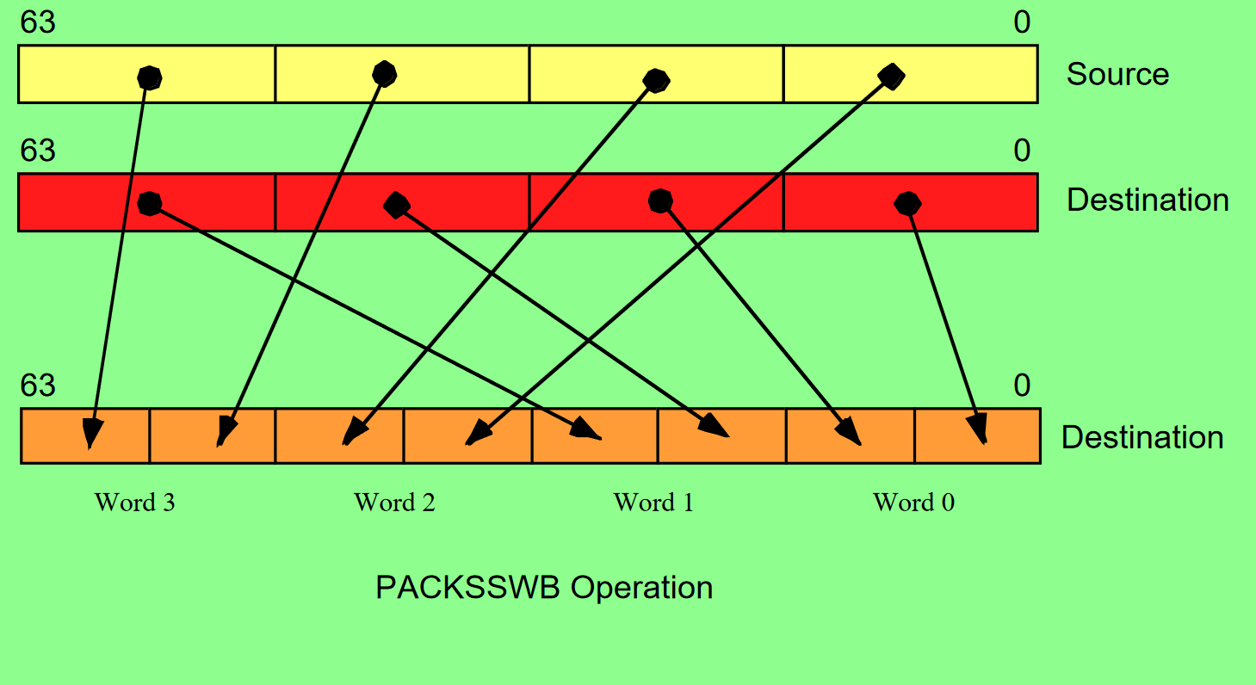

Slide 13
Arithmatic
paddb( mem64, mmi );
paddb( mmi, mmi );
paddw( mem64, mmi );
paddw( mmi, mmi );
paddd( mem64, mmi );
paddd( mmi, mmi );
paddsb( mem64, mmi );
paddsb( mmi, mmi );
paddsw( mem64, mmi );
paddsw( mmi, mmi );

Slide 14
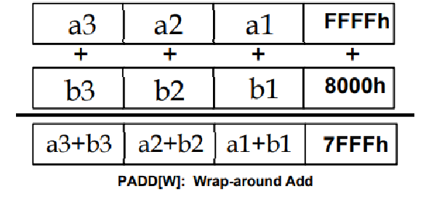
Wrap Around Method
The PADDB, PADDW, and PADDD instructions add the individual bytes, words, or double words in the two 64-bit operands using a wrap-around (i.e., non-saturating) addition.
Any carry out of a sum is lost
FFFFh + 8000h would be a 17-bit result. The 17th bit is lost because of wrap around, so the result is 7FFFh

Slide 15
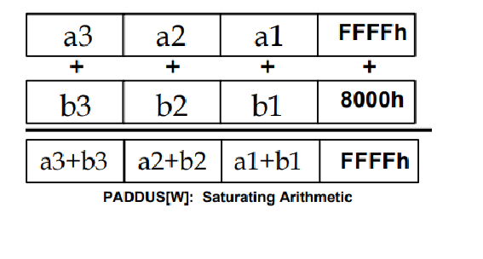
Saturation Method
The PADDSB and PADDSW instructions add the eight eight-bit or four 16-bit operands in the source and destination locations together using signed saturation arithmetic.

Slide 16
Subtraction
The PSUBB, PSUBW, and PSUBD instructions work just like their addition counterparts,
Likewise, the PSUBSB, PSUBSW, PSUBUSB, and PSUBUSW instruction compute the difference of the destination and source operands using saturation arithmetic.

Slide 17
Muliplication
While addition and subtraction can produce a one-bit carry or borrow, multiplication of two n-bit operands can produce as large as a 2*n bit result
To successfully multiply two packed values requires two instructions - one to compute the L.O. component of the result and one to produce the H.O. component of the result.
The PMULLW instruction multiplies the four words of the source operand by the four words of the destination operand and stores the four L.O. words of the four double word results into the destination operand.
You use either the PMULHW or PMULHUW instruction to compute the H.O. words of the products
The difference between the two is that you use PMULHW for signed operands and PMULHUW for unsigned operands.

Slide 18
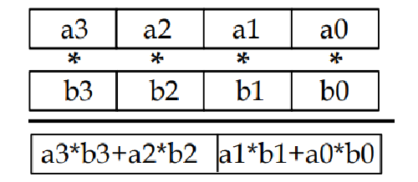
PMADDWD
The PMADD instruction starts from a 16-bit, packed data type and generates a 32-bit packed, data type result.

Slide 19
Logic Instructions
pand( mem64, mmi );
pand( mmi, mmi );
pandn( mem64, mmi );
pandn( mmi, mmi );
por( mem64, mmi );
por( mmi, mmi );
pxor( mem64, mmi );
pxor( mmi, mmi );

Slide 20
Comparison Instructions
pcmpeqb( mem64, mmi );
pcmpeqb( mmi, mmi );
pcmpeqw( mem64, mmi );
pcmpeqw( mmi, mmi );
pcmpeqd( mem64, mmi );
pcmpeqd( mmi, mmi );
pcmpgtb( mem64, mmi );
pcmpgtb( mmi, mmi );
pcmpgtw( mem64, mmi );
pcmpgtw( mmi, mmi );
pcmpgtd( mem64, mmi );
pcmpgtd( mmi, mmi );

Slide 21
The packed comparison instructions compare the destination (second) operand to the source (first) operand to test for equality or greater than.
Okay, so where do these instructions return their true or false values?
These instruction compare each pair of bytes in the two operands and write false ($00) or true ($FF) to the corresponding byte in the destination operand,

Slide 22
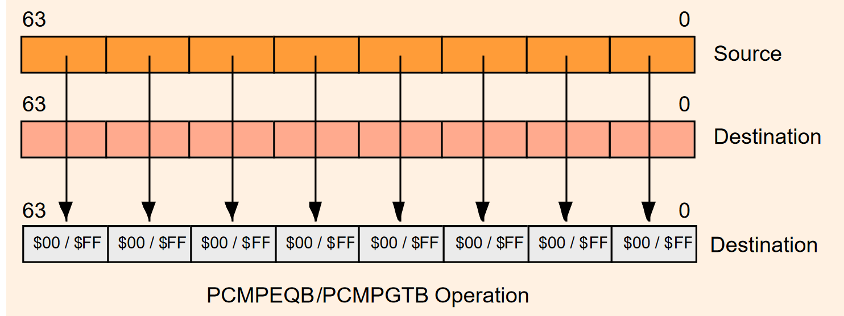

Slide 23
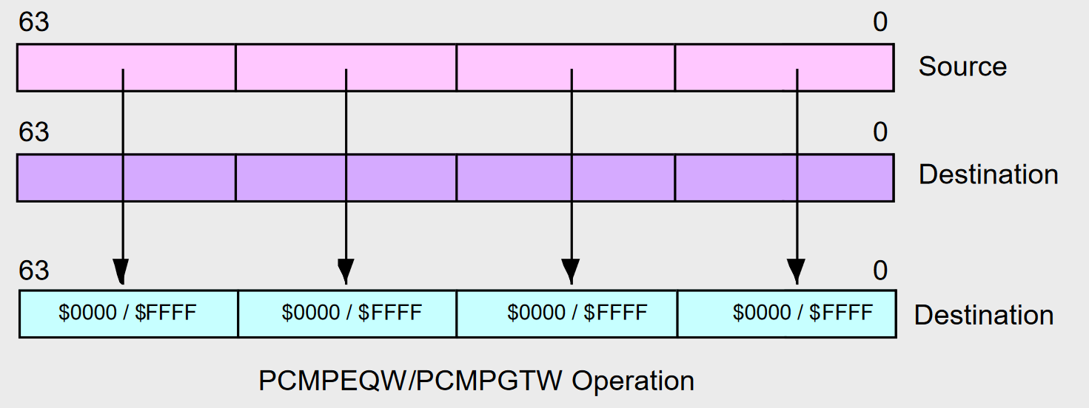

Slide 24
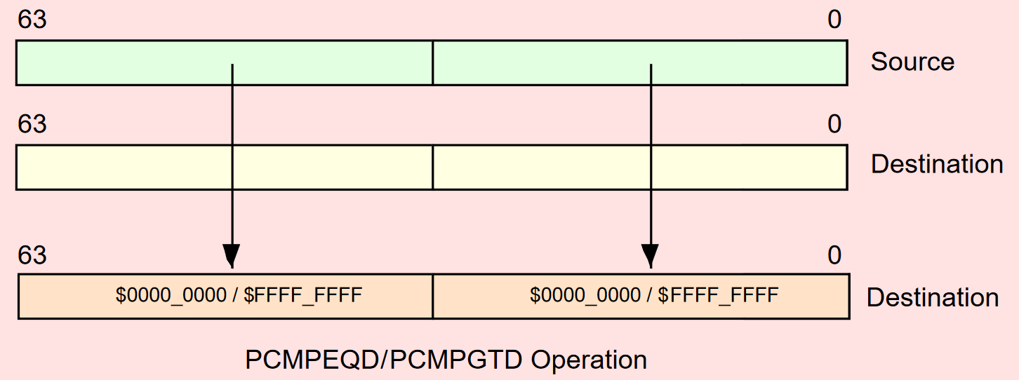

Slide 25
Shift
psllw( mmi, mmi );
psllw( imm8, mmi );
pslld( mmi, mmi );
pslld( imm8, mmi );
psllq( mmi, mmi );
psllq( imm8, mmi );
pslrw( mmi, mmi );
pslrw( imm8, mmi );

Slide 26
psrld( mmi, mmi );
psrld( imm8, mmi );
pslrq( mmi, mmi );
pslrq( imm8, mmi );
psraw( mmi, mmi );
psraw( imm8, mmi );
psrad( mmi, mmi );
psrad( imm8, mmi );

Slide 27
The first operand to these instructions specifies a shift count. This should be an unsigned integer value in the range 0..15 for word shifts, 0..31 for double word operands, and 0..63 for quadword operands.
The PSLLW instruction simultaneously shifts the four words in the destination MMX register to the left the number of bit positions specified by the source operand.
The PSLRW, PSLRD, and PSLRQ instructions work just like their left shift counterparts except that these instructions shift their operands to the right rather than to the left.
The PSRAW and PSRAD instructions do an arithmetic shift right operation on the words or double words in the destination MMX register.
The PSLLQ and PSLRQ instructions provide a convenient way to shift a quad word to the left or right.

Slide 28
The EMMS Instruction
emms();
The EMMS (Empty MMX Machine State) instruction restores the FPU status on the CPU so that it can begin processing FPU instructions again after an MMX instruction sequence. You should always execute the EMMS instruction once you complete some MMX sequence.

