Slide 1
Computer Organization & Assembly Language
Lecture 1

Slide 2
Outline
About this Course
Basic Structure of Computer
What is Computer Organization?
About Assembly Language

Slide 3
Course Objectives
To understand organization of a computer system
To gain an insight knowledge about the internal architecture and working of microprocessors.
To understand working of memory devices, interrupt controllers and I/O devices.
To learn Assembly Language
To understand how low level logic is employed for problem solving by using assembly language as a tool.

Slide 4
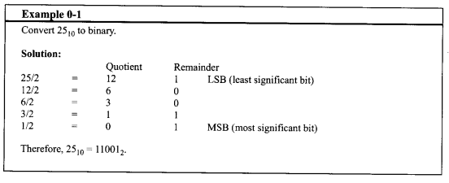
Numbering and Coding system

Slide 5
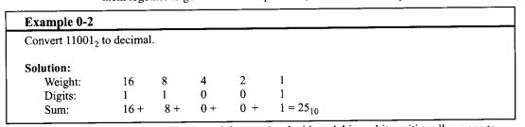
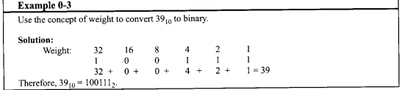
Numbering and Coding system

Slide 6
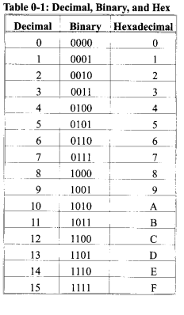

Slide 7
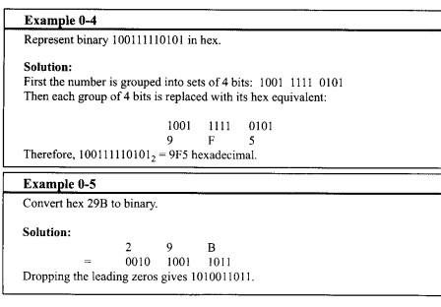

Slide 8
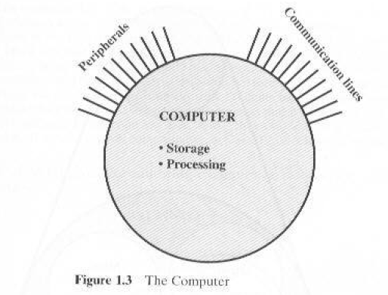
Structure
Structure is the way in which components relate to each other

Slide 9
Difference in Peripherals & Communication Lines
When data is received from or delivered by a device that is directly connected to the computer, process is called Input-Output (I/O).
When data are moved over longer distance, to or from a remote device, the process is known as Data Communication.

Slide 10
Structure - Top Level
Peripherals
Computer
Central
Processing
Unit
Main
Memory
Computer
Systems
Interconnection
Input
Output
Communication
lines

Slide 11
Structure – Top Level Contd..
Four main structural components:
CPU: controls the operation of the computer and performs its data processing functions; often referred as processor.
Main Memory: stores data
I/O: moves data between the computer and its external environment.
System Interconnections: Mechanism for communication among CPU, memory, and I/O.

Slide 12
Structure - The CPU
CPU
Computer
Arithmetic
and
Login Unit
I/O
Registers
System
Bus
CPU
Internal CPU
Interconnection
Memory
Control
Unit

Slide 13
What is a Bus?
A communication pathway connecting two or more devices
Often grouped
A number of channels in one bus
e.g. 32 bit data bus is 32 separate single bit channels
Address Bus
CPU
Memory
I/O
Control Bus
Data Bus

Slide 14
Data Bus
Carries data
Remember that there is no difference between “data” and “instruction” at this level
Width is a key determinant of performance
8, 16, 32, 64 bit
BiDirectional.

Slide 15
Address bus
Identify the source or destination of data
e.g. CPU needs to read an instruction (data) from a given location in memory
Bus width determines maximum memory capacity of system
e.g. 8080 has 16 bit address bus giving 64k address space

Slide 16
Control Bus
Control and timing information
Memory read/write signal
Interrupt request
Timing signals

Slide 17
Programming Languages
High-Level Languages (HLL)
Assembly Language
Machine Language

Slide 18
High-Level Language
Allow programmers to write programs that look more like natural language.
Examples: C++, Java, C#.NET etc
A program called Compiler is needed to translate a high-level language program into machine code.
Each statement usually translates into multiple machine language instructions.

Slide 19
Machine Language
The "native" language of the computer
Numeric instructions and operands that can be stored in memory and are directly executed by computer system.
Each ML instruction contains an op code (operation code) and zero or more operands.
Examples:
Opcode Operand Meaning
-------------------------------------------------
40 increment the AX register
05 0005 add 0005 to AX

Slide 20
Assembly Language
Use instruction mnemonics that have one-to-one correspondence with machine language.
An instruction is a symbolic representation of a single machine instruction
Consists of:
label always optional
mnemonic always required
operand(s) required by some instructions
comment always optional

Slide 21
Sample Program

Slide 22
Computer Architecture
Computer Architecture refers to those attributes of a system visible to a programmer
Those attributes that have direct impact on logical execution of a program.
Architectural attributes include:
the instruction set,
no. of bits used to represent various data types (numbers, characters etc),
I/O mechanisms and technology for addressing memory.
Example: Architectural design issue whether a computer will have multiply instruction or not.
Notes:
Architecture = Logical aspects
Explain the terms underlined

