Slide 1
Computer Organization & Assembly Language
Lecture 2

Slide 2
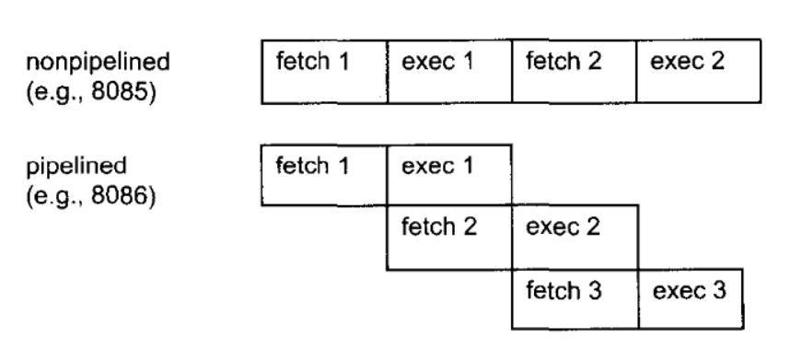
What is pipelining
In a system with pipelining, the data and address buses are busy transferring data while the CPU is processing information, thereby increasing the effective processing power of the microproces­sor.

Slide 3
CPU
Brain of Computer; controls all operations
Uses Memory Circuits to store information
Uses I/O Circuits to communicate with I/O Devices
Executes programs stored in memory
System programs
Application programs
Instruction Set: Instructions performed by CPU
Two main components:
Execution Unit (EU)
Bus Interface Unit (BIU)

Slide 4
Execution Unit (EU)
Purpose: Execute instructions
Contains ALU (Arithmetic & Logic Unit)
To perform arithmetic (+, -, x,/) and logic (AND, OR, NOT) operations.
The data for the operations are stored in circuits called Registers.
A register is like a memory location except that it is referred by a name not a number (address).
EU uses registers for:
Storing data.
Holding operands for ALU
To reflect result of a computation – FLAG register
Notes:
Register details covered in later slides

Slide 5
Bus Interface Unit (BIU)
Facilitates communication between the EU and the memory or I/O circuits.
Responsible for transmitting address, data and control signals on the buses.

Slide 6
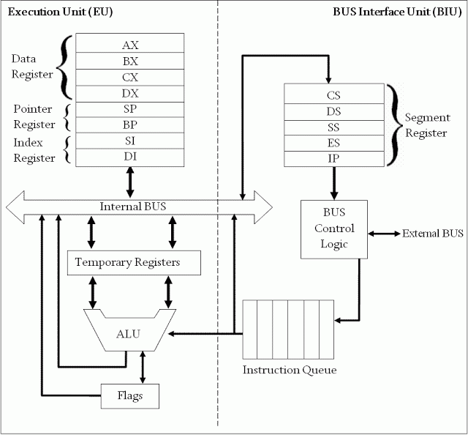
Intel 8086 Microprocessor Organization

Slide 7
Registers
Registers are high-speed storage locations inside the microprocessor.
Designed to be accessed at much higher speed than conventional memory.
Registers are classified according to the functions they perform.
General Types of Registers:
Data Registers: To hold data for an operation.
Address Registers: To hold the address of an instruction or data.
Status/Flag Register: keeps the current status of the processor or result of an arithmetic operation.

Slide 8
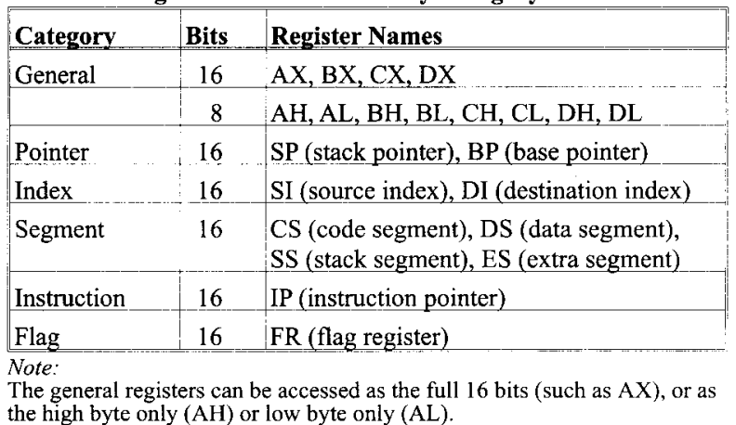
Registers of 8086

Slide 9
8086 Internal registers 16 bits (2 bytes each)
AX, BX, CX and DX are two
bytes wide and each byte can
be accessed separately
These registers are used as
memory pointers.
6 status; 3 control ; 7 unused
Segment registers are used
as base address for a segment

Slide 10
General Purpose/Data Registers
Following four registers are available to the programmer for general data manipulation:
AX (Accumulator): Used in arithmetic, logic and data transfer instructions. Also required in multiplication, division and input/output operations.
BX (Base): It can hold a memory address that points to a variable.
CX (Counter): Act as a counter for repeating or looping instructions. These instructions automatically repeat and decrement CX and quit when equals to 0.
DX (Data): It has a special role in multiply and divide operations. Also used in input/output operations.

Slide 11
Segment Registers
Store addresses of instruction and data in memory.
These values are used by the processor to access memory locations.
CS (Code): Defines the starting address of the section of memory holding code.
DS (Data): Defines the section of memory that holds most of the data used by programs.
ES (Extra): This is an additional data segment that is used by some of the string instructions.
SS (Stack): It defines the area of the memory used for stack

Slide 12
Pointers and Index Registers
These can be accessed only as 16 bit registers.
IP - instruction pointer: Always points to next instruction to be executed. IP register always works together with CS segment register and it points to currently executing instruction.
SI - source index register: Can be used for pointer addressing of data. Offset address relative to DS
DI - destination index register: Can be used for pointer addressing of data . Offset address relative to ES
SI and DI used in string movement instructions.
SP and BP are used to access data inside the stack segment
BP - base pointer: Primarily used to access parameters passed via the stack. Offset address relative to SS
SP – stack pointer: Always points to top item on the stack. Offset address relative to SS

Slide 13
Bits, Bytes and Double words
Each 1 or 0 is called a bit.
Group of 4 bits = Nibble
Group of 8 bits = Byte
Group of 16 bits = Word
Group of 32 bits = Double words

Slide 14
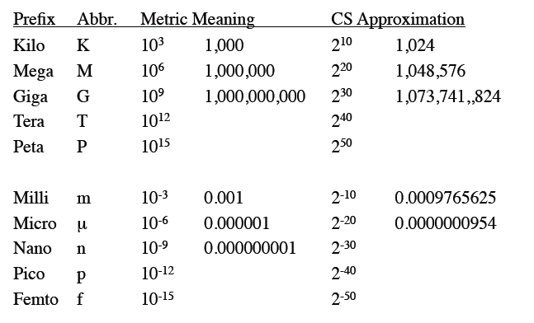
Common Prefixes

