Slide 1
Computer Organization & Assembly Language
Lecture 3

Slide 2
Introduction to program segments
Asslembly language program consist of at least 3 segments
CODE SEGMENT
It contains assembly language instructions that perform the tasks that the program was designed to accomplish.
DATA SEGMENT
Is used to store info (data) that needs to be processed by the instructions in CS
STACK SEGMENT
Used to information temporarily

Slide 3
Origin and definition of the segment
A segment is an area of memory that includes upto 64K bytes.
8085 micro processor
Address max. of 64K bytes of physical memory since it had only 16 pins for the address lines(2¹⁶ = 64K)
64K bytes of memory for all code, data and stock info

Slide 4
8086 micro processor
64K bytes of memory assigned to each category
Range of 1MB of memory because of its 20 address pins (2²⁰ = 1megabyte)

Slide 5
PHYSICAL ADDRESS AND LOGICAL ADDRESS
Physical Address: 20 bit address that is actually put on the address pins and decoded by the memory.
The actual location in physical memory (RAM or ROM) where data is stored.
Range is 00000H to FFFFFH
OFFSET Address:
Location within a 64 Kbyte segment range.
Range is from 0000H to FFFFH

Slide 6
PHYSICAL ADDRESS AND LOGICAL ADDRESS
Logical Address:
An address generated by the CPU during program execution, consisting of a segment value and an offset address.
Physical address will be calculated by Segment address and Offset
Both Segment address and Offset size is 16 bits.
So Physical address is calculated by Segment * 10h + offset address

Slide 7

Code Segment
Logical address always consist
of CS and an IP
Physical address is generated by shifting CS left
one hex digit and then added it to IP.
IP contains the offset address.
Resulting 20 bit address is called the physical address

Slide 8
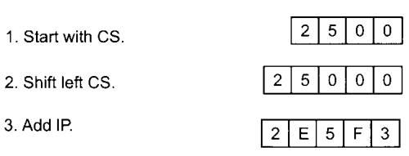
To Calculate Physical Address
Offset address is contained in IP. Here it is 95F3H
Logical address is CS:IP or 2500:95F3H
Physical address will be 25000+95F3 = 2E5F3H

Slide 9
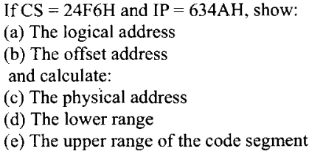
Example

Slide 10
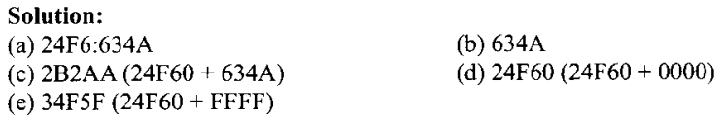
Solution:

Slide 11
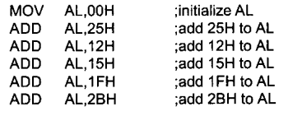
DATA SEGMENT

Slide 12
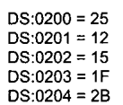
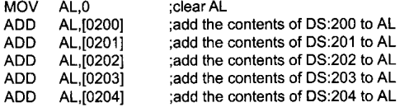
Assume that the offset for the data
segment begins at 200H. The data is
placed in memory locations:
Program can be rewritten as
follows:

Slide 13
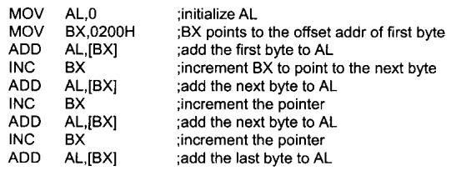
DATA SEGMENT
Data segment uses BX, SI and DI as an offset registers

Slide 14
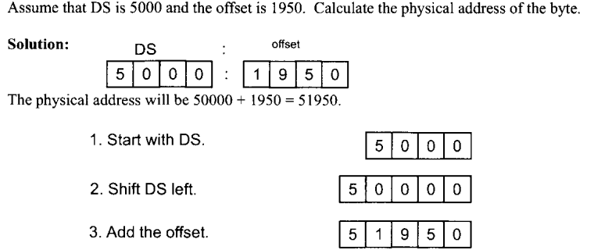
Logical and physical address in data segment

Slide 15
Practice question
If DS = 7FA2H and offset is 438EH
Calculate physical address, logical address, lower range and upper range of the data segment.

Slide 16
SOLUTION
A) 83DAE
B) 7FA2:438E
C) 7FA20
D) 8FA1F

Slide 17
LITTLE ENDIAN CONVENTION
MOV AX, 35F3H ; LOAD 35F3H INTO AX
MOV [1500]. AX ; COPY THE CONTENTS OF AX TO OFFSET 1500H
Low byte goes to low memory location and high byte goes to high memory address.
DS:1500 contains F3H
DS:1501 contains 35H

Slide 18
Programming Model x8086
Structure of an Assembly Language Program
.model small ; Select a memory model.
.stack stack_size ; Define the stack size
.data ; Variable and array declarations;
; Declare variables at this level
.code
main proc ; Write the program main code at this level
main endp

Slide 19
Model
Defines the number of code and data segments a program can have.
Small: For 1 code and 1 data segment. Code and data are located in a single 64 KB segment. Well-suited for small programs that fit within the 64 KB limit.
Medium: for 1 data and more than 1 code segments. Code and data have their own separate 64 KB segments. Suitable for larger programs, providing more flexibility.
Large: for more than 1 code and data segments. Supports multiple code and data segments, each up to 64 KB in size. Useful for even larger programs, but with increased complexity.

Slide 20
Stack
In 8086 assembly language programming, the .stack directive is used to define the size of the stack segment. The stack segment is a region of memory reserved for the stack, which is a data structure used for storing temporary data such as local variables and return addresses.
The syntax for specifying the stack size is:
.stack size_in_bytes
The stack size should be chosen based on the needs of your program.

Slide 21
Code & Data
In 8086 assembly language programming, the .code directive is used to specify the beginning of the code segment. The code segment is where the actual executable instructions of your program reside.
In 8086 assembly language programming, the .data directive is used to define the data segment. The data segment is a section of memory where you allocate and initialize variables that your program will use.
Examples:
message db 'Hello, Assembly!', '$'
count dw 0

Slide 22
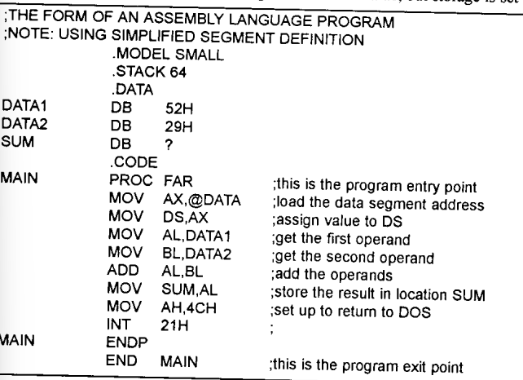

Slide 23
Machine Instruction Elements
Each instruction must have elements that contain the information required by the CPU for execution.
These elements can be:
Operation code: Specifies the operation to be performed (e.g.. ADD, I/O). The operation is specified by a binary code, known as the operation code, or opcode.
Source operand reference: The operation may involve one or more source operands, that is, operands that are inputs for the operation.
Result operand reference: The operation may produce a result. Also called destination operand.
Next instruction reference: This tells the CPU where to fetch the next instruction.

Slide 24
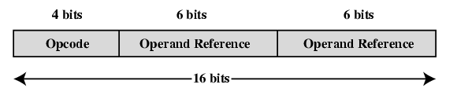
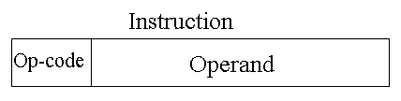
Instruction Representation
Within the computer, each instruction is represented by a sequence of bits.
16 bits instruction
4 bit opcode, 6 bit operand 1, 6 bit operand 2
4 bit opcode, 12 bit operand
32 bits instruction
64 bits instruction
Figure: A Simple Instruction Format

Slide 25
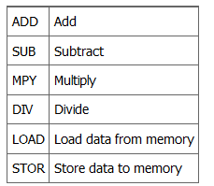
Contd..
Binary representations of machine instructions is difficult to remember.
Use a symbolic representation of machine instructions.
Opcodes are represented by abbreviations, called mnemonics, that indicate the operation. Common examples include:

Slide 26
Some Rules To Follow
Both source and destination operands should be the same size.
Both operands cannot be segment registers
The destination operand cannot be a CS or an IP register
If the destination operand is a segment register, the source operand cannot be an immediate value.

Slide 27
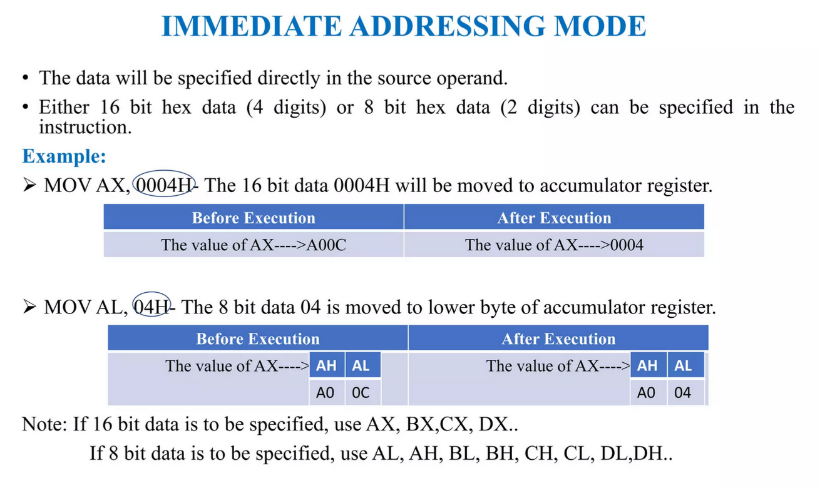

Slide 28
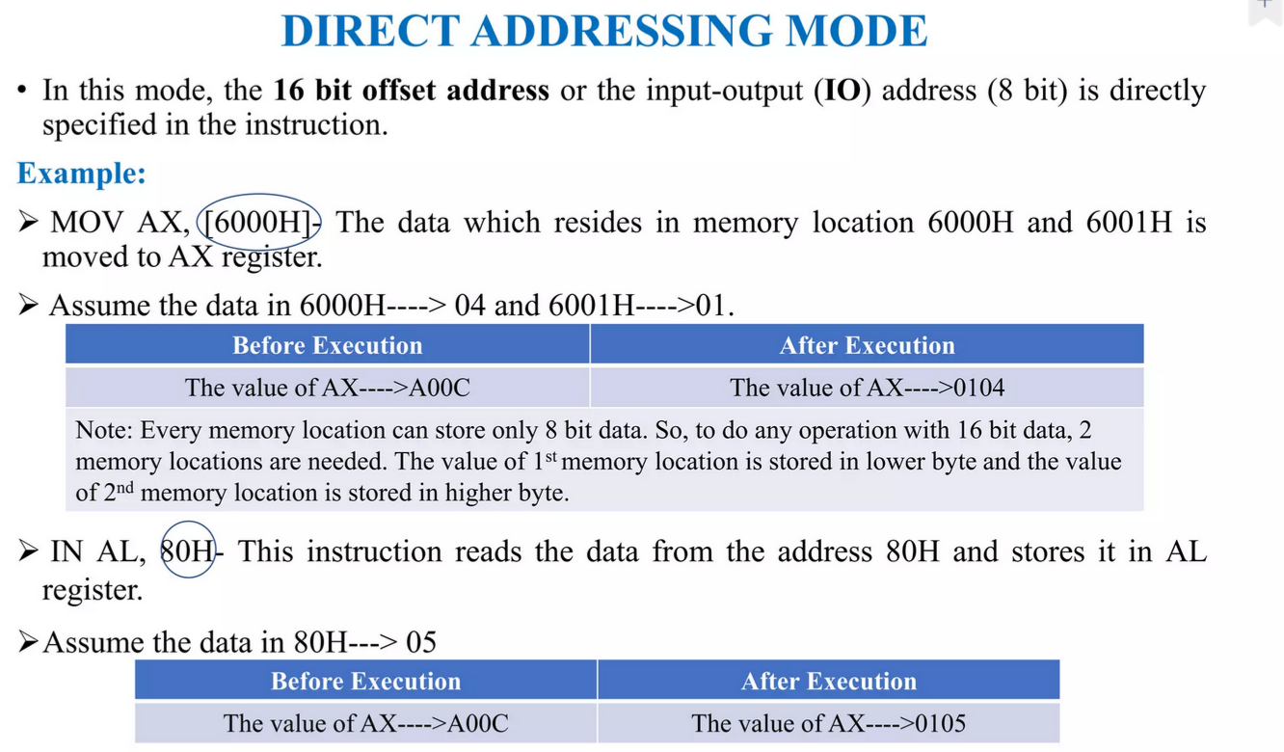

Slide 29
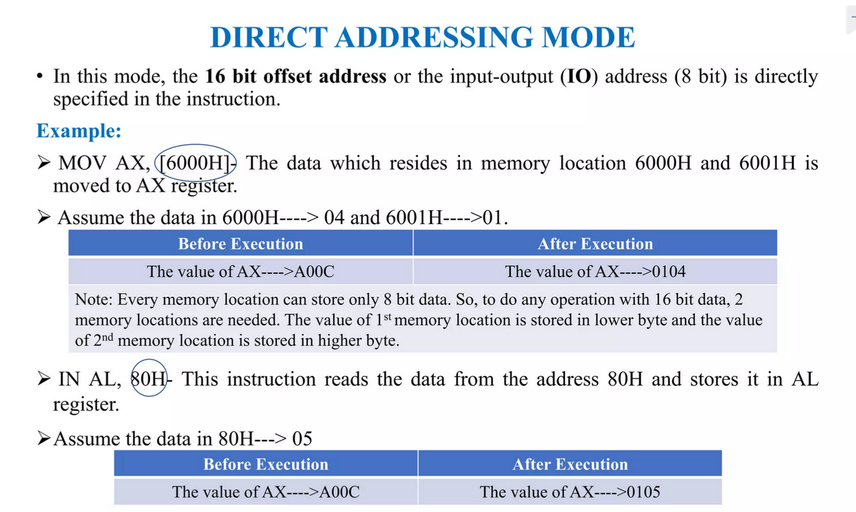

Slide 30
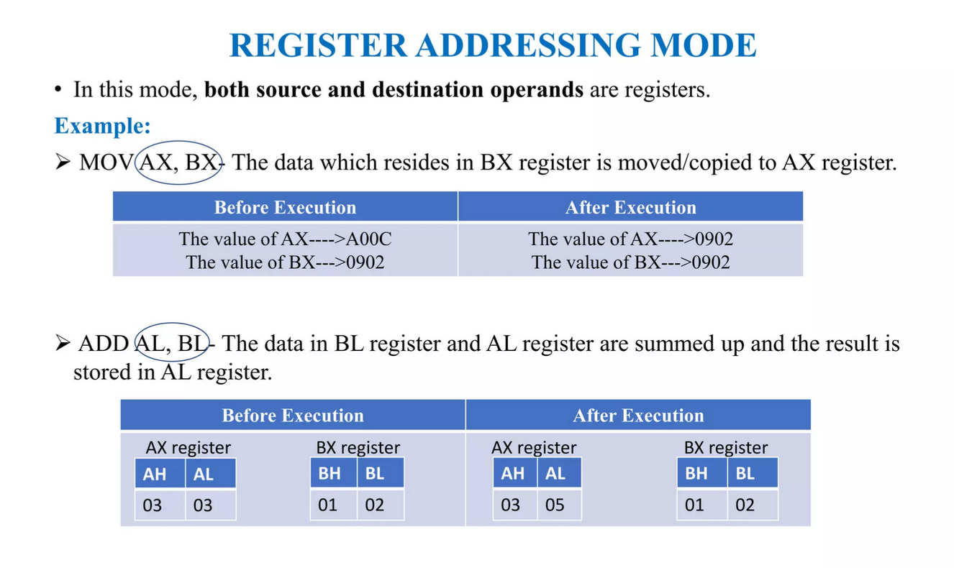

Slide 31
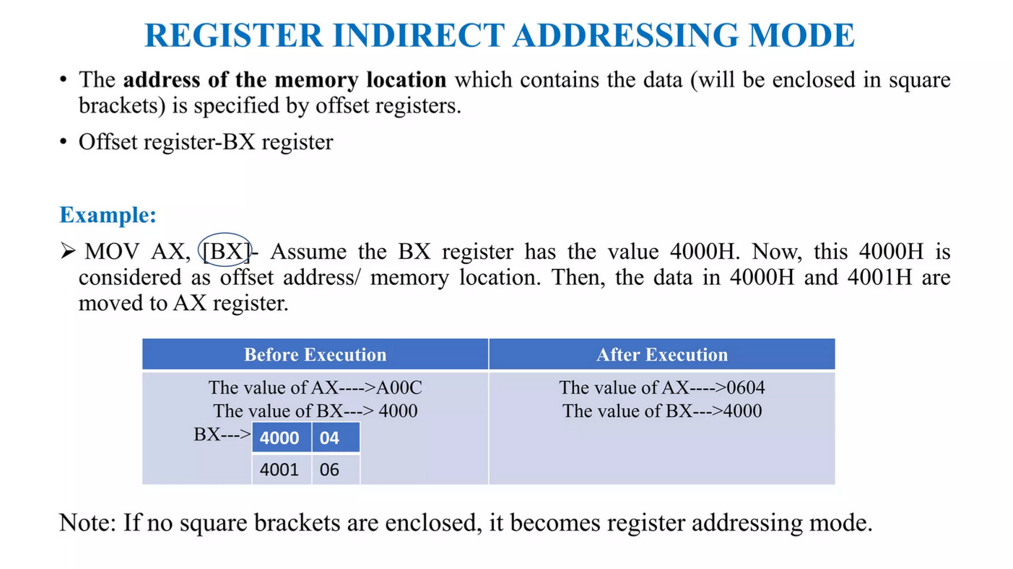

Slide 32
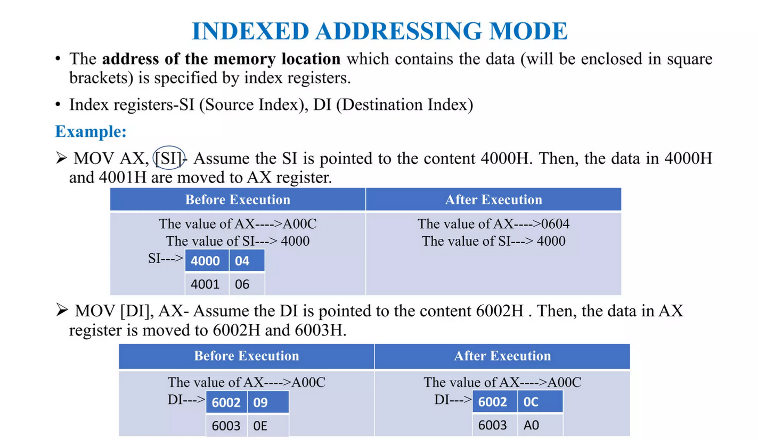

Slide 33
Physical Address to Logical Address
Size of Physical Address is 20bits. While 8086 has max size16 bits.
Physical address will be calculated by Segment address and Offset
Both Segment address and Offset size is 16 bits.
So Physical address is calculated by Segment * 10h + offset address

Slide 34
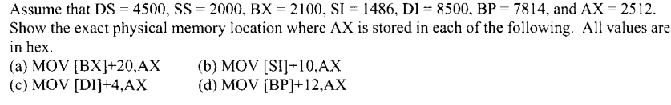
Example

Slide 35
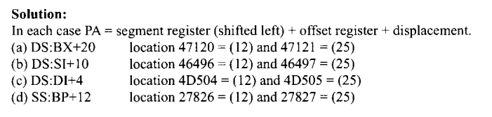
Solution

Slide 36
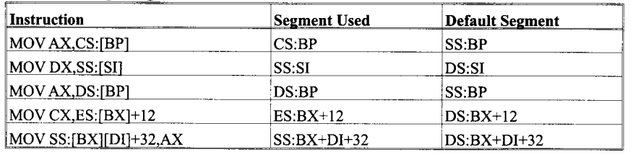
Sample segment overrides

Slide 37
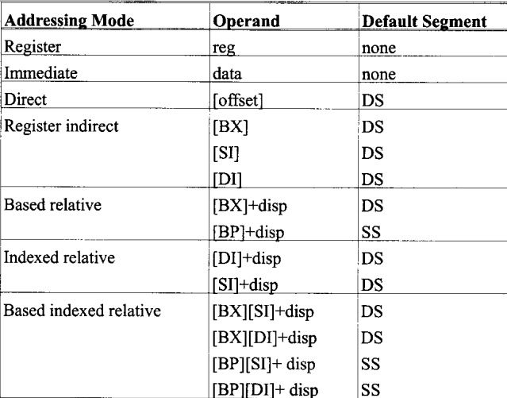
Summary

Slide 38
Flags
Carry flag
Overflow
Direction
Parity flag
Interrupt enable
Auxiliary flag
Trap
Zero
6 are status flags
3 are control flag
Sign

Slide 39
The Status Flags
1. Carry Flag:
Carry Flag is set to 1 when there is an unsigned overflow. For example, when you add bytes 255 +
1 (result is not in range 0…255). When there is no overflow, this flag is set to 0.Examples:
The Carry Flag is set to 1 when there is a carry out from MSB on addition or there is a borrow into the MSB on subtraction. Also affected by shift and rotate instructions.
0FFh + 11h = 110h (If a register can store only 1 byte, then where to store the carry generated by MSB?)
1000 0001b – 1000 0010b = 11111111b (How processor would know a borrow is required to perform subtraction?)

Slide 40
Contd..
2. Parity Flag:
Parity Flag is set to 1 when there is even number of ones in result, and to 0 when there is odd number of ones.
PE (Even Parity): If the byte of a result has even number of one bits. For Even parity, PF = 1
PO (Odd Parity): If the byte of a result has odd number of one bits. For Even parity, PF = 0
Examples:
1000 0001b – 1000 0010b = 11111111b (Number of one’s in result = 8, so PF = 1)

Slide 41
Contd..
3. Auxiliary Carry Flag:
Auxiliary Flag is set to 1 when there is an unsigned overflow for low nibble (4 bits).
The Auxiliary Carry Flag is set to 1 if there is a carry out from bit 3 on addition, or a borrow into bit 3 on subtraction.
Used in Binary Coded Decimal (BCD) Operations.
Examples:
1000 0001b – 0000 0010b = 01111111b (Borrow from bit 4 to bit 3)

Slide 42
Contd..
4. Zero Flag:
Zero Flag is set when the result is zero.
Zero Flag is unset when result is non zero.
Examples:
0FFh – 0FFh = 00h

Slide 43
Contd..
5. Sign Flag:
Sign Flag is set to 1 when result is negative. When result is positive it is set to 0. This flag takes the value of the most significant bit.
Examples:
0FFh – 0FFh = 00h (MSB = 0, PF = 0)

Slide 44
Contd..
6. Overflow Flag:
Overflow:
Range of numbers that can be represented in a computer is limited.
Overflow Flag is set to 1 when there is a signed overflow. For example, when you add bytes 100 + 50 (result is not in range -128…127).

Slide 45
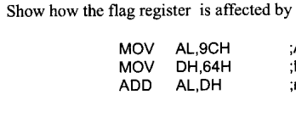
Status of flags

Slide 46
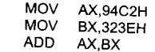
Results of flags?

Slide 47
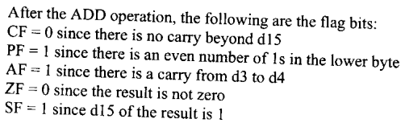
Solution

