Slide 1
ALU operations (MUL & DIV)
Data Types
Variable declaration and initialization
Arrays

Slide 2
Multiplication
MUL instruction is used with unsigned operands
Unsigned multiplication of 128 and 255 = 32, 640.
2 bytes multiplied, product = 1 word (16 bits)
AL is implied destination operand
Source operand can be a register or variable (8 bits)
16-bit output is AX
2 words multiplied, product = 1 double word (32 bits)
AX is implied destination operands
Source operand can be a register or variable (16 bits)
32-bit output is DX:AX

Slide 3
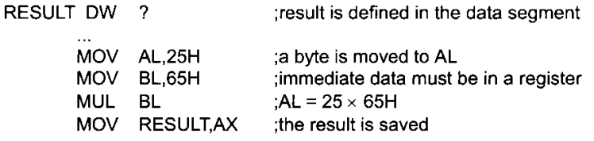
Byte x Byte

Slide 4
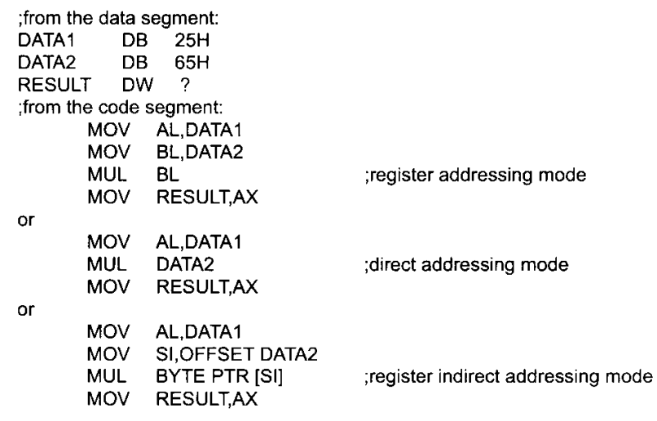
Byte x byte

Slide 5
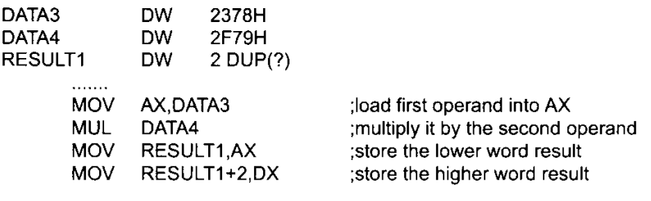
Word x word

Slide 6
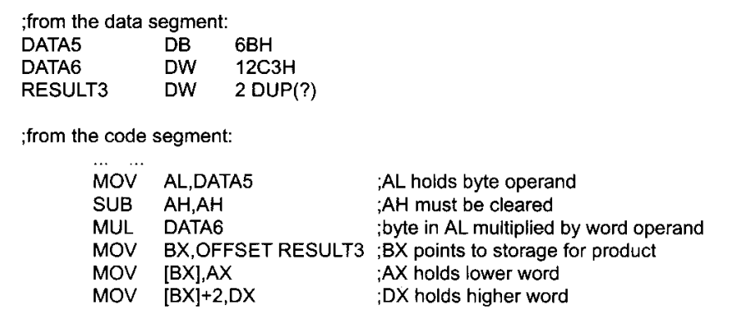
Word x byte

Slide 7
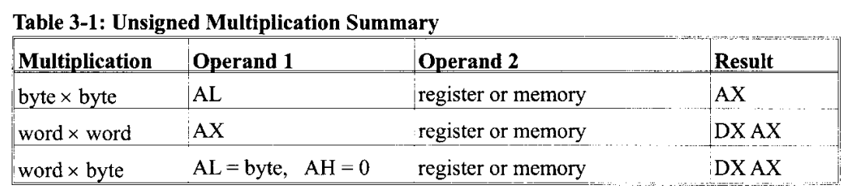

Slide 8
MUL (Flags)
Carry and Overflow flags are set when the product extends into its high register:
mov ax,5000h
mov bx,10h
mul bx ; DX:AX = 00050000h
; CF=1, OF=1
mov ax,500h
mov bx,10h
mul bx ; DX:AX = 00005000h
; CF=0, OF=0

Slide 9
DIV Instruction
Dividend is divided by divisor
Result: Quotient and Remainder
Byte Form:
Dividend is AX
Divisor can be 8-bit register or variable
Quotient is AL, Remainder is AH
Word Form:
Dividend is DX:AX
Divisor can be 16-bit register or variable
Quotient is AX, Remainder is DX
Status flag values are undefined

Slide 10
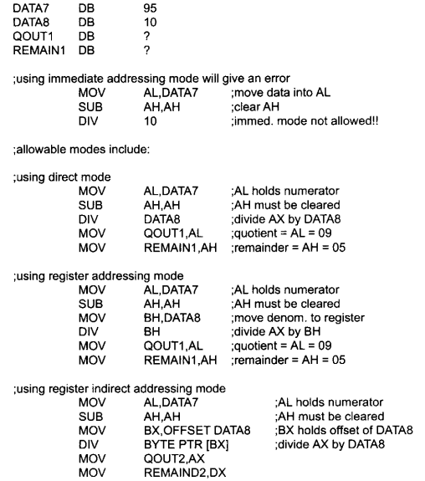
Byte/byte

Slide 11
Byte/byte

Slide 12
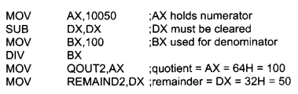

Word/word
Word/byte

Slide 13
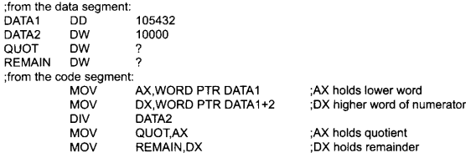
Doubleword/word

Slide 14
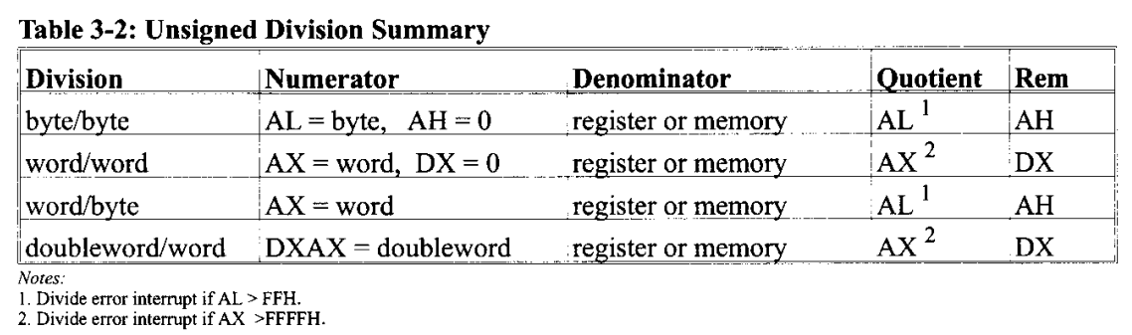

Slide 15
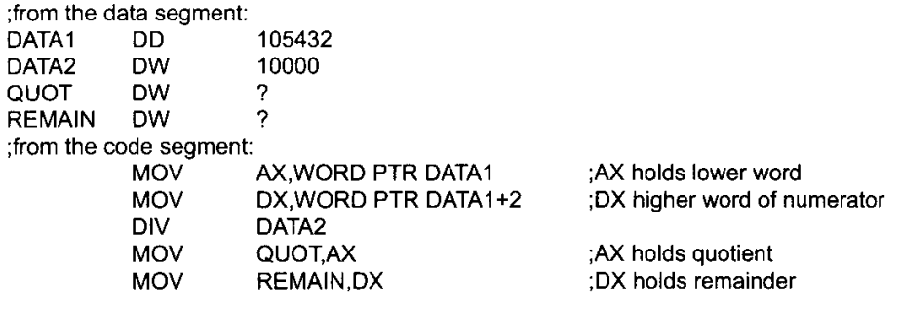
Doubleword/word

Slide 16
Divide Overflow
Happens when the quotient is too large to fit in the destination register. Causes a processor interrupt.
mov dx,0050h ; dividend, high
mov ax,0000h ; dividend, low
mov cx,10h ; divisor
div cx ; quotient= 50000h, cannot ; fit in AX register

Slide 17
Variables In Emu8086
Variable is a memory location. For a programmer it is much easier to have some value be kept in a variable named "var1" then at the address 5A73:235B, especially when you have 10 or more variables.
name DB value name DW value DB - stays for Define Byte. DW - stays for Define Word.
name - can be any letter or digit combination, though it should start with a letter. It's possible to declare unnamed variables by not specifying the name (this variable will have an address but no name).
value - can be any numeric value in any supported numbering system (hexadecimal, binary, or decimal), or "?" symbol for variables that are not initialized.

Slide 18
Example
.code
main proc
mov ax, @data
mov ds, ax
mov dl, var1
mov var2, 20h
mov ax, offset var3
main endp
.exit
.model small
.data
var1 db 10h
var2 db ?
var3 db 'ABCD$'

Slide 19
One Dimensional Array
An ordered list of elements
Examples:
MSG DB ‘abcde$’
W DW 10, 20, 30, 40, 50, 60
Base Address of an array or offset address assigned to an array
Offset Address | Symbolic Address | Decimal Content
0200h | W | 10
0202h | W + 2h | 20
0204h | W + 4h | 30
0206h | W + 6h | 40
0208h | W + 8h | 50
020Ah | W + Ah | 60

Slide 20
Base-plus-Index addressing mode
Arrays can be accessed using direct or register-indirect addressing modes. However, the base-plus- index addressing mode facilitates the programmer in accessing arrays better.
There is a base register that points to the base address of an array,
while the index register points to the index of the array that is to be accessed
Offset is the keyword to access array address.
mov bx, offset Array

Slide 21
PROGRAM TO MOVE ELEMNETS TO REGISTERS
.model small
.data
Array db 1,2,3,4,5
.code
Mov ax,@data
Mov ds,ax
Mov bx, offset Array
Mov si, 0
Mov al, [bx + si]
Inc si
Mov ah, [bx + si]
Inc si
Mov cl, [bx + si]
Inc si
Mov ch, [bx + si]
Inc si
Mov dl, [bx + si]
.exit

Slide 22
The DUP Operator
Used to define an array if initial value of elements are same.
Examples:
GAMMA DW 100 DUP (0) ;sets an array of 100 elements initialized to 0
DELTA DB 20 DUP (?) ; creates an array with 20 uninitialized bytes

Slide 23
CONSTANTS
Constants are just like variables, but they exist only until your program is assembled.
After assembling, the definition of a constant is replaced with its value. Constant is defined as follows:
name EQU < any expression >
COUNT EQU 25
MOV BX, COUNT

Slide 24

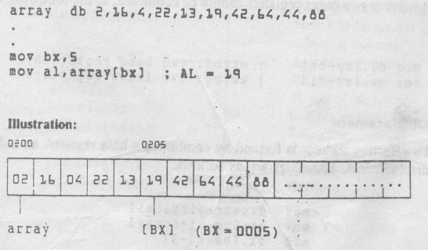
Example

Slide 25
Adding 8-bit Integers
.data
aList db 10h,20h,30h
sum db 0
.code
mov bx,offset aList
mov al,[bx] ; AL = 10h
inc bx
add al,[bx] ; AL = 30h
inc bx
add al,[bx] ; AL = 60h
mov si,offset sum ; get offset of sum
mov [si],al ; store the sum
If you want to paste a code example such as this into a program, remember that the code segment must always begin with the following statements:
mov ax,@data
mov ds,ax

Slide 26
Adding 16-bit Integers
.data
wordList dw 1000h,2000h,3000h, 0
.code
mov bx,offset wordList
mov ax,[bx] ; first number
add ax,[bx+2] ; second number
add ax,[bx+4] ; third number
mov [bx+6],ax ; store the sum

