Slide 1
Arrays, Loops and Jumps

Slide 2
Arrays & Loops (Labels and Loop Instruction)
An ordered list of elements
Examples:
MSG DB ‘abcde’
W DW 10, 20, 30, 40, 50, 60
Base Address of an array or offset address assigned to an array

Slide 3
Example
• Loops are used to repeat instructions automatically.
.data
array db 10, 20, 30, 40, 50
count equ 5
.code
mov cx, count ; loop counter
mov si, 0 ; index register
L1: ; label for loop start
mov al, [array + si] ; access array element
add al, 1 ; perform operation (increment)
mov [array + si], al ; store back
inc si ; move to next element
loop L1 ; loop until CX=0

Slide 4
Explanation
array is the label marking where the array starts in memory.
si acts as the index.
loop L1 automatically decrements cx and jumps to L1 until cx = 0.

Slide 5
Base Plus Index Addressing Mode
• Combines a base register (BX/BP) and index register (SI/DI).
• Used to access array elements.
• Syntax: [BaseReg+IndexReg]
Example:
mov bx, offset array
mov si, 2
mov al, [bx + si] ; Access 3rd element

Slide 6
Base Relative Plus Index Addressing Mode
• Adds a displacement to Base + Index formula.
• Syntax: [BaseReg + IndexReg + Displacement]
• Used for structured data with headers.
Example:
mov bx, offset table
mov si, 1
mov al, [bx + si + 3]

Slide 7
Understanding OFFSET
• OFFSET = distance (in bytes) from start of segment to variable.
• Used to get the memory address of labels.
• 'mov bx, offset var' stores the address of var, not its value.
Example:
mov bx, offset array
mov al, [bx + 2] ; Access array[2]

Slide 8
OFFSET Visualization
Label Value Address
num1 10 2000H
num2 20 2001H
• offset num1 → 2000H
• offset num2 → 2001H
• Access with: mov al, [bx]

Slide 9
Loops Instruction
A loop is a set of instructions that repeat again and again until a condition is met.
Assembly uses CX register as the loop counter.
Before starting a loop, we store in CX how many times we want to repeat the block.

Slide 10
Example
MOV CX, 5 ; repeat 5 times
L1:
LOOP L1 ; decrement CX and repeat if CX ≠ 0

Slide 11
EXECUTION
Iteration | CX Before | CX After | Action
1 | 5 | 4 | Jump to L1
2 | 4 | 3 | Jump to L1
3 | 3 | 2 | Jump to L1
4 | 2 | 1 | Jump to L1
5 | 1 | 0 | Stop loop

Slide 12
TASK TO DO!
Write an assembly code to perform the sum of 5 numbers using loop and array.

Slide 13
WHAT CMP DOES?
The CMP instruction compares two operands and changes the flags according to the result of the comparison.
The operands themselves remain unchanged.
The destination operand can be in a register or in memory, and the source operand can be in a register. in memory, or immediate.
Although all the CF, AF, SF, PF, ZF, and OF flags reflect the result of the comparison, only the CF and ZF are used.

Slide 14
Flag Settings for Compare Instruction
CMP (compare) instruction performs an implied subtraction of a source operand from destination operand. Neither operand is modified.
CMP destination, source
FLAGS
CF | ZF | CMP Result
1 | 0 | Destination < Source
0 | 0 | Destination > Source
0 | 1 | Destination = Source

Slide 15
JUMP Instructions Overview
• Used to change the normal execution flow.
• Two main types:
1. Unconditional (JMP Label)
2. Conditional (JE, JNE, JG, JL, etc.)
• Labels are used as jump targets.

Slide 16
Unconditional Jump
Syntax:
JMP destination_label
Purpose: To Transfer control to another part of the program.
Example:
ORG 100h .CODE MOV AX, 2 MOV BX, 2 JMP LABEL_SUB ADD AX, BX ;this instruction will never execute LABEL_SUB: SUB AX, BX RET

Slide 17
Example
mov ax, 5
jmp skip
mov ax, 10
skip:
add ax, 2

Slide 18
Unconditional Jump (JMP)
• Always jumps to the target label.
Example:
mov al, 10
jmp done
mov al, 20
done: add al, 5 ; AL = 15

Slide 19
Conditional Jumps
Conditional jumps happen only if a certain flag or condition is set.
These instructions depend on previous instruction results .
Command Format:
CMP operand1, operand2
J<condition> label

Slide 20
Conditional Jumps
Instruction | Meaning | Used for
JE | Jump If Equal | Unsigned/Signed
JNE | Jump if Not Equal | Unsigned/Signed
JG | Jump if Greater | Signed
JL | Jump if Less | Signed
JGE | Jump if Greater or Equal | Signed
JLE | Jump if Less or Equal | Signed

Slide 21
Example – JE (Jump if Equal)
mov al, 5
cmp al, 5 ;ZF = 1
je equal_label
mov bl, 0
equal_label:
mov bl, 1 ; BL = 1 since AL == 5

Slide 22
Example – JNE (Jump if NOT Equal)
mov al, 5
cmp al, 8 ;ZF = 0
jne not_equal
mov bl, 0
not_equal:
mov bl, 1

Slide 23
JUMP if ABOVE
MOV AL, 9
CMP AL, 5
JA ABOVE_LABEL
MOV BL, 0
ABOVE_LABEL:
MOV BL, 1
CF = 0 and ZF = 0 → True → Jump occurs

Slide 24
JUMP if BELOW
MOV AL, 3
CMP AL, 5
JB BELOW_LABEL
MOV BL, 0
BELOW_LABEL:
MOV BL, 1
CF = 1 → True → Jump occurs

Slide 25
Using Jumps to Create Loops
mov cx, 5 ; counter
mov ax, 0
start:
add ax, 2
dec cx
jnz start ;Jump if Not Zero
• AX = 10 after loop completes

Slide 26
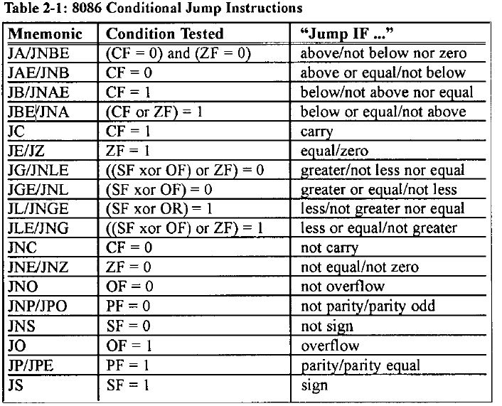

Slide 27
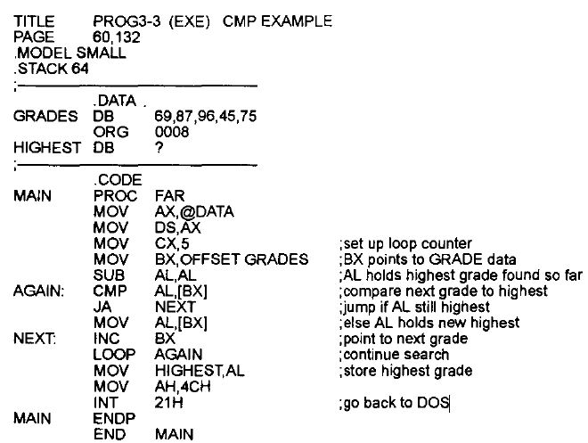
Finding the highest grade

Slide 28
Task to do!
Write an assembly program that counts how many numbers in an array are greater than 50.

