Slide 1
STACK
WEEK 7

Slide 2
Introduction to stack
Stack is a section of read/write memory used by the CPU to store information temporarily.
CPU needs this storage as there are only limited number of registers.
One limitation of stack… is its access time compared to the registers

Slide 3
How Stacks are Accessed?
Two main registers used to access the stack are:
SS
SP
Every register inside the 80x86 can be stored in the stack and brought back to CPU except SS and SP.
The storing of CPU reg is called a PUSH
Loading the contents of the stack into CPU is a POP

Slide 4
PUSH AND POP
a register is pushed onto the stack to store it
And popped off the stack to retrieve it.

Slide 5
How Stacks are Accessed?
SP points at the current memory location used for the top of the stack
As data is pushed onto the stack it is decremented
It is incremented as data is popped off the stack into the CPU.
When an instruction pushes or pops a general purpose register, it must be entire 16 bit register.

Slide 6
How Stacks are Accessed?
SP is decremented after the PUSH to make sure that the stack is growing downward from upper addresses to lower addresses
This is opposite of the IP.
To ensure that the Code section and Stack section never write over each other, they are located at opposite ends of the RAM

Slide 7
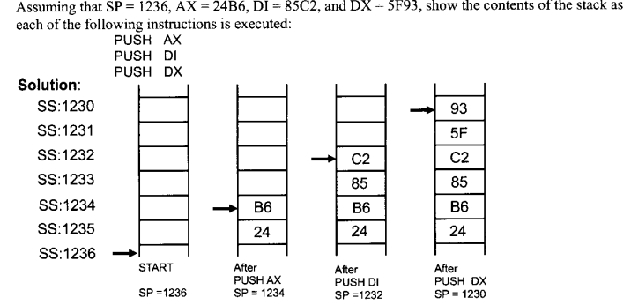
PUSHING ONTO THE STACK

Slide 8
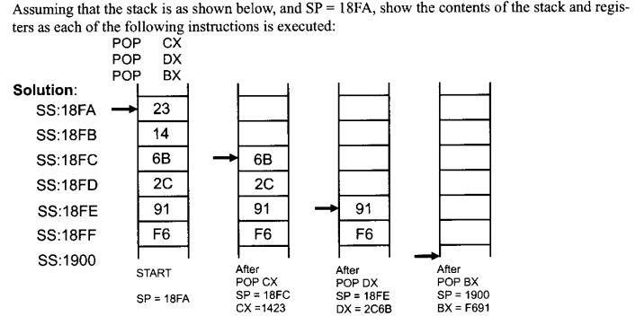
POPPING THE STACK

Slide 9
CALL STATEMENTS
Used to call a procedure
Near call: only IP is saved on stack; current CS
Far call: both CS and IP are saved
Last instruction in subroutine must be RET

Slide 10
Subroutines
You can have one main prog and many subroutines.
If no RET, sequential execution continues
Main proc is entry point from DOS and is FAR

Slide 11
SUBROUTINES
SUBR1 PROC
-
-
-
RET
SUBR1 ENDP
SUBR2 PROC
-
-
-
RET
SUBR2 ENDP
SUBR3 PROC
-
-
-
RET
SUBR3 ENDP
END MAIN
.CODE
MAIN PROC FAR
MOV AX, @DATA
MOV DS, AX
CALL SUBR1
CALL SUBR2
CALL SUBR3
MOV AH, 4CH
INT 21H
MAIN ENDP

Slide 12
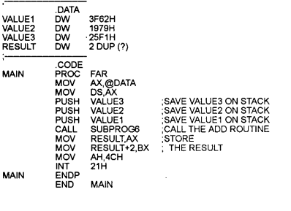
PARAMETER PASSING THROUGH STACK

Slide 13
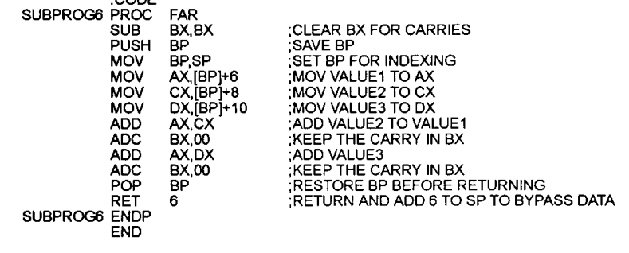
PARAMETER PASSING THROUGH STACK

Slide 14
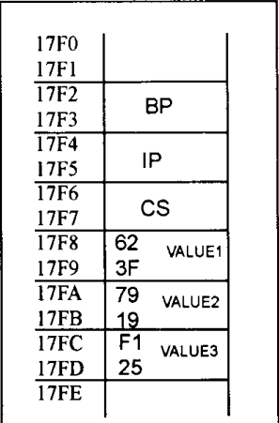
STACK CONTENT DIAGRAM

Slide 15
EXAMPLE
.MODEL SMALL
.DATA
RESULT DW 2 DUP(?)
.CODE
MAIN PROC
MOV AX,@DATA
MOV DS,AX
MOV AX, 1234H
MOV BX, 4567H
MOV CX, 254FH
PUSH AX
PUSH BX
PUSH CX
CALL SUBPROG
MOV RESULT, AX
MOV RESULT+2,BX
MOV AH,4CH
INT 21H
MAIN ENDP
SUBPROG PROC
SUB BX,BX
PUSH BP
MOV BP,SP
MOV AX,[BP]+4
MOV CX,[BP]+6
MOV DX, [BP]+8
ADD AX,CX
ADC BX,00
ADD AX,DX
ADC BX,00
POP BP
RET 6
SUBPROG ENDP
END

