Slide 1




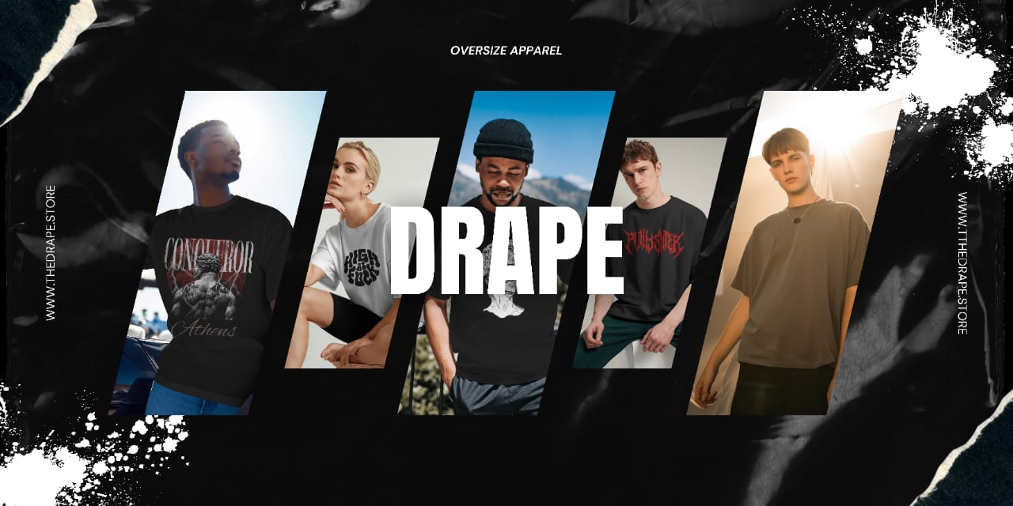

Group Project
Opportunity and Concept Testing

Slide 2

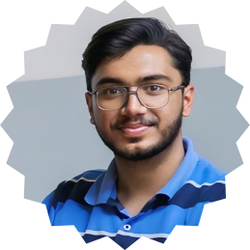

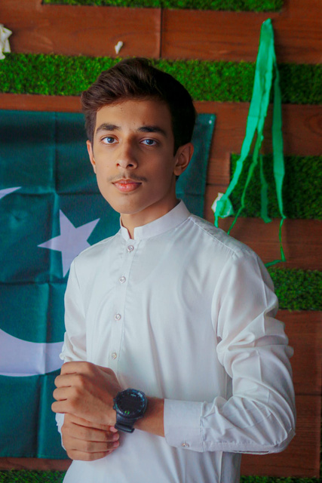

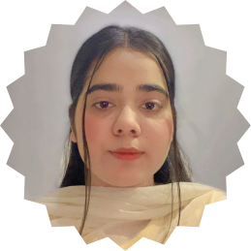


Group Members
Leader
Salman Farooq
Hussain Durrani
L1F24BSCS0829
L1F24BSCS0937
Ali Hamza
Esha Shareef
L1F24BSCS1037
L1F24BSCS1019

Slide 3

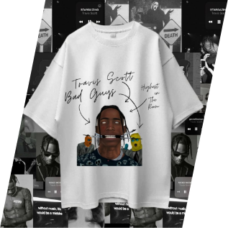

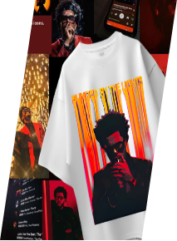
Drape Store
Target Audience: Young males, 18–35, city youth in Lahore
Goal: Capture streetwear trend & self-expression
Oversized T-shirts with trendy, expressive designs

Slide 4

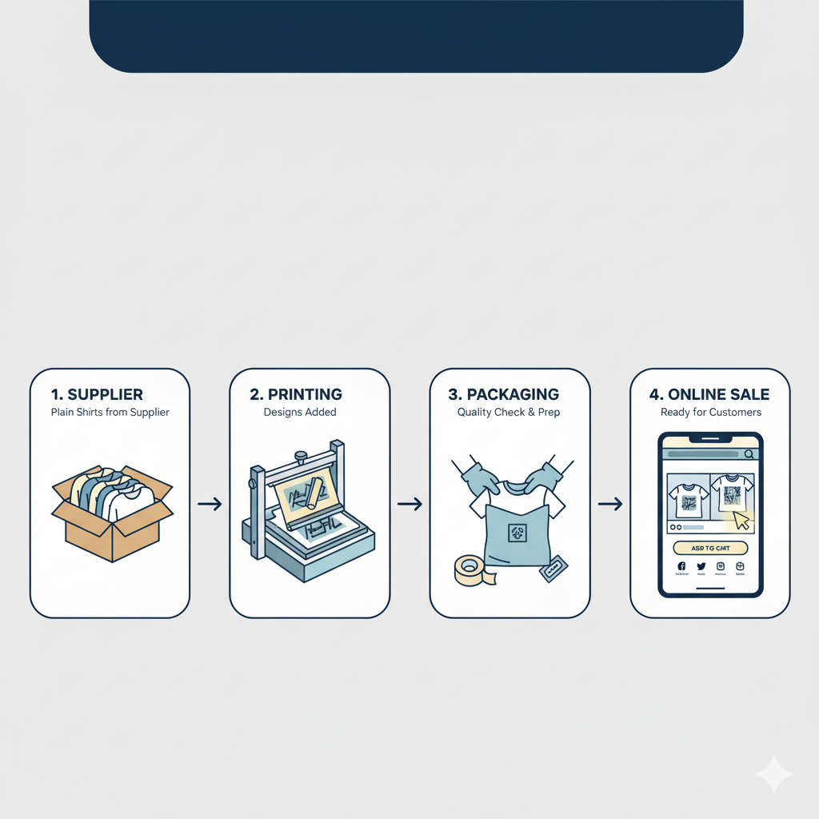

Concept & Operations
White-labeled shirts sourced from Karachi, printed locally
Manual production, packaging, branding
Sold via Shopify, Instagram, Facebook
Designs: Anime, Cars, Quotes, Luxury Logos

Slide 5

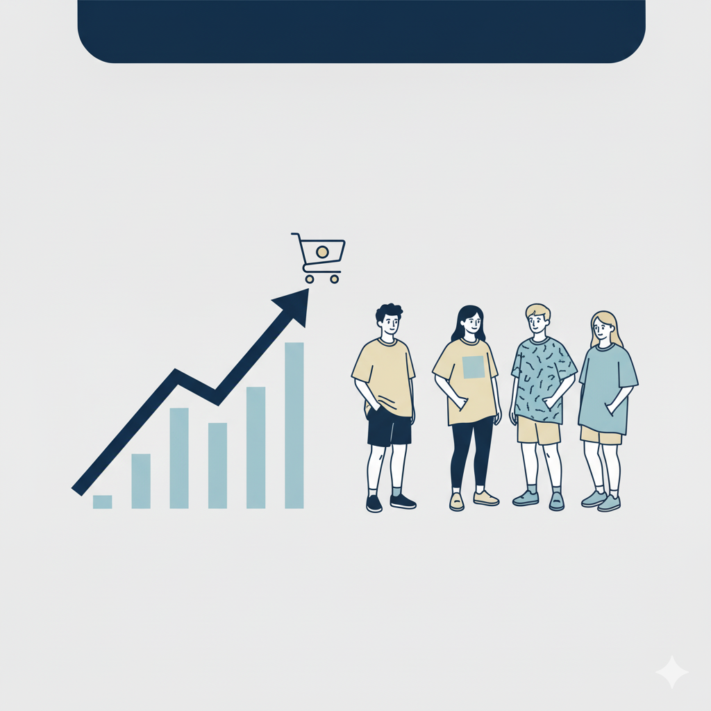

Commercialization Potential
Market Opportunity: Youth population drives fashion trends and e-commerce growth in Pakistan's clothing sector.
Product Fit: Demand for casual, expressive apparel; highly scalable.
Key Challenge: Intense competition and limited initial brand awareness.

Slide 6


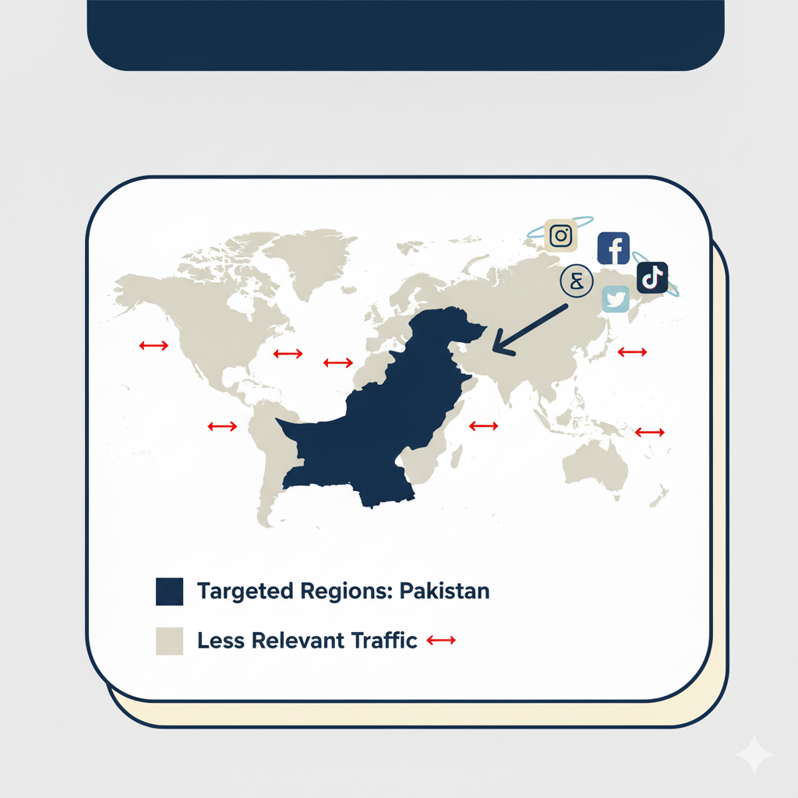
Target Audience & Marketing
Audience: University students & young adults, 18–35
Channels: Instagram, Facebook, Shopify
Problem: SEO failure → ranked in Maldives/Sri Lanka
Result: Real local audience couldn’t find the website

Slide 7
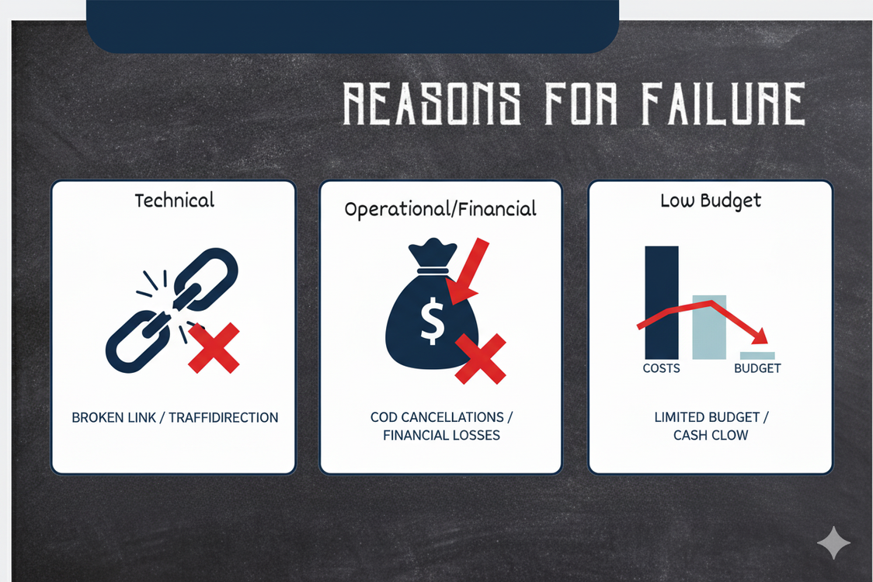
Why It Failed
Technical
Operational/Financial
Low Budget
SEO misdirected, irrelevant traffic pulls uninterested visitors to your site, wasting resources and hindering conversions.
Cash-on-delivery (COD) cancellations directly lead to repeated financial losses for the business.
A limited marketing budget and low brand awareness contribute to unsustainable cash flow.

Slide 8




How It Could Succeed
Technical: Geo-targeting + proper local SEO
Marketing: Focused Instagram/Facebook Ads, better visuals
Operations: Partial advance payment, new suppliers, small-batch inventory
Key lessons: Market validation, technical execution, risk management, resilience

Slide 9

Entrepreneurial Lessons Learned
Technical setup & payment strategy are critical
Failure = learning opportunity → refine, test, repeat
Idea works if execution aligns with target audience

Slide 10
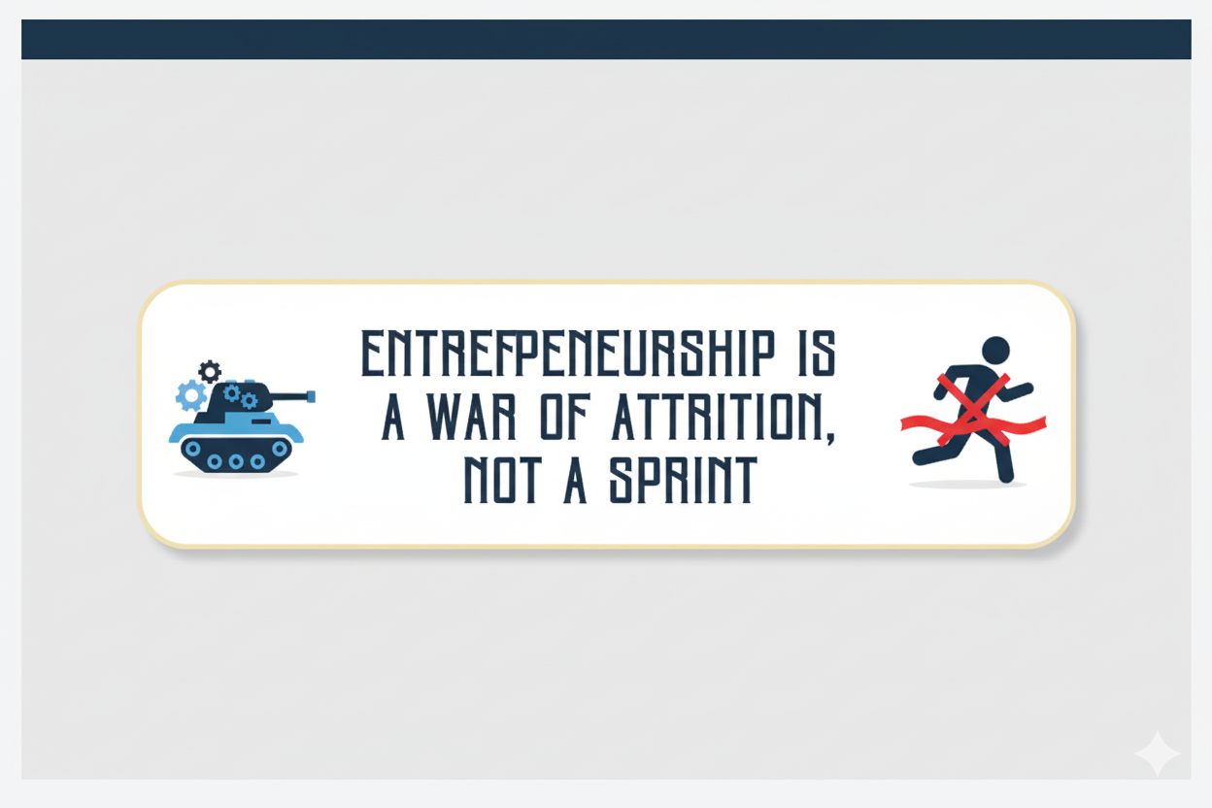

Slide 11


Time to Ask

Slide 12
Thank You

