Slide 1

Object Oriented Programming
Polymorphism
Lecture 13

Slide 2
Polymorphism
Polymorphism is an important concept of object- oriented programming. It simply means more than one form. That is, the same entity (function or operator) behaves differently in different scenarios.

Slide 3
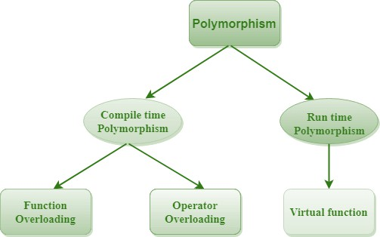

Slide 4
The overloaded functions are invoked by matching the type and number of arguments.
This information is available at the compile time and, therefore, compiler selects the appropriate function at the compile time.
It is achieved by function overloading and operator overloading which is also known as static binding or early binding.
Compile time polymorphism

Slide 5
Function Overloading
By Value
By Reference

Slide 6

By Reference
By Value
include<iostream> using namespace std; void func(int a)
{
a = 20;
cout << "Value of a: "<<a;
}
int main()
{
int x = 10;
func(x);
cout << "\nValue of x: " << x; return 0;
}
include<iostream> using namespace std; void func(int &a)
{
a = 20;
cout << "Value of a: "<<a;
}
int main()
{
int x = 10; func(x);
cout << "\nValue of x: " << x; return 0;
}

Slide 7
Operator Overloading
Unary
Binary
Use: Lecture 8 and 9

Slide 8
Runtime polymorphism
Run time polymorphism is achieved when the object's method is invoked at the run time instead of compile time.
It is achieved by method overriding which is also
known as dynamic binding or late binding.

Slide 9

that we expect to redefine in derived classes.
A virtual function is a member function in the base class
Virtual Functions
Basically, a virtual function is used in the base class in order to ensure that the function is overridden. This especially applies to cases where a pointer of base class points to an object of a derived class.

Slide 10
C++ Example
include<iostream> using namespace std; class A
{
public:
virtual void display()
{
cout << "I am a Base Class";
}
};
class B :public A
{
public:
void display()
{
cout << "I am a Derived Class";
}
};
int main()
{
A* ptr;
B obj;
ptr = &obj;
ptr->display(); return 0;
}

Slide 11
Activity
Create parent class Shapes with public data members width and height and function printarea() and a virtual function cal_area(). Create two sub classes Rectangle and Sqaure. In main() create 2 pointers of Shapes and assign Rectangle and Square to it. Call printarea function with the pointer objects.

Slide 12
Solution C++
#include<iostream> using namespace std; class Shapes
{
public:
int height, width;
Shapes() :height(10), width(20) {} virtual int cal_area()
{
return width * height;
}
void printarea()
{
cout <<cal_area()<<endl;
}
};
class Rectangle :public Shapes
{
public:
Rectangle() :Shapes()
{
height = 20;
width = 30;
}
int cal_area()
{
return width * height;
}
};
class Square :public Shapes
{
public:
Square():Shapes()
{
height = 30;
width = 30;
}
int cal_area()
{
return width * height;
}
};
int main()
{
Shapes* s1, * s2; Rectangle r;
Square s;
s1 = &r;
s2 = &s;
s1->cal_area(); s1->printarea(); s2->cal_area(); s2->printarea();
return 0;
}

Slide 13
Pure virtual functions are used:
if a function doesn't have any use in the base class
but the function must be implemented by all its derived classes
A pure virtual function doesn't have the function body
and it must end with = 0. For example,
Pure Virtual Functions
class Shape
{
public:
// creating a pure virtual function
virtual void calculateArea() = 0;
};

Slide 14
A class that contains a pure virtual function is known as an abstract class.
Abstract Class
We cannot create objects of an abstract class. However, we can derive classes from them, and use their data members and member functions (except pure virtual functions).

Slide 15
Code C++
#include<iostream> using namespace std; class Shapes
{
public:
int height, width;
Shapes() :height(10), width(20) {} virtual int cal_area() = 0{}
void printarea()
{
cout <<cal_area()<<endl;
}
};
class Rectangle :public Shapes
{
public:
Rectangle() :Shapes()
{
height = 20;
width = 30;
}
int cal_area()
{
return width * height;
}
};
class Square :public Shapes
{
public:
Square():Shapes()
{
height = 30;
width = 30;
}
int cal_area()
{
return width * height;
}
};
int main()
{
Shapes* s1, * s2; Rectangle r; Square s;
s1 = &r;
s2 = &s;
s1->cal_area(); s1->printarea(); s2->cal_area(); s2->printarea(); return 0;
}

