Slide 1
Object Oriented Programming
Templates
Lecture 15

Slide 2

Templates in C++ is an interesting feature that is used
for generic programming.
Templates
Generic Programming is an approach of programming where generic types are used as parameters in algorithms to work for a variety of data types.
Templates in C++ is defined as a blueprint or formula for creating a generic class or a function.
To simply put, you can create a single function or single class to work with different data types using templates.

Slide 3
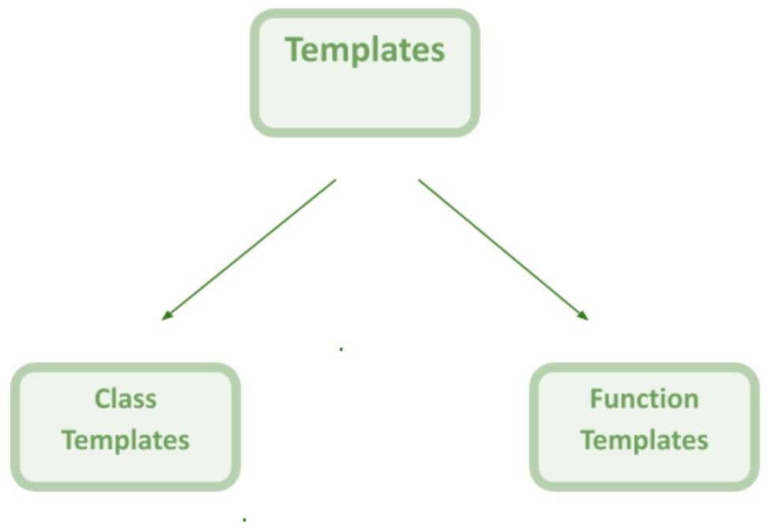

Slide 4
Function template in C++ is a single function template that works with multiple data types simultaneously, but a standard function works only with one set of data types.
Function Templates
Syntax:
//typename/class are the keywords you can use anyone of them at a time.
template <typename/class T>
T functionName(T parameter1, T parameter2, ...)
{ // code }

Slide 5





nclude<ostream> us ng namespace std;
template<class T> T add(T a, T b)
{
return a + b;
}
nt ma n()
{
nt ans = add< nt>(20, 12);
double ans2 = add<double>(12.3, 34.3); cout << "Integer Addt on: " << ans;
cout << endl << "Double Addton: " << ans2;
}

Slide 6
nclude<ostream>
us ng namespace std;
template<class T1,class T2>
nt add(T1 a, T2 b)
{
return a + b;
}
nt ma n()
{
nt ans = add< nt, nt>(20, 12);
double ans2 = add<double, nt>(12.3, 34);
cout << "Integer Addt on: " << ans;
cout << endl << "Double Addton: " << ans2;
}

Slide 7
nclude<ostream> us ng namespace std;
template<class T>
vo d func(T &a)
{
a = 30.4;
cout << a;
}
nt ma n()
{
double x = 20.5;
func< double>(x);
cout << " " << x;
}

Slide 8
nclude<ostream> us ng namespace std;
template<class T> vo d func(T *a)
{
cout << *a;
}
nt ma n()
{
nt x = 20;
func <int>(&x); cout << " " << x;
}

Slide 9
The class template in c++ is like function templates. They are known as generic templates. They define a family of classes in C++.
Class Templates
Syntax:
template<class Ttype>
class class_name
{
//class body;
}

Slide 10
nclude<ostream> us ng namespace std; template<class T>
class Numbers
{
T num;
publ c:
Numbers(T a):num(a){} vo d d splay()
{
cout << "Value: " << num;
}
};
nt ma n()
{
Numbers< nt> n1(20);
n1.d splay();
}

