Slide 1
Class Diagram - UML

Slide 2
UML Diagrams
Unified Modeling Language (UML) is a general-purpose modeling language.
The main aim of UML is to define a standard way to visualize the way a system has been designed.
It is quite similar to blueprints used in other fields of engineering.
UML is not a programming language, it is rather a visual language.

Slide 3
Why We need UML?
We need UML (Unified Modeling Language) to visually represent and communicate complex system designs, facilitating better understanding and collaboration among stakeholders.
Complex applications need collaboration and planning from multiple teams and hence require a clear and concise way to communicate amongst them.
Businessmen do not understand code. So UML becomes essential to communicate with non-programmers about essential requirements, functionalities, and processes of the system.
A lot of time is saved down the line when teams can visualize processes, user interactions, and the static structure of the system.

Slide 4
Types of UML Diagram
Structural Diagram
Behavioral Diagram

Slide 5
Class Diagram
A UML class diagram is a visual tool that represents the structure of a system by showing its classes, attributes, methods, and the relationships between them.
Class diagrams are a type of UML (Unified Modeling Language) diagram used in software engineering to visually represent the structure and relationships of classes within a system i.e. used to construct and visualize object-oriented systems.
In these diagrams, classes are depicted as boxes, each containing three compartments for the class name, attributes, and methods. Lines connecting classes illustrate associations, showing relationships such as one-to-one or one-to-many.

Slide 6
Class Diagram
Class diagrams provide a high-level overview of a system’s design, helping to communicate and document the structure of the software.
They are a fundamental tool in object-oriented design and play a crucial role in the software development lifecycle.

Slide 7
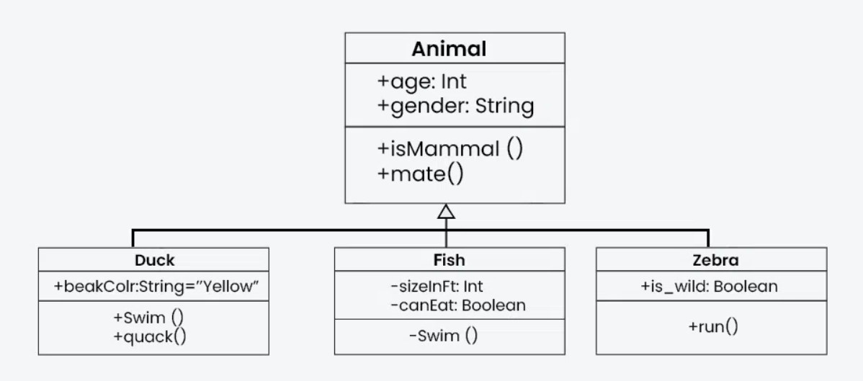
Class Diagram

Slide 8
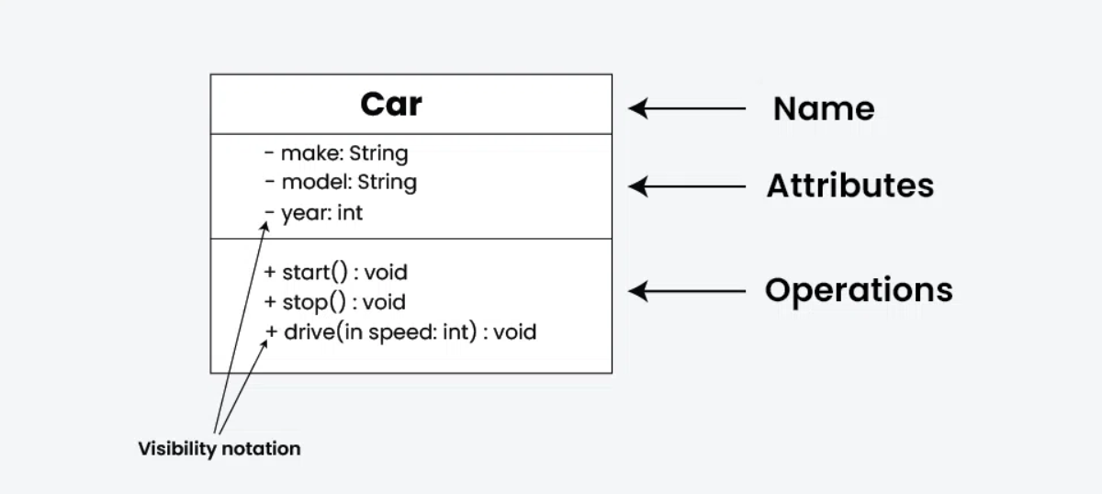
UML Class Notation

Slide 9
UML Class Notation
Class Name:
The name of the class is typically written in the top compartment of the class box and is centered and bold.
Attributes:
Attributes, also known as properties or fields, represent the data members of the class. They are listed in the second compartment of the class box and often include the visibility (e.g., public, private) and the data type of each attribute.
Methods:
Methods, also known as functions or operations, represent the behavior or functionality of the class. They are listed in the third compartment of the class box and include the visibility (e.g., public, private), return type, and parameters of each method.

Slide 10
UML Class Notation
Visibility Notation:
Visibility notations indicate the access level of attributes and methods. Common visibility notations include:
+ for public (visible to all classes)
- for private (visible only within the class)
# for protected (visible to subclasses)
~ for package or default visibility (visible to classes in the same package)

Slide 11
Parameter Directionality
In class diagrams, parameter directionality refers to the indication of the flow of information between classes through method parameters.
It helps to specify whether a parameter is an input, an output, or both. This information is crucial for understanding how data is passed between objects during method calls.

Slide 12
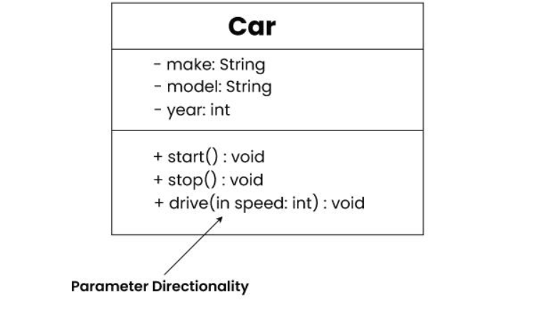
Parameter Directionality

Slide 13
Parameter Directionality
In (Input):
An input parameter is a parameter passed from the calling object (client) to the called object (server) during a method invocation.
It is represented by an arrow pointing towards the receiving class (the class that owns the method).
Out (Output):
An output parameter is a parameter passed from the called object (server) back to the calling object (client) after the method execution.
It is represented by an arrow pointing away from the receiving class.
InOut (Input and Output):
An InOut parameter serves as both input and output. It carries information from the calling object to the called object and vice versa.
It is represented by an arrow pointing towards and away from the receiving class.

Slide 14
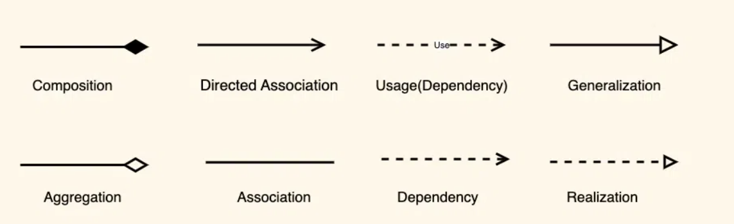
Relationships between classes
In class diagrams, relationships between classes describe how classes are connected or interact with each other within a system.
There are several types of relationships in object-oriented modeling, each serving a specific purpose.

Slide 15
Association
An association represents a bi-directional relationship between two classes. It indicates that instances of one class are connected to instances of another class. Associations are typically depicted as a solid line connecting the classes, with optional arrows indicating the direction of the relationship.

Slide 16
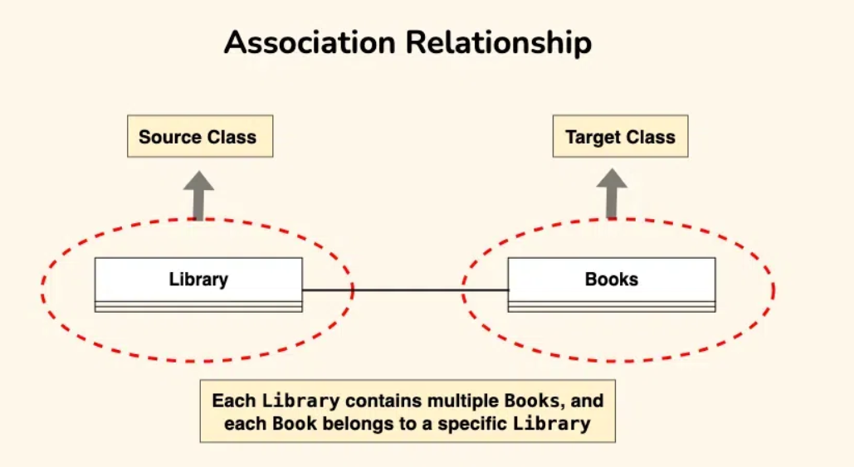
Association

Slide 17
Aggregation
Aggregation is a specialized form of association that represents a “whole-part” relationship. It denotes a stronger relationship where one class (the whole) contains or is composed of another class (the part).
Aggregation is represented by a diamond shape on the side of the whole class.
In this kind of relationship, the child class can exist independently of its parent class.

Slide 18
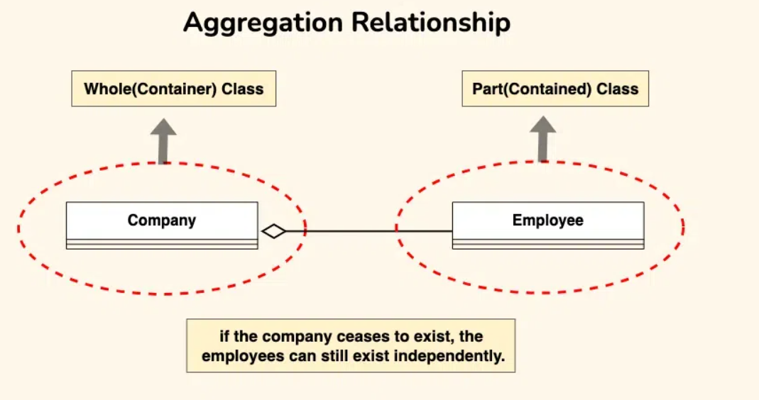
Aggregation

Slide 19
Composition
Composition is a stronger form of aggregation, indicating a more significant ownership or dependency relationship.
In composition, the part class cannot exist independently of the whole class.
Composition is represented by a filled diamond shape on the side of the whole class.

Slide 20
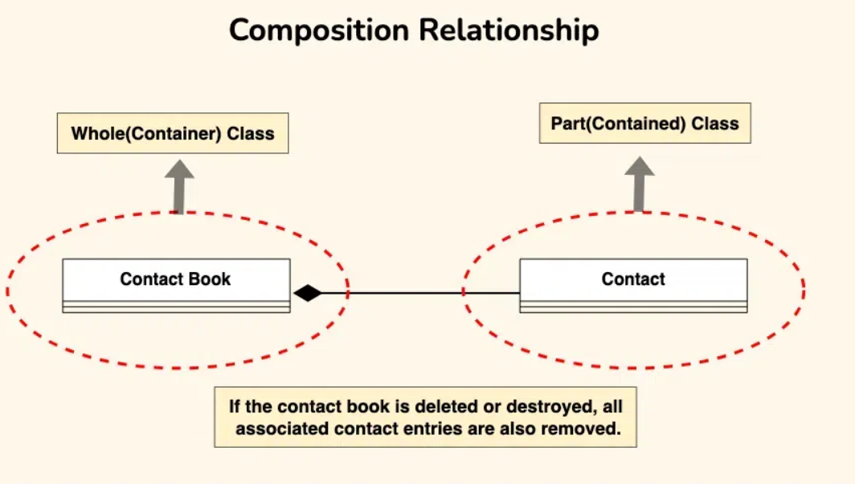
Composition

