Slide 1
OOP

Slide 2
Contents
Passing objects as arguments
Returning Objects
Copy Constructor vs Member-wise Copy
Deep copy vs Shallow Copy
The this Pointer

Slide 3
Passing Objects as Arguments
In C++ we can pass class’s objects as arguments and also return them from a function the same way we pass and return other variables.
No special keyword or header file is required to do so.

Slide 4
#include <iostream>
using namespace std;
class Student {
public:
double marks;
Student(double m): marks{m} {}
};
double average_marks(Student s1, Student s2) {
return (s1.marks + s2.marks)/2 ;
}
int main() {
Student student1(88.0), student2(56.0);
cout << "Average Marks = " << average_marks(student1, student2) << "\n";
return 0;
}

Slide 5
Return Object from a Function
#include <iostream>
using namespace std;
class Student {
public:
double marks1, marks2;
};
Student createStudent() {
Student student;
student.marks1 = 96.5;
student.marks2 = 75.0;
cout << "Marks 1 = " << student.marks1 << endl;
cout << "Marks 2 = " << student.marks2 << endl;
return student;
}
int main() {
Student student1;
student1 = createStudent();
return 0;
}

Slide 6
Copy Constructor
A copy constructor is a type of constructor that initializes an object using another object of the same class.
In simple terms, a constructor which creates an object by initializing it with an object of the same class, which has been created previously is known as a copy constructor.

Slide 7
#include <iostream>
using namespace std;
class Wall {
private:
double length;
double height;
public:
Wall(double len, double hgt)
: length{len}
, height{hgt} { }
Wall(const Wall& obj)
: length{obj.length}
, height{obj.height} { }
double calculateArea() { return length * height; }};
int main() {
Wall wall1(10.5, 8.6);
Wall wall2 = wall1;
cout << "Area of Wall 1: " << wall1.calculateArea() << endl;
cout << "Area of Wall 2: " << wall2.calculateArea();
return 0;

Slide 8
Shallow Copy and Deep Copy
creating a copy of an object means to create an exact replica of the object having the same literal value,
data type, and resources.
There are two ways that are used by C++ compiler to create a copy of objects.
-Copy Constructor
-Assignment Operator
// Copy Constructor Geeks Obj1(Obj); or Geeks Obj1 = Obj; // Default assignment operator Geeks Obj2; Obj2 = Obj1;

Slide 9
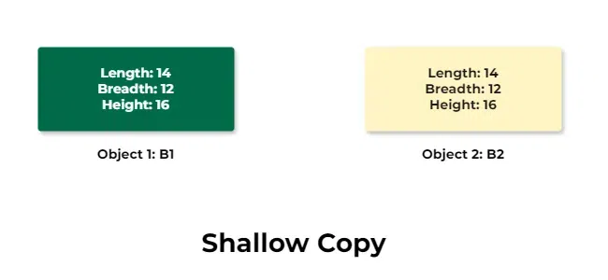
Shallow Copy
In shallow copy, an object is created by simply copying the data of all variables of the original object.

Slide 10
Shallow Copy
This works well if none of the variables of the object are defined in the heap section of memory.
but if some variables are dynamically allocated memory from heap section,then the copied object variable will also reference the same memory location.This will create ambiguity and run-time errors, dangling pointer.
Since both objects will reference to the same memory location, then change made by one will reflect those change in another object as well.
Since we wanted to create a replica of the object, this purpose will not be filled by Shallow copy.

Slide 11
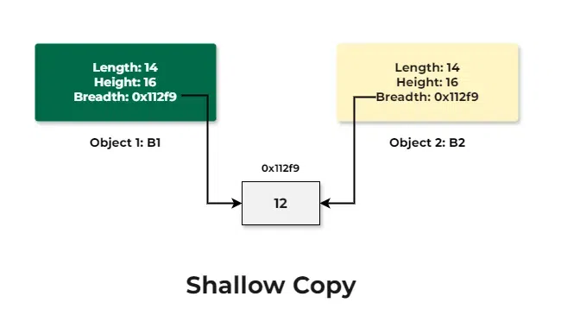
Now imagine one of the members is a pointer to the integer variable. Here, the shallow copy will only copy the address stored in the pointer leading both the object member pointing to the same object.

Slide 12
What is Deep Copy?
In Deep copy, an object is created by copying data of all variables, and it also allocates similar memory resources with the same value to the object.
In order to perform Deep copy, we need to explicitly define the copy constructor and assign dynamic memory as well, if required.
Also, it is required to dynamically allocate memory to the variables in the other constructors, as well.

Slide 13
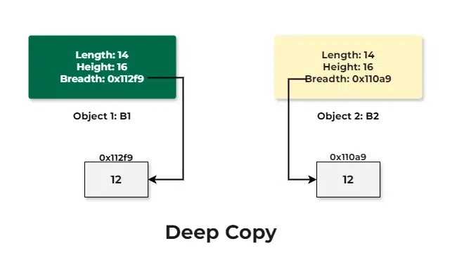
Consider the previous example again. If we deep copy the object, then each object will have their own copy of the data pointed by the breadth pointer.

Slide 14
int main() { box first; first.set_dimension(12, 14, 16); first.show_data(); // When the data will be copied then // all the resources will also get // allocated to the new object box second = first; // Display the dimensions second.show_data(); return 0; }
#include <iostream>
using namespace std;
// Box Class
class box {
private:
int length;
int* breadth;
int height;
public:
box()
{breadth = new int;
}
void set_dimension(int len, int brea,int heig)
{
length = len;
*breadth = brea;
height = heig;
}
void show_data()
{
cout << " Length = " << length
<< "\n Breadth = " << *breadth
<< "\n Height = " << height
<< endl;
}
// Parameterized Constructors for
// for implementing deep copy
box(box& sample)
{
length = sample.length;
breadth = new int;
*breadth = *(sample.breadth);
height = sample.height;
}
~box()
{
delete breadth;
}
};

Slide 15
Difference between the Shallow Copy and Deep Copy
No. | Shallow Copy | Deep copy
1. | When we create a copy of object by copying data of all member variables as it is, then it is called shallow copy | When we create an object by copying data of another object along with the values of memory resources that reside outside the object, then it is called a deep copy
2. | A shallow copy of an object copies all of the member field values. | Deep copy is performed by implementing our own copy constructor.
3. | In shallow copy, the two objects are not independent | It copies all fields, and makes copies of dynamically allocated memory pointed to by the fields
4. | It also creates a copy of the dynamically allocated objects | If we do not create the deep copy in a rightful way then the copy will point to the original, with disastrous consequences.

Slide 16
this’ pointer in C++
To understand ‘this’ pointer, it is important to know how objects look at functions and data members of a class.
Each object gets its own copy of the data member.
All-access the same function definition as present in the code segment.

Slide 17
each object gets its own copy of data members and all objects share a single copy of member functions.
Then now question is that if only one copy of each member function exists and is used by multiple objects, how are the proper data members are accessed and updated?
The compiler supplies an implicit pointer along with the names of the functions as ‘this’.
The ‘this’ pointer is passed as a hidden argument to all nonstatic member function calls and is available as a local variable within the body of all nonstatic functions.
‘this’ pointer is not available in static member functions as static member functions can be called without any object (with class name).

Slide 18
#include<iostream>
using namespace std;
class Test
{
private:
int x;
public:
void setX (int x)
{
// The 'this' pointer is used to retrieve the object's x
// hidden by the local variable 'x'
this->x = x;
}
void print() { cout << "x = " << x << endl; }
};
int main()
{
Test obj;
int x = 20;
obj.setX(x);
obj.print();
return 0;
}

