Slide 1
OPERATOR
OVERLOADING

Slide 2
OVERLOADING
C++ allows you to specify more than one definition for a function name or an operator in the same scope, which is called function overloading and operator overloading, respectively.
An overloaded declaration is a declaration that is declared with the same name as a previously declared declaration in the same scope, except that both declarations have different arguments and obviously different definition (implementation).

Slide 3
OPERATORS
3
Binary (+,-,*,/,%,>,<,+=,-=,*= etc)
Unary (++, --, -)
Ternary (?,:,:: )

Slide 4
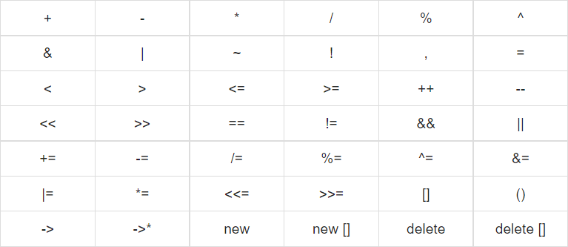



Slide 5
WHY OPERATOR LOADING IN OOP
The purpose of operator overloading is to provide a
special meaning of an operator for a user-defined data type.
With the help of operator overloading, you can redefine most of the C++ operators.
You can also use operator overloading to perform different
operations using one operator.
With class objects you can not use operators without
overloading them.

Slide 6
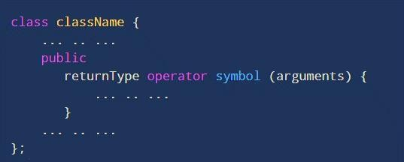
SYNTAX
returnType is the return type of the function.
operator is a keyword.
symbol is the operator we want to overload. Like: +, <, -, ++, etc.
arguments is the arguments passed to the function.

Slide 7
Unary operators operate on only one operand.
Prefix and Postfix increment examples of unary operator
--obj
obj++
Unary Operator Overloading
and decrement are the

Slide 8
class Increment
{
int i; public:
Increment(int void operator { | a):i(a){} ++()
i = ++i; } |  | Output:
void operator { | ++(int) | Value: 11 Value: 12
i = i++;
}
void display()
{
cout << "Value:
}
int main()
{
Increment obj(10); obj++; obj.display();
" << i << endl;
};
++obj; obj.display();
}

Slide 9
class Increment
{
int i; public:
Increment(int a):i(a){}
Increment operator { | ++()
i = ++i; return i; |  |  |  |  | Output:
} Increment operator | ++(int) |  |  |  | Value: 11 Value: 12
{
i = i++; return i; } void display() { cout << "Value: |  |  |  |  | int { | main() Increment obj(10); obj++; obj.display();
 | " | << | i | << | endl;
}
};
++obj; obj.display();
}

Slide 10
Converts the number into negative value.
class Increment
{
int i;
public:
Increment(int a):i(a){}
Increment operator - (){
i = -i;
return i;
}
void display(){
cout << "Value: " << i << endl;
}
};
int main()
{
Increment obj(10);
-obj; obj.display();
}
Unary (-)

Slide 11
Binary operators work on two operands.
result = a+ b;
Here, + is a binary operator that works on the
operands a and b
Binary Operators

Slide 12

CLASS CALCULATOR
{
int i,j; public:
Calculator(int a,int b):i(a),j(b){}
int operator +(Calculator c)
{
i = c.i + c.j; return i;
}
void display()
{
cout << “Sum: " << i << endl;
}
};
Output:
Sum: 51
int main()
{
Calculator obj1(11,40);
int ans;
ans = obj1 + obj1: obj1.display();
}

Slide 13
class Calculator
{
int i,j; public:
Calculator():i(0),j(0){}
Calculator(int a,int b):i(a),j(b){}
using & makes our code efficient by referencing
the Calculator object instead of making a duplicate object inside the operator function
Calculator operator +(Calculator | &c)
{ Calculator temp; | Output:
temp.i = i + c.i; | Sum: 31 107
temp.j = j + c.j;
return temp;
}
void display()
{
cout << "Sum: " << i << " " << j << endl;
}
int main()
{
Calculator obj1(11, 40), obj2(20, 67), ans; ans = obj1 + obj2;
ans.display();
}
};

Slide 14
USING CONST IS CONSIDERED A GOOD PRACTICE BECAUSE IT PREVENTS THE OPERATOR FUNCTION FROM MODIFYING CALCULATOR.
class Calculator
{
int i,j; public:
Calculator():i(0),j(0){}
Calculator(int a,int b):i(a),j(b){} Calculator operator +(const Calculator &c)
{
Calculator temp; temp.i = i + c.i; temp.j = j + c.j; return temp;
}
void display()
{
cout << "Sum: " << i << " " << j << endl;
}
};
Output:
Sum: 31 107
int main()
{
Calculator obj1(11, 40), obj2(20, 67), ans; ans = obj1 + obj2;
ans.display();
}

Slide 15
class Calculator
{
int i,j; public:
Calculator():i(0),j(0){}
Calculator(int a,int b):i(a),j(b){}
Calculator operator -(Calculator | &c)
{ Calculator temp; | Output:
temp.i = i - c.i; | Sum: -9 -27
temp.j = j - c.j;
return temp;
}
void display()
{
cout << "Sum: " << i << " " << j << endl;
}
int main()
{
Calculator obj1(11, 40), obj2(20, 67), ans; ans = obj1 - obj2;
ans.display();
}
};

Slide 16
DISTANCE CLASS
EXAMPLE
Operators: +,-,/,*,>,<,>=,<=,=,+=

Slide 17
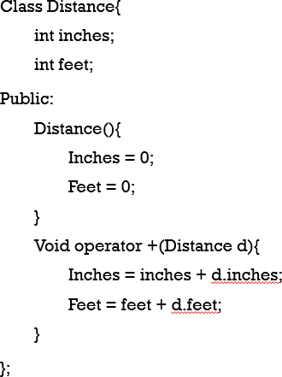
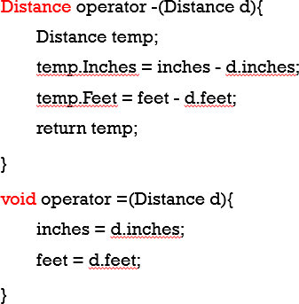

Slide 18
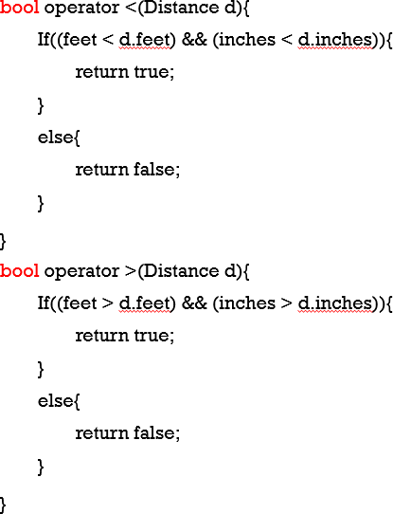
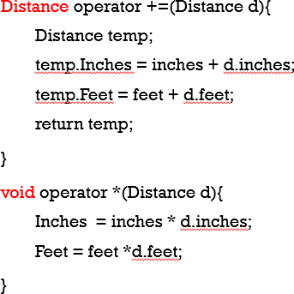

Slide 19
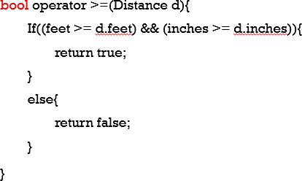
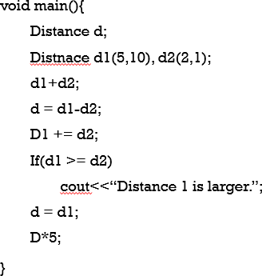

Slide 20
Stream Insertion and Extraction
Operators: <<, >>
Used to input and output user-defined objects.
Example: Overloading '<<' to display object details.

Slide 21
#include<iostream>
using namespace std;
class Complex {
int real;
char imag;
public:
Complex() {
real = 0;
imag = 'i';}
Complex(int r, char i) : real(r), imag(i) {}
// Overload >> (stream extraction operator) for input
friend istream& operator>>(istream& in, Complex& c) {
cout << "Enter real part: ";
in >> c.real;
cout << "Enter imaginary part: ";
in >> c.imag;
return in; // Allow chaining}
// Overload << (stream insertion operator) for output
friend ostream& operator<<(ostream& out, const Complex& c) {
out << c.real << c.imag;
return out; // Allow chaining
}};
int main()
{
Complex c1, c2(2, 'i');
cin >> c1;
cout << c1 <<endl;
cout << c2;
system("pause");
return 0;
}

