Slide 1
Association, Aggregation and Composition

Slide 2
Association
Association defines the connection between two classes that are set up through their objects.
Association manages one-to-one, one-to-many, and many-to-many relationships. the multiplicity between objects is defined by the Association.
It shows how objects communicate with each other and how they use the functionality and services provided by that communicated object.
Association manages one-to-one, one-to-many, many-to-one and many-to-many relationships.

Slide 3
Types
A person can have only one passport. It defines the one-to-one
If we talk about the Association between a College and Student, a College can have many students. It defines the one-to-many
A state can have several cities, and those cities are related to that single state. It defines the many-to-one
A single student can associate with multiple teachers, and multiple students can also be associated with a single teacher. Both are created or deleted independently, so it defines the many-to-many

Slide 4
Example of Association
class Bank { public: void transferMoney(Account* fromAccount, Account* toAccount, double amount) { // Code to transfer money from one account to another } }; class Account { public: Account(int id, double balance) : id(id), balance(balance) {} int getId() { return id; } double getBalance() { return balance; } private: int id; double balance; }; int main() { Account* account1 = new Account(123, 1000.00) Account* account2 = new Account(456, 500.00); Bank bank; bank.transferMoney(account1, account2, 250.00); return 0; }

Slide 5
nclu de<ios t r e am>
nclude<strng>
us ng names pace s td;
c l a s s Department
{
c l a s s Teacher
{
s t r ng name;
name;
publ c :
publ
c :
Department( strng n )
{
Teacher( str ng n )
{
th s->name = n ;
th s->name = n ;
}
}
s t r ng getDepartmentname()
{
s t r ng getTeachername()
{
return ths->name;
return ths->name;
}
}
};
};
two separate classes Teacher and Department are associated through their Objects. A Department can have many Teachers, So it is a one-to- many relationship.
nt ma n()
Teacher t( " A L I " ); Depart men t d (" C S " );
cout << t . ge tTeacher n ame( )
{
<< " s from " << d.getDepartmentname()
<< " department";
}

Slide 6
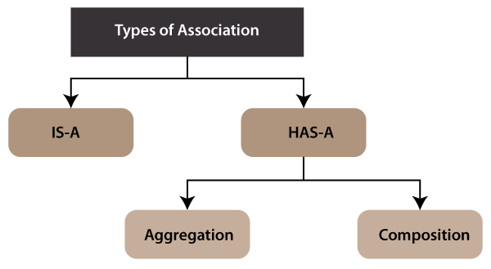

Slide 7
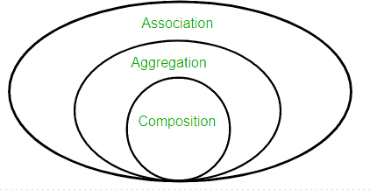

Slide 8
1) IS-A Association
The IS-A Association is also referred to as Inheritance.
2) HAS-A Association
The HAS-A Association is further classified into two parts, i.e., Aggregation and Composition.

Slide 9
Aggregation
the Aggregation association defines the HAS-A relationship.
Aggregation follows the one-to-one or one-way relationship.
If two entities are in the aggregation composition, and one entity fails due to some error, it will not affect the other entity.

Slide 10
Example
Let's take the example of a toy and its battery. The battery belongs to a toy, and if the toy breaks and deletes from our database, the battery will still remaining in our database, and it may still be working. So in Aggregation, objects always have their own lifecycles when the ownership exists there.

Slide 11
It is a unidirectional association i.e. a one-way relationship. For example, a department can have students but vice versa is not possible and thus unidirectional in nature.
In Aggregation, both the entries can survive individually which means ending one entity will not affect the other entity.

Slide 12
Department
Teacher

Slide 13
Aggregation is a relationship between two classes in which one class, known as the aggregate class, contains a pointer or reference to an object of another class, known as the component class. The component class can exist independently of the aggregate class, and it can be shared by multiple aggregate classes. In other words, the lifetime of the component class is not controlled by the aggregate class.

Slide 14
class Person { public: Person(std::string name) : name(name), address(nullptr) {} void setAddress(Address* address) { this->address = address; } private: std::string name; Address* address; }; class Address { public: Address(std::string street, std::string city, std::string state, std::string zip) : street(street), city(city), state(state), zip(zip) {} private: std::string street; std::string city; std::string state; std::string zip; }; int main() { Address* address = new Address("123 Main St.", "Anytown", "CA", "12345"); Person person("John Doe"); person.setAddress(address); return 0; }

Slide 15
nclude< ostream> nclude<str ng>
us ng namespace s t d ; c l a s s Teacher
{
s t r ng name;
publ c :
Teacher(){}
Te a c h e r ( s t r ng n )
{
th s->name = n ;
}
s t r ng getTeachername()
{
return th s->name;
c l a s s Department
{
s t r ng name; Teacher * t 1 ;
publ c :
Department(Teacher * t )
{
t1 = t ;
th s->name = " C S " ;
}
s t r ng getDepartmentname()
{
return th s->name;
}
~Department()
{
cout << "\nDepartment
}
}
~Teacher()
{
cout << "\ n Teacher
Destroyed" ;
Destroyed"; };
}
};
nt ma n()
{
Teacher t( " A L I " ); Department d ( & t ) ;
cout << t.getTeachername() << "
s from " << d.getDepartmentname() << " department";
}

Slide 16
Composition
A restricted form of the Aggregation where the entities are strongly dependent on each other.
Unlike Aggregation, Composition represents the part-of relationship.
When there is an aggregation between two entities, the aggregate object can exist without the other entity, but in the case of Composition, the composed object can't exist.

Slide 17
We create a class Mobile that contains variables, i.e., name, ram and rom.
We also create a class MobileStore that has a reference to refer to the list of mobiles.
A mobile store can have more than one mobile. So, if a mobile store is destroyed, then all mobiles within that particular mobile store will also be destroyed because mobiles cannot exist without a mobile store.
The relationship between the mobile store and mobiles is Composition.

Slide 18
Department
Teacher

Slide 19
Composition is a relationship between two classes in which one class, known as the composite class, contains an object of another class, known as the component class, as a member variable. The composite class owns the component class, and the component class cannot exist independently of the composite class. In other words, the lifetime of the component class is controlled by the composite class.

Slide 20
class Engine { public: void start() { // Code to start the engine } }; class Car { public: Car() : engine(new Engine()) {} void startCar() { engine->start(); } private: Engine* engine; }; int main() { Car car; car.startCar(); return 0; }

Slide 21
nclude< ostream> nclude<str ng>
us ng namespace s t d ; c l a s s Teacher
{
s t r ng name;
publ c :
Teacher(){}
Te a c h e r ( s t r ng n )
{
th s->name = n ;
}
s t r ng getTeachername()
{
return th s->name;
c l a s s Department
{
s t r ng name; Teacher t1;
publ c :
Department(Teacher t )
{
t1 = t ;
th s->name = " C S " ;
}
s t r ng getDepartmentname()
{
return th s->name;
}
~Department()
{
cout << "\nDepartment
}
}
~Teacher()
{
cout << "\ n Teacher
Destroyed" ;
Destroyed"; };
}
};
nt ma n()
{
Teacher t( " A L I " ); Department d ( t ) ;
cout << t.getTeachername() << "
s from " << d.getDepartmentname() << " department";
}

