Slide 1

C SC -210: Object Oriented Programming
Inheritance
Lecture 11 (Week 09 & 10)

Slide 2

The capability of a class to derive properties and characteristics from another class is called Inheritance. Inheritance is one of the most important feature of Object-Oriented Programming.
Sub Class: The class that inherits properties from another class is called Sub class or Derived Class.
Super Class: The class whose properties are inherited by sub class is called Base Class or Super class.
Inheritance

Slide 3
Single Class Inheritance
Hierarchal Class Inheritance
Multi-Level Class Inheritance
Multiple Class Inheritance
Hybrid Class Inheritance
Types of Inheritance

Slide 4


Single inheritance is defined as the inheritance in which a derived class is inherited from the only one base class.
Single Class

Slide 5
nclude<ostream>
us ng names pace s td; c l a s s Base
{
publ c :
Base()
{
cout << " Base
}
C l a s s " ;
};
c l a s s Sub Class : p u b l c Base
{
publ c :
Su b C la s s ( )
{
cout<<"\ n Sub
}
C l a s s "
};
nt ma n ( )
{
Sub Class
ob j ;
}

Slide 6
nclude<ostream>
us ng names pace s td; c l a s s A
{
nt a, b;
c :
publ
A ( ) : a ( 1 0 ) , b ( 2 0 ) { }
nt add()
{
return a + b;
nt ma n()
{
}
B ob j ;
obj . dspla y( ) ;
};
c l a s s B : publ c A
{
publ c :
}
vo d d s p l a y ( )
{
cout << " A nswe r:
}
" << add ();
};

Slide 7
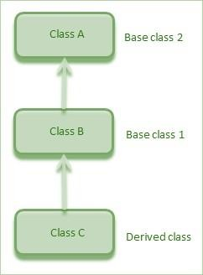
Multilevel inheritance is a process of deriving a class from another derived class.
Multi-Level Class

Slide 8
nclude<ostream>
us ng names pace s td;
c l a s s Base
{
publ c :
c l a ss SubCl a ss2 : publ c SubCla s s 1
{
publ c :
Base()
{
cout << " Base
}
Sub Class 2 ( )
{
C l a s s " ;
cout << " \ n Sub C l a s s 2" ;
};
}
c l a s s Sub Class 1 : publ c Base
{
publ c :
};
nt ma n ( )
{
Sub Class 1 ( )
{
cout << " \ nSub C la ss 1" ;
}
Sub Class 2
ob j ;
}
};

Slide 9
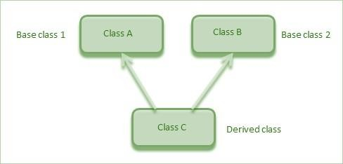
Multiple inheritance is the process of deriving a new class that inherits the attributes from two or more classes.
Multiple Class

Slide 10
nclude<ostream>
us ng names pace s td;
c l a s s Base1
{
publ c :
c l a s s Sub Class : p u b l c Base1,publ
{
publ c :
c Base2
Base 1 ()
{
cout << " Base C l a s s 1" ;
}
S u b C la s s ( )
{
cout << " \ n Sub
}
};
C l a s s " ;
c l a s s Base2
{
publ c :
};
nt ma n ( )
Base 2 ()
{
cout << " \ nBase Cla ss 2 " ;
}
{
Sub Class
obj;
}
};

Slide 11
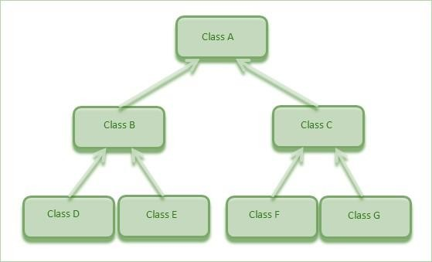
than one class from a base class.
Hierarchical inheritance is defined as the process of deriving more
Hierarchical Class

Slide 12
nclude<ostream>
us ng names pace s td;
c l a s s Base
{
publ c :
c l a s s Sub Class 2 : publ c Base
{
publ c :
Base()
{
cout << “\n Base C l a s s " ;
}
Sub Class 2 ( )
{
cout << " \ nSub C la ss 2" ;
}
};
c l a s s Sub Class 1 : publ c Base
{
publ c :
};
nt ma n ( )
{
Sub Class 1 ( )
{
cout << " \ nSub C la ss 1" ;
}
Sub Class 2
ob j ;
}
};

Slide 13
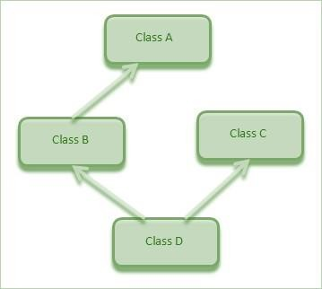
Hybrid inheritance is a combination of more than one type of
inheritance.
Hybrid Class

Slide 14
QUESTION 01
Write a program in which class A is base class for class B. While Class C is derived from class B and class D is derived from class
E. Provide explicit implementation of default constructors and destructors. Write a test program which initializes each class object and shows execution order of constructor and destructor by printing appropriate messages.

