Slide 1

AI Risks & Threat Landscape
Ethics, Security, and Legal Challenges in Intelligent Systems

Slide 2

Categories of Risk
Ethical
Reliability
Bias, dignity, and social impact
Errors, hallucinations, and validation
Security
Legal
Hacking, theft, and malicious use
Malpractice, fraud, and compliance

Slide 3

Bias and Discrimination
Core Mandate
Leadership Duty
Social Risk
"Be fair and take action not to discriminate"
Protect user dignity
Cyberstalking and unchecked harassment

Slide 4
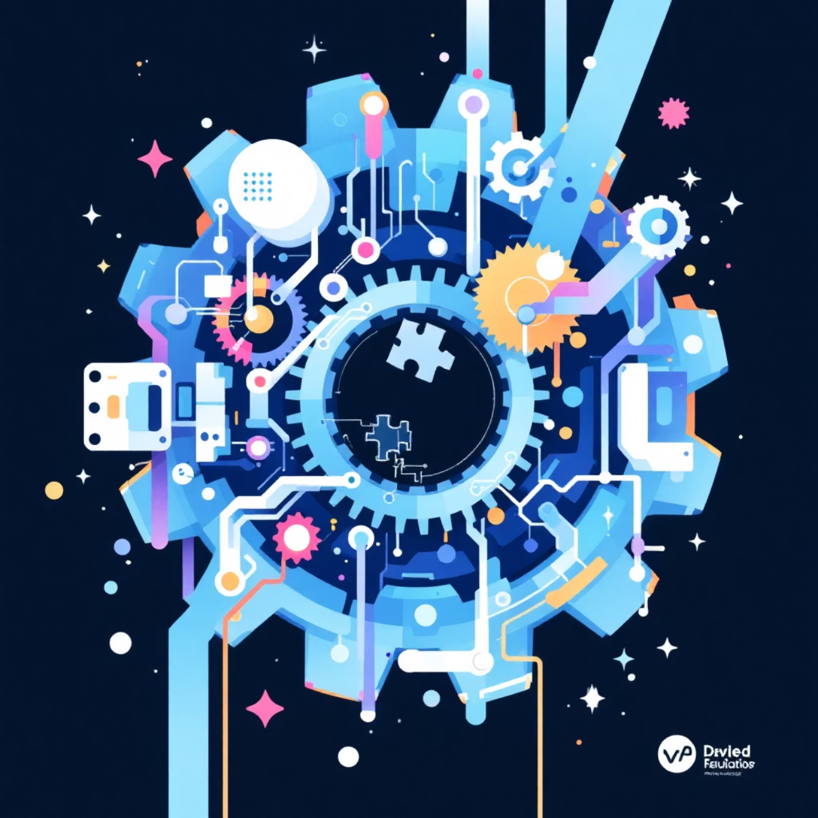
Unreliable Outputs & System Errors
Golden Rule
Requirement
Don't assume software is safe
Review, test, and validate
Transparency
Be honest about limitations

Slide 5

Data Privacy Risks
01
02
Confidentiality
Identity Theft
Obligation to protect sensitive data
Phishing and Pharming attacks
03
Misuse
Inappropriate sharing of corporate info

Slide 6




The AI Threat Landscape
Hacking
Unauthorized access and shutdowns
Theft
Stealing Model Weights (Trade Secrets)
Piracy
Illegal copying or access enabling

Slide 7

Consequences of Failure
Legal
Financial
Malpractice and Breach of Contract
Fraud and misrepresentation damages
1
2
3
Reputation
Whistle-blowing and public trust

