Slide 1
A GIFT OF FIRE THIRD EDITION SARA BAASE
Chapter 8: Errors, Failures, and Risks
SLIDES PREPARED BY CYNDI CHIE AND SARAH FRYE

Slide 2
WHAT WE WILL COVER
Failures and Errors in Computer Systems
Case Study: The Therac-25
Increasing Reliability and Safety
Dependence, Risk, and Progress

Slide 3
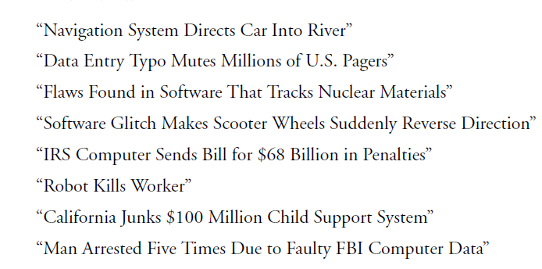
SOME EXAMPLES …

Slide 4
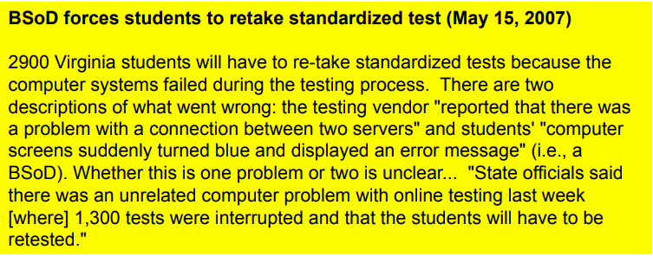

Slide 5
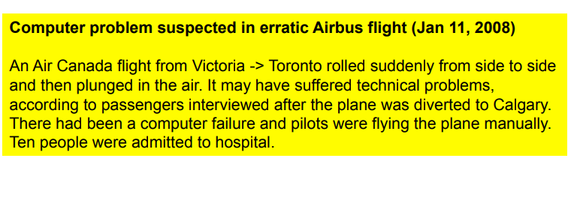

Slide 6
FAILURES AND ERRORS IN COMPUTER SYSTEMS
Computer applications are so complex it is virtually impossible to produce programs with no errors
The cause of failure is often more than one factor.

Slide 7
WHAT TO DO ?
Computer professionals must study failures to learn how to avoid them in future
Computer professionals must study failures to understand the impacts of poor work
Errors can be reduced by following good software development procedures

Slide 8
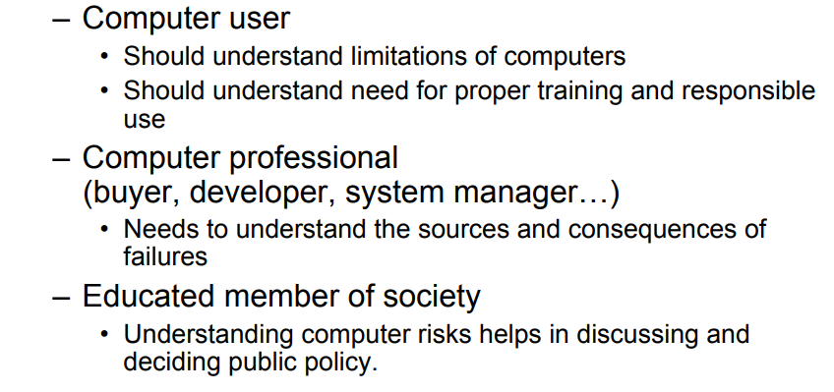
ROLES

Slide 9
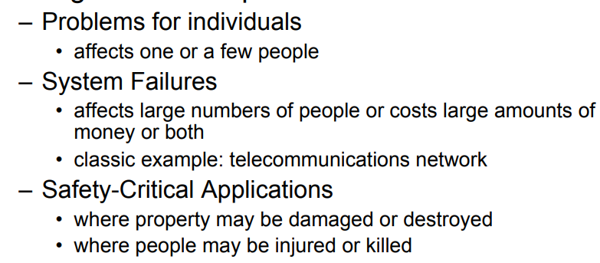
CATEGORIES OF ERRORS & FAILURES

Slide 10
1. PROBLEMS FOR INDIVIDUALS

Slide 11

1. PROBLEMS FOR INDIVIDUALS

Slide 12
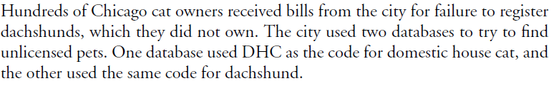
1. PROBLEMS FOR INDIVIDUALS

Slide 13
1. PROBLEMS FOR INDIVIDUALS
In one case, a county agency used the wrong middle name in a report to a credit bureau about a father who did not make his child-support payments. Another man in the same county had the exact name reported. He could not get credit to buy a car or a house.

Slide 14
1. PROBLEMS FOR INDIVIDUALS
A high school excluded a 14-year-old boy from football and some classes without explanation. He eventually learned that school officials thought he had been using drugs while in junior high school. The two schools used different disciplinary codes in their computerized records. The boy had been guilty of chewing gum and being late.
Both cases illustrate the problems of relying on computer systems without taking the responsibility of learning enough about them to use them properly

Slide 15
1. PROBLEMS FOR INDIVIDUALS
Terrorist attacks in 2001
The FBI gave a “watch list”
Many incorporated the list into their databases
some companies labeled the list “Suspected terrorists”
Many entries did not include date-of-birth, address, or other identifying information, making mistaken identifications likely
FBI stopped updating the list but did not tell the recipients

Slide 16
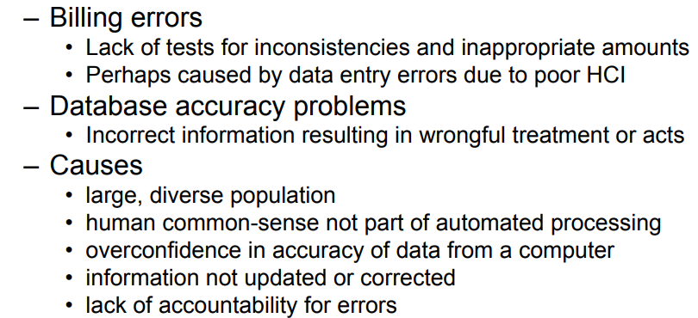
1. PROBLEMS FOR INDIVIDUALS

Slide 17
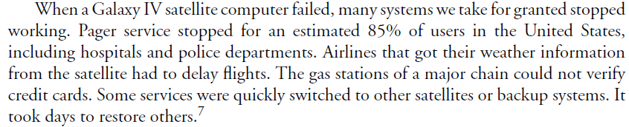
2. SYSTEM FAILURES

Slide 18
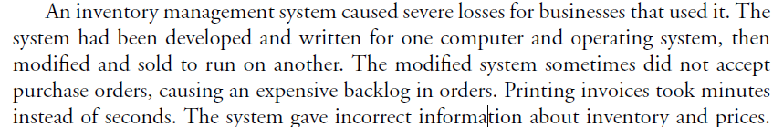
2. SYSTEM FAILURES

Slide 19
2. SYSTEM FAILURES
Voting Systems
In 2002, Congress passed the Help America Vote Act and authorized $3.8 billion to improve voting systems. By the 2006 elections, only a very small percentage of Americans voted with paper ballots. The rush to electronic voting machines demonstrated that they too could have numerous faults

Slide 20
2. SYSTEM FAILURES
Voting Systems
Some electronic voting systems just crashed-voters were unable to vote.
Machines in North Carolina failed to count more than 400 votes because of a technical problem.
One county lost more than 4000 votes because the machine’s memory was full.
A programming error generated 100,000 extra votes in one Texas county.
A programming error caused some candidates to receive votes actually cast for other candidates.

Slide 21
2. SYSTEM FAILURES
Voting Systems
Programmers or hackers can intentionally rig software to give inaccurate results.
One research group demonstrated a system’s vulnerability to a virus that essentially took over the machine and manipulated the vote results.
Programmers omitted basic procedures such as input validation and boundary checks.
There were certification standards for voting systems, but some flawed systems were certified; the standards were inadequate

Slide 22
2. SYSTEM FAILURES
Voting Systems – causes of Failures
lack of sufficient planning
Lack of thought about security issues
insufficient testing & insufficient training.
An underlying cause is haste. In projects like these, the desire of states to obtain federal grants encourages haste. The grants have short limits on how soon the states must spend the money.

Slide 23
2. SYSTEM FAILURES
Denver Airport
$3.2 billion Denver International Airport
It covers 53 square miles
computer-controlled baggage-handling system

Slide 24
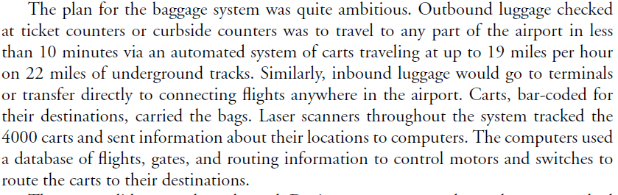
2. SYSTEM FAILURES
Denver Airport
$3.2 billion Denver International Airport
It covers 53 square miles
computer-controlled baggage-handling system

Slide 25
2. SYSTEM FAILURES
Denver Airport – failures
carts crashed into each other at track intersections.
The system misrouted, dumped, and flung luggage.
Carts needed to move luggage went by mistake to waiting pens.

Slide 26
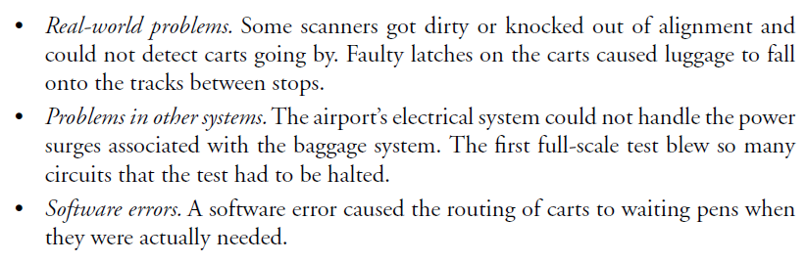
2. SYSTEM FAILURES
Denver Airport – failures
carts crashed into each other at track intersections.
The system misrouted, dumped, and flung luggage.
Carts needed to move luggage went by mistake to waiting pens.

Slide 27
2. SYSTEM FAILURES
Denver Airport – Causes
The time allowed for development and testing of the system was insufficient. (only 2 years)
Denver made significant changes in specifications after the project began. (was to serve United Airlines)

Slide 28
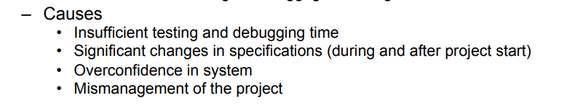
2. SYSTEM FAILURES

Slide 29
HIGH-LEVEL CAUSES OF COMPUTER-SYSTEM FAILURES
Lack of clear, well thought out goals and specifications
Poor management and poor communication among customers, designers, programmers, etc.
Pressures that encourage unrealistically low bids, low budget requests, and underestimates of time requirements
Use of very new technology, with unknown reliability and problems
Refusal to recognize or admit a project is in trouble

Slide 30
OTHER FACTORS
Class Activity

Slide 31
FAILURES AND ERRORS IN COMPUTER SYSTEMS (CONT.)
Safety-Critical Applications:
A-320: "fly-by-the-wire" airplanes (many systems are controlled by computers and not directly by the pilots)
Between 1988-1992 four planes crashed
Air traffic control is extremely complex, and includes computers on the ground at airports, devices in thousands of airplanes, radar, databases, communications, and so on - all of which must work in real time, tracking airplanes that move very fast
In spite of problems, computers and other technologies have made air travel safer

Slide 32
CASE STUDY: THE THERAC-25
Therac-25 Radiation Overdoses:
Massive overdoses of radiation were given; the machine said no dose had been administered at all
Caused severe and painful injuries and the death of three patients
Important to study to avoid repeating errors
Manufacturer, computer programmer, and hospitals/clinics all have some responsibility

Slide 33
CASE STUDY: THE THERAC-25 (CONT.)
Software and Design problems:
Re-used software from older systems, unaware of bugs in previous software
Weaknesses in design of operator interface
Inadequate test plan
Bugs in software
Allowed beam to deploy when table not in proper position
Ignored changes and corrections operators made at console

Slide 34
CASE STUDY: THE THERAC-25 (CONT.)
Why So Many Incidents?
Hospitals had never seen such massive overdoses before, were unsure of the cause
Manufacturer said the machine could not have caused the overdoses and no other incidents had been reported (which was untrue)
The manufacturer made changes to the turntable and claimed they had improved safety after the second accident. The changes did not correct any of the causes identified later

Slide 35
CASE STUDY: THE THERAC-25 (CONT.)
Why So Many Incidents? (cont.)
Recommendations were made for further changes to enhance safety; the manufacturer did not implement them
The FDA declared the machine defective after the fifth accident
The sixth accident occurred while the FDA was negotiating with the manufacturer on what changes were needed

Slide 36
CASE STUDY: THE THERAC-25 (CONT.)
Observations and Perspective:
Minor design and implementation errors usually occur in complex systems; they are to be expected
The problems in the Therac-25 case were not minor and suggest irresponsibility
Accidents occurred on other radiation treatment equipment without computer controls when the technicians:
Left a patient after treatment started to attend a party
Did not properly measure the radioactive drugs
Confused micro-curies and milli-curies

Slide 37
CASE STUDY: THE THERAC-25 DISCUSSION QUESTION
If you were a judge who had to assign responsibility in this case, how much responsibility would you assign to the programmer, the manufacturer, and the hospital or clinic using the machine?

Slide 38
REASONS FOR COMPUTER SYSTEM FAILURES
Job is difficult
Real time systems & humans
Software is Non linear
Job is done poorly
Can be done in system design, implementation, management or use.

Slide 39
WHAT GOES WRONG?
Computer systems fail for two general reasons: the job they are doing is inherently difficult, and sometimes the job is done poorly.
Several factors combine to make the task difficult. Computer systems interact with the real world (including both machinery and unpredictable humans), include complex communications networks, have numerous features and interconnected subsystems, and are extremely large.
Automobiles, passenger airplanes, and jet fighters contain millions of lines of computer code.
A smartphone has several millions of lines of code. Computer software is “nonlinear” in the sense that, whereas a small error in a mechanical system might cause a small degradation in performance, a single error in a computer program can cause a dramatic difference in behavior.

Slide 40
WHAT GOES WRONG?
Design and development problems
Management and use problems
Misrepresentation, hiding problems and inadequate response to reported problems
Insufficient market or legal incentives to do a better job
Re-use of software without sufficiently understanding the code and testing it
Failure to update or maintain a database

Slide 41
WHAT GOES WRONG?
Some factors in computer errors and system failures are:-
Design and development:
Inadequate attention to potential safety risks
Interaction with physical devices that do not work as expected
Incompatibility of software and hardware, or of application software and the operating system
Not planning and designing for unexpected inputs or circumstances
Confusing user interfaces
Insufficient testing
Reuse of software from another system without adequate checking
Overconfidence in software
Carelessness

Slide 42
WHAT GOES WRONG?
Some factors in computer errors and system failures are:-
Management and use:
Data-entry errors
Inadequate training of users
Errors in interpreting results or output
Failure to keep information in databases up to date
Overconfidence in software by users
Insufficient planning for failures; no backup systems or procedures
Misrepresentation, hiding problems; inadequate response to reported problems
Insufficient market or legal incentives to do a better job

Slide 43
INCREASING RELIABILITY AND SAFETY
Professional techniques
Law & Regulation
Professional licensing
Taking responsibility

Slide 44
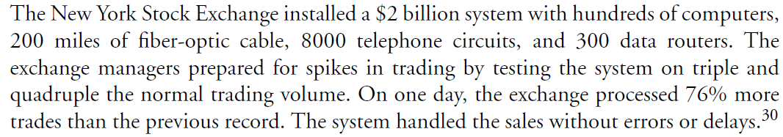
PROFESSIONAL TECHNIQUES

Slide 45
PROFESSIONAL TECHNIQUES
we must use good software engineering techniques at all stages:
development,
including specifications,
design,
implementation,
documentation, and
testing.
Both programmers and managers, have the responsibility to study and use the professional techniques and tools that are available and to follow the procedures and guidelines established in the various relevant codes of ethics and professional practices

Slide 46
PROFESSIONAL TECHNIQUES
1. Management and communication
high reliability organization (HRO) :
an organization (business or government) that operates in difficult environments, often with complex technology, where failures can have extreme consequences (for example, air traffic control, nuclear power plants).
There are few characteristics of HROs that perform extremely well.
These characteristics can improve software and computer systems in both critical and less critical applications.

Slide 47
PROFESSIONAL TECHNIQUES
a. preoccupation with failure
That means always assuming something unexpected can go wrong—not just planning, designing, and programming for all problems the team can foresee, but always being aware that they might miss something.
b. loose structure
It should be easy for a designer or programmer to speak to people in other departments or higher up in the company without going through rigid channels that discourage communication.
An atmosphere of open, honest communication within the organization and between a company and client are essential for learning of problems early and reducing the effort required to handle them.

Slide 48
PROFESSIONAL TECHNIQUES
2. Safety-Critical Application
Safety specialists emphasize that developers must “design in” safety from the start.
There are techniques of hazard analysis that help system designers identify risks and protect against them.
Software engineers who work on safety-critical applications should have special training.
Software expert Nancy Leveson :
“One lesson is that most accidents are not the result of unknown scientific principles but rather of a failure to apply well-known, standard engineering practices.”

Slide 49
PROFESSIONAL TECHNIQUES
2. Safety-Critical Application
For the ethical decision maker, the policy should be to suspend or delay use of the system in the absence of a convincing case for safety, rather than to proceed in the absence of a convincing case for disaster.

Slide 50
PROFESSIONAL TECHNIQUES
3. Specifications
Companies that do well expend extensive effort to learn the needs of the client and to understand how the client will use the system.
Good software developers help clients better understand their own goals and requirements, which the clients might not be good at articulating.
The long planning stage allows for discovering and modifying unrealistic goals.

Slide 51
PROFESSIONAL TECHNIQUES
3. Specifications
One company that developed a successful financial system that processes one trillion dollars in transactions per day spent several years developing specifications for the system, then only six months programming, followed by carefully designed, extensive testing.

Slide 52
PROFESSIONAL TECHNIQUES
4. User interfaces and human factors
If you are editing a document and you try to quit without saving your changes, what happens?
The designers of the programs know that people forget or sometimes click or type the wrong command. This is a simple and common example of considering human factors in designing software—one that has avoided personal calamities for millions of people.

Slide 53
PROFESSIONAL TECHNIQUES
4. User interfaces and human factors
System designers and programmers need to learn from psychologists and human-factors experts who know principles and practices for doing a good job.

Slide 54
PROFESSIONAL TECHNIQUES
4. User interfaces and human factors
What a good interface should be like ?
Should provide clear instructions
Clear error messages
They should be consistent
They should include appropriate checking of input to reduce major system failures caused by typos or other errors a person will likely make.

Slide 55
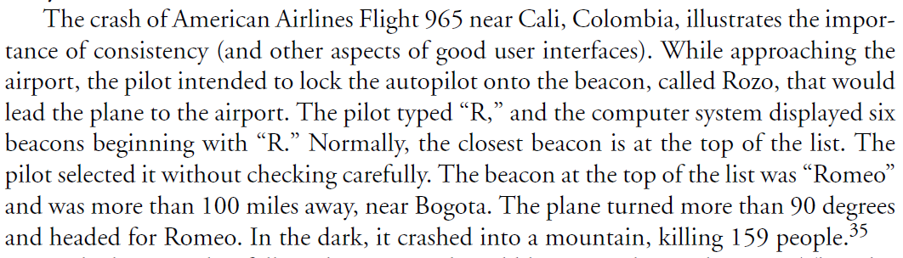
PROFESSIONAL TECHNIQUES
4. User interfaces and human factors

Slide 56
PROFESSIONAL TECHNIQUES
5. Redundancy and self-checking
Redundancy and self-checking are two techniques important in systems on which lives and fortunes depend.
On aircraft, several computers can control an actuator on, say, a wing flap. If one computer fails, another can do the job.
Software modules can check their own results—either against a standard or by computing the same thing in two different ways and then comparing to see if the two results match.

Slide 57
PROFESSIONAL TECHNIQUES
6. Testing
It is difficult to overemphasize the importance of adequate, well-designed testing of software.
Testing is not arbitrary. There are principles and techniques for doing a good job.
Many significant computer system failures in previously working systems occurred soon after installation of an update or upgrade.
Even small changes need thorough testing.

Slide 58
PROFESSIONAL TECHNIQUES
6.Testing
A practice called independent verification and validation (IV&V) can be very useful in finding errors in software systems.
IV&V means that an independent company (that is, not the one that developed the program and not the customer) tests and validates the software.
Testing and verification by an independent organization is not practical for all projects, but many software developers have their own testing teams that are independent of the programmers who develop a system.

Slide 59
LAW & REGULATION
Criminal and civil penalties
Legal remedies for faulty systems include suits against the company that developed or sold the system and criminal charges when fraud or criminal negligence occurs.
Families of Therac-25 victims sued; they settled out of court.
A bank won a large judgment against a software company for a faulty financial system that caused problems a user described as “catastrophic.”
Several people have won large judgments against credit bureaus for incorrect data in credit reports that caused havoc in their lives.

Slide 60
LAW & REGULATION
Regulation and safety-critical applications
Is there legislation or regulation that can prevent life-threatening computer failures?
A law saying that a radiation machine should not overdose a patient would be silly. We know that it should not do that.
We could ban the use of computer control for applications where an error could be fatal, but such a ban is ill advised. In many applications, the benefits of using computers are well worth the risks.
A widely accepted option is regulation, possibly including specific testing requirements and requirement for approval by a government agency before a new product can be sold.

Slide 61
PROFESSIONAL LICENSING
Another controversial approach to improving software quality is mandatory licensing of software development professionals.
Laws require licenses for hundreds of trades and professions.
Licensing requirements typically include specific training, the passing of competency exams, ethical requirements, and continuing education.
The desired effect is to protect the public from poor quality and unethical behavior. The history of mandatory licensing in many fields shows that the actual goals and the effects were and are not always very noble.

Slide 62
PROFESSIONAL LICENSING
Requirements for specific degrees and training programs, as opposed to learning on one’s own or on the job, tend to keep poorer people from qualifying for licenses.
Economic analyses have shown that the effect of licensing is to reduce the number of practitioners in the field and keep prices and income for licensees higher than they would otherwise be—in many cases, without any improvement in quality.

Slide 63
TAKING RESPONSIBILITY
In some cases of computer errors, businesses pay customers for problems or damages (without a lawsuit).
When United Airlines mistakenly posted ticket prices on its website as low as about $25 for flights between the United States and Europe, it honored tickets purchased before it corrected the error.
United, at first, charged the buyers the correct fare and probably had the legal right to do so, but the airline concluded that having angry customers would cost more than the tickets.

Slide 64
TAKING RESPONSIBILITY
Good business managers recognize the importance of customer satisfaction and the reputation of the business. Also, some businesses have an ethical policy of behaving responsibly and paying for mistakes, just as a person would pay for accidentally breaking a neighbor’s window with a misdirected softball.
Market mechanisms besides consumer backlash encourage a quality job and provide ways to deal with the risk of failures.

Slide 65
TAKING RESPONSIBILITY
How can customers protect themselves from faulty software? How can a business avoid buying a seriously flawed program?
For high-volume consumer and small-business software, one can consult the many websites that review new programs, or consult one’s social network. One can consult previous customers. Online user groups for specific software products are excellent sources of information for prospective and current customers.

Slide 66
DEPENDENCE, RISK, AND PROGRESS

Slide 67
DEPENDENCE
Is dependence on the technology good or bad or neutral ?
What else dependencies we have?
Anesthesia , plow/plough, electricity

Slide 68
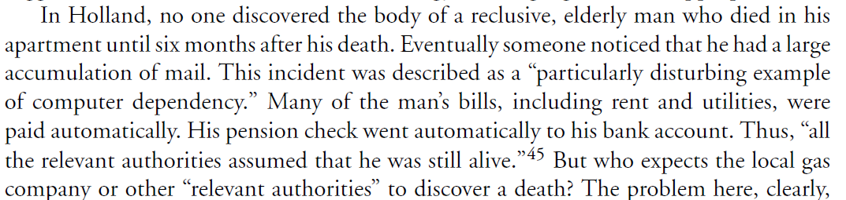
DEPENDENCE

Slide 69
DEPENDENCE
Many people and businesses are not prepared to do without the computer systems and electronic devices.
Any drivers would be lost if their navigation system failed
A BlackBerry email blackout disrupted the work of bankers, technology workers, talent agents etc.
Some military jets cannot fly without the assistance of computers.
Drivers could not buy gasoline with their credit cards.

Slide 70
DEPENDENCE
Are We Too Dependent on Computers?
Computers are tools
They are not the only dependence
Computers, smartphones, and plows are tools. We use tools because we are better off with them than without them.
They reduce the need for hard physical labor and tedious routine mental labor.
They help us be more productive, or safer, or more comfortable. When we have a good tool, we can forget (or no longer even learn) the older method of performing a task.

Slide 71
DEPENDENCE
If the tool breaks down ??
we are stuck. We cannot perform the task until someone fixes it. That can mean that no telephone calls get through for several hours. It might mean the loss of a large amount of money, and it can mean danger or death for some people.
But the negative effects of a breakdown do not condemn the tool.
The breakdown can remind us… ?
Notes:
To the
contrary, for many applications (not all), the inconveniences or dangers of a breakdown
are a reminder of the convenience, productivity, or safety the tool provides when it is
working. The breakdown can remind us, for example, of the billions of communications,
carrying voice, text, photos, and data, that are possible or more convenient or cheaper
because of the technology

Slide 72
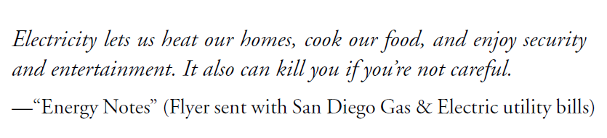
RISK AND PROGRESS

Slide 73
RISK AND PROGRESS
As the tools and technologies we use become more complex and more interconnected, the amount of damage that results from an individual disruption or failure increases, and we sometimes pay the costs in dramatic and tragic events.
Example: car, jet

Slide 74
RISK AND PROGRESS
Most new technologies were not very safe when first developed.
Airplane, polio vaccine, design the front of an automobile,
Secondly a significant factor is increased education about responsible use.
the campaign against drunk driving, seatbelt etc.

Slide 75
RISK AND PROGRESS
There are some important differences between computers and other technologies.
Computers make decisions; electricity does not.
The power and flexibility of computers encourages us to build more complex systems—where failures have more serious consequences.
The pace of change in computer technology is much faster than that in other technologies. Software is not built from standard, trusted parts as is the case in many engineering fields. These differences affect the kind and scope of the risks we face.

Slide 76
RISK AND PROGRESS
Computer system developers and other professionals responsible for planning and choosing systems must assess risks carefully and honestly, include safety protections, and make appropriate plans for shutdown of a system when it fails, for backup systems where appropriate, and for recovery.
Knowing that one will be liable for the damages one causes is strong incentive to find improvements and increase safety.
When evaluating a specific instance of a failure, we can look for those responsible and try to ensure that they bear the costs of the damage they caused.

Slide 77
RISK
A project manager has to deal with risks arising from three possible cases:
Known knowns
Known unknowns
Unknown Unknowns

Slide 78
RISK
Known knowns are software risks that are actually facts known to the team as well as to the entire project.
For example not having enough number of developers can delay the project delivery.

Slide 79
RISK
Known unknowns are risks that the project team is aware of but it is unknown that such risk exists in the project or not.
For example if the communication with the client is not of good level then it is not possible to capture the requirement properly. This is a fact known to the project team however whether the client has communicated all the information properly or not is unknown to the project.

Slide 80
RISK
Unknown Unknowns are those kind of risks about which the organization has no idea. Such risks are generally related to technology such as working with technologies or tools that you have no idea about because your client wants you to work that way suddenly exposes you to absolutely unknown unknown risks.

Slide 81
RISK- STRATEGIES
Each type of strategy has particular activities and behaviors that are useful in different situations.
Reactive: mitigate severity of safety events and threats
Proactive: identify safety concerns before safety events happen
Predictive: anticipate future exposure based on past performance data.

Slide 82
DISCUSSION QUESTIONS
Do you believe we are too dependent on computers? Why or why not?
In what ways are we safer due to new technologies?

Slide 83
DISCUSSION QUESTIONS
Consider the case described earlier in which a school assumed a boy was a drug abuser because two schools used different disciplinary codes in their computerized records. Describe some policies or practices that can help prevent such problems.
Suppose you are on a consulting team to design a voting system for your state in which people can vote by logging on to a website (from a computer, smartphone, or other Internet-connected device). What are some important design considerations? Discuss some pros and cons of such a system. Overall, do you think it is a good idea?

