Slide 1
Ethics in Information Technology, Fourth Edition
Chapter 10
Ethics of IT Organizations

Slide 2
Key Ethical Issues for Organizations
Ethical topics are pertinent to organizations in the IT industry and organizations that make use of IT
  Use of nontraditional workers
  Whistle-blowing
  Outsourcing
  Contingent Workers

Slide 3
Key Ethical Issues for Organizations
When should nontraditional workers be employed?
How does such employment affect an organization’s ability to grow and develop its own employees?
How does the use of such resources impact the wages of the organization’s employees?
How does one safely and effectively report misconduct?
How should managers handle a whistle-blowing incident?
When and how to transition to green computing, and at what cost?

Slide 4
ICT - Industry Code of Conduct
The electronics and information and communications technology (ICT) industry recognizes the need for a code to address ethical issues in the areas of worker safety and fairness, environmental responsibility, and business efficiency.

Slide 5
The Need for Nontraditional Workers
Concern about a shortfall in the number of workers to fill the positions
Employers turn to nontraditional sources due to cost
Ethical decisions about whether to:
  Recruit new/more workers from these sources
  Develop their own staff to meet their needs

Slide 6

Outsourcing
Ethics in Information Technology, Fourth Edition

Slide 7
Outsourcing
Outsourcing
  Approach to meeting staffing needs
  Long-term business arrangement
    Company contracts with an outside organization that has expertise in providing a specific function
  Company may contract with an organization to provide services as
    operating a data center
    supporting a telecommunication network
    staffing a computer help desk
    supporting a software

Slide 8
Outsourcing
Rationale
  Co-employment
  Lower costs
  Obtain flexibility
  Keep staff focused on core competencies
Companies outsource entire IT business units
  which could take over the operation of a company’s data center
  perform other IT functions

Slide 9
Offshore Outsourcing
Variation of outsourcing
  Services provided by an organization whose employees are in a foreign country
  Any work done at a relatively high cost may become a candidate for offshore outsourcing
  IT professionals in particular can do much of their work anywhere

Slide 10
Offshore Outsourcing
Benefits:
  Companies reduce labor costs
  Increased number of services available
Software firms set up development centers in low-cost foreign countries where they have access to a large pool of well-trained candidates and minimal language problems.
Accenture, IBM, and Microsoft maintain large development centers in India
Common to use offshore outsourcing for major programming projects

Slide 11
Offshore Outsourcing
It is now quite common to use offshore outsourcing for major programming projects because
  the high salaries earned by application developers
  ease with which customers and suppliers can communicate

Slide 12
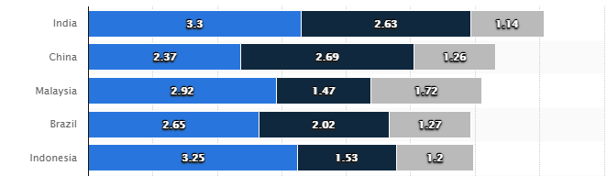

Leading countries in offshore business services worldwide in 2017

Slide 13
Factors
Cost
Technical Skills
Language
Professionalism
Government

Slide 14

Ethics in Information Technology, Fourth Edition

Slide 15
Pros Offshore Outsourcing
Wages that a local worker might consider low represent an excellent salary in many other parts of the world, and some companies feel they would be foolish not to exploit such an opportunity.
Offshore demand is driving up salaries in India by roughly 15 percent per year.
Indian offshore suppliers have begun to charge more for their services
The cost advantage for offshore outsourcing to India used to be 6:1 worker. The cost advantage has now shrunk to 3:1

Slide 16
Pros Offshore Outsourcing
a virtual “24-hour workday” that saves its customers money, speeds projects to completion, and provides continuous support for key software applications.
Getting expert help
If you outsource most of the tasks, you don’t have to worry about many employees separate desks, computers, life insurance, vacation, personal problems, sickness, 15 plus holidays, retirement etc.

Slide 17
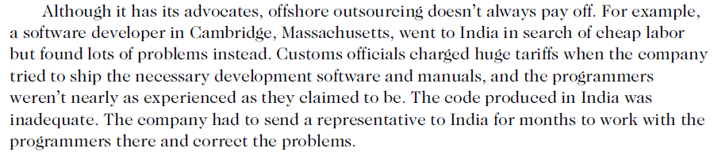
Cons Offshore Outsourcing

Slide 18
Cons Offshore Outsourcing
Determining how much money and time a company will save with offshore outsourcing
The firm must take into account the additional time that will be required to select an offshore vendor as well as the additional costs that will be incurred for travel and communications.
It can take years of ongoing effort and a large up-front investment to develop a good working relationship with an offshore outsourcing firm.
Finding a reputable vendor can be especially difficult for a small or midsized firm that lacks experience in identifying and selecting contractors.
members of a department can become bitter and nonproductive, and morale can become extremely low.

Slide 19
Cons Offshore Outsourcing
Cultural and language differences can cause misunderstandings among project members in different countries
Indian programmers, for instance, are known for keeping quiet even when they notice problems. And the difficulty of communicating directly with people over long distances can make offshore outsourcing perilous, especially when key team members speak English as their second language.

Slide 20
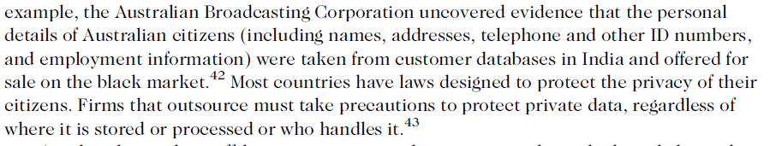
Cons Offshore Outsourcing

Slide 21
Cons Offshore Outsourcing
Company loses the knowledge and experience gained by outsourced workers
offshore outsourcing does not advance the development of permanent IT workers

Slide 22
Strategies for successful offshore outsourcing
require day-to-day interaction between software development and business teams
  Expertise in technologies involved in the project
  Project manager speaks native language of employer
  Large staff available
  State-of-the-art telecommunications setup
  High-quality on-site managers and supervisors

Slide 23
Contingent Workers
Contingent work is a job situation in which an individual does not have an explicit or implicit contract for long-term employment

Slide 24

Contingent Workers
Contingent workers include:
  Independent contractors
  Temporary workers through employment agencies
  On-call or day laborers
  On-site workers provided by contract firms

Slide 25
Contingent Workers
Non-permanent workers who are hired on a per-project basis.
They can work on site or remotely.
Contingent workers are highly skilled experts in their fields.
They are not salaried and are responsible for their own taxes.
Contingent workers also have more control over their own work than employees of a company do. They aren’t told how to complete projects or when to work. The company’s focus is not on how the work is completed but rather on the results.

Slide 26
When to Hire Contingent Workers
Needed for pronounced IT staffing fluctuations
Workers hired for the life of the project only
hired to complete specified tasks under a statement of work provision.
Once the project is over, they leave, though they may be called back when another project arises.
They are not employees of a company and the business owner has no responsibility to provide continuous work on a permanent basis.

Slide 27
Contingent Workers
Sources
  Temporary staffing firms
    Temporary staffing firms recruit, train, and test job seekers in a wide range of job categories and skill levels
    Then assign them to clients as needed.
    Often used to fill in during staff vacations and illnesses, handle seasonal workloads, and help staff special projects
    they are not considered official employees of the company, nor are they eligible for company benefits such as vacation, sick pay, and medical insurance.
    That’s why they are often paid a higher hourly wage than full-time employees doing equivalent work.

Slide 28
Contingent Workers
Sources
  Employee leasing
    A business transfers all or part of its workforce to another firm (say your firm)
    It handles all human resource related activities and costs, such as payroll, training, and the administration of employee benefits.
    You retain essential management control over the work performed by the employees.
    Your main responsibility is writing a check to the leasing company to cover the payroll, taxes, benefits and administrative fees.

Slide 29
Contingent Workers
  Leased Employee
    Workers who are officially employed by a professional employer organization, which is responsible for overseeing all HR-related functions, but who actually perform all work for your company

Slide 30
Contingent Workers
Sources
  Consulting firm
    Consulting organizations maintain a staff of employees with a wide range of skills and experience, up to and including world-renowned industry experts
    They can provide the exact skills and expertise that an organization requires.
    E.g. implementation of an ERP system, or selection of a hardware vendor

Slide 31
Contingent Workers (cont’d.)
Advantages of using contingent workers
  Business does not pay for benefits
  Can continually adjust the number of contingent workers to stay consistent with its business needs
  Does not customarily incur training costs
  No need to pay and collect taxes
  save on administrative costs associated with payroll and human resources
  Access to expertise

Slide 32
Contingent Workers (cont’d.)
Disadvantages of using contingent workers
  Workers may lack a strong relationship with the firm
  Workers gain valuable practical experience working within a company’s structure and culture which is lost when workers depart at the project’s completion
  Lack of control
  Cannot rely on contingent workers to be available during specific hours
  Cannot manage how the work is done.
Notes:
When an organization decides to use contingent workers for a project, it should recognize
the trade-off it is making between completing a single project quickly and cheaply versus
developing people within its own organization. If the project requires unique skills that are
probably not necessary for future projects, there may be little reason to invest the additional
time and costs required to develop those skills in full-time employees.

Slide 33
Contingent Workers (cont’d.)
When deciding to use contingent workers:
  Recognize the trade-off between:
    Completing a single project quickly and cheaply
    Developing people in the organization
  When staffing need is truly temporary:
    Use of contingent workers is a good approach
  Think twice about using contingent workers:
    When they are likely to learn corporate processes and strategies that are key to the company’s success
      Worker’s next assignment may be with major competitor

Slide 34
Contingent Workers (cont’d.)
The Microsoft ruling means that employers must exercise care in their treatment of contingent workers. If a company wants to hire contingent workers through an agency, then the agency must hire and fire the workers, promote and discipline them, do performance reviews, decide wages, and tell them what to do on a daily basis.

Slide 35
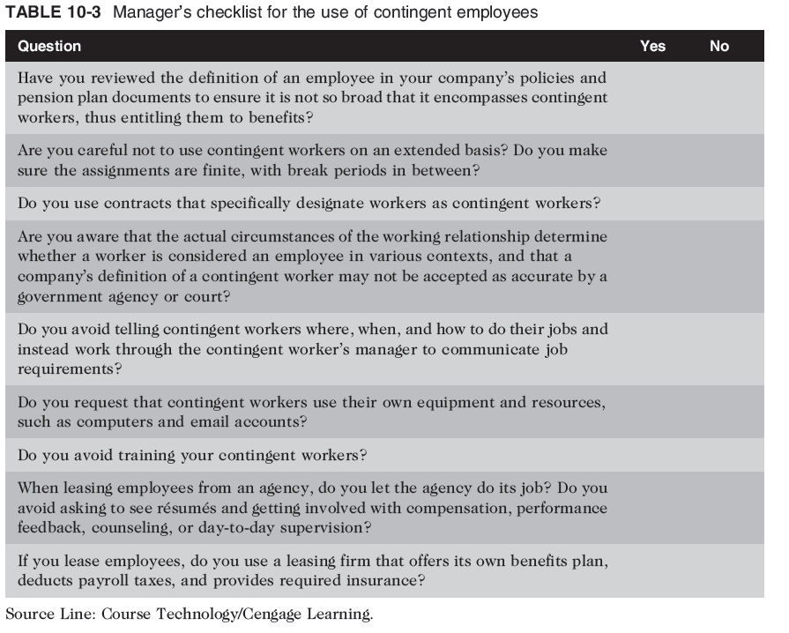

Slide 36
Whistle-Blowing
Effort to attract public attention to a negligent, illegal, unethical, abusive, or dangerous act by a company

Slide 37
Whistle-Blowers
  employees who act as informants on their company, revealing information to enrich themselves or to gain revenge for a perceived wrong.
  whistle-blowers act ethically in an attempt to correct what they think is a major wrongdoing, often at great personal risk.

Slide 38
Whistle-Blowers
Whistle-blower
  Usually has personal or special knowledge
  Risks own career
  Might even affect lives of friends and family
  Must choose between protecting society and remaining silent
Notes:
A whistle-blower usually has personal knowledge of what is happening inside the offending
organization because of his or her role as an employee of the organization. Sometimes
the whistle-blower is not an employee but a person with special knowledge gained from a
position as an auditor or business partner.

Slide 39
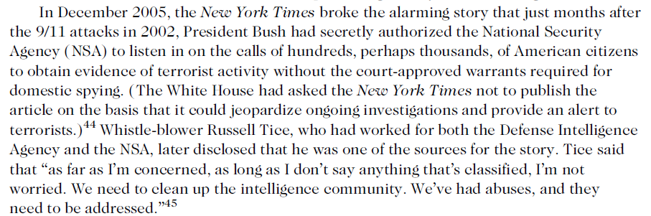
Whistle Blowing

Slide 40
Whistle-Blowing
Protection laws allow employees to alert authorities to employer actions that are unethical, illegal, or unsafe or that violate specific public policies
  No comprehensive federal law

Slide 41
Whistle-Blowing
An employee could traditionally be terminated for any reason, or no reason in absence of a contract.
Whistle-blower protection for private-sector workers
  Many states, not all, have laws that prevent workers from being fired because of an employee’s participation in “protected” activities
Whistle-blowers can file claims against their employers for retaliatory termination
Whistle-blowers are entitled to jury trials
If successful at trial, can receive damage awards

Slide 42
Whistle-Blowing
Dealing with a whistle-blowing situation
  Each potential whistle-blowing case involves different circumstances, issues, and personalities.
  Two people working together in the same company may have different values and concerns that cause them to react in different ways to a particular situation—and both reactions might be ethical.
  It is impossible to outline a definitive step-by-step procedure of how to behave in a whistle-blowing situation.

Slide 43
Assess the seriousness of the situation
  a person should have specific knowledge that his company or a coworker is acting unethically and that the action represents a serious threat to the public interest.
  The employee should carefully and informally seek trusted resources outside the company and ask for their assessment.
      Do they also see the situation as serious?
      Their point of view may help the employee see the situation from a different perspective and alleviate concerns.
Notes:
On the other hand, the outside resources may reinforce the employee’s initial suspicions, forcing a series of difficult ethical decisions.

Slide 44
Begin documentation
An employee who identifies an illegal or unethical practice should begin to compile adequate documentation to establish wrong doing.
The documentation should record all events and facts as well as the employee’s insights about the situation.
This record helps construct a chronology of events if legal testimony is required in the future.
An employee should identify and copy all supporting memos, correspondence, manuals, and other documents before taking the next step. He must keep them updated throughout the process.

Slide 45
Attempt to Address the Situation Internally
An employee should next attempt to address the problem internally by providing a written summary to the appropriate managers.
Ideally, the employee can expose the problem and deal with it from inside the organization. The focus should be on disclosing the facts and how the situation affects others.
The employee’s goal should be to fix the problem, not to place blame.

Slide 46
Attempt to Address the Situation Internally
many problems are solved at this point
appropriate managers get involved and resolve the issue
Unethical managers might not welcome an employee’s questions or concerns
  Employee demotion or termination
  Attempts at discrediting the employee
  Receive deaths threats

Slide 47
Consider Escalating the Situation Within the Company
Initial step may be unsuccessful
a determined and conscientious employee may feel forced to choose between escalating the problem and going over the manager’s head or going outside the organization to deal with the problem.
some organizations may have an effective corporate ethics officer who can be trusted to give the employee a fair and objective hearing.
a senior manager with a reputation for fairness and some responsibility for the area of concern might step in.

Slide 48
Consider Escalating the Situation Within the Company
Challenger is likely to be fired, demoted, or reassigned to a less desirable position or job location.
Such actions send a loud signal throughout an organization that loyalty is highly valued and that challengers will be dealt with harshly.
If the employee is truly overreacting to a minor issue, then the employee may deserve some sort of reprimand for exercising poor judgment.
If senior managers refuse to deal with a legitimate problem, the employee can decide to drop the matter or go outside the organization to try to remedy the situation.

Slide 49
Assess the Implications of Becoming a Whistle-Blower
An employee may incur significant legal fees in order to air or bring charges against an agency or company that may have access to an array of legal resources.
An employee who chooses to proceed might be accused of having a grievance with the employer or of trying to profit from the accusations.
The employee may be fired and may lose the confidence of coworkers, friends, and even family members.

Slide 50
Assess the Implications of Becoming a Whistle-Blower
Given the potentially high price, do I really want to proceed?
Have I exhausted all means of dealing with the problem? Is whistle-blowing all that is left?
Am I violating an obligation to be loyal to my employer and work for its best interests?
Will the public exposure of corruption and mismanagement in the organization really correct the underlying cause of these problems and protect others from harm?

Slide 51
Assess the Implications of Becoming a Whistle-Blower
Whistle-blowers can expect attacks on their personal integrity and character as well as negative publicity in the media.
Friends and family members will hear these accusations, and ideally, they should be notified beforehand and consulted for advice before the whistle- blower goes public.
This notification helps prevent friends and family members from being surprised at future actions by the whistle-blower or the employer.

Slide 52
Assess the Implications of Becoming a Whistle-Blower
The whistle-blower should also consider consulting support groups, elected officials, and professional organizations.
  For example, the Whistleblowers Center provides referrals for legal counseling and education about the rights of whistle-blowers

Slide 53
Use Experienced Resources to Develop an Action Plan
A whistle-blower should consult with competent legal counsel who has experience in these kinds of cases.
He or she will determine which statutes and laws apply, depending on the agency, employer, state involved, and nature of the case.
Counsel should also know the whistle-blower’s protection under the law.
Before blowing the whistle, the employee should get an honest assessment of the soundness of his or her legal position and an estimate of the costs of a lawsuit.

Slide 54
Execute the Action Plan
If the whistle-blower wants to remain unknown, the safest course of action is to leak information anonymously to the press.
The problem with this approach, however, is that anonymous claims are often not taken seriously.
In most cases, working directly with appropriate regulatory agencies and legal authorities is more likely to get results, including the imposition of fines, the halting of operations, or other actions that draw the offending organization’s immediate attention.

Slide 55
Live with the Consequences
discredited by coworkers
Threatened
management may attempt to have the whistleblower, transferred, demoted, or fired for breaking some minor rule, such as arriving late to work or leaving early.
To justify their actions, management may argue that such behavior has been ongoing.
The whistle-blower might need a good strategy and a good attorney to counteract such actions and take recourse under the law.

Slide 56
Green Computing
To manufacture truly “green” products, companies must:
  Produce product that requires less electricity
  Reduce the amount of hazardous materials used
  Increase amount of reusable or recyclable materials
  Help consumers dispose of their products in an environmentally safe manner at the end of the product’s useful life

Slide 57
Green Computing (cont’d.)
Personal computers and cell phones contain thousands of components composed of many different materials
  Some harmful to humans and environment
  Workers along the entire supply chain at risk
  Users can also be exposed to these materials
  Careful when recycling or destroying these devices
Notes:
Electronic manufacturing employees and suppliers at all steps along the supply chain
and manufacturing process are at risk of unhealthy exposure to these raw materials. Users
of these products can also be exposed to these materials when using poorly designed or
improperly manufactured devices.

Slide 58
Green Computing (cont’d.)
EPEAT (Electronic Product Environmental Assessment Tool)
  Enables purchasers to evaluate, compare, and select electronic products
    Based on a total of 51 environmental criteria
    Products are ranked in three tiers of environmental performance

Slide 59
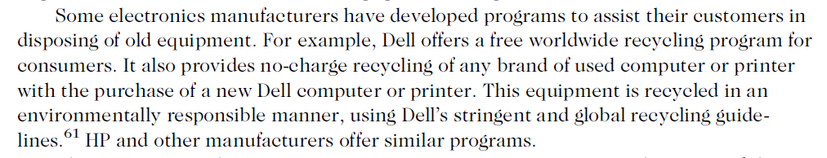
Green Computing (cont’d.)
How to safely dispose of obsolete computers
  Many states have recycling programs
  Some manufacturers have developed programs
Ethics in Information Technology, Fourth Edition

Slide 60
Green computing
Greenpeace environmental activist organization
  Issues quarterly ratings of manufacturers according to the manufacturers’ policies on toxic chemicals, recycling, and climate change
    Manufacturers have long way to go to meet the high standards

Slide 61
ICT Industry Code of Conduct
Electronic Industry Citizenship Coalition (EICC)
  Promotes common code of conduct for ICT industry
  Focuses on the areas of:
    Worker safety and fairness
    Environmental responsibility
    Business efficiency
  Coalition membership is voluntary
Code of conduct defines performance, compliance, auditing, and reporting guidelines across five areas of social responsibility
Ethics in Information Technology, Fourth Edition

Slide 62
ICT Industry Code of Conduct (cont’d.)
Guiding principles of social responsibility
  Labor
    Must uphold the human rights of workers
  Health and safety
    Must provide safe and healthy work environment
  Environment
    Adverse effects minimized
  Management system
    Ensures compliance with code
  Ethics
    Must uphold the highest standards of ethics
Ethics in Information Technology, Fourth Edition

Slide 63
Summary
Contingent workforce includes:
  Independent contractors
  Temporary workers through employment agencies
  On-call or day laborers
  On-site workers provided by contract firms
Outsourcing
  Long-term business arrangement
  Contract for services with outside organization
  Expertise in providing a specific function
Ethics in Information Technology, Fourth Edition

Slide 64
Summary (cont’d.)
Whistle-blowing
  Effort to attract public attention to negligent, illegal, unethical, abusive, or dangerous acts by company
  Whistle-blowing process
    Assess the seriousness of the situation
    Begin documentation
    Attempt to address the situation internally
    Consider escalating the situation within the company
    Assess the implications of becoming a whistle-blower
    Use experienced resources to develop an action plan
    Execute the action plan
    Live with the consequences
Ethics in Information Technology, Fourth Edition

Slide 65
Summary (cont’d.)
Green computers
  Use less electricity
  Include fewer hazardous materials
  Contain reusable or recyclable material
Manufacturers must help consumers:
  Dispose of products in an environmentally safe manner at the end of the product’s useful life
EPEAT (Electronic Product Assessment Tool)
  Purchasers can evaluate, compare, and select
  Based on 51 environmental criteria
Ethics in Information Technology, Fourth Edition

