Slide 1

CSGE4963
Professional Practices
Spring 2023
Sections: A, B, C, D, E, F

Slide 2
Professional Practices Credit Hours: 3
Professional Practices is a very interesting course in which you will be introduced to Professional practices being followed in different organizations.
Objective of this course is to provide you an insight about working environment of organizations, your future destination.
In this course, you will learn everything about organizational Practices ranging from Employee's perspective to organizational strategies in an organization.

Slide 3
Week # 01 Plan:
Week # | Lecture # | Topics Covered | Evaluation Instrument Used
1 | 1 | Introduction Introduction to Professional Practices Professional Responsibilities Traits of a Profession. Applying profession on scenarios What are the characteristics of a professional?
 | 2 | What is ethics? Definition of ethics Importance of integrity The difference between Morals, Ethics, and Laws Ethics In Information Technology

Slide 4
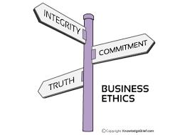
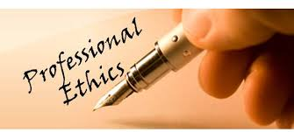
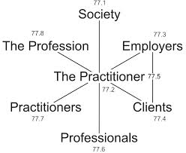

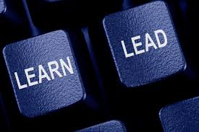
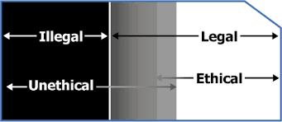

Slide 5
Today’s Agenda
• Get to Know Each Other
• Course Contents
• Grading Policy
• Introduction to Professional Practices

Slide 6
Course Outline
Introduction
Ethics
Privacy
Intellectual property
SE/ACM codes
Crimes
Errors failures and risks
Ethics of IT organizations

Slide 7
Marks Distribution
Mid Term (25%)
4 Assignments (10%)
6 Quizzes (10 %)
Final Exam (40%)
Project Presentation (10%)
Class Participation (5%)

Slide 8
Assignments & Quizzes
Before Midterm
A1 Q1
A2 Q2
Q3
After Midterm
A3 Q4
A4 Q5
Q6

Slide 9
Introduction
Profession:
A paid occupation, especially one that involves prolonged training and a formal qualification.
Professional:
A professional is a member of a profession or any person who earns their living from a specified professional activity. The term also describes the standards of education and training that prepare members of the profession with the particular knowledge and skills necessary to perform their specific role within that profession.

Slide 10
The Professionalism
A profession isn’t just what you do, it’s who you are.
Professionalism is a way of thinking and living rather than an accumulation of learning.

Slide 11
Professional Practices
Professional Practices is partly comprised of what a professional should or should not do in the work-place.
If a professional is to have ethics then that person needs to adopt that conduct in all of his dealings.
Another aspect is the enhancement of the profession and the industry within which the professional works.

Slide 12
Professional Practices
Professional Practices is a discipline aimed at: -
Understanding the moral values that ought to guide engineering profession or practice.
Resolving moral issue in engineering.
Justifying the moral judgment in engineering.

Slide 13
Professional Practices
It deals with moral problems and issues connected with engineering.
Another important goal is to discover the set of justified moral principles or obligations, rights and ideals and apply them to concrete situations.

Slide 14
Traits of a Profession
Four Traits of Profession
Varied activities requiring special skills
Society-centric motivation
Personal standards of excellence
Giving back to society

Slide 15
A professional behaves ethically
Ethics means something more than ‘law’ and ‘morals’.
It carries an additional connotation of ‘rightness’.
Breaking the law: can earn a fine or jail time
Breaking a moral: can ruin your reputation
Breaking an ethic: can ruin your conscience
It’s possible to break all three, simultaneously!

Slide 16
Traits of a Professional
Being a professional means that there are certain traits which are expected from you.
We will go through Each of them

Slide 17
Trait # 1 of a professional: Seriousness
Serious about job
The job is only a job. It’s not just a means to an end.

Slide 18
Trait # 2 of a professional: Wanting to do better
Exhibit a never-ending quest to improve their performance in every variable, every project, every relationship, and every detail.

Slide 19
Trait # 3 of a professional: Dealing with the Unexpected
Stuff happens, things change, and the true professional rises to the occasion

Slide 20
Trait # 4 of a professional: Communication Skills
Clear
Concise
Confident

Slide 21
Trait # 5 of a professional: Enthusiasm
Attitude is everything. Those who exhibit enthusiasm for what they do and greet each day with a positive attitude inevitably become a leader

Slide 22
Trait # 6 of a professional: Helpfulness
Understand that real success in the workplace requires teamwork
Always ready to lend a hand
Make a suggestion
Offer a compliment when it’s deserved

Slide 23
Trait # 7 of a professional: Taking the Initiative
Takes the initiative to get things done

Slide 24
Trait # 8 of a professional: Cool under Pressure
Level headed and calm
Cheerful demeanor-even under stressful times

Slide 25
Trait # 9 of a professional: Remains Focused
Stay focused on the task at hand and the goal ahead
Navigate through obstacles or setbacks but never lose sight of where they headed

Slide 26
Trait # 10 of a professional: Don’t Follow, Lead
True Professionals aren’t faint of heart
Analyze the situation and willing to take new paths and try new solutions
That’s why they call it LEADERSHIP!

Slide 27
Applying Professionalism in Real Life
Scenario #1
You are the owner of a software engineering company. Your employees (engineers) want you to pay for them to attend training.
How would you respond in a way that is legal, moral, and ethical?

Slide 28
Scenario #2
You are the owner of a software engineering company. Your employees (engineers) want you to let them do pro bono work for a local non-profit organization on company time.
How would you respond in a way that is legal, moral, and ethical?

Slide 29
Scenario #3
You are a software engineer at a company where management routinely encourages you and your colleagues to use pirated software.
How would you respond in a way that is legal, moral, and ethical?

Slide 30
What are the characteristics of a professional?
True professionals possess a number of important characteristics that can apply to virtually any type of business.
Appearance. [Dress for Success]
Demeanor. [manner, air, attitude, appearance, look]
Reliability.
Competence.
Ethics.
Maintaining Your Poise.[balance · equilibrium · control · grace · gracefulness · presence]
Written Correspondence.
Organizational Skills
Accountability

Slide 31
ETHICS FIRST
Wrong is wrong even if everyone is doing it. Right is right even if no one is doing it.

Slide 32
Dictionary meaning
Ethics
The branch of knowledge that deals with moral principles.
Moral
Concerned with the principles of right and wrong behavior and the goodness or badness of human character.
Holding or manifesting high principles for proper conduct.

Slide 33
Definition of Ethics
Ethics is a set of beliefs about right and wrong behavior within a society.
Virtues
Habits that incline people to do what is acceptable
Vices
Habits of unacceptable behavior
Virtues and vices define a personal value system
Scheme of moral values
Fairness, generosity, and loyalty are examples of virtues,
while vanity, greed, envy, and anger are considered vices.

Slide 34
The Difference Between Morals, Ethics, and Laws
Morals: one’s personal beliefs about right and wrong
Ethics: standards or codes of behavior expected of an individual by a group(nation, organization, profession).
Law: system of rules that tells us what we can and cannot do
Laws are enforced by a set of institutions
Legal acts conform to the law
Moral acts conform to what an individual believes is the right belief of right and wrong.

Slide 35
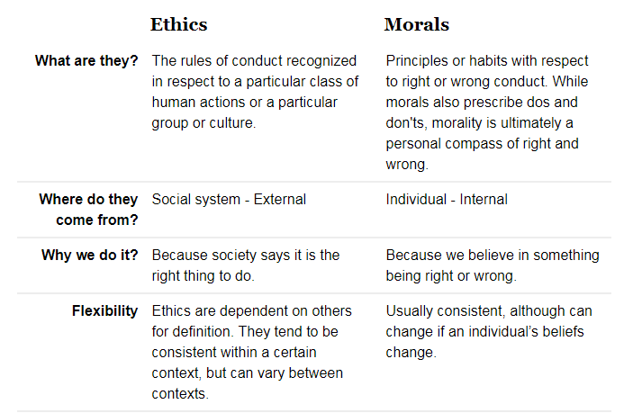
Comparison

Slide 36
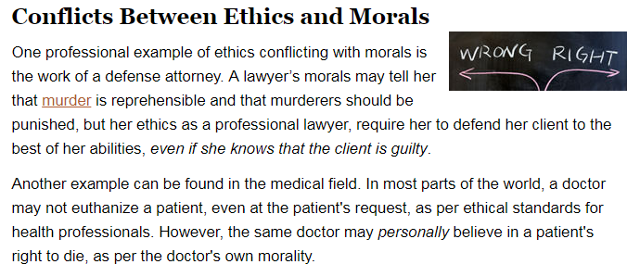

Slide 37
Code of Ethics
Established by various professional organizations
Produce a positive effect on judgment.
Establishes responsibility of professionals to act ethically according to the policies and procedures of their employers, professional organizations, and laws of society.
Organizations assume responsibility to develop, disseminate, and enforce policies.

Slide 38
Code of Ethics’ Goals
Provides an aid to individual decision making, presentation addresses nine different cases (with some overlap).
Intellectual property
Privacy
Confidentiality
Professional quality
Fairness or discrimination
Liability
Software risks
Conflicts of interest
Unauthorized access to computer systems

Slide 39
The Importance of Integrity
Integrity is a cornerstone of ethical behaviour
People with integrity:
Act in accordance with a personal code of principles
Extend to all the same respect and consideration
Apply the same moral standards in all situations
Lack of integrity emerges if you apply moral standards differently according to situation or people involved
Many ethical dilemmas are not as simple as right versus wrong

Slide 40
Immoral or Unethical ??
If the son of a big politician has committed a crime and he uses his powers to free his son from legal consequences.
A very close friend or relative of an interviewer comes for an interview and without asking a single question, he selects him.
A grocer sells adulterated products to his customers to earn more profit.

Slide 41

Workplace Ethics

Slide 42
Punctuality
Responsibility
Integrity
Loyalty
Positive attitude
Teamwork
Showing respect
Courtesy
Productivity
Taking care of office equipment
Minding Language

Slide 43
For example, Jon Huntsman, Sr. is a multibillionaire who started a chemical company from scratch and grew it into a $12 billion enterprise. His book, Winners Never Cheat, is filled with stories taken from his own experience in which he steadfastly refused to compromise his principles. Huntsman says that integrity is the reason that he has been as successful as he is.
“There are no moral shortcuts in the game of business or life,” he writes. “There are, basically, three kinds of people, the unsuccessful, the temporarily successful, and those who become and remain successful. The difference is character.”

Slide 44
Leaders with Integrity
Aren’t Afraid Of The Truth
seeing the world as it really is, not as you wish it to be
open to the idea that they could be wrong
Good at giving And Keeping Promises
Do The Right Thing Because It’s The Right Thing To Do
Never Compromise Their Honesty And Integrity By Cheating
Notes:
There are many examples of temporary winners who won by cheating. For a number of years, Enron was cited as one of America’s most innovating and daring companies. The CEO of the company knew the most important people in the country, including the President of the United States. Except that Enron’s success was built on lies, and the “winners” who headed the company are case studies in lack of integrity.

Slide 45
The Quran reminded man of a number of basic moral and ethical values
You are the best nation that has been raised up for mankind; You enjoin right conduct, forbid evil and believe in Allah. (3:110)
كُنْتُمْ خَيْرَ أُمَّةٍ أُخْرِجَتْ لِلنَّاسِ تَأْمُرُونَ بِالْمَعْرُوفِ وَتَنْهَوْنَ عَنِ الْمُنْكَرِ وَتُؤْمِنُونَ بِاللَّهِ
45

Slide 46
Cont. Ethics from Islamic Perspective
The Quran addresses the Prophet. “Thou has been created with an excellent character”
وانه لعلى خلق عظيم
The Prophet highlighted one of his main objective is to perfecting good morals
“I have been sent for the purpose of perfecting good morals”.
بعثت لاتمم مكارم الاخلاق
46

Slide 47
HADITH
“He who has a good nature will have the reward of those who observe fasting in days and keep awake praying at nights.”

Slide 48
Why Professional Ethics?
The success or the expected results depend on how the workers deal with the situations. Whether ethically or unethically. If they are dealt ethically, the chances are positive for growth and development.

