Slide 1
Intellectual Property
Book: Ethics in Information Technology
Chapter 6

Slide 2
What Is Intellectual Property?
Term used to describe works of the mind
Distinct and “owned” or created by a person or group

Slide 3

How is intellectual Property protected?
Although intellectual property or intellectual ideas are created in the human mind, intellectual property does not refer to the ideas. It is how the idea materializes itself and the end result that is protected with a patent, a copyright
The design of a fuel-efficient car maybe patented but not the idea.
The story or the manuscript of a book is copyrighted and not the idea of the book itself.

Slide 4

How is intellectual Property protected?
Copyright law
Protects authored works
Patent law
Protects inventions
Trade secret law
Helps safeguard information critical to an organization’s success

Slide 5
Copyrights
Securing for limited times to authors the exclusive rights to their writings and discoveries.

Slide 6
Copyrights
Grants creators of original works the exclusive right to:
Distribute
Display
Perform
Reproduce work
Prepare derivative works based upon the work
Author may grant exclusive right to others

Slide 7
What type of work can be Copyright
Tangible medium of expression
Work that is saved in some permanent way so that it can be communicated to some one else at some other time.
Examples
Work may be fixed while transmitting. i.e. Live TV
IT related work saved on hard drive or cloud.

Slide 8
Copyright term
Copyright law guarantees developers the rights to their works for a certain amount of time
Copyright Document
http://www.ipo.gov.pk/uploads/CMS/Copyright_Ordinance_1962.pdf

Slide 9
Eligible Works
Types of work that can be copyrighted
Architecture
Art
Audiovisual works
Choreography
Drama
Graphics
Literature
Motion pictures etc.
and other mentioned in the Copyright_Ordinance_1962

Slide 10
Eligible Works
Must fall within one of the preceding categories
Must be original
Evaluating originality can cause problems
Some works are not eligible for copyright protection ??
Not in a tangible form of expression

Slide 11
Fair use doctrine
Allows portions of copyrighted materials to be used without permission under certain circumstances
Maintains balance between protecting an author’s rights and enabling public access to copyrighted works

Slide 12
Fair use doctrine
Fair use doctrine factors include:
Purpose and character of the use
Nature of the copyrighted work
Portion of the copyrighted work used
Effect of the use upon the value of the copyrighted work
Key concept: an idea cannot be copyrighted, but the expression of an idea can be

Slide 13
Copyright Infringement
Copy substantial and material part of another’s copyrighted work without permission

Slide 14
Software copyright protection
Raises many complicated issues of interpretation
For example, a software manufacturer can observe the operation of a competitor’s copyrighted program and then create a program that accomplishes the same result and performs in the same manner.
Two software manufacturers could conceivably develop separate programs for a simple game such as tic-tac-toe without infringing the other’s copyright.

Slide 15
Patents
Grant of property right to inventors
Permits an owner to exclude the public from making, using, or selling the protected invention
Allows legal action against violators
Prevents independent creation as well as copying

Slide 16
How to obtain a Patent?
Applicant must file with the Patent organization
Organization searches prior art, existing patents and published material in the same area.
Takes an average of 25 months from filing an application until application is issued as a patent or abandoned
Prior art
Existing body of knowledge
Available to a person of ordinary skill in the art

Slide 17
Invention must pass
An invention must pass four tests
Must be in one of the five statutory classes of items
Process, machine, manufactures, composition of matter, new uses in any of previous
Must be useful
Must be novel
Must not be obvious to a person having ordinary skill in the same field
Items cannot be patented if they are:
Abstract ideas
Laws of nature
Natural phenomena

Slide 18
Patent infringement
Making unauthorized use of another’s patent
No specified limit to the monetary penalty
many software patent infringements are for independent inventions—the same invention discovered by two different parties without knowledge of the other’s work.
Before obtaining a software patent, do a patent search

Slide 19
Software patent
Protects feature, function, or process embodied in instructions executed on a computer
Applications software, business software, expert systems, and system software have been patented, as well as such software processes as compilation routines, editing and control functions, and operating system techniques.
Even electronic font types and icons have been patented.

Slide 20
Software cross-licensing Agreements
Large software companies agree not to sue each other over patent infringements
Small businesses have no choice but to license patents if they use them
Small businesses are generally unsuccessful in enforcing their patents against larger companies.
Average patent lawsuit costs $3 - $10 million

Slide 21
Defensive publishing
Alternative to filing for patents
Company publishes a description of the innovation
Establishes the idea’s legal existence as prior art
Costs mere hundreds of dollars
No lawyers
Fast

Slide 22
Submarine patent
Standard is a definition or format
Approved by recognized standards organization or accepted as a de facto standard by the industry
Enables hardware and software from different manufacturers to work together
Submarine Patent
Patented process/invention hidden within a standard
Does not surface until standard is broadly adopted

Slide 23
EXAMPLE
An inventor or company may be able to predict the future direction of a particular technology, or the activities of their competitors. In doing so, a patent application could be filed in the US which is not allowed to proceed to grant, but rather is kept pending. Because there was no pre-grant publication of patent applications in the US before 2000, a third party may then develop a product, which is covered by the scope of the submarine patent, unaware of the pending application. Once the product is on the market, the patent application can then be allowed to proceed to grant. The patentee can then demand a royalty from the unsuspecting third party.

Slide 24
Example
For example, under the old system, someone in 1950 could have filed a patent on, say, a packet-based computer network router, though there were as yet hardly any computers to speak of. By requesting repeated "continuations" during the patent application process, the filer could force the patent to be delayed indefinitely until packet-based routers started to come onto the market, say in 1970. The filer then stops requesting continuations, the patent issues, and the patent-seeker can collect royalties on network routers for 17 years from that point, until 1987

Slide 25
Patents (cont’d.)
Patent farming involves:
Influencing a standards organization to make use of a patented item without revealing the existence of the patent
Demanding royalties from all parties that use the standard

Slide 26
Patent Troll
A patent troll is a person or company whose main business or purpose is to sue other people or companies or patent infringement.

Slide 27
Patent Troll
Example
For example, John Doe buys a patent for the design and manufacture of a flat, rotating disc used to hold objects on a countertop or other flat surface. John Doe has no intention of manufacturing this item; he simply invests $25,000 to buy the patent and then sues every manufacturer of lazy Susans, record players, Asian restaurant table manufacturer, and cabinet-organizer manufacturer he can find. John Doe sends a letter to these people that states they are infringing on his patent. John Doe requests payment for the damages or threatens to sue the manufacturer in court.

Slide 28
Trade Secrets
Trade secret
Business information
Represents something of economic value
Requires an effort or cost to develop
Some degree of uniqueness or novelty
Generally unknown to the public
Kept confidential
Information is only considered a trade secret if the company takes steps to protect it

Slide 29
Trade Secrets (cont’d.)
Trade secret law has a few key advantages over patents and copyrights
No time limitations
No need to file an application
Patents can be ruled invalid by courts
No filing or application fees
Law doesn’t prevent someone from using the same idea if it is developed independently
Trade secret law varies greatly from country to country

Slide 30
Employees and Trade Secrets
Employees are the greatest threat to trade secrets
Unauthorized use of an employer’s customer list
Customer list is not automatically considered a trade secret
Educate workers about the confidentiality of lists
Court must consider:
did the firm take steps to keep the list secret?
did the firm expend money or effort to develop the customer list?

Slide 31
Nondisclosure clauses
Nondisclosure clauses in employee’s contract
The employees cannot take copies of software programs
The employees cannot reveal details of software owned by the organization.
Enforcement can be difficult
Confidentiality issues are reviewed at the exit interview

Slide 32
Non-compete agreements
Protect intellectual property from being used by competitors when key employees leave
Require employees not to work for competitors for a period of time

Slide 33
Non-compete agreements
Example:
The employee agrees as a condition of employment that in the event of termination for any reason, he or she will not engage in a similar or competitive business for a period of two years, nor will he or she contact or solicit any customer with whom Employer conducted business during his or her employment. This restrictive covenant shall be for a term of two years from termination, and shall encompass the geographic area within a 100-mile radius of Employer’s place of business.

Slide 34
Can a Product or Service Have Multiple Forms of IP?
Yes. For example, a mobile phone might use technology (data encryption) and include features (a camera) that have been patented. The phone may be marketed under a brand name that has a registered trademark. The look and feel of the phone’s home screen design may be the subject of a copyright registration. If the phone’s manufacturer hasn’t created all of the phone’s IP by itself, it may have licensed some of the IP from others.

Slide 35
Key Intellectual Property Issues
Issues that apply to intellectual property and information technology
Plagiarism
Reverse engineering
Open source code
Competitive intelligence
Trademark infringement
Cybersquatting

Slide 36
Plagiarism
Stealing someone’s ideas or words and passing them off as one’s own
Many students:
Do not understand what constitutes plagiarism
Believe that all electronic content is in the public domain
Plagiarism is also common outside academia
Plagiarism detection systems
Check submitted material against databases of electronic content

Slide 37
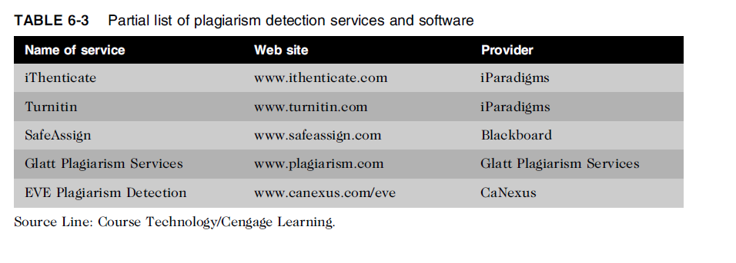
Plagiarism (cont’d.)

Slide 38
Plagiarism (cont’d.)
Steps to combat student plagiarism
Help students understand what constitutes plagiarism and why they need to cite sources
Schedule major writing assignments in portions due over the course of the term
Tell students that instructors are aware of Internet paper mills and plagiarism detection services
Incorporate detection into an antiplagiarism program

Slide 39
Plagiarism forms
Verbatim copying
Copying elements of another author's paper, such as equations or illustrations that are not common knowledge, or copying or purposely paraphrasing sentences without citing the source.
Self-plagiarism

Slide 40
Plagiarism (cont’d.)
HEC Plagiarism policy :
http://hec.gov.pk/english/services/faculty/Documents/Plagiarism/Plagiarism%20Policy.pdf

Slide 41
Reverse Engineering
Process of taking something apart in order to:
Understand it
Build a copy of it
Improve it
Applied to computer:
Hardware
Software
Convert a program code
To a higher-level design
To create a new representation
Begins by extracting design stage details

Slide 42
Reverse Engineering (cont’d.)
Convert an application that ran on one vendor’s database to run on another’s
Compiler
Language translator
Converts computer program statements expressed in a source language to machine language
Software manufacturer
Provides software in machine language form
Decompiler
Reads machine language
Produces source code

Slide 43
Reverse Engineering (cont’d.)
Courts have ruled in favor of reverse engineering:
To enable interoperability
Software license agreements forbid reverse engineering
Ethics of using reverse engineering are debated
Fair use if it provides useful function/interoperability
Can uncover designs that someone else has developed at great cost and taken care to protect

Slide 44
Open Source Code
Program source code made available for use or modification:
As users or other developers see fit
Basic premise
Many programmers can help software improve
Can be adapted to meet new needs
Bugs rapidly identified and fixed
High reliability

Slide 45

Reasons to Create Open Source
To earn respect for solving a common problem
Feel the need to pay back
To attract potential clients
Reluctant to license and market it

Slide 46

Why license is needed for open source software ?
Notes:
A software developer could attempt to make a program open source simply by putting it into the public domain with no copyright. This would allow people to share the program
and their improvements, but it would also allow others to revise the original code and then
distribute the resulting software as their own proprietary product. Users who received the
program in the modified form would no longer have the freedoms associated with the
original software. Use of an open source license avoids this scenario

Slide 47
Competitive Intelligence
Gathering of legally obtainable information
To help a company gain an advantage over rivals
Often integrated into a company’s strategic plans and decision making
Not the same as industrial espionage, which uses illegal means to obtain business information not available to the general public
Without proper management safeguards, it can cross over to industrial espionage

Slide 48
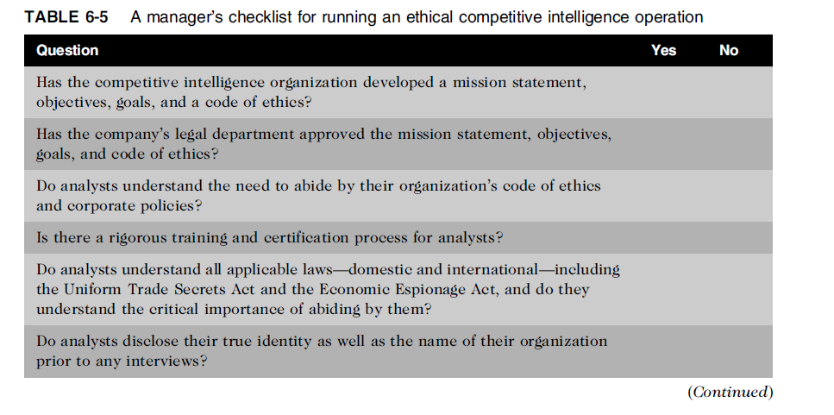
Competitive Intelligence (cont’d.)

Slide 49
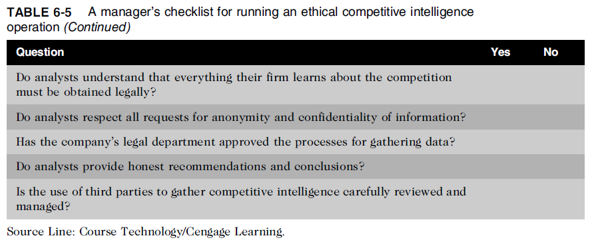
Competitive Intelligence (cont’d.)

Slide 50
Trademark Infringement
Trademark is logo, package design, phrase, sound, or word that enables consumer to differentiate one company’s product from another’s
Trademark owner can prevent others from using the same mark or a confusingly similar mark on a product’s label
Organizations frequently sue one another over the use of a trademark in a Web site or domain name
Nominative fair use is defense often employed by defendant in trademark infringement case

Slide 51
Cybersquatting
Cybersquatters
Register domain names for famous trademarks or company names
Hope the trademark’s owner will buy the domain name for a large sum of money
To curb cybersquatting, register all possible domain names
.org, .com, .info

Slide 52
Cybersquatting (cont’d.)
Internet Corporation for Assigned Names and Numbers (ICANN)
Several top-level domains (.com, .edu, edu., .gov, .int, .mil, .net, .org, aero, .biz, .coop, .info, .museum, .name, .pro, .asis, .cat, .mobi, .tel, and .travel)
Current trademark holders are given time to assert their rights in the new top-level domains before registrations are opened to the general public
Anti-cybersquatting Consumer Protection Act allows trademark owners to challenge foreign cybersquatters

Slide 53
Summary
Intellectual property is protected by laws for:
Copyrights
Patents
Trademarks
Trade secrets
Plagiarism is stealing and passing off the ideas and words of another as one’s own
Reverse engineering
Process of breaking something down in order to understand, build a copy of, or improve it

Slide 54
Summary (cont’d.)
Open source code
Made available for use or modification as users or other developers see fit
Competitive intelligence
Uses legal means and public information
Trademark infringement
Use of other’s trademark in a Web site can lead to issues
Cybersquatting
Registration of a domain name by an unaffiliated party

Slide 55
Summary (cont’d.)
Open source code
Made available for use or modification as users or other developers see fit
Competitive intelligence
Uses legal means and public information
Trademark infringement
Use of other’s trademark in a Web site can lead to issues
Cybersquatting
Registration of a domain name by an unaffiliated party

