Slide 1
Principal Component Analysis(PCA)

Slide 2
PCA – The Real-World Power of Eigenvectors
Principal Component Analysis, or PCA, is a technique that reduces complex data into fewer dimensions while keeping as much important variation as possible.
It’s like summarizing a whole book into a few powerful sentences without losing the meaning.

Slide 3
Role of Eigenvectors & Eigenvalues in PCA
Eigenvectors → Directions of Maximum Variance They point to the new coordinate axes (principal components) that best capture the spread of the data.
Eigenvalues → Amount of Variance Captured They tell us how much information (variance) is preserved along each eigenvector.
Ranking by Eigenvalues The larger the eigenvalue, the more important that direction is.
Dimensionality Reduction By keeping only the top eigenvectors (with largest eigenvalues), we reduce features while still preserving most of the information.

Slide 4
Housing Dataset
HouseID | Area_sqft | Bedrooms | Age_years | Dist_to_Center_km | Crime Index | Price_kUSD
H100 | 850 | 2 | 10 | 12.5 | 3.2 | 85
H101 | 1200 | 3 | 5 | 8 | 2.5 | 140
H102 | 950 | 2 | 20 | 14 | 4 | 95
H103 | 1500 | 4 | 2 | 6.5 | 2 | 200
H104 | 2000 | 4 | 15 | 18 | 4.5 | 320
H105 | 1100 | 3 | 8 | 9.5 | 3 | 130
H106 | 780 | 1 | 30 | 20 | 4.8 | 70
H107 | 1600 | 4 | 1 | 5 | 1.8 | 280
H108 | 1300 | 3 | 12 | 10 | 2.9 | 150
H109 | 1750 | 4 | 3 | 7 | 2.2 | 260
H110 | 900 | 2 | 25 | 16 | 4.1 | 90
H111 | 1400 | 3 | 7 | 9 | 2.7 | 175

Slide 5
What we are going to do?
Often in real life, we have many features — like in housing data: size, bedrooms, age, price, location. Too many dimensions make patterns hard to see.
Principal Component Analysis (PCA) helps us summarize the data by creating new axes (principal components) that capture the most important variation.
The trick: these new axes are built from eigenvectors of the data’s covariance matrix, and the eigenvalues tell us how much information each axis captures.
So instead of staring at 6 messy features, we can look at just 2 or 3 principal components that explain most of the story.

Slide 6
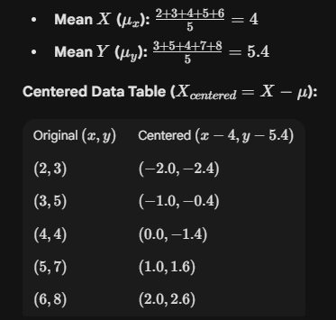
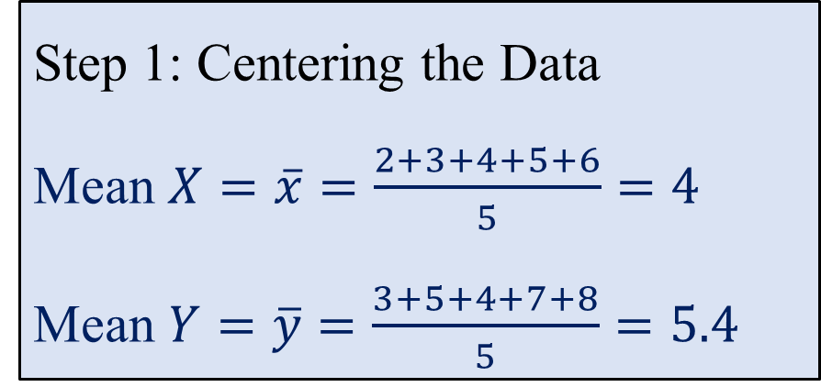
PCA Case Study: Reducing 2D Data to 1D
X | Y
2 | 3
3 | 5
4 | 4
5 | 7
6 | 8
Step 1: Centering the Data
Mean $X=\overline{x}=\frac{2+3+4+5+6}{5}=4$
Mean $Y=\overline{y}=\frac{3+5+4+7+8}{5}=5.4$

Slide 7
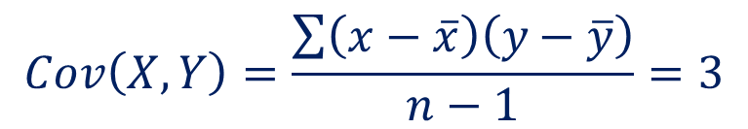
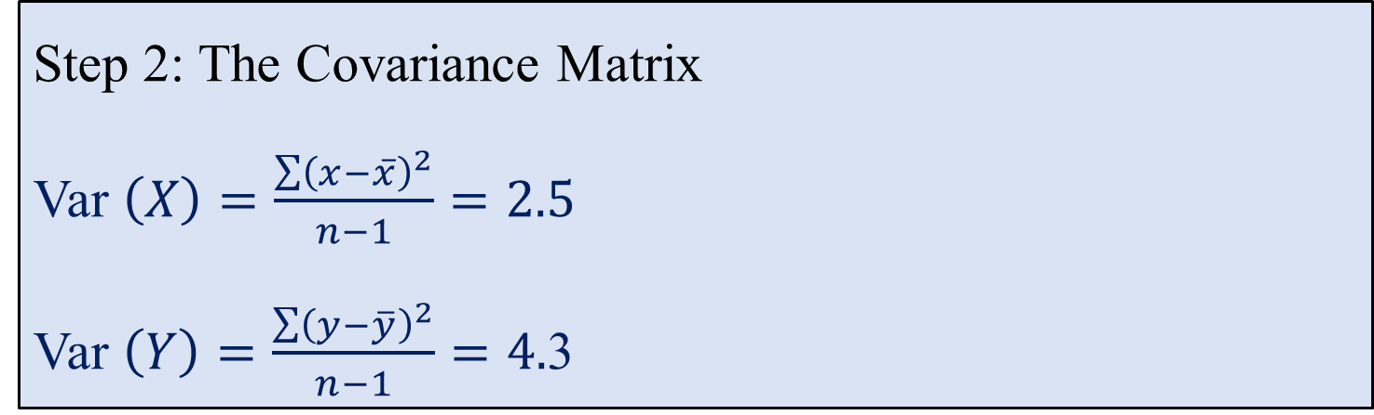
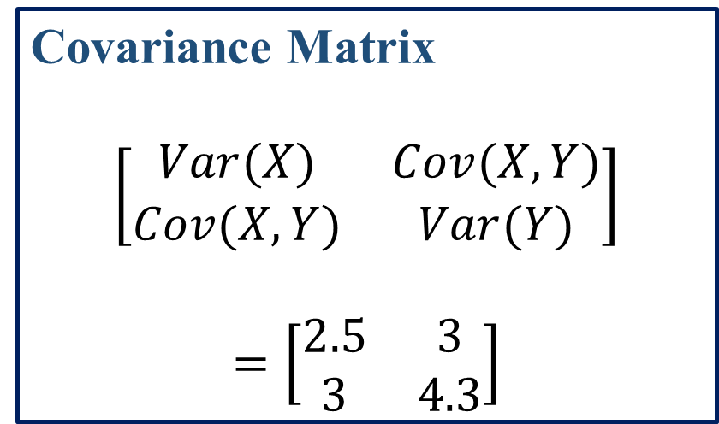
PCA Case Study: Reducing 2D Data to 1D
X | Y
2 | 3
3 | 5
4 | 4
5 | 7
6 | 8
Step 2: The Covariance Matrix
Var $\left(X\right)=\frac{\sum{{\left(x−\overline{x}\right)}^{2}}}{n−1}=2.5$
Var $\left(Y\right)=\frac{\sum{{\left(y−\overline{y}\right)}^{2}}}{n−1}=4.$3
$$Cov\left(X,Y\right)=\frac{\sum{\left(x−\overline{x}\right)\left(y−\overline{y}\right)}}{n−1}=3$$
Covariance Matrix
$$\left[\begin{matrix}Var(X) & Cov(X,Y) \\ Cov(X,Y) & Var(Y)\end{matrix}\right]$$
$$=\left[\begin{matrix}2.5 & 3 \\ 3 & 4.3\end{matrix}\right]$$

Slide 8
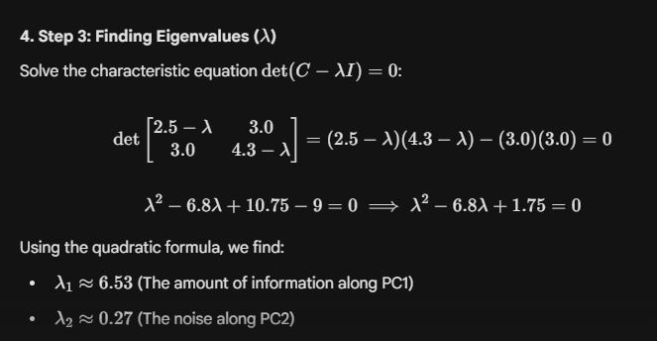
PCA Case Study: Reducing 2D Data to 1D
X | Y
2 | 3
3 | 5
4 | 4
5 | 7
6 | 8

Slide 9
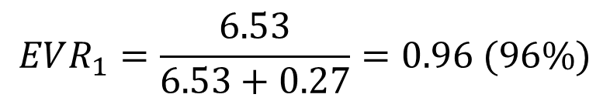
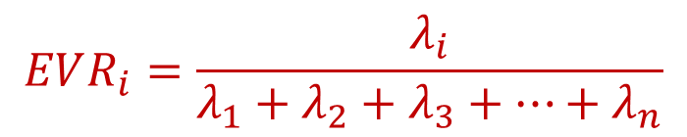

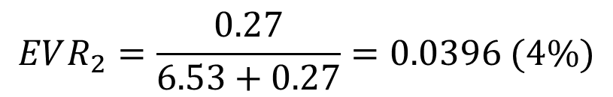
2-D Example
X | Y
2 | 3
3 | 5
4 | 4
5 | 7
6 | 8
Explained Variance Ratio
It represents the proportion, or percentage, of the total variance of the original dataset that is captured by each new principal component.
$$EVR_{i}=\frac{λ_{i}}{λ_{1}+λ_{2}+λ_{3}+…+λ_{n}}$$
$$EVR_{1}=\frac{6.53}{6.53+0.27}=0.96 (96\%)$$
$$EVR_{2}=\frac{0.27}{6.53+0.27}=0.0396 (4\%)$$
$$PC1≈0.6∗x+0.8∗y$$

Slide 10
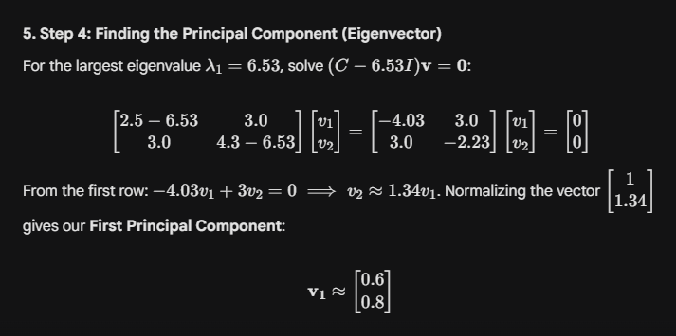
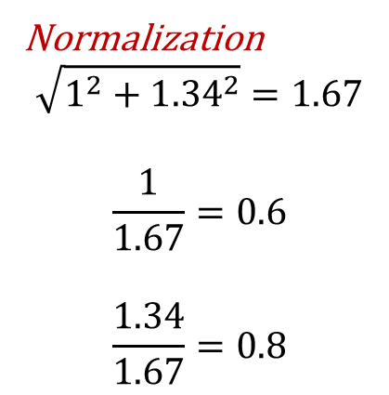
PCA Case Study: Reducing 2D Data to 1D
X | Y
2 | 3
3 | 5
4 | 4
5 | 7
6 | 8
Normalization
$$\sqrt{1^{2}+{1.34}^{2}}=1.67$$
$$\frac{1}{1.67}=0.6$$
$$\frac{1.34}{1.67}=0.8$$

Slide 11
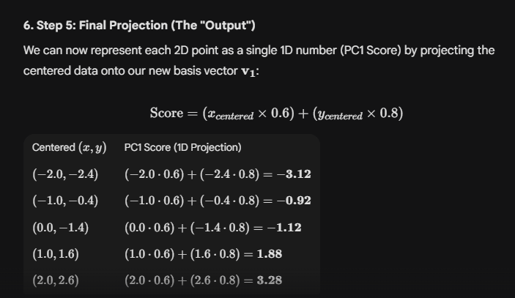
PCA Case Study: Reducing 2D Data to 1D

Slide 12
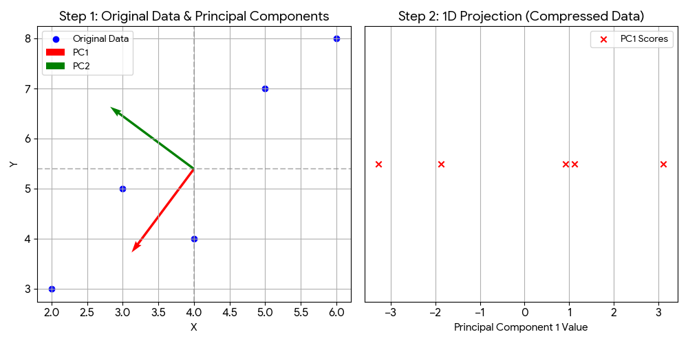
PCA Case Study: Reducing 2D Data to 1D

Slide 13
PCA is Feature Extraction not Feature Selection
Feature extraction transforms raw data into a new, reduced set of features, while feature selection chooses a subset of the original features and discards the rest
Process:
Creates new features by combining, transforming, or reformatting existing ones
When to use:
High-dimensional data where you need to capture underlying patterns or when original features are too complex.
Feature selection aims to remove irrelevant or redundant original features to simplify models and improve generalization.
In case of Housing, it may be $PC1≈0.6∗Size+0.4∗Bedrooms+0.2∗Age$

Slide 14
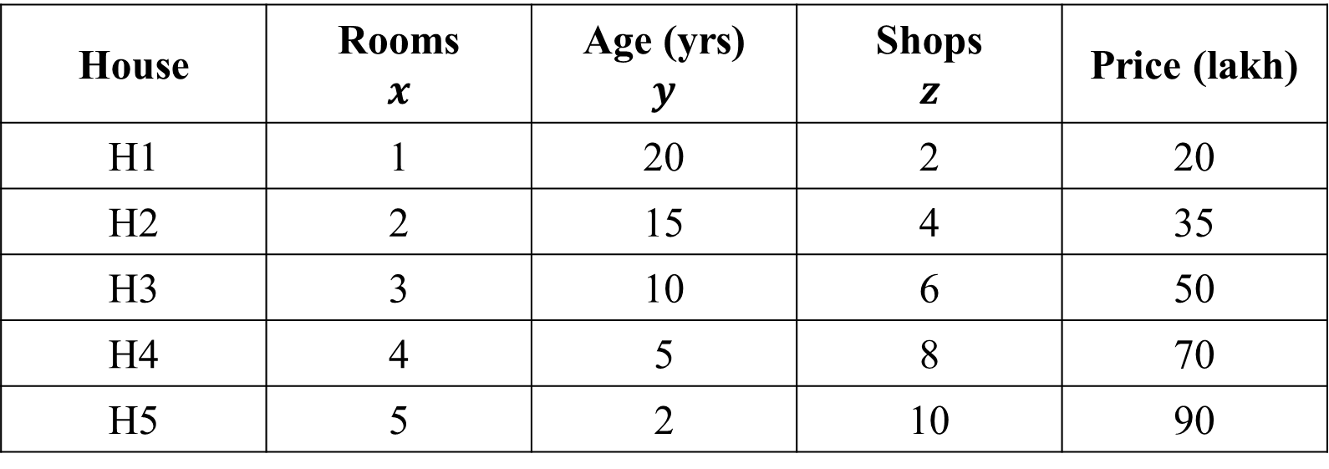
Example The dataset: 5 Houses $×$ 3 Features
Three features: Rooms (count), Age (years), NearbyShops (count). We will compress this 3D data, 1D and see how much information survives.
House | Rooms $$x$$ | Age (yrs) $$y$$ | Shops $$z$$ | Price (lakh)
H1 | 1 | 20 | 2 | 20
H2 | 2 | 15 | 4 | 35
H3 | 3 | 10 | 6 | 50
H4 | 4 | 5 | 8 | 70
H5 | 5 | 2 | 10 | 90

Slide 15
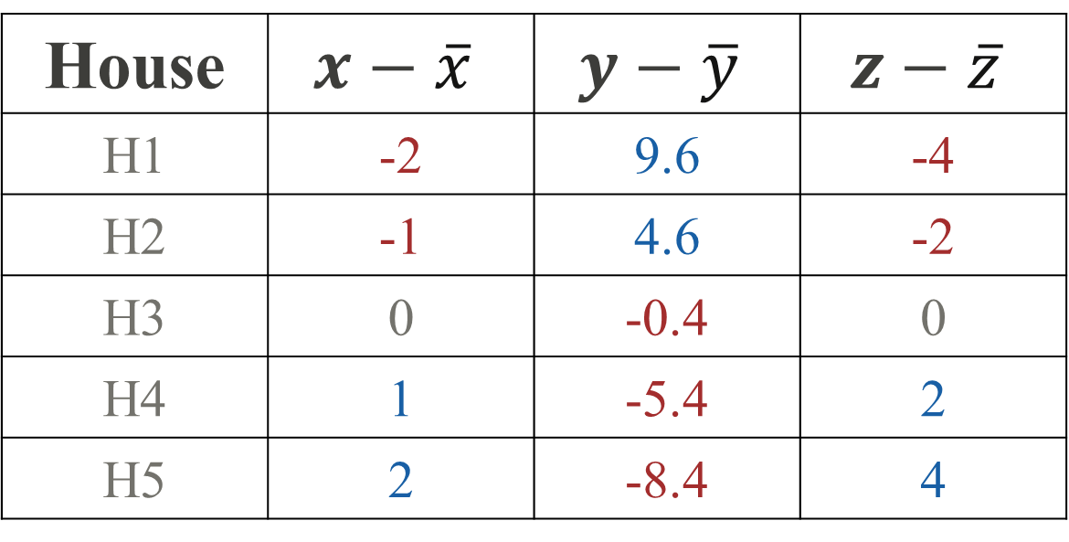
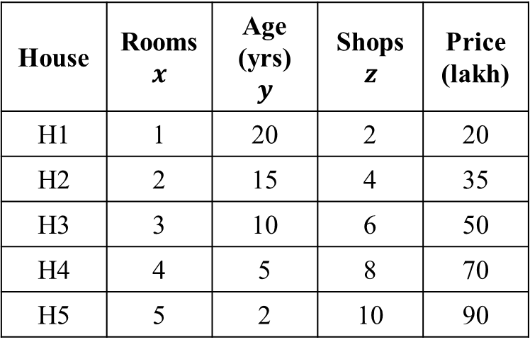
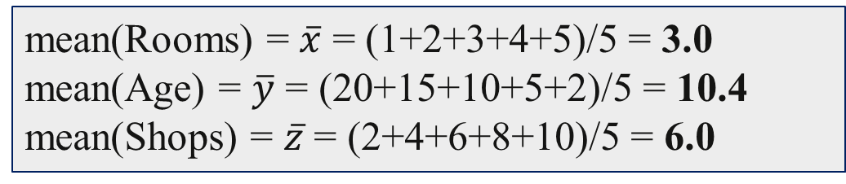
Example The dataset: 5 Houses $×$ 3 Features
Step 2: Mean center each column
House | Rooms $$x$$ | Age (yrs) $$y$$ | Shops $$z$$ | Price (lakh)
H1 | 1 | 20 | 2 | 20
H2 | 2 | 15 | 4 | 35
H3 | 3 | 10 | 6 | 50
H4 | 4 | 5 | 8 | 70
H5 | 5 | 2 | 10 | 90
mean(Rooms) = $\overline{x}$ = (1+2+3+4+5)/5 = 3.0
mean(Age) = $\overline{y}$ = (20+15+10+5+2)/5 = 10.4
mean(Shops) = $\overline{z}$ = (2+4+6+8+10)/5 = 6.0
House | $$x−\overline{x}$$ | $$y−\overline{y}$$ | $$z−\overline{z}$$
H1 | -2 | 9.6 | -4
H2 | -1 | 4.6 | -2
H3 | 0 | -0.4 | 0
H4 | 1 | -5.4 | 2
H5 | 2 | -8.4 | 4

Slide 16
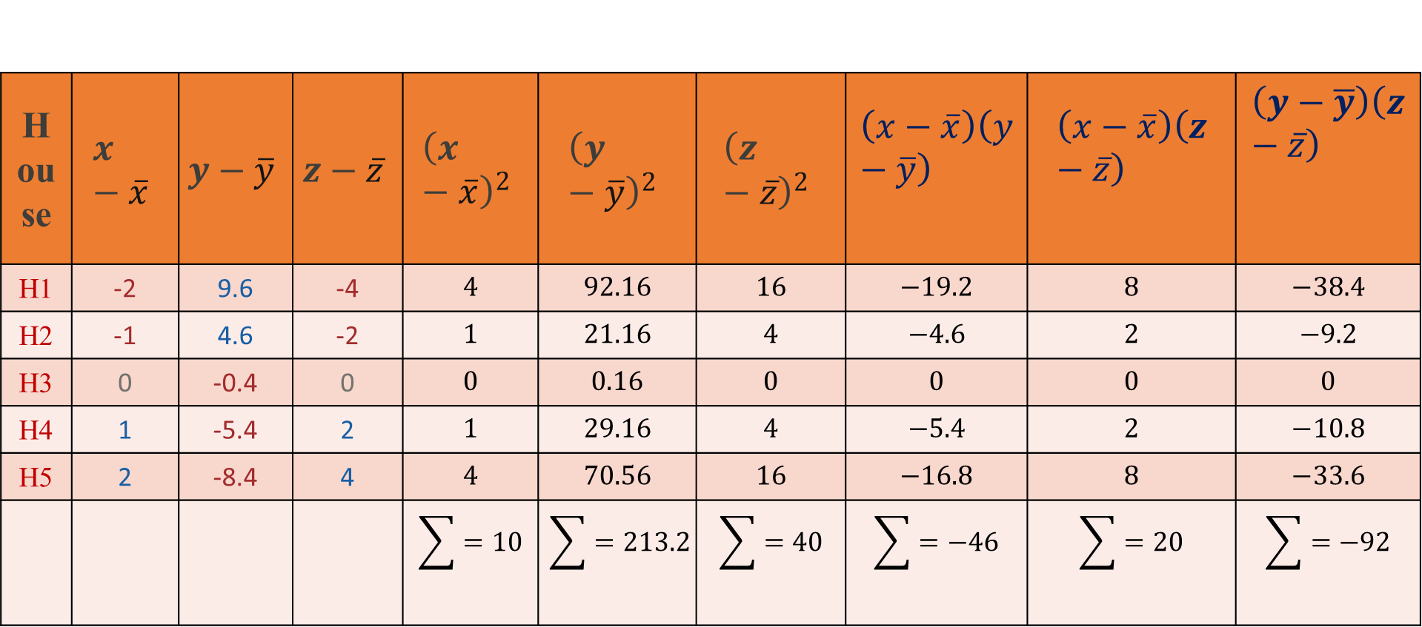
Example The dataset: 5 Houses $×$ 3 Features
Step 3: Co-Variance
House | $$x−\overline{x}$$ | $$y−\overline{y}$$ | $$z−\overline{z}$$ | $${\left(x−\overline{x}\right)}^{2}$$ | $${\left(y−\overline{y}\right)}^{2}$$ | $${\left(z−\overline{z}\right)}^{2}$$ | $$\left(x−\overline{x}\right)\left(y−\overline{y}\right)$$ | $$\left(x−\overline{x}\right)\left(z−\overline{z}\right)$$ | $$\left(y−\overline{y}\right)\left(z−\overline{z}\right)$$
H1 | -2 | 9.6 | -4 | $$4$$ | $$92.16$$ | $$16$$ | $$−19.2$$ | $$8$$ | $$−38.4$$
H2 | -1 | 4.6 | -2 | $$1$$ | $$21.16$$ | $$4$$ | $$−4.6$$ | $$2$$ | $$−9.2$$
H3 | 0 | -0.4 | 0 | $$0$$ | $$0.16$$ | $$0$$ | $$0$$ | $$0$$ | $$0$$
H4 | 1 | -5.4 | 2 | $$1$$ | $$29.16$$ | $$4$$ | $$−5.4$$ | $$2$$ | $$−10.8$$
H5 | 2 | -8.4 | 4 | $$4$$ | $$70.56$$ | $$16$$ | $$−16.8$$ | $$8$$ | $$−33.6$$
 |  |  |  | $$\sum{=10}$$ | $$\sum{=213.2}$$ | $$\sum{=40}$$ | $$\sum{=−46}$$ | $$\sum{=20}$$ | $$\sum{=−92}$$

Slide 17
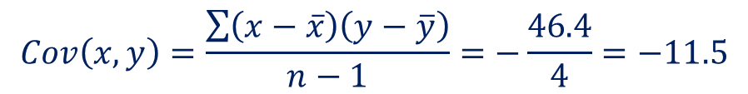
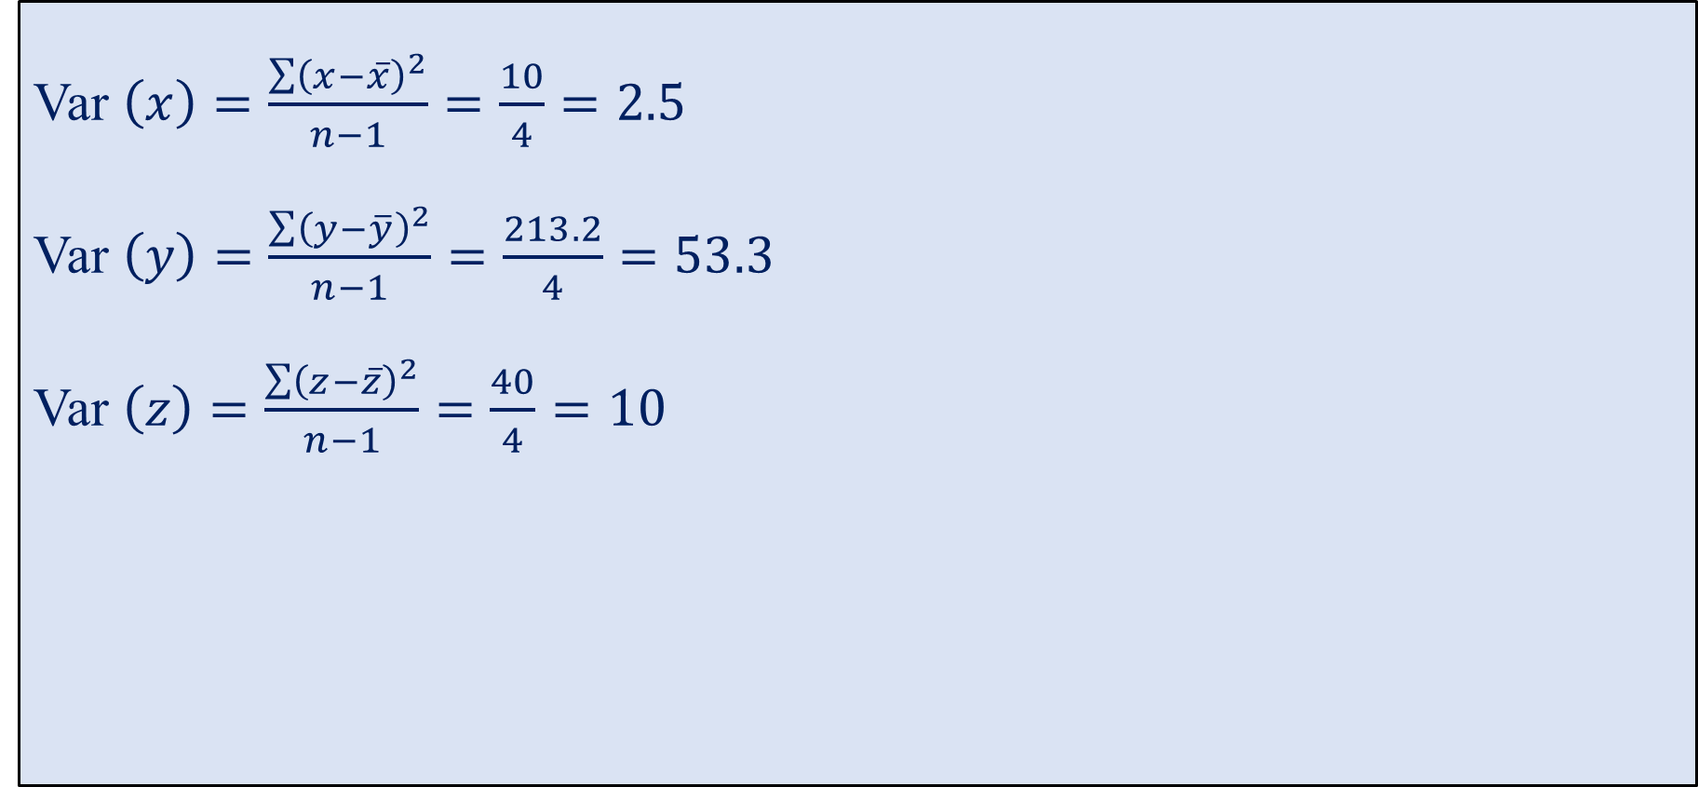

Variance and Co-Variance Calculations
Var $\left(x\right)=\frac{\sum{{\left(x−\overline{x}\right)}^{2}}}{n−1}=\frac{10}{4}=2.5$
Var $\left(y\right)=\frac{\sum{{\left(y−\overline{y}\right)}^{2}}}{n−1}=\frac{213.2}{4}=53.3$
Var $\left(z\right)=\frac{\sum{{\left(z−\overline{z}\right)}^{2}}}{n−1}=\frac{40}{4}=10$
$$Cov\left(x,y\right)=\frac{\sum{\left(x−\overline{x}\right)\left(y−\overline{y}\right)}}{n−1}=−\frac{46.4}{4}=−11.5$$
$$Cov\left(x,z\right)=\frac{\sum{\left(x−\overline{x}\right)\left(z−\overline{z}\right)}}{n−1}=\frac{20}{4}=5$$
$$Cov\left(y,z\right)=\frac{\sum{\left(x−\overline{x}\right)\left(y−\overline{y}\right)}}{n−1}=−\frac{92}{4}=−23$$

Slide 18

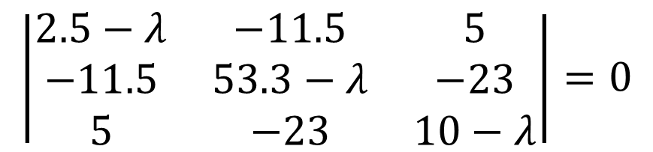

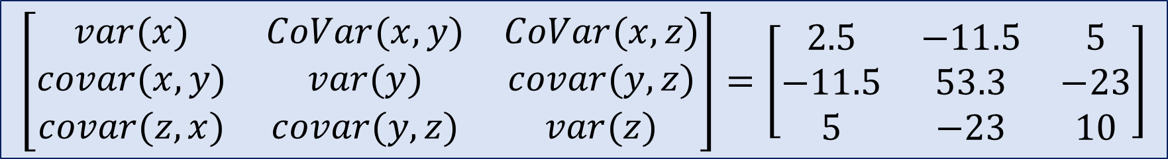


Co-Variance Matrix
$$\left[\begin{matrix}var(x) & CoVar(x,y) & CoVar(x,z) \\ covar(x,y) & var(y) & covar(y,z) \\ covar(z,x) & covar(y,z) & var(z)\end{matrix}\right]=\left[\begin{matrix}2.5 & −11.5 & 5 \\ −11.5 & 53.3 & −23 \\ 5 & −23 & 10\end{matrix}\right]$$
Eigen Values
Eigen Vectors
$$\left|\begin{matrix}2.5−λ & −11.5 & 5 \\ −11.5 & 53.3−λ & −23 \\ 5 & −23 & 10−λ\end{matrix}\right|=0$$
$$For λ=65.7, [0.5, −2.3, 1]$$
$$For λ=0.07, [0.5, 0.54, 1]$$
$$λ^{3}−65.8λ^{2}+5λ=0$$
$$For λ=0, [−2, 0, 1]$$
$$λ=0, 65.7, 0.07$$

Slide 19
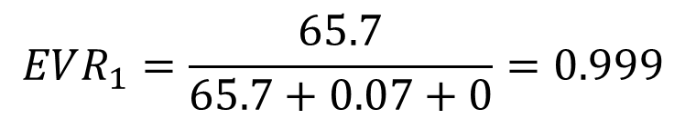

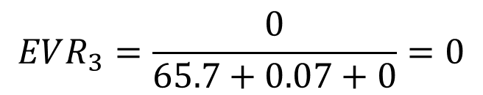
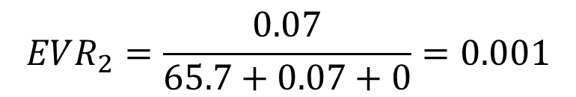
Explained Variance Ratio
$$EVR_{i}=\frac{λ_{i}}{λ_{1}+λ_{2}+λ_{3}+…+λ_{n}}$$
$$EVR_{1}=\frac{65.7}{65.7+0.07+0}=0.999$$
$$EVR_{2}=\frac{0.07}{65.7+0.07+0}=0.001$$
$$EVR_{3}=\frac{0}{65.7+0.07+0}=0$$

Slide 20
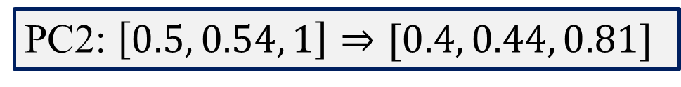
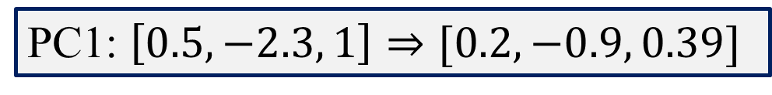
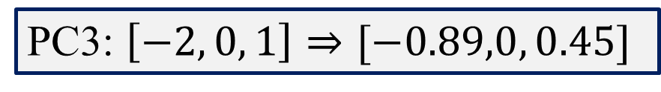
Eigenvectors: the new axis directions
After Normalization
PC1: $\left[0.5, −2.3, 1\right]⇒[0.2, −0.9, 0.39]$
PC2: $\left[0.5, 0.54, 1\right]⇒[0.4, 0.44, 0.81]$
PC3: $\left[−2, 0, 1\right]⇒[−0.89,0, 0.45]$
Feature | PC1 (λ=65.7) | PC2 (λ=0.07) | PC3 (λ=0)
Rooms | 0.2 | 0.4 | -0.89
Age | -0.9 | 0.44 | 0
Shops | 0.39 | 0.81 | 0.45

Slide 21
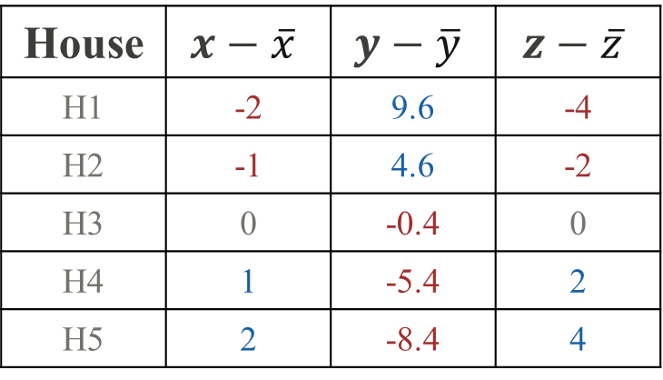
Reduce to 1D
H1: 0.2×(-2) + (−0.9)×(9.6) + 0.39×(-4) = -10.6
H2: 0.2 ×(-1) + (−0.9)×(4.6) + 0. 39×(-2) = -5.12
H3: 0.2 ×(0) + (−0.9)×(-0.4) + 0. 39×(0) = 0.36
H4: 0.2 ×(1) + (−0.9)×(-5.4) + 0. 39×(2) = 5.84
H5: 0.2 ×(2) + (−0.9)×(-8.4) + 0. 39×(4) = 9.52
House | $$x−\overline{x}$$ | $$y−\overline{y}$$ | $$z−\overline{z}$$
H1 | -2 | 9.6 | -4
H2 | -1 | 4.6 | -2
H3 | 0 | -0.4 | 0
H4 | 1 | -5.4 | 2
H5 | 2 | -8.4 | 4
House | Rooms | Age | Shops | PC1 score (only) | Price
H1 | 1 | 20 | 2 | -10.6 | 20
H2 | 2 | 15 | 4 | -5.12 | 35
H3 | 3 | 10 | 6 | 0.36 | 50
H4 | 4 | 5 | 8 | 5.84 | 70
H5 | 5 | 2 | 10 | 9.52 | 90
Most negative (H1 = −10.6) → cheapest (20 lakh).
Most positive (H5 = +9.52)
→ most expensive
(90 lakh).

Slide 22

Thank You!

