Slide 1
CSBP 461 Internet Computing: Integrating Servlets and JSP: The Model View Controller (MVC) Architecture
Dr. M. Elarbi Badidi
Fall 2020

Slide 2
Outline
Understanding the benefits of MVC
Using RequestDispatcher to implement MVC
Forwarding requests from Servlets to JSP pages
Handling relative URLs
Choosing among different display options
Comparing data-sharing strategies

Slide 3

Traditional Applications
Browser directly accesses page.
Does not centralize control
No content/style separation
Easy and fast to produce
Difficult to maintain

Slide 4
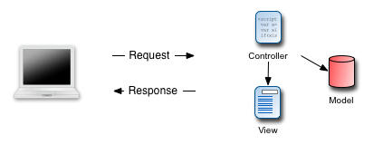
MVC Applications
Browser accesses a “controller”
Centralizes control
Clean separation of content/style
More involved to produce
Easier to maintain and expand

Slide 5
MVC
MVC is an Architectural Design Pattern
Separates a web application into three different modules.

Slide 6
Design Pattern
A pattern that has been developed to help programmers cope with common problems.
Blueprints on how to construct something.
Notes:
There are also ‘anti-patterns’ patterns that happen but are bad (pitfalls)
Façade - unified interface
Singelton - insure only one instance, provide single point of access

Slide 7
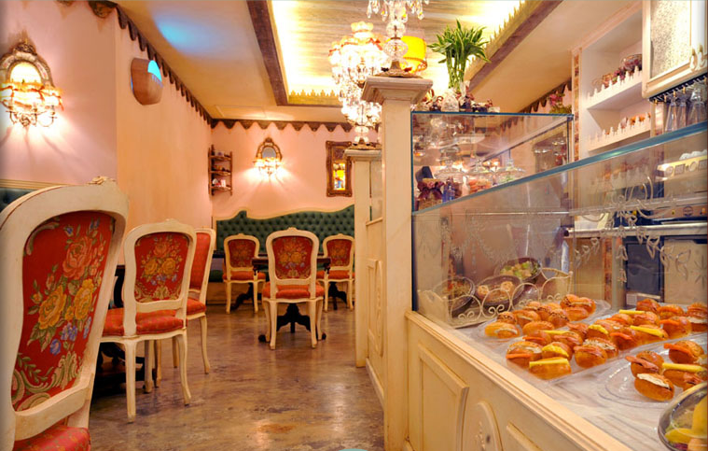
Trip to Shakespeare and Co
A Patisserie in Dubai
http://www.shakespeareandco.ae/

Slide 8

Typical Bakery Interaction
Request a tasty treat from the baker

Slide 9
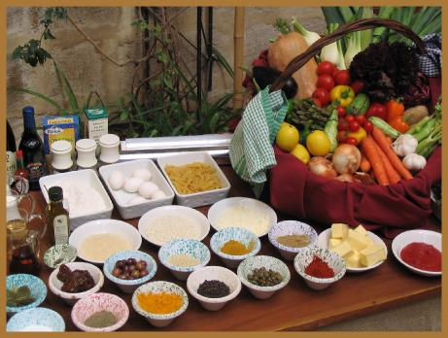
Baker Gathers Ingredients
Baker gathers raw ingredients to fulfill the request.
Some requests utilize same ingredients.

Slide 10
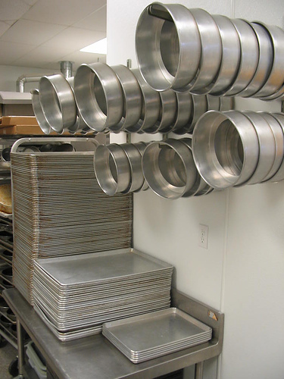
Baker Selects Pan
The pan dictates what the response looks like.

Slide 11
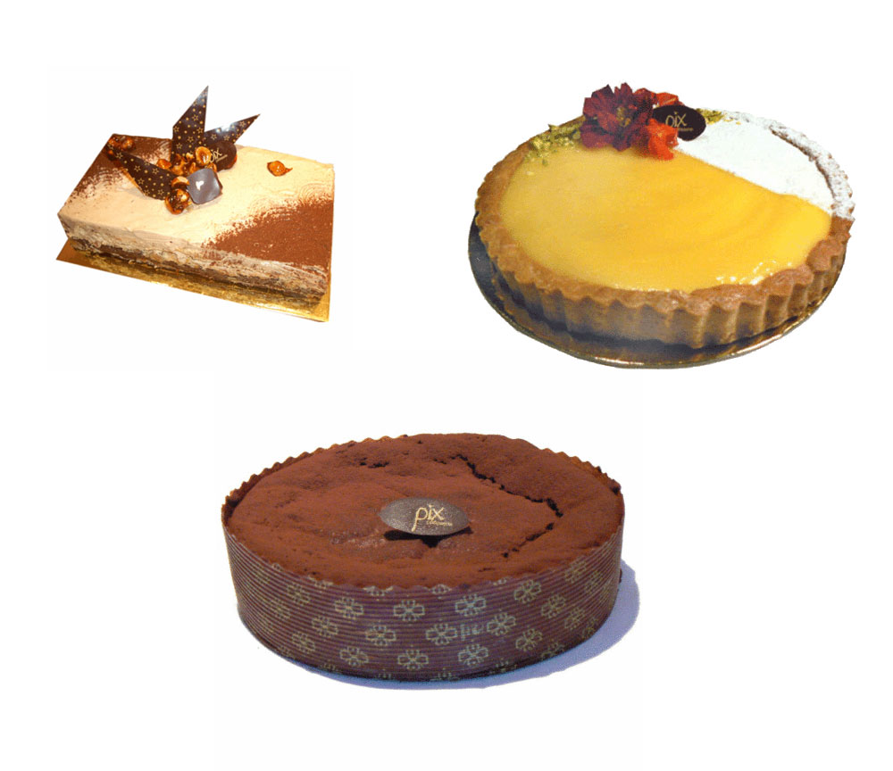
Baker responds with your treat

Slide 12
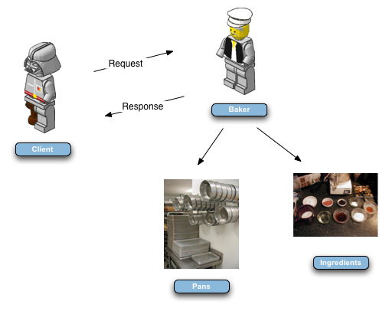
Patisserie Flow

Slide 13
MVC Diagram

Slide 14
Controller (Baker)
Dispatches Requests and controls flow.
Centralizes access.
Interacts with Model and View.

Slide 15
Model (Ingredients)
Data representation and business logic.
Can be database/xml/etc
Business Logic

Slide 16
View (Pan)
Data presentation and user input.
Renders the Model in to a View.
Can be HTML/PDF/WML/Javascript
No computations, very little logic, display logic i.e. loops

Slide 17
MVC Diagram

Slide 18
MVC Advantages
Separation of interests.
Model centralizes business logic.
View centralizes display logic.
Controller centralizes application flow.
Clean separation of content/style.
Improved decoupling.
Easier testing.
Allow multiple people to work on different parts.

Slide 19
Possibilities for Handling a Single Request
Servlet only. Works well when:
Output is a binary type. E.g.: an image
There is no output. E.g.: you are doing forwarding or redirection as in Search Engine example.
Format/layout of page is highly variable. E.g.: portal.
JSP only. Works well when:
Output is mostly character data. E.g.: HTML
Format/layout mostly fixed.
Combination (MVC architecture). Needed when:
A single request will result in multiple substantially different-looking results.
You have a large development team with different team members doing the Web development and the business logic.
You perform complicated data processing, but have a relatively fixed layout.

Slide 20
MVC Flow of Control
HTML or JSP
Java Code (Business Logic)
Results (beans)
submit form (URL matches url-pattern of servlet)
Servlet
Form
(Store beans in request, session, or application scope)
Invoke appropriate JSP page
JSP₁ JSP₂ JSP₃
return final result
(Extract data from beans and put in output)

Slide 21
Implementing MVC with RequestDispatcher
Define beans to represent the data
Use a Servlet to handle requests
Servlet reads request parameters, checks for missing and malformed data, etc.
Populate the beans
The Servlet invokes business logic (application-specific code) or data-access code to obtain the results. Results are placed in the beans that were defined in step 1.
Store the bean in the request, session, or servlet context
The Servlet calls setAttribute on the request, session, or Servlet context objects to store a reference to the beans that represent the results of the request.

Slide 22
Implementing MVC with RequestDispatcher (Cont.)
Forward the request to a JSP page.
The Servlet determines which JSP page is appropriate to the situation and uses the forward method of RequestDispatcher to transfer control to that page.
Extract the data from the beans.
The JSP page accesses beans with jsp:useBean and a scope matching the location of step 4. The page then uses jsp:getProperty to output the bean properties.
The JSP page does not create or modify the bean; it merely extracts and displays data that the Servlet created.

Slide 23
Request Forwarding Example
public void doGet(HttpServletRequest request,
HttpServletResponse response)
throws ServletException, IOException {
String operation = request.getParameter("operation");
if (operation == null) {
operation = "unknown";
}
String address;
if (operation.equals("order")) {
address = "/WEB-INF/Order.jsp";
} else if (operation.equals("cancel")) {
address = "/WEB-INF/Cancel.jsp";
} else {
address = "/WEB-INF/UnknownOperation.jsp";
}
RequestDispatcher dispatcher =
request.getRequestDispatcher(address);
dispatcher.forward(request, response);
}

Slide 24
jsp:useBean in MVC vs. in Standalone JSP Pages
The JSP page should not create the objects
The Servlet, not the JSP page, should create all the data objects. So, to guarantee that the JSP page will not create objects, you should use
<jsp:useBean ... type="package.Class" />
instead of
<jsp:useBean ... class="package.Class" />
The JSP page should not modify the objects
So, you should use jsp:getProperty but not jsp:setProperty.

Slide 25
Reminder: jsp:useBean Scope Alternatives (JSP 1.2 only!)
request
<jsp:useBean id="..." type="..." scope="request" />
session
<jsp:useBean id="..." type="..." scope="session" />
application
<jsp:useBean id="..." type="..." scope="application" />
page
<jsp:useBean id="..." type="..." scope="page" /> or just <jsp:useBean id="..." type="..." />
This scope is not used in MVC (Model 2) architecture

Slide 26
Request-Based Data Sharing
Servlet
ValueObject value = new ValueObject(...);
request.setAttribute("key", value);
RequestDispatcher dispatcher =
request.getRequestDispatcher("/WEB-INF/SomePage.jsp");
dispatcher.forward(request, response);
JSP 1.2
<jsp:useBean id="key" type="somePackage.ValueObject"
scope="request" />
<jsp:getProperty name="key" property="someProperty" />
JSP 2.0
${key.someProperty}
Name chosen by the servlet.
Name of accessor method, minus the
word "get", with next letter changed
to lower case.

Slide 27
Request-Based Data Sharing: Example
Servlet
Customer myCustomer =
new Customer(request.getParameter("customerID"));
request.setAttribute("customer", myCustomer);
RequestDispatcher dispatcher =
request.getRequestDispatcher("/WEB-INF/SomePage.jsp");
dispatcher.forward(request, response);
JSP 1.2
<jsp:useBean id="customer" type="somePackage.Customer"
scope="request" />
<jsp:getProperty name="customer”Property="firstName"/>
JSP 2.0
${customer.firstName}
Note: the Customer class must
have a method called "getFirstName".

Slide 28
Session-Based Data Sharing
Servlet
ValueObject value = new ValueObject(...);
HttpSession session = request.getSession();
session.setAttribute("key", value);
RequestDispatcher dispatcher =
request.getRequestDispatcher
("/WEB-INF/SomePage.jsp");
dispatcher.forward(request, response);
JSP 1.2
<jsp:useBean id="key" type="somePackage.ValueObject"
scope="session" />
<jsp:getProperty name="key" property="someProperty" />
JSP 2.0
${key.someProperty}

Slide 29
Session-Based Data Sharing: Variation
Use response.sendRedirect instead of RequestDispatcher.forward
Distinctions: with sendRedirect:
User sees JSP URL (user sees only Servlet URL with RequestDispatcher.forward)
Two round trips to client (only one with forward)
Advantage of sendRedirect
User can visit JSP page separately
User can bookmark JSP page
Disadvantage of sendRedirect
Since user can visit JSP page without going through Servlet first, JSP data might not be available
So, JSP page needs code to detect this situation

Slide 30
ServletContext-Based Data Sharing
Servlet
synchronized(this) {
ValueObject value = new ValueObject(...);
getServletContext().setAttribute("key", value);
RequestDispatcher dispatcher =
request.getRequestDispatcher
("/WEB-INF/SomePage.jsp");
dispatcher.forward(request, response);
}
JSP 1.2
<jsp:useBean id="key" type="somePackage.ValueObject"
scope="application" />
<jsp:getProperty name="key" property="someProperty" />
JSP 2.0
${key.someProperty}

Slide 31
Relative URLs in JSP Pages
Issue:
Forwarding with a request dispatcher is transparent to the client. Original URL is the only URL browser knows about.
Why does this matter?
What will browser do with tags like the following:
<IMG SRC="foo.gif" …> <LINK REL=STYLESHEET HREF="JSP-Styles.css“ TYPE="text/css"> <A HREF="bar.jsp">…</A>
Answer: browser treats them as relative to Servlet URL

Slide 32
Applying MVC: Bank Account Balances
Bean
BankCustomer
Servlet that populates bean and forwards to appropriate JSP page
Reads customer ID, calls data-access code to populate BankCustomer
Uses current balance to decide on appropriate result page
JSP pages to display results
Negative balance: warning page
Regular balance: standard page
High balance: page with advertisements added
Unknown customer ID: error page

Slide 33
Bank Account Balances: Servlet Code
public class ShowBalance extends HttpServlet {
public void doGet(HttpServletRequest request,
HttpServletResponse response)
throws ServletException, IOException {
BankCustomer customer =
BankCustomer.getCustomer
(request.getParameter("id"));
String address;
if (customer == null) {
address =
"/WEB-INF/bank-account/UnknownCustomer.jsp";
} else if (customer.getBalance() < 0) {
address =
"/WEB-INF/bank-account/NegativeBalance.jsp";
request.setAttribute("badCustomer", customer);
}
…
RequestDispatcher dispatcher =
request.getRequestDispatcher(address);
dispatcher.forward(request, response);

Slide 34
Bank Account Balances: JSP 1.2 Code (Negative Balance)
…
<BODY>
<TABLE BORDER=5 ALIGN="CENTER">
<TR><TH CLASS="TITLE">
We Know Where You Live!</TABLE>
<P>
<IMG SRC="/bank-support/Club.gif" ALIGN="LEFT">
<jsp:useBean id="badCustomer"
type="coreservlets.BankCustomer"
scope="request" />
Watch out,
<jsp:getProperty name="badCustomer"
property="firstName" />,
we know where you live.
<P>
Pay us the $<jsp:getProperty name="badCustomer"
property="balanceNoSign" />
you owe us before it is too late!
</BODY></HTML>

Slide 35
Bank Account Balances: JSP 2.0 Code (Negative Balance)
…
<BODY>
<TABLE BORDER=5 ALIGN="CENTER">
<TR><TH CLASS="TITLE">
We Know Where You Live!</TABLE>
<P>
<IMG SRC="/bank-support/Club.gif" ALIGN="LEFT">
Watch out, ${badCustomer.firstName},
we know where you live.
<P>
Pay us the $${badCustomer.balanceNoSign}
you owe us before it is too late!
</BODY></HTML>

Slide 36
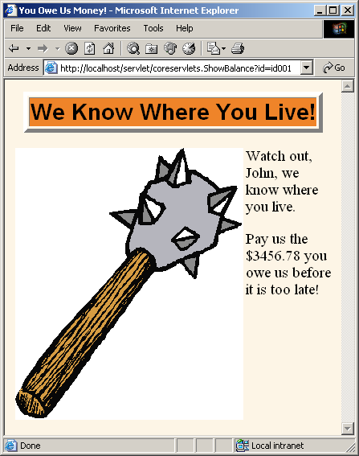
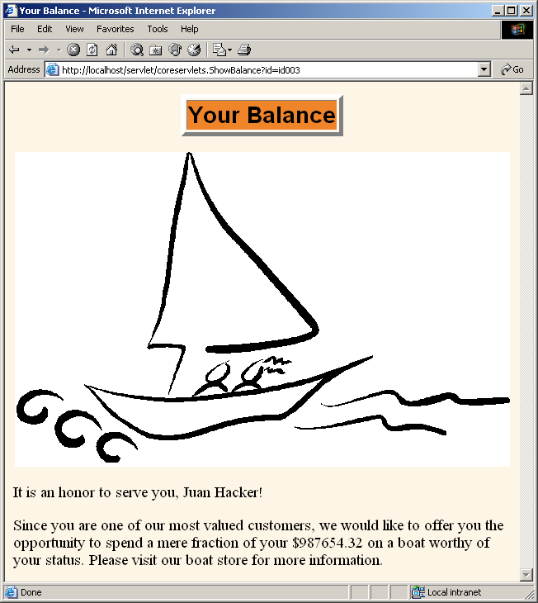
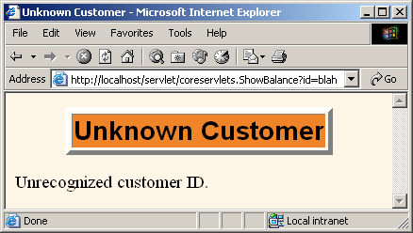
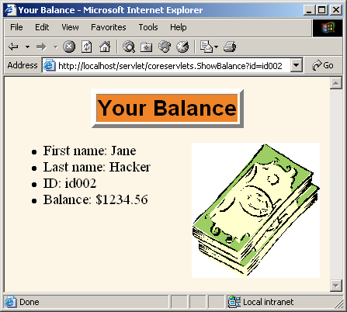
Bank Account Balances: Results

Slide 37
Comparing Data-Sharing Approaches: Request
Goal
Display a random number to the user
Type of sharing
Each request should result in a new number, so request-based sharing is appropriate.

Slide 38
Request-Based Sharing: Bean
package coreservlets;
public class NumberBean {
private double num = 0;
public NumberBean(double number) {
setNumber(number);
}
public double getNumber() {
return(num);
}
public void setNumber(double number) {
num = number;
}
}

Slide 39
Request-Based Sharing: Servlet
public class RandomNumberServlet extends HttpServlet {
public void doGet(HttpServletRequest request,
HttpServletResponse response)
throws ServletException, IOException {
NumberBean bean =
new NumberBean(Math.random());
request.setAttribute("randomNum", bean);
String address =
"/WEB-INF/mvc-sharing/RandomNum.jsp";
RequestDispatcher dispatcher =
request.getRequestDispatcher(address);
dispatcher.forward(request, response);
}
}

Slide 40
Request-Based Sharing: JSP 1.2
…
<BODY>
<jsp:useBean id="randomNum"
type="coreservlets.NumberBean"
scope="request" />
<H2>Random Number:
<jsp:getProperty name="randomNum"
property="number" />
</H2>
</BODY></HTML>

Slide 41
Request-Based Sharing: JSP 2.0
…
<BODY>
<H2>Random Number: ${randomNum.number}</H2>
</BODY></HTML>

Slide 42
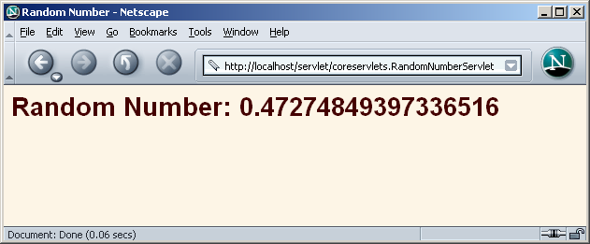
Request-Based Sharing: Results

Slide 43
Comparing Data-Sharing Approaches: Session
Goal
Display users’ first and last names.
If the users fail to tell us their name, we want to use whatever name they gave us previously.
If the users do not explicitly specify a name and no previous name is found, a warning should be displayed.
Type of sharing
Data is stored for each client, so session-based sharing is appropriate.

Slide 44
Session-Based Sharing: Bean
public class NameBean implements Serializable {
private String firstName = "Missing first name";
private String lastName = "Missing last name";
public NameBean(String firstName, String lastName) {
setFirstName(firstName);
setLastName(lastName);
}
public String getFirstName() {
return(firstName);
}
public void setFirstName(String firstName) {
if (!isMissing(firstName)) {
this.firstName = firstName;
}
}
... // getLastName, setLastName
private boolean isMissing(String value) {
return((value == null) || (value.trim().equals("")));
}
}

Slide 45
Session-Based Sharing: Servlet
public class RegistrationServlet extends HttpServlet {
public void doGet(HttpServletRequest request,
HttpServletResponse response)
throws ServletException, IOException {
HttpSession session = request.getSession();
NameBean nameBean =
(NameBean)session.getAttribute("nameBean");
if (nameBean == null) {
String firstName= request.getParameter("firstName");
String lastName = request.getParameter("lastName");
nameBean = new NameBean(firstName, lastName);
session.setAttribute("nameBean", nameBean);
}
String address = "/WEB-INF/mvc-sharing/ShowName.jsp";
RequestDispatcher dispatcher =
request.getRequestDispatcher(address);
dispatcher.forward(request, response);
}
}

Slide 46
Session-Based Sharing: JSP 1.2
…
<BODY>
<H1>Thanks for Registering</H1>
<jsp:useBean id="nameBean"
type="coreservlets.NameBean"
scope="session" />
<H2>First Name:
<jsp:getProperty name="nameBean"
property="firstName" /></H2>
<H2>Last Name:
<jsp:getProperty name="nameBean"
property="lastName" /></H2>
</BODY></HTML>

Slide 47
Session-Based Sharing: JSP 2.0
…
<BODY>
<H1>Thanks for Registering</H1>
<H2>First Name: ${nameBean.firstName}</H2>
<H2>Last Name: ${nameBean.lastName}</H2>
</BODY></HTML>

Slide 48
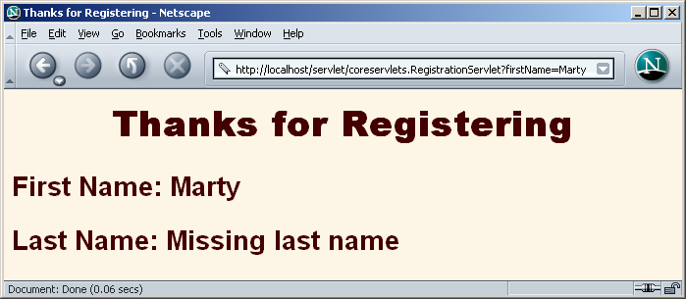
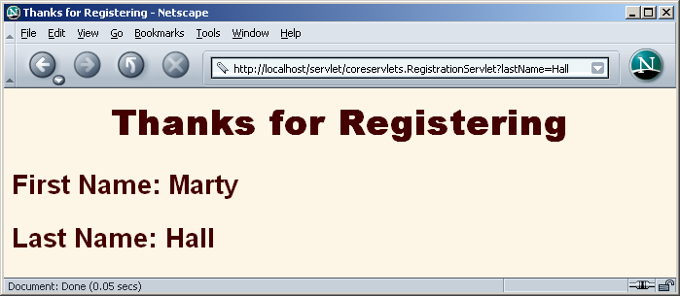
Session-Based Sharing: Results

Slide 49
Comparing Data-Sharing Approaches: ServletContext
Goal
Display a prime number of a specified length.
If the user fails to tell us the desired length, we want to use whatever prime number we most recently computed for any user.
Type of sharing
Data is shared among multiple clients, so application-based sharing is appropriate.

Slide 50
ServletContext-Based Sharing: Bean
package coreservlets;
import java.math.BigInteger;
public class PrimeBean {
private BigInteger prime;
public PrimeBean(String lengthString) {
int length = 150;
try {
length = Integer.parseInt(lengthString);
} catch(NumberFormatException nfe) {}
setPrime(Primes.nextPrime(Primes.random(length)));
}
public BigInteger getPrime() {
return(prime);
}
…
}

Slide 51
ServletContext-Based Sharing: Servlet
public class PrimeServlet extends HttpServlet {
public void doGet(HttpServletRequest request, HttpServletResponse response)
throws ServletException, IOException {
String length = request.getParameter("primeLength");
ServletContext context = getServletContext();
synchronized(this) {
if ((context.getAttribute("primeBean") == null) ||
(length != null)) {
PrimeBean primeBean = new PrimeBean(length);
context.setAttribute("primeBean", primeBean);
}
String address = "/WEB-INF/mvc-sharing/ShowPrime.jsp";
RequestDispatcher dispatcher = request.getRequestDispatcher(address);
dispatcher.forward (request, response);
}
}
}

Slide 52
ServletContext-Based Sharing: JSP 1.2
…
<BODY>
<H1>A Prime Number</H1>
<jsp:useBean id="primeBean"
type="coreservlets.PrimeBean"
scope="application" />
<jsp:getProperty name="primeBean"
property="prime" />
</BODY></HTML>

Slide 53
ServletContext-Based Sharing: JSP 2.0
…
<BODY>
<H1>A Prime Number</H1>
${primeBean.prime}
</BODY></HTML>

Slide 54
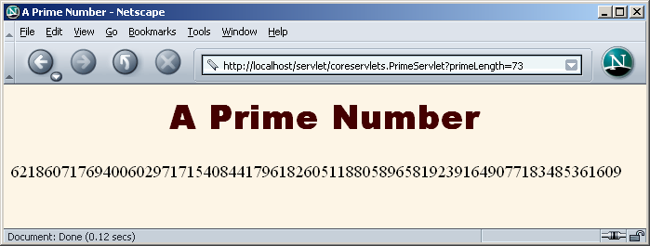
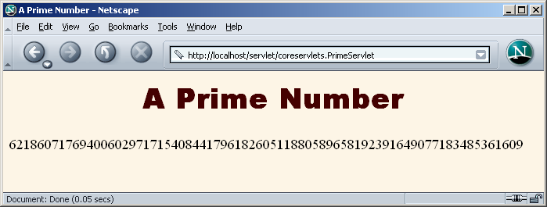
ServletContext-Based Sharing: Results

Slide 55
Forwarding from JSP Pages
<% String destination;
if (Math.random() > 0.5) {
destination = "/examples/page1.jsp";
} else {
destination = "/examples/page2.jsp";
}
%>
<jsp:forward page="<%= destination %>" />
Legal, but bad idea
Business and control logic belongs in servlets
Keep JSP focused on presentation

Slide 56
Including Pages Instead of Forwarding to Them
With the forward method of RequestDispatcher:
Control is permanently transferred to new page
Original page cannot generate any output
With the include method of RequestDispatcher:
Control is temporarily transferred to new page
Original page can generate output before and after the included page
Original servlet does not see the output of the included page (for this, see later topic on servlet/JSP filters)
Useful for portals: JSP presents pieces, but pieces arranged in different orders for different users

Slide 57
Including Pages Instead of Forwarding to Them
response.setContentType("text/html");
String firstTable, secondTable, thirdTable;
if (someCondition) {
firstTable = "/WEB-INF/Sports-Scores.jsp";
secondTable = "/WEB-INF/Stock-Prices.jsp";
thirdTable = "/WEB-INF/Weather.jsp";
} else if (...) { ... }
RequestDispatcher dispatcher = request.getRequestDispatcher("/WEB-INF/Header.jsp");
dispatcher.include(request, response);
dispatcher = request.getRequestDispatcher(firstTable);
dispatcher.include(request, response);
dispatcher = request.getRequestDispatcher(secondTable);
dispatcher.include(request, response);
dispatcher = request.getRequestDispatcher(thirdTable);
dispatcher.include(request, response);
dispatcher = request.getRequestDispatcher("/WEB-INF/Footer.jsp");
dispatcher.include(request, response);

Slide 58
Summary
Use MVC (Model 2) approach when:
One submission will result in more than one basic look
Several pages have substantial common processing
Architecture
A servlet answers the original request
Servlet does the real processing & stores results in beans
Beans stored in HttpServletRequest, HttpSession, or ServletContext
Servlet forwards to JSP page via forward method of RequestDispatcher
JSP page reads data from beans by means of jsp:useBean with appropriate scope (request, session, or application)
Or, in JSP 2, with ${beanName.propertyName}

