Slide 1
Plotting Parallel Performance: Examples
Plotting Parallel Runtime, Speedup, Efficiency
CptS 411: Intro to Parallel Computing

Slide 2
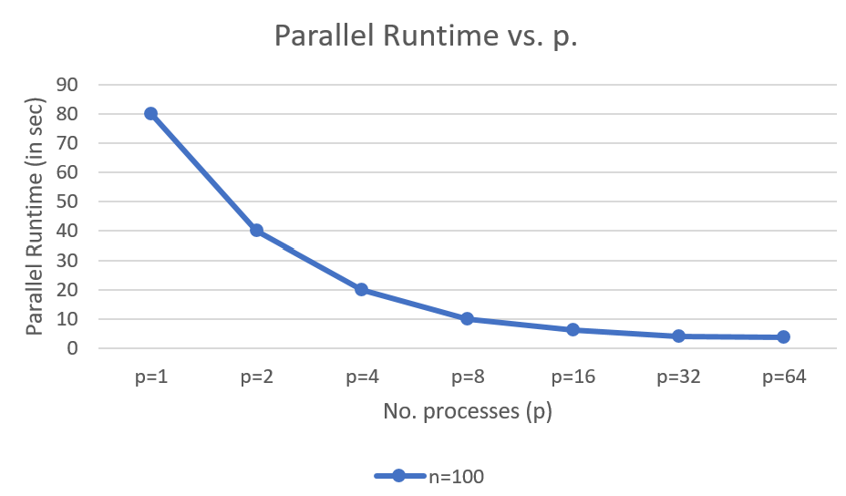
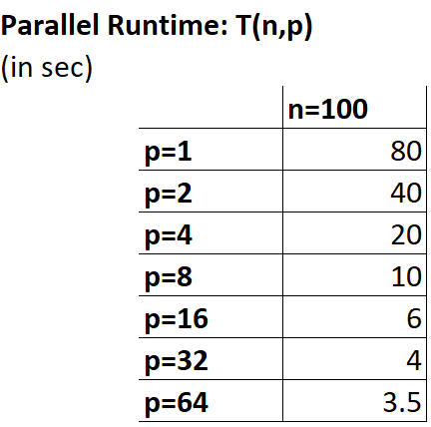
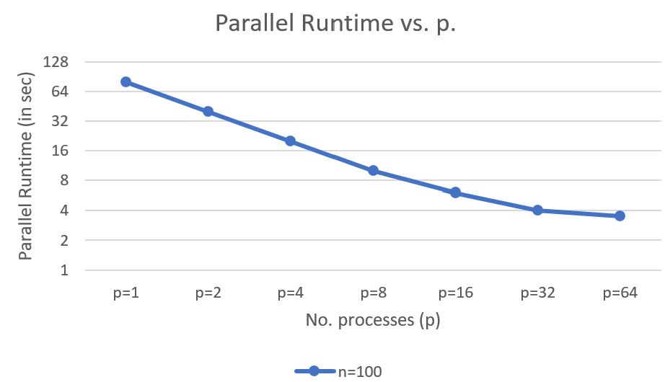
Parallel Runtime
Input size (n)
No. processes (p)
Log scale
CptS 411: Intro to Parallel Computing

Slide 3
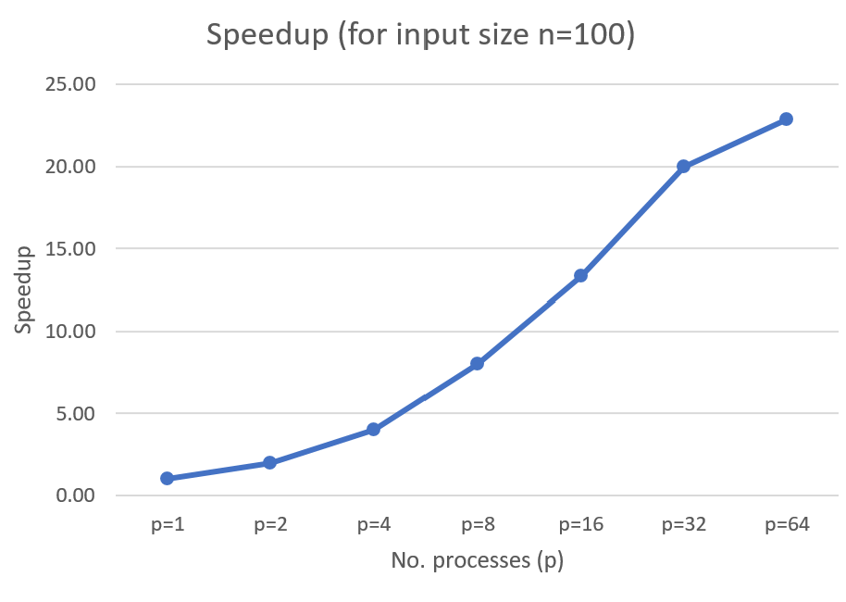
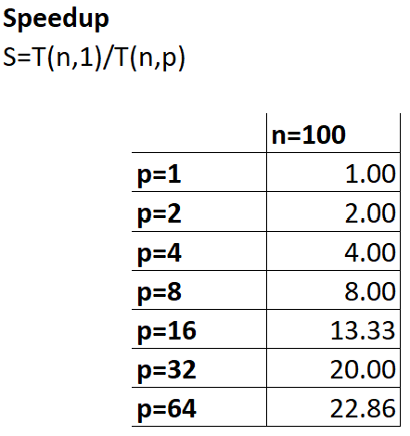
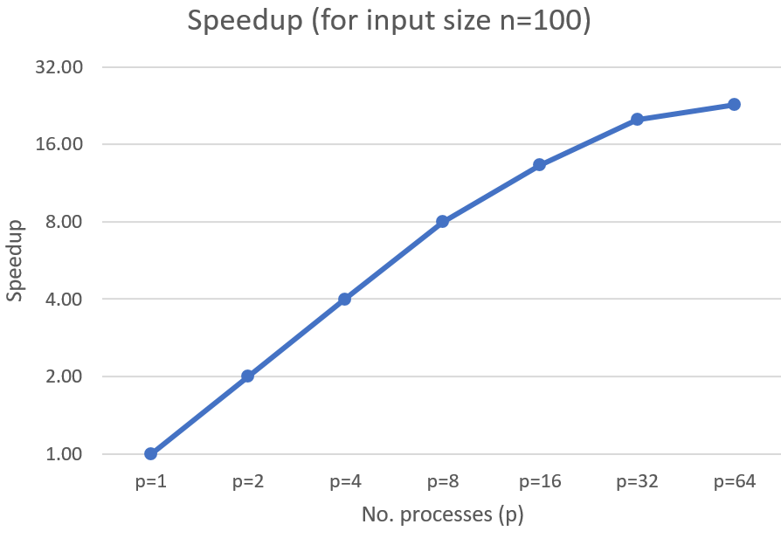
Speedup
Input size (n)
No. processes (p)
Log scale
CptS 411: Intro to Parallel Computing

Slide 4
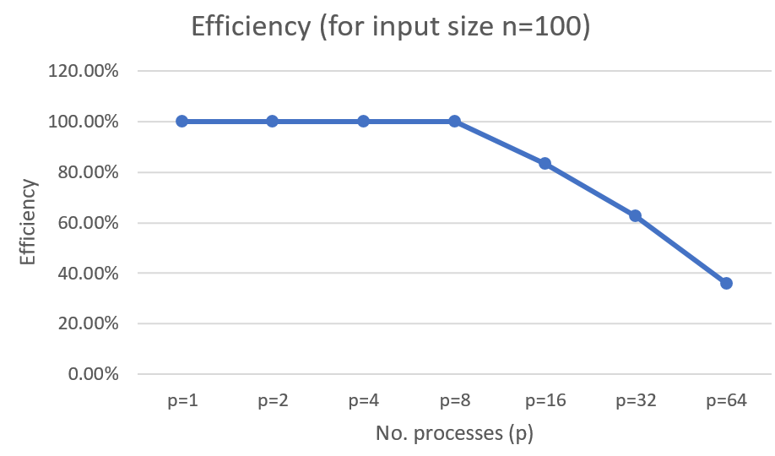
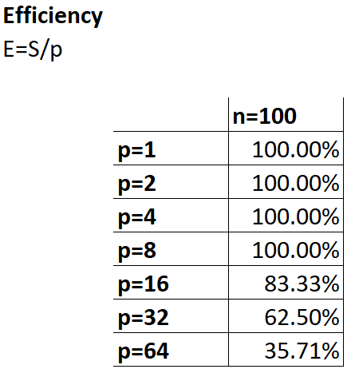
Efficiency
Input size (n)
No. processes (p)
CptS 411: Intro to Parallel Computing

Slide 5
Comparing two algorithms
Given: Alg A vs. Alg B
Fix input size (n)
Vary no. processes (p)
Plot T(n,p)
Derive speedup and efficiency, and compare
CptS 411: Intro to Parallel Computing

Slide 6
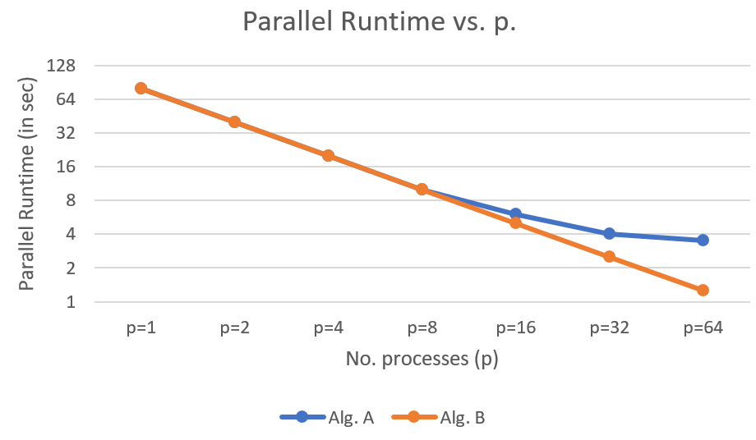
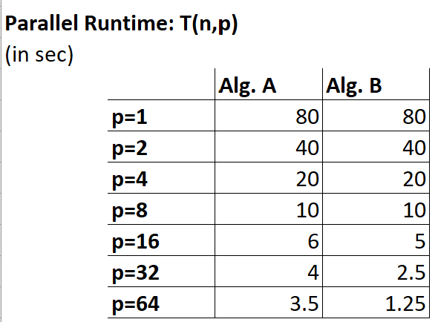
Parallel Runtime
Input size (n)
No. processes (p)
CptS 411: Intro to Parallel Computing

Slide 7
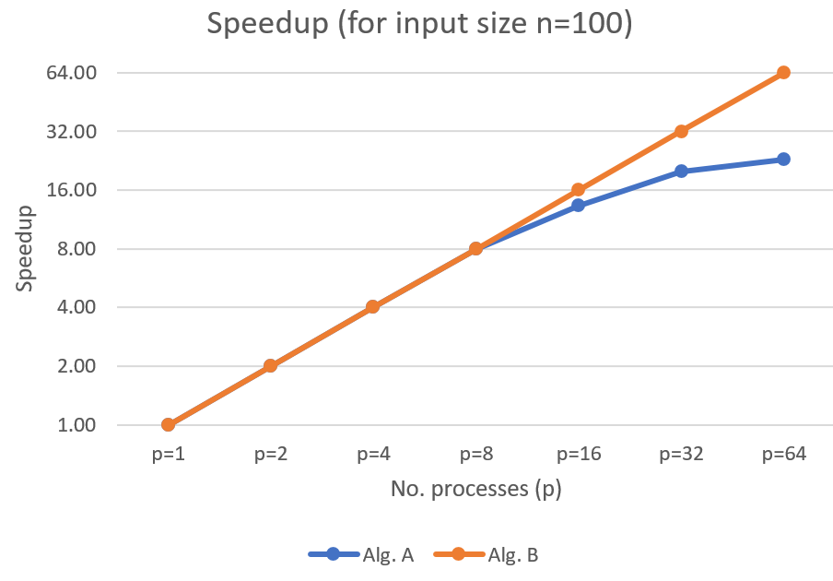
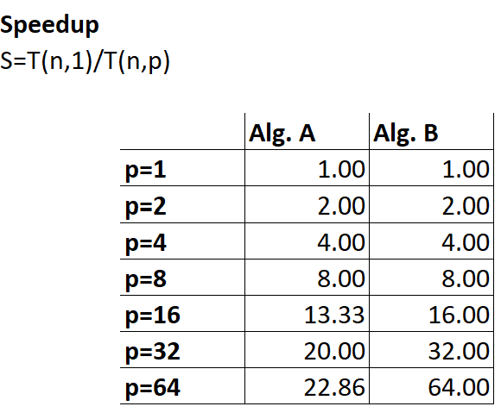
Speedup
Input size (n)
No. processes (p)
Note: Alg. B’s trend is what we sometimes call an “Ideal Speedup” trend
CptS 411: Intro to Parallel Computing

Slide 8
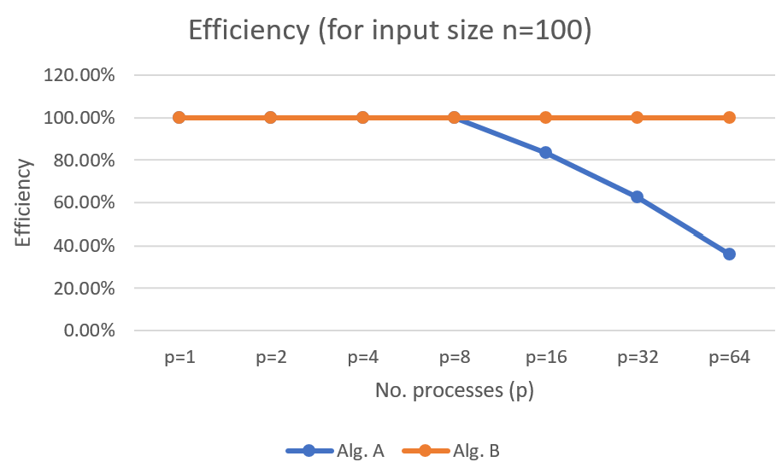
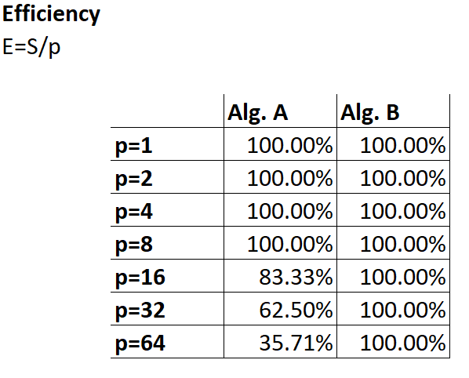
Efficiency
Input size (n)
No. processes (p)
CptS 411: Intro to Parallel Computing

Slide 9
Plotting for multiple input sizes
Vary n
Vary p
Tabulate T(n,p)
Derive Speedup and Efficiency
CptS 411: Intro to Parallel Computing

Slide 10
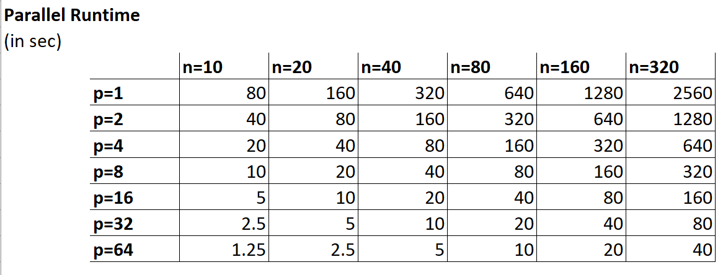
Parallel Runtime
CptS 411: Intro to Parallel Computing

Slide 11
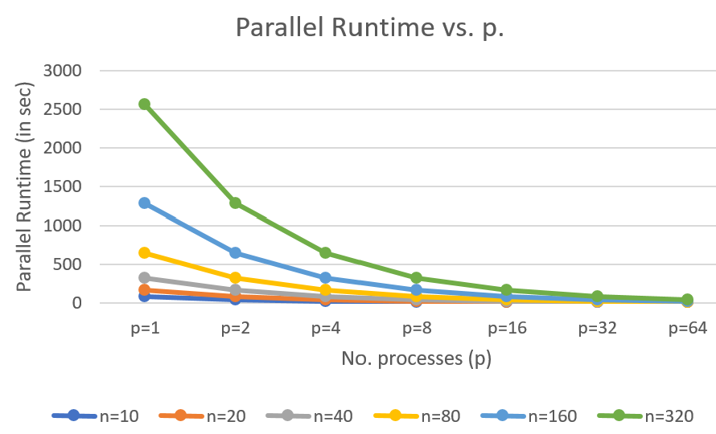
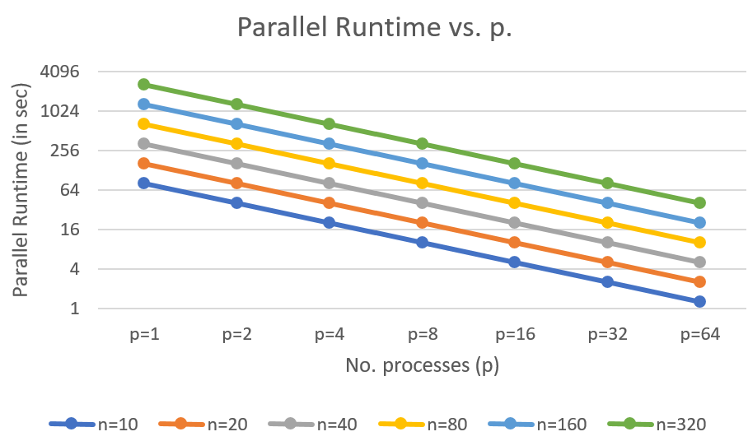
Parallel Runtime
(with log scale on y-axis)
You can plot speedup and efficiency plots similarly
CptS 411: Intro to Parallel Computing

Slide 12
Sum of p elements
Example charts
CptS 411: Intro to Parallel Computing

Slide 13
Sum of p numbers
The parallel algorithm we discussed in class to sum p numbers, using p processing elements, has the following complexity:
Runtime complexity = O(lg p) ➔ T(n,p)
This implies the following:
Speedup = O(p/lg p) ➔ S(n,p)
Efficiency = O(1/lg p) ➔ E(n,p)
What do the curves look like for these measures as a function of p?
CptS 411: Intro to Parallel Computing

Slide 14
Speedup
Note the lg scale along the axes.
CptS 411: Intro to Parallel Computing

Slide 15
Efficiency
What does this difference mean?
Number of processes (p)
CptS 411: Intro to Parallel Computing

