Slide 1
Jira Tool Bug Tracking
By
Hussainaiah Muppuri

Slide 2
What is a bug and issue tracking tool ?
Bug and issue tracking tools help software teams find, record, and track bugs in their software. It's critical that everyone on your team is able to find and record bugs, and even more important, assign them to the right team members at the right time. A great bug and issue tracking tool gives your team a single view of all items in the backlog, regardless of whether the work item is a bug or a task related to new feature development. Having a single source of truth of all issue types helps teams prioritize against their big picture goals, while continually delivering value to their customers.
Jira Software for bug tracking
Quickly capture, assign and prioritize bugs with Jira Software and track all aspects of the software development cycle. Jira's powerful workflow engine provides a clear view of a bug's status, and automation keeps you in the know with notifications as issues transition from backlog to done. Jira Software is the connective tissue for your software team, giving you full visibility and control of your products' end-to-end development.

Slide 3
Capture and track bugs in your software
Capture bugs anywhere in your software projects with Jira Software. Once you've identified a bug, create an issue and add all relevant details, including descriptions, severity level, screenshots, version, and more. Issues can represent anything from a software bug, a project task to a leave request form, and each unique issue type can have its own custom workflow.
Track bugs from backlog to done
Always stay in the know by tracking bugs and issues through your team's workflow. Jira Software has a powerful workflow engine, planning features, comprehensive search, and reporting capabilities designed to help you find, record, and track bugs in your software.

Slide 4
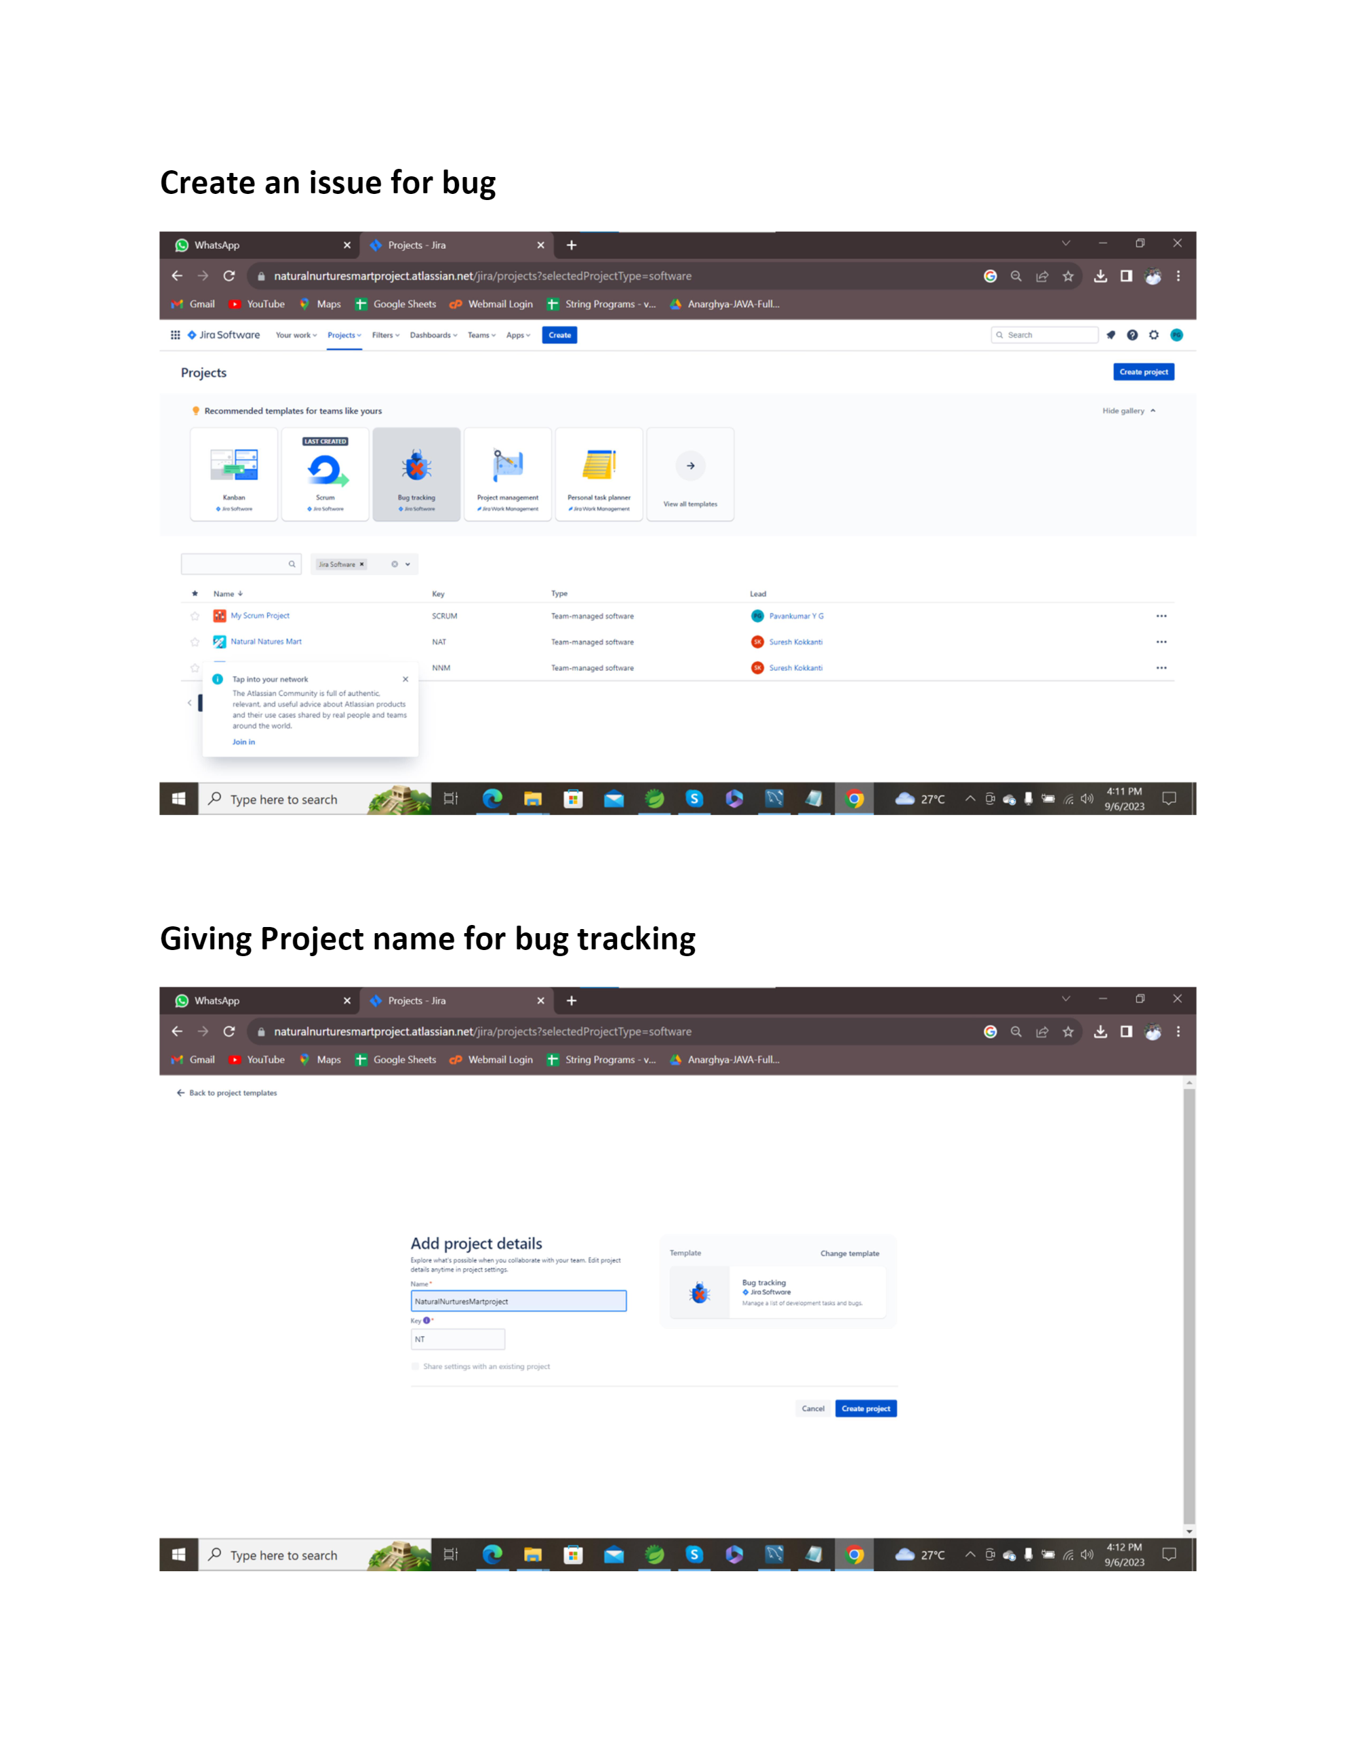

Slide 5
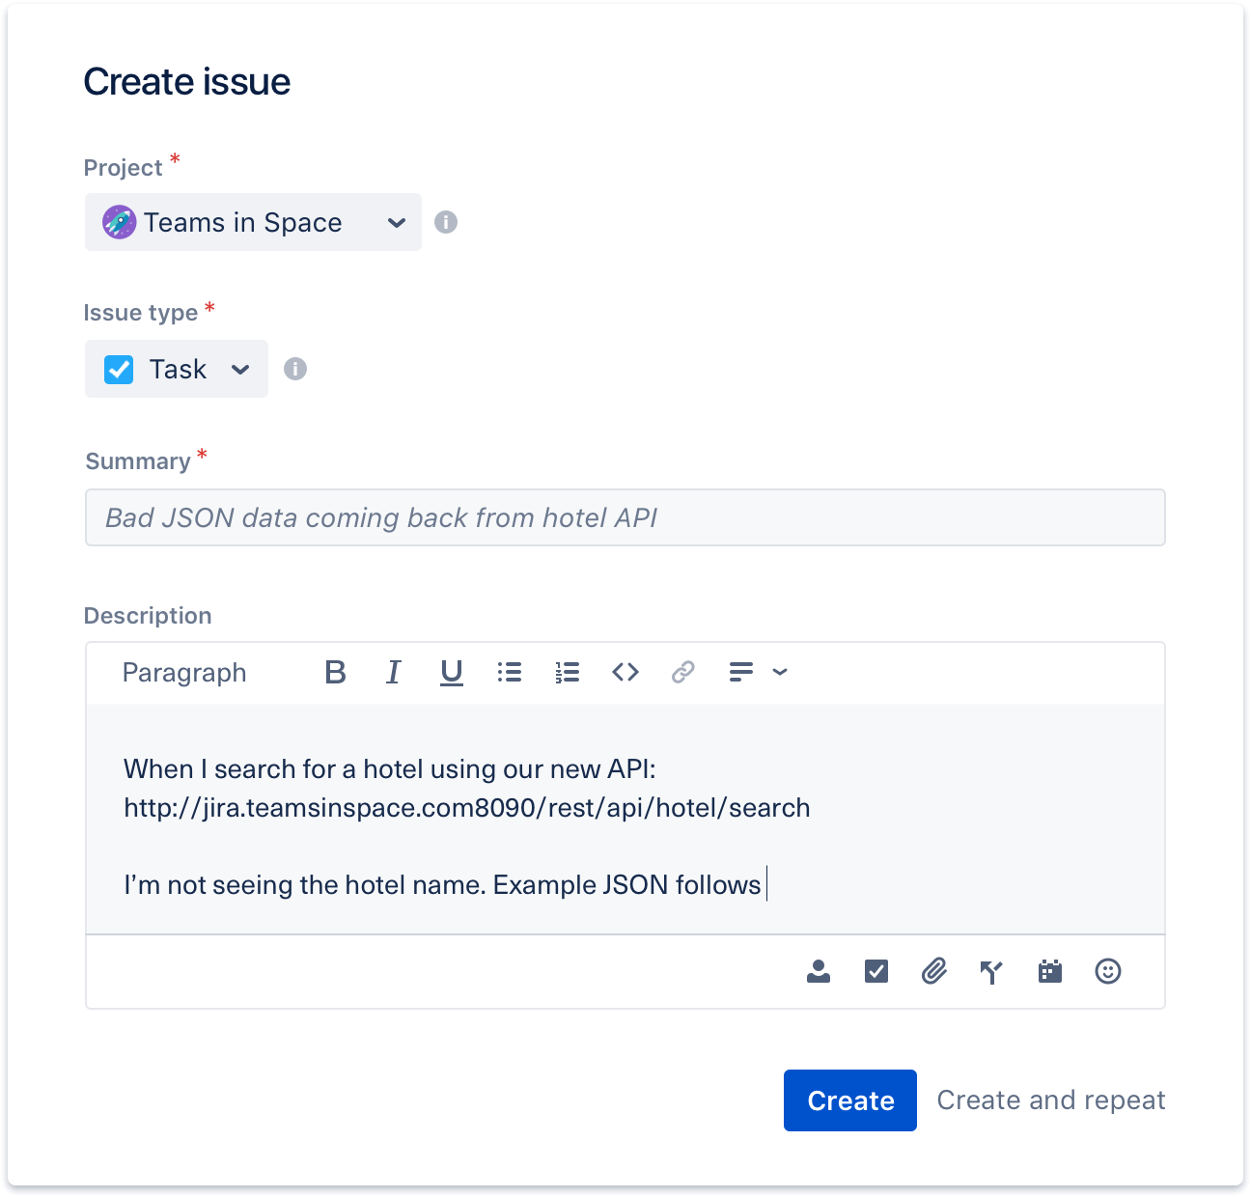

Slide 6
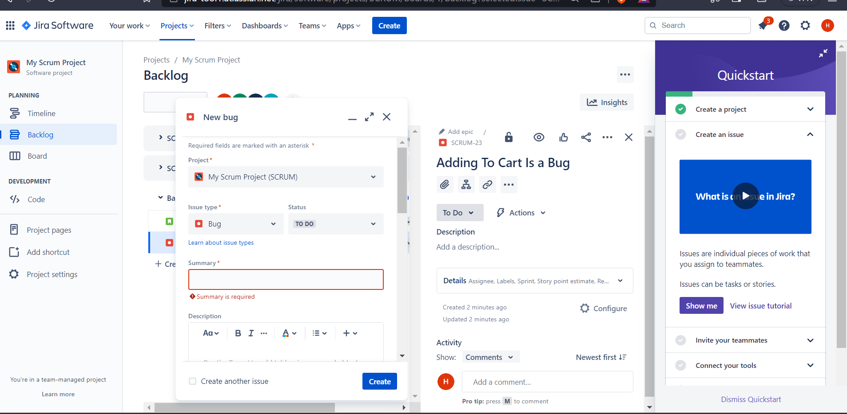

Slide 7
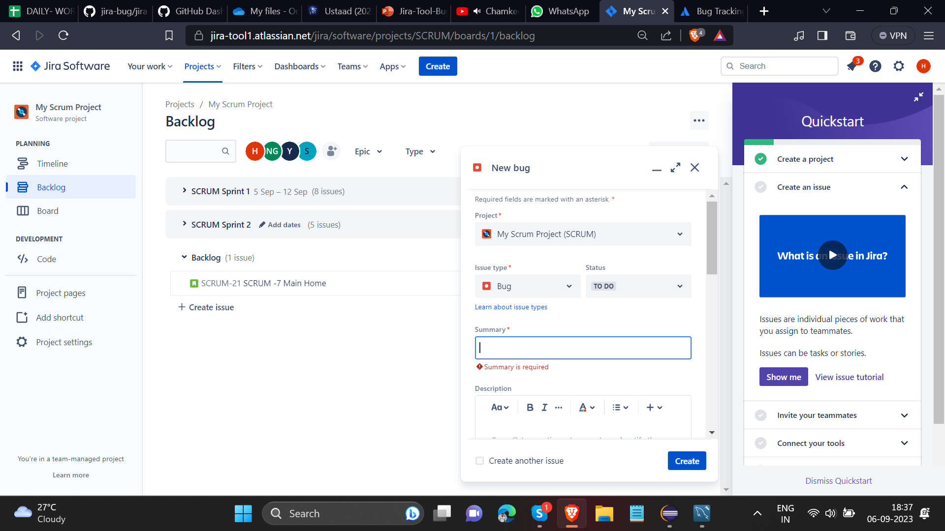

Slide 8
Thank You

