Slide 1
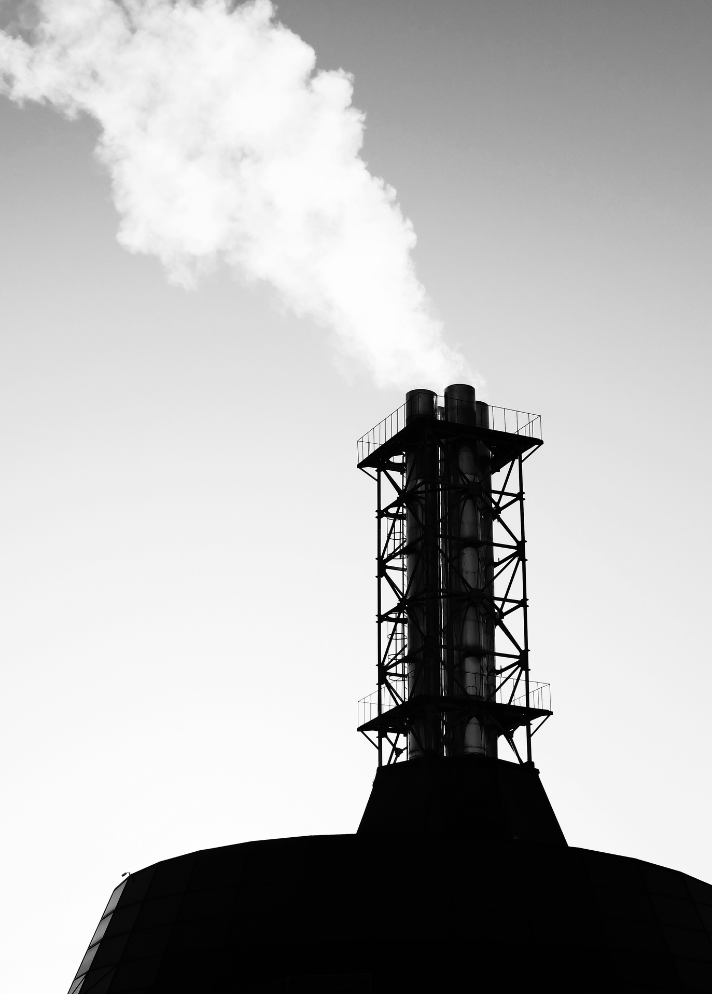
Carbon Majors
Global Industrial Emissions
Done by : Hussain Alshaway

Slide 2



Introduction
This dataset is important because it provides a reliable basis for analyzing how emissions change over time, which essential for understanding trends, identifying emerging risks, and guiding better environmental decisions

Slide 3


Problem Statement
The global emissions from major industries increased by about 4628% since 1950, driven by production expansion

Slide 4
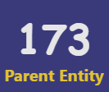


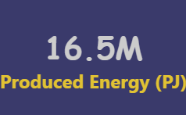
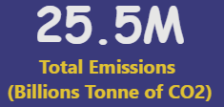
Key dimensions of
Carbon Emissions
Page 03

Slide 5

Objectives
1- To highlight where the highest contributions come from and why certain entities impact the environment more than others
2- To see how ownership structures might influence emission performance
3- To identify the worst entities in operation

Slide 6
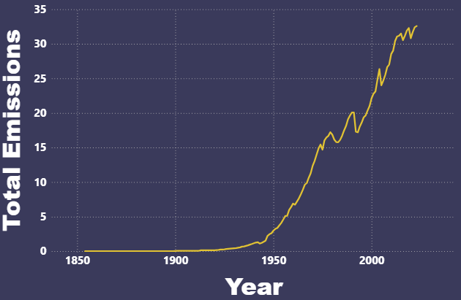
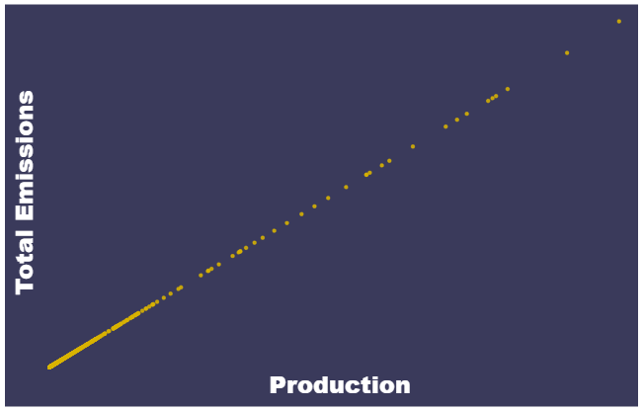
How do the total emissions change over time?

Slide 7
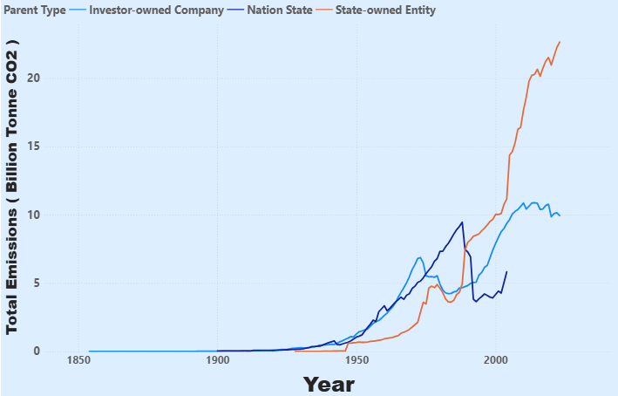
How Ownership Shapes the Trend?

Slide 8
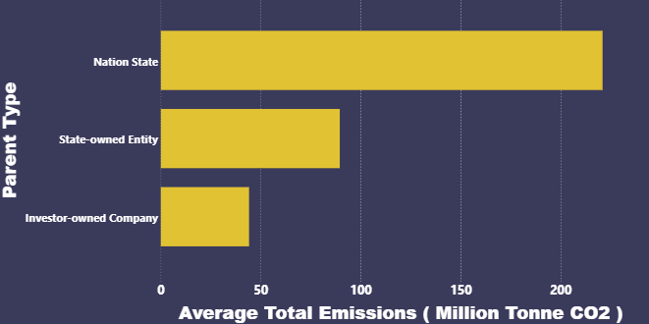
Nation States Added the Most Carbon

Slide 9
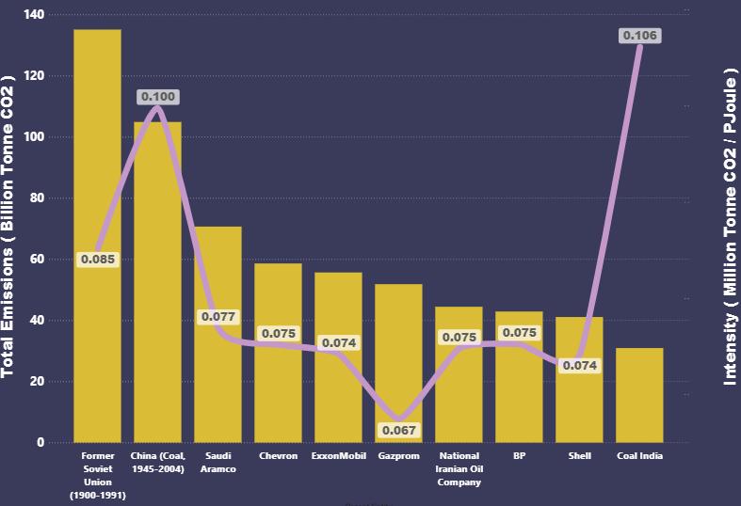
Total Emissions Don’t tell the Full Story—Or Do They?

Slide 10
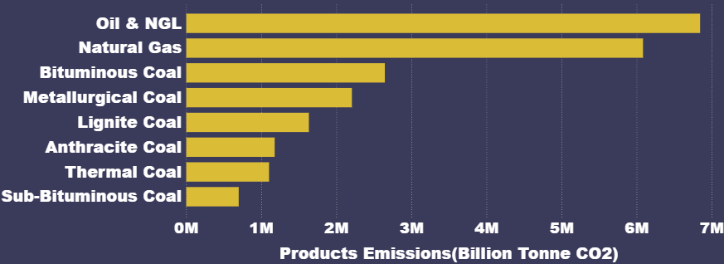
Oil , NGL s, and natural gas contributed the most in product emissions

Slide 11
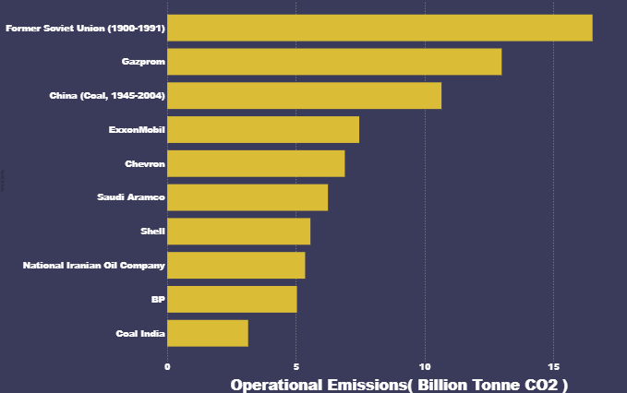
Cutting Out the Market: Which Entity Emits Most at Source?

Slide 12


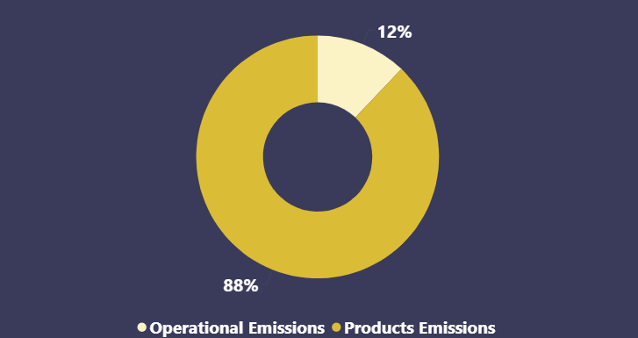
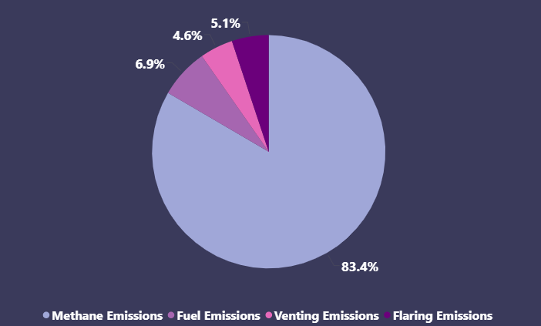
Emission Sources

Slide 13
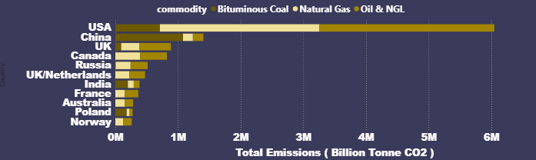
Highest Contributors to Total Emissions

Slide 14
Conclusion & Findings
1- Total Emissions are rapidly increasing due to industrial growth by both the state and investors
2- Emission intensity is a good KPI to measure the industrial efficiency
2- Products emissions is contributing the most to total emissions
4- Usage of Oil and natural gas caused the highest total emissions

Slide 15
Recommendations
Operation | Only 0.1% of global annual emissions are being captured, so, building carbon Capture plants would be useful to minimize the carbon released to atmosphere | Only 0.1% of global annual emissions are being captured, so, building carbon Capture plants would be useful to minimize the carbon released to atmosphere
Operation | Usage of infrared cameras, ultrasonic sensors, or settelite to detect leaks of methane in the pipes | Usage of infrared cameras, ultrasonic sensors, or settelite to detect leaks of methane in the pipes
Products | Transition to electric cars that produce zero tailpipe emissions | Transition to electric cars that produce zero tailpipe emissions
Products | Improve public transport to reduce car dependency | Improve public transport to reduce car dependency
Products | Encourage smaller cars; SUVs emits 30-40% more CO2 than small cars | Encourage smaller cars; SUVs emits 30-40% more CO2 than small cars
Products | Use low carbon fuels (biofuel) | Use low carbon fuels (biofuel)

Slide 16


Tools used

Slide 17
Thank you very much!

