Slide 1
Car2Go
Mubeen Khan, Hussain Amin, Sayem Shah, Maxym Galenko

Slide 2
Scenario
The scenario we have selected consist of a company called Car2Go which is a car rental company.
It offers different car models, colors and “year made” to customers in different company locations.

Slide 3
Who Did What
We haven’t really given a role or a big task to anyone in particular. We all worked equally at each step of the project and helped each other out.

Slide 4
Business Rules
Each car has a unique license plate
Customer can only rent one car at a time
If the car requested by the customer is not available, they can get a car of higher class at the same price as the car requested
Company keeps track of the rented cars
Company keeps record of the customer
All cars in the same class have the same price
Drop-off charge can be found with the price of the car, duration in days, and promotion, if there are any.
For every car rented, the company keeps the odometer reading before it is rented and after it is returned
The cars rented in a particular location may be returned to a different location
When a car is being returned the company records the tank Volume and indicate whether the tank is empty, quarter full, half full, three quarters full, or full.
The company also keeps track of the day a car was rented and returned

Slide 5
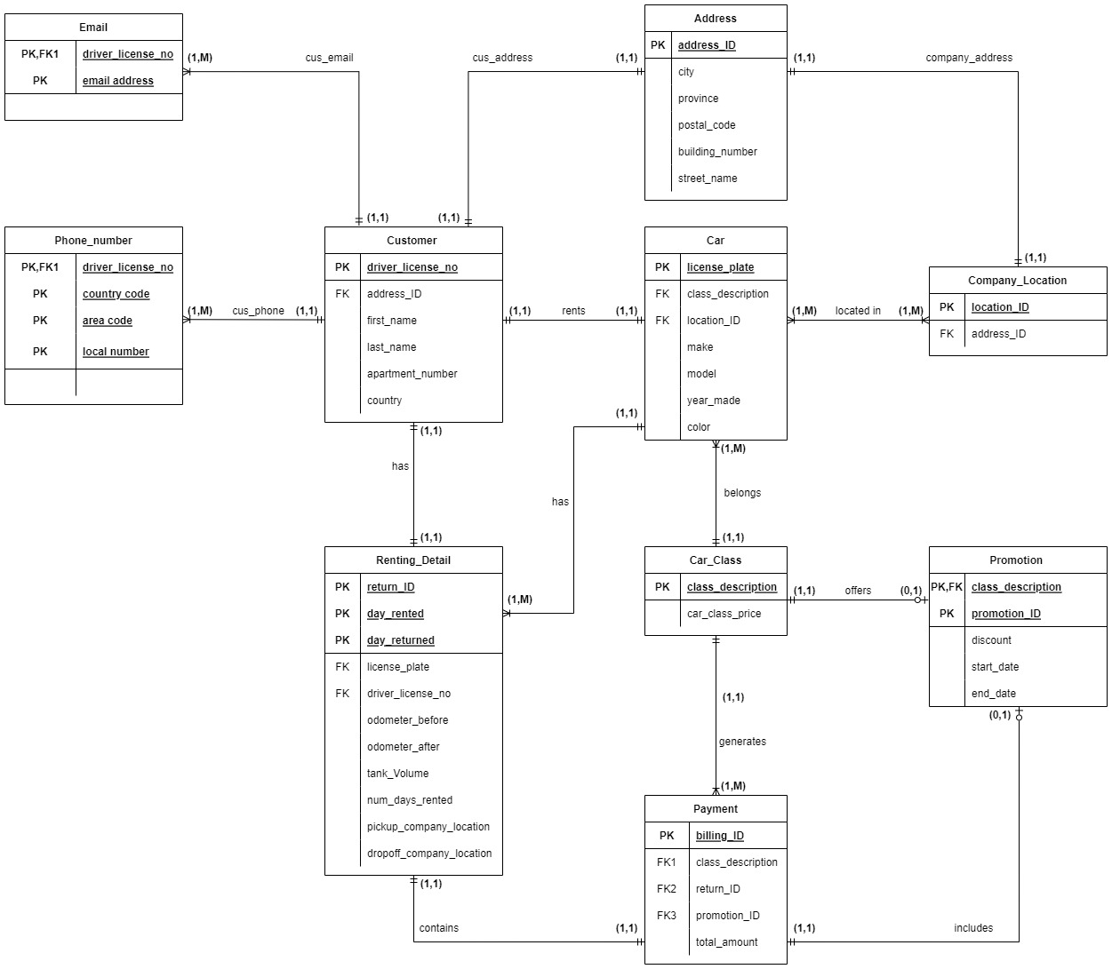
ERD
The attribute driver_license_number was removed from the Car Table(moved to Renting_detail)
The attribute car_class_id was replaced by class_description in the table Car_class (changes were made in every table that had car_class_id)
It was recommended that we add car_id (PK), however, we turned license_plate into a PK instead
The attributes driver_license_no , pickup_company_location and dropoff_company_location were included in the table Renting_Detail
Removed the connection between Car_class and Renting_Detail (class_description was a PK in Car table + no more car_class_id)

Slide 6
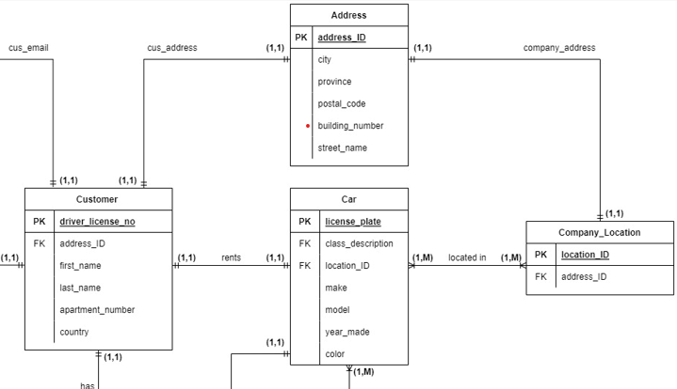
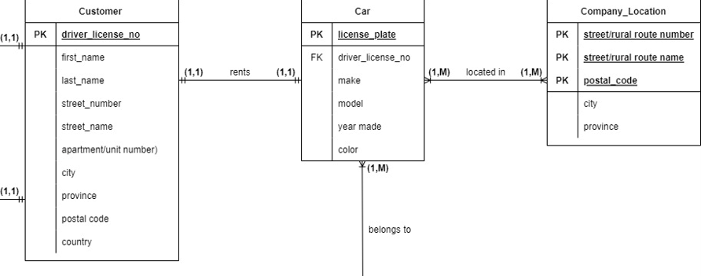
Normalization
The table Address was added to the ERD in order to identify the addresses for each record in the tables Customer and Company_Location
This change allowed us to the 2NF from deliverable 1

Slide 7
Relation Schema
Email ( driver_license_no, email_address )
Phone_Number ( driver_license_no, country_code, area_code, local_number )
Address ( address_ID, city, province, postal_code, building_number, street_name )
Customer ( driver_license_no, address_ID, first_name, last_name, apartment_number, country )
Company_Location ( location_ID, address_ID )
Car ( license_plate, class_description, location_ID, make, model, year_made, color )
Car_Class ( class_description, car_class_price )
Renting_Detail ( return_ID, day_rented, day_returned, license_plate, driver_license_no, odometer_before, odometer_after, tank_volume, num_days_rented, pickup_company_location, dropoff_company_location )
Promotion ( class_description , promotion_ID, discount, start_date, end_date )
Payment ( billing_ID, class_description, return_ID, promotion_ID, total_amount )

Slide 8
Query Statements
Most queries allow us to find simple data from one table or many tables joint together that satisfy our needs.
For Example:
Display the cars that where made before 2018.
Display all values of customers that have an email address that start with "mat“.
Display the license plate, make, color, and year made of all cars that have a promotion that starts after '2020-09-01’, while using subqueries.
Most complex query:
CREATE FUNCTION dbo.ufnGetcalculatePayment(@BillingID VARCHAR(10) )
It’s the most complex and the most useful query we have.
Allows us to calculate the total amount in a Payment, whether they have a promotion or not.

Slide 9
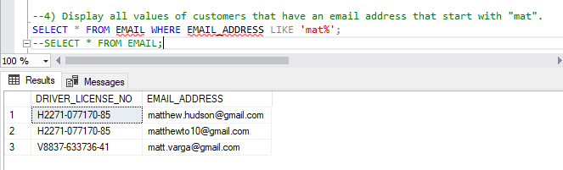
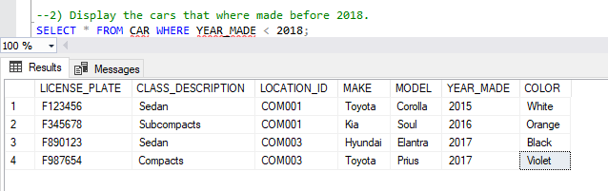
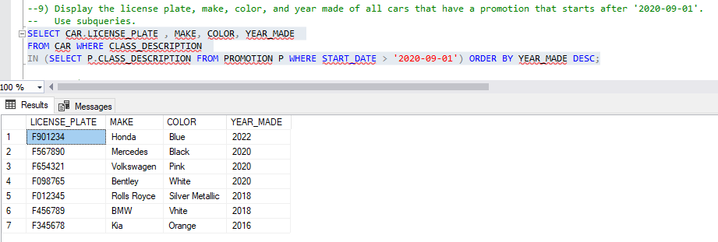
Query Statements (continued)

Slide 10
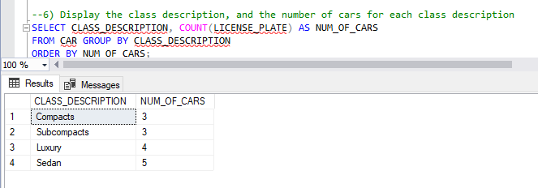
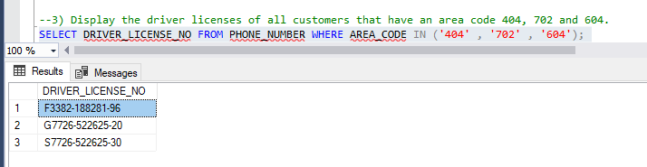
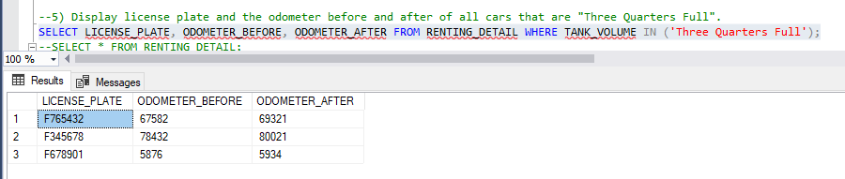
Query Statements (continued)

Slide 11
Views
v_listOfCarsRentedInPast6Months
Displays all license plates for cars rented in the past 6 months along with the driver license, first name, last name and phone number of the customer
v_listOfCustomersThatLiveInUSA
Display DRIVER_LISCENSE_NO, FIRST_NAME, LAST_NAME and EMAIL_ADDRESS of cutomers that live in USA

Slide 12
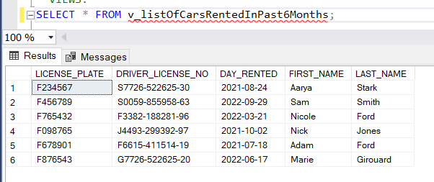
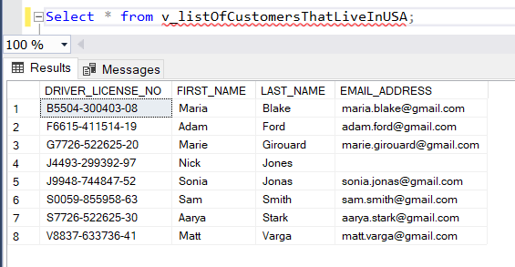
Views

Slide 13
Stored Procedures
dbo.uspAddPromotion
This procedure adds an additional 50$ promotion for all vehicles belonging to a given class
dbo.CustomerInformation
Displays the most important information of a customer, just by giving the Driver license number. So it displays the driver license number, first name, last name, email, country code, area code, local number, city, province, postal code
If customer has 2 email, it will print 2 rows with same customer but different emails.
Same thing will occur if the customer has 2 phone numbers

Slide 14
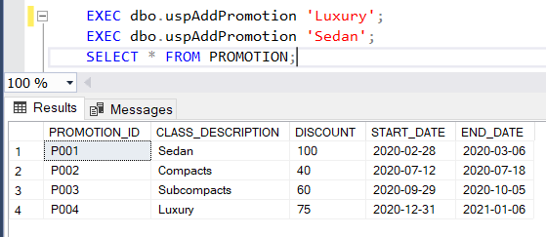
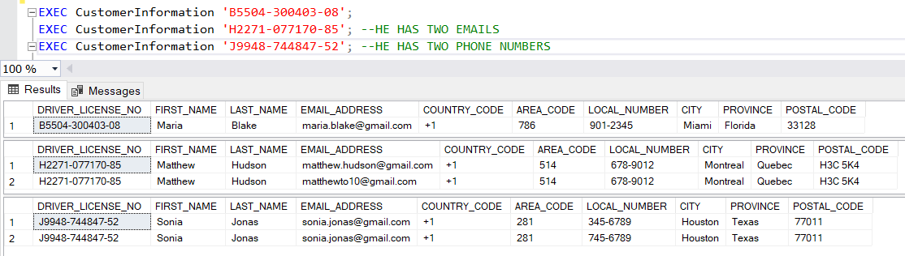
Stored Procedures

Slide 15
How to Improve the Database (approach)
Organize the source code better to make it more clean and clear (easier to understand)
Write the code in a way that you just need to hit execute without selecting different parts of the code to run it
Make sure the ER diagram is well done and complete before coding to make it easier

Slide 16
Challenges Faced
ER Diagram
Connecting the tables
Finding the primary keys
Creating functions
Creating attributes (constraint errors)
Having a good number of tables
Normalization (2NF)
Variable datatype
Query Number 10:
Calculating the price with and without promotion
Solution: Cartesian Product

Slide 17
Conclusion
In conclusion, this project helped us learn a lot of important things such as creating a database, using SQL and managing our time and work as a team.

