Slide 1
Counter
Digital electronics

Slide 2
Introduction to counter
A counter is a sequential digital device, which stores (or sometimes displays)the number of times a particular event or process has occurred.
Counters is a very wide application of flip-flops, where it is a group of flip-flops with a clock signal applied .

Slide 3
Types of counters :
Synchronous counters
Asynchronous counters

Slide 4
Difference between synchronous and asynchronous counter
Synchronous counter | Asynchronous counter
Only 1 clock pulse is common for all flip flop | each flip flop output serves as the clock input signal for the next FF in the sequence
It is a random counter | It is a sequential counter, which uses up counter or down counter
It is a faster then asynchronous counter | It is slower
Extra circuits requires | Less circuits required
Complex design | Simple design
Cost high | Cost low

Slide 5
Cont.
Synchronous counter | Asynchronous counter
Less delay | More delay
Ex. Ring counter, johnson counter | Ex. Ripple counter

Slide 6
Questions
How to find the Mod value of counter?
Different states
mod
After 21 clock pulse ,which state will come?
How to find no of flip flops required to design Mod –n counter?
2^{n}≥ N or log 2^{N}

Slide 7
More uses of counter
It is used to count the no. of pulses.
It can be used as frequency divider circuit
An n bit counter will have 2^{n} state

Slide 8
Applications
Digital clock
Frequency counter
Analog to digital converter

Slide 9
Designing of asynchronous counter
Decide the no. of flip flops
Type of flip flop
Truth table of counter
Obtain simplified equation using k-map
Draw the logic diagram

Slide 10
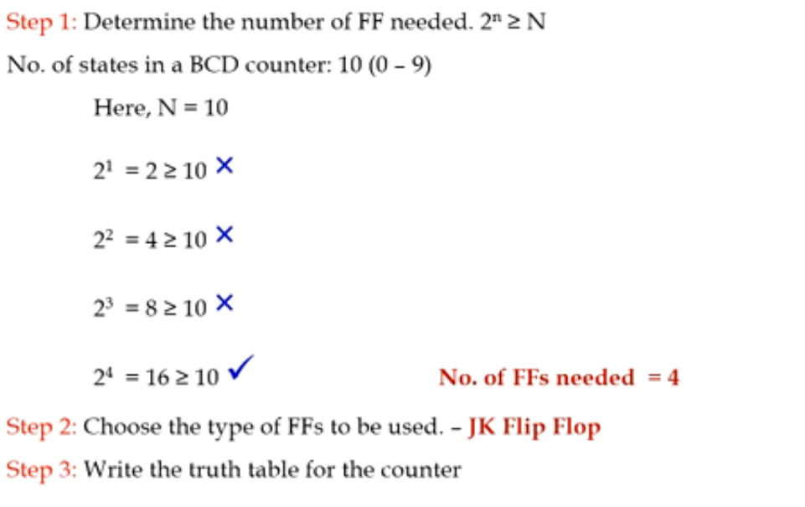
Design the BCD ripple counter

Slide 11
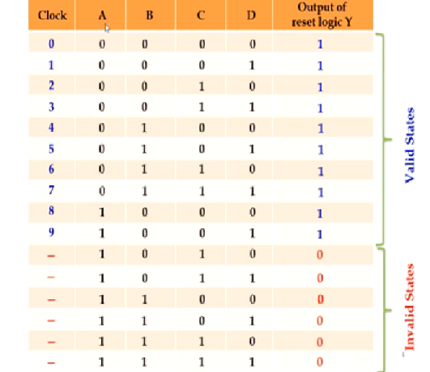
Truth table of counter

Slide 12
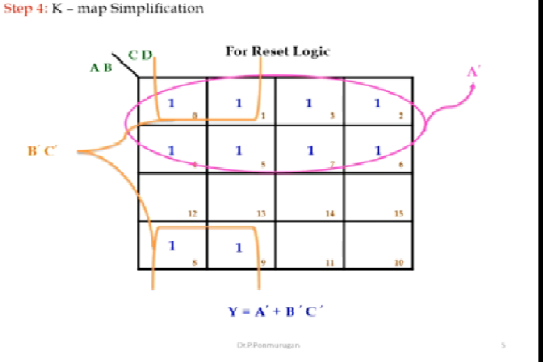

Slide 13
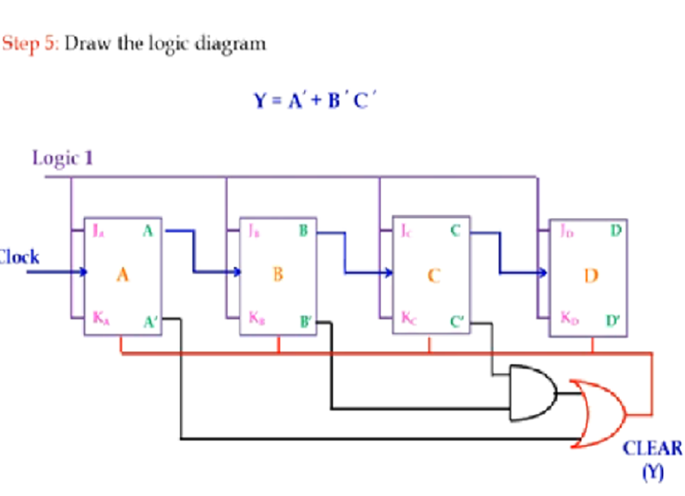

Slide 14
Designing of synchronous counter
Decide the no. of flip flops
Type of flip flop
Truth table/Excitation table of counter
Obtain simplified equation using k-map
Draw the logic diagram

Slide 15
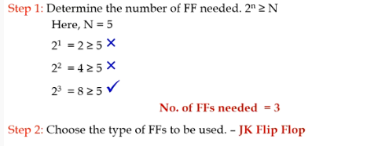
Design a mod-5 synchronous counter using jk flip flop

Slide 16
Excitation table of jk flip flop
Q | J | K | Q next
0 | 0 | 0 | 0
0 | 0 | 1 | 0
0 | 1 | 0 | 1
0 | 1 | 1 | 1
1 | 0 | 0 | 1
1 | 0 | 1 | 0
1 | 1 | 0 | 1
1 | 1 | 1 | 0
Q | Q next | J | K
0 | 0 | 0 | *
0 | 1 | 1 | *
1 | 0 | * | 1
1 | 1 | * | 0

Slide 17
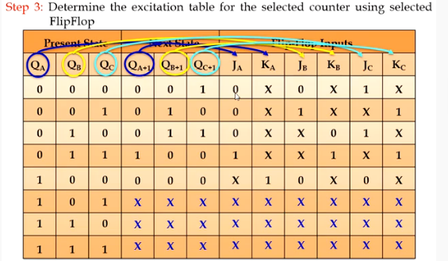
Truth table
Q | Q next | J | K
0 | 0 | 0 | *
0 | 1 | 1 | *
1 | 0 | * | 1
1 | 1 | * | 0

Slide 18
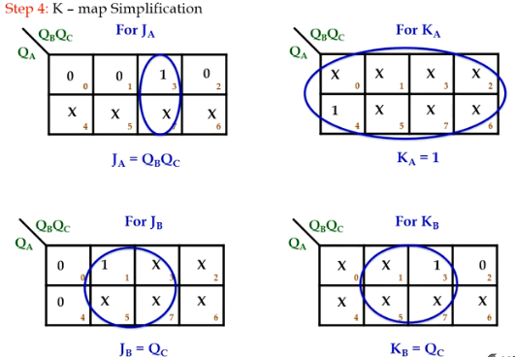

Slide 19
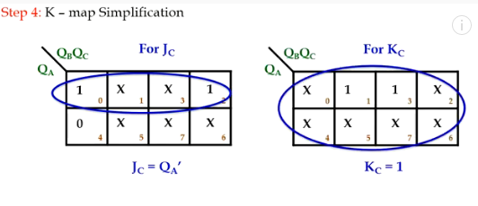

Slide 20
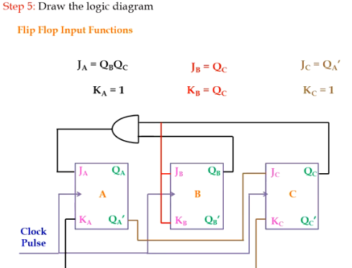

Slide 21
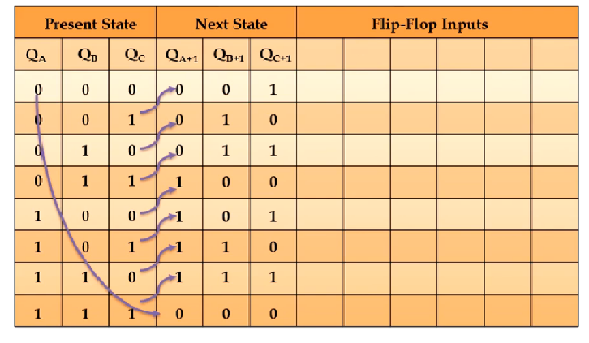
Design of 3 bit synchronous up counter

Slide 22
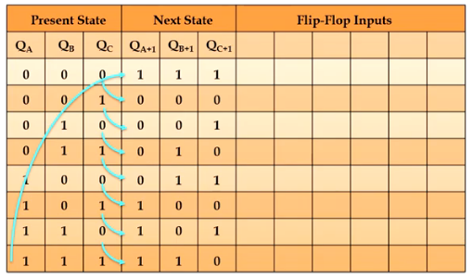
Design of 3 bit synchronous down counter

Slide 23
Thank you

