Slide 1
Kanban App
Developer: Hussain Farooqui
Full-Stack Web Application

Slide 2
Introduction
- Digital Kanban board for task management
- Allows create, read, update, delete (CRUD) tasks

Slide 3
Objectives
- CRUD operations for tasks
- JWT-based authentication
- Frontend deployed on Netlify
- Backend runs locally

Slide 4
Technology Stack
Frontend: React, Vite, Netlify
Backend: NestJS, Express, Prisma, PostgreSQL (local)

Slide 5
System Architecture
Frontend (Netlify) ↔ Backend (local) ↔ Database (local PostgreSQL)

Slide 6
Folder Structure
Frontend: Components, Pages, Assets
Backend: Modules (Users, Tasks, Auth), Controllers, Services

Slide 7
REST APIs (Local Backend)
- /users, /tasks, /auth
- JWT authentication implemented locally

Slide 8
Deployment
- Frontend deployed on Netlify
- Backend runs locally
- Environment variables configured locally

Slide 9
Challenges & Solutions
- Backend not deployed → working locally
- Local database required → PostgreSQL
- Future deployment plan: Vercel or other cloud provider

Slide 10
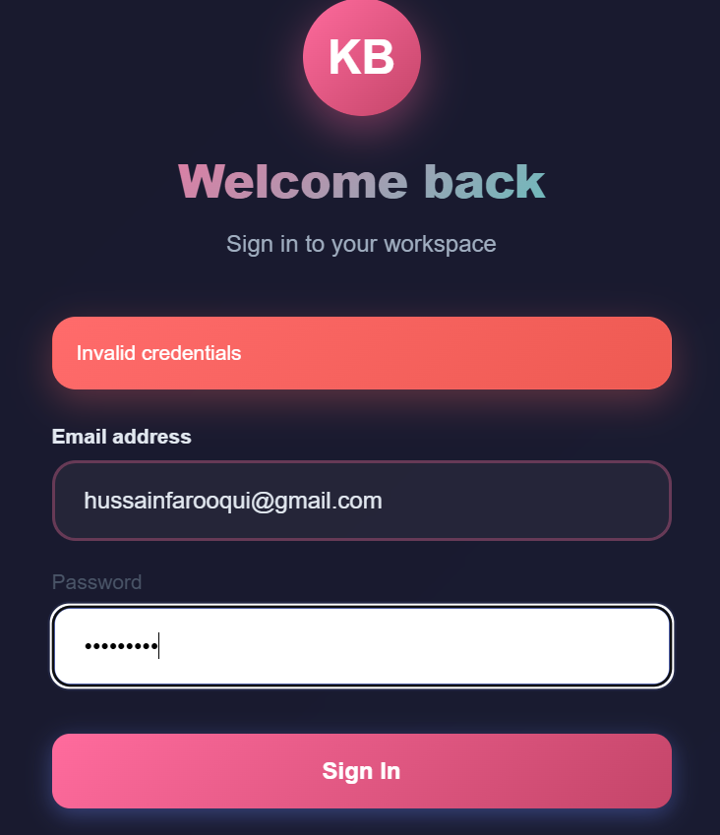
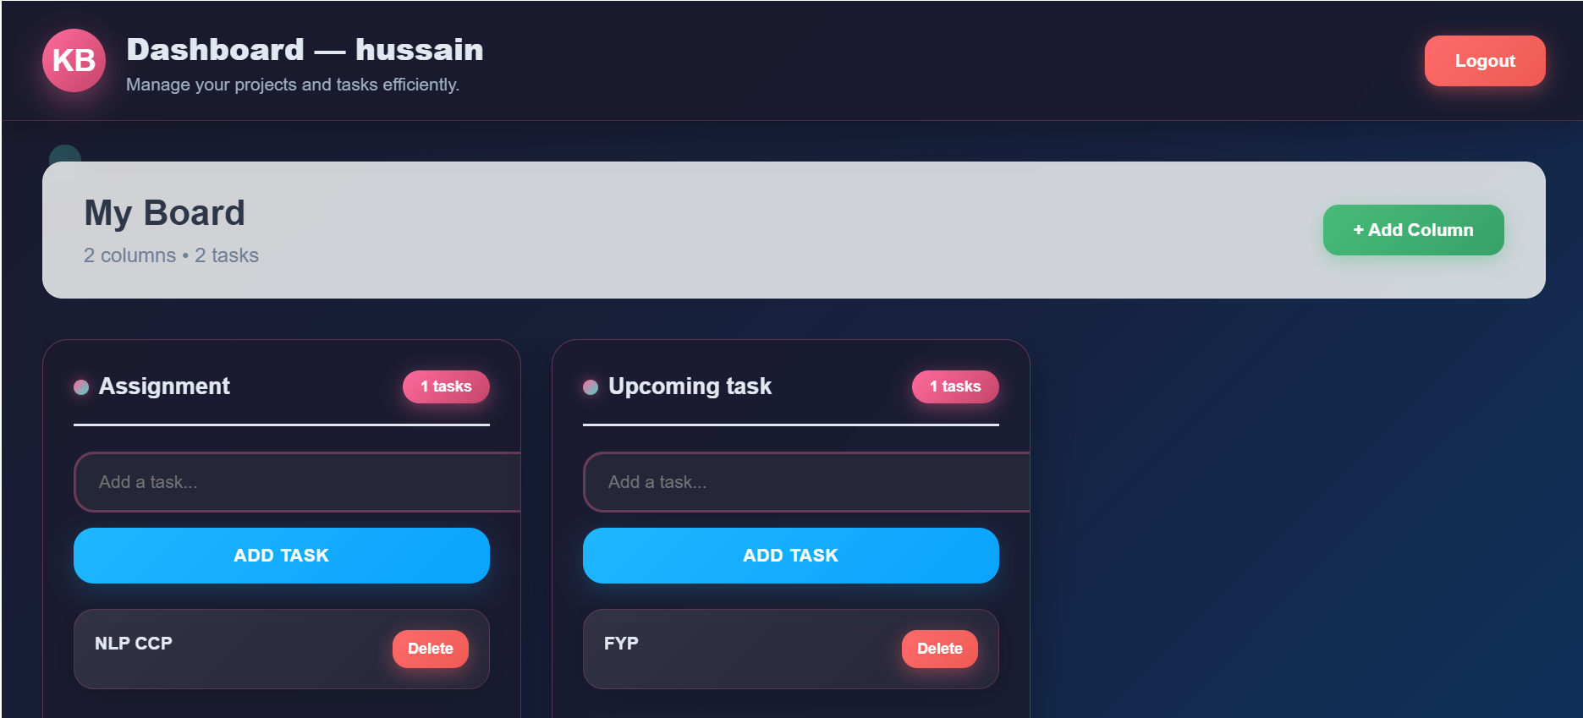
Demo / Screenshots

Slide 11
Conclusion
- Frontend fully functional and deployed
- Backend fully functional locally
- Full-stack testing possible

