Slide 1



BY SYED ARSHAD HUSSAIN
Ad hoc Insights Analysis
On consumer Goods

Slide 2

Objective
Atli Q Hardware is one of the major computer hardware manufacturers in India, with a strong presence in other nations.
Nevertheless, the management did note that they do not have sufficient insights to make prompt, wise, and darta-informed judgments.
Plan to expand the data analytics team by adding junior data analysts.
To assess candiates, data analytics director, Tony sharma plan to conduct a SQL challenge to evaluated both tech and soft skills.
The company seeks insights for 10 ad hoc requests.

Slide 3
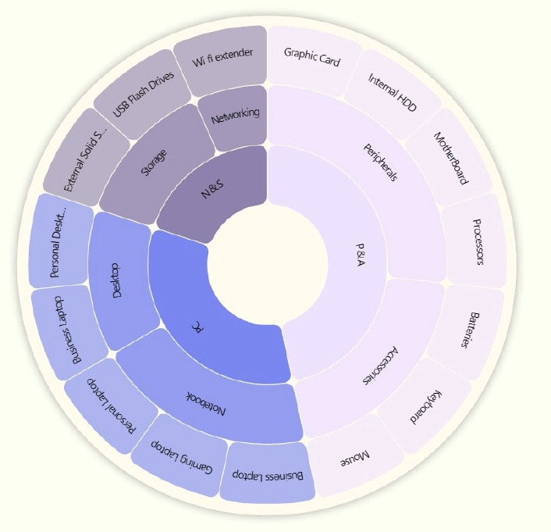
Company Details
Atli q Hardware is a computer hardware and accessory manufacturer.
FISSCAL YEAR
September 2019 – August 2020 (FY 2020)
September 2020 – August 2021 (FY 2021)
Outer circle: Category
Mid circle : segment
Inner Circle: Division

Slide 4
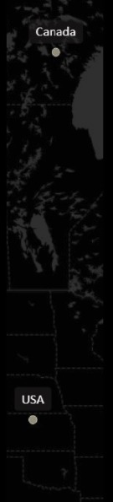
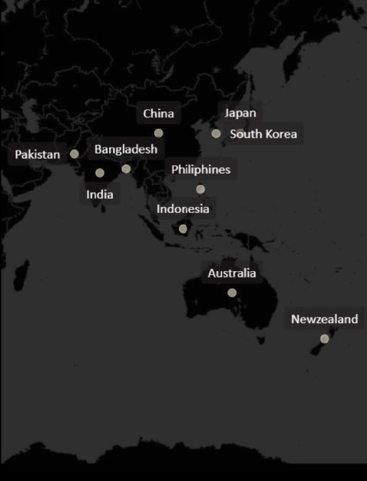
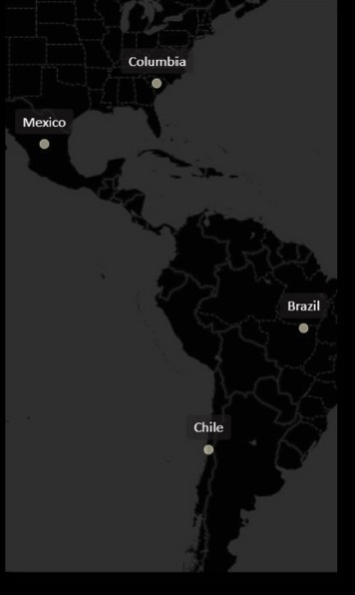
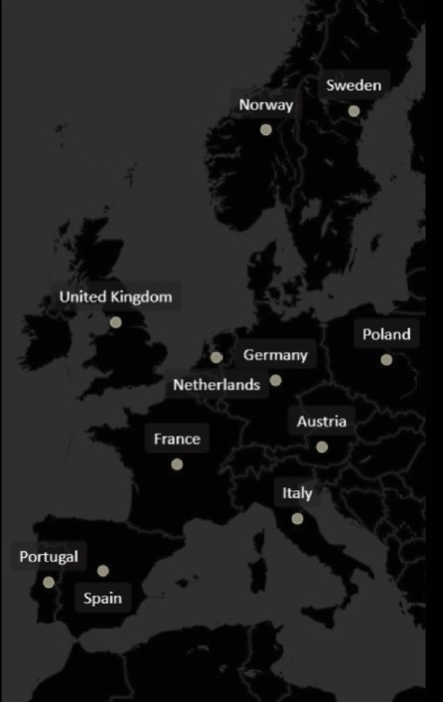
Company’s Market

Slide 5
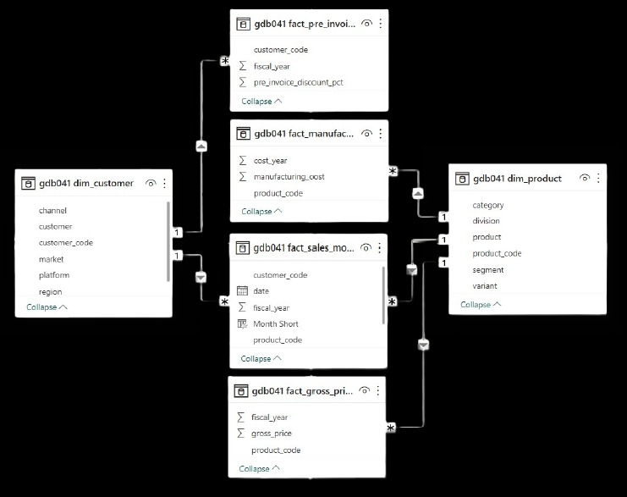
Data, requests, and tools

Slide 6
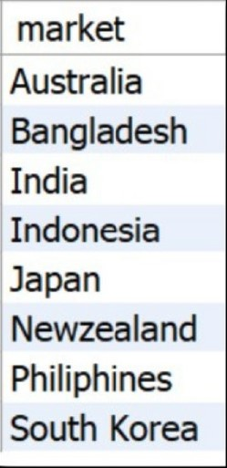
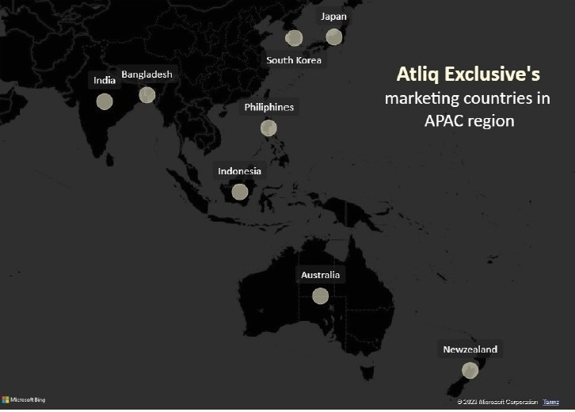
1.Provide the list of markets in which customer ‘Atli q Exclusive’ operates its business in the APAC region.

Slide 7
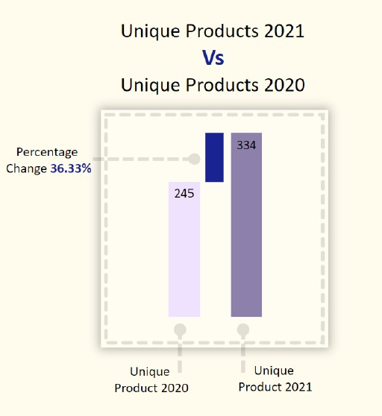

2.What is the percentage of unique product increase in 2021 vs 2020. the final output contains these fields,

Slide 8
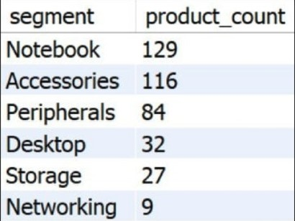
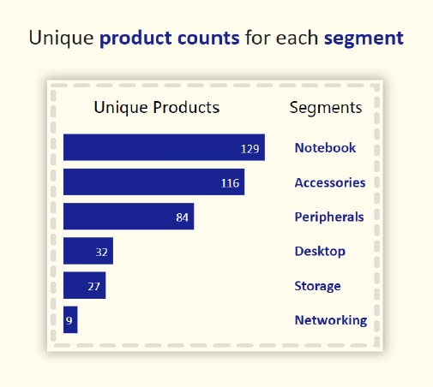
3.Provide a report with all unique product counts for each segment and sort them in descending order of product counts. The final output contains 2 fields.
Segments: notebooks, accessories, and peripherals are showing significant manufacturing growth as compared to desktops, storage, and networking.
Notebooks, accessories, and peripherals constitute 83% of the total manufactured product.

Slide 9
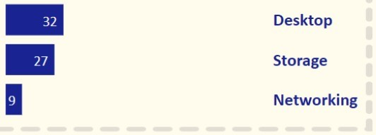
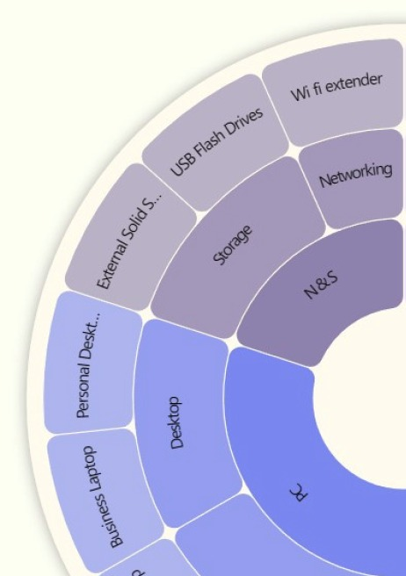
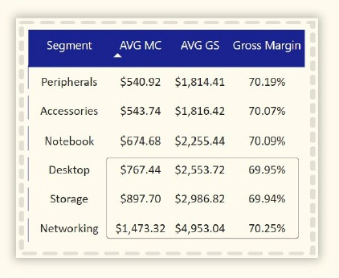
Suggestions:
Package deals
Customer services
Free vouchers
Student discounts
Cash back
Gift cards
memberships

Slide 10
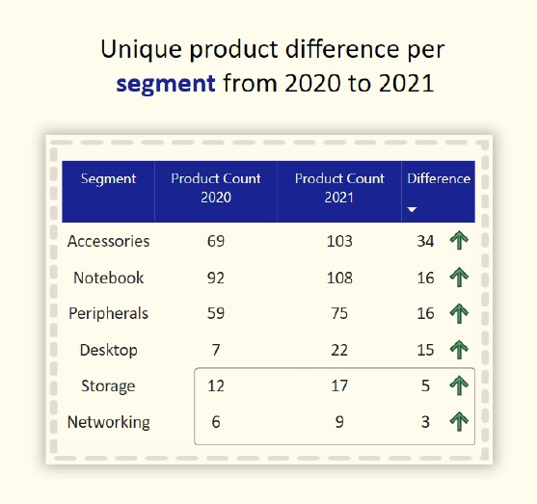
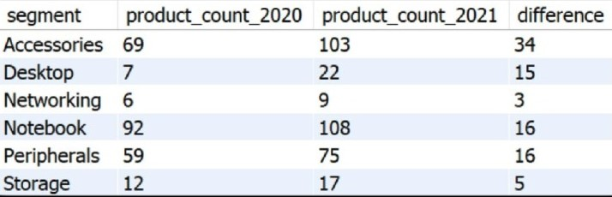
4.Follow-up : which segment had the most increase in unique products in 2021 vs 2020, the final output contains these fields.
Accessories had the largest increase in production.
Storage and networking are experiencing slower production growth than other segments.

Slide 11
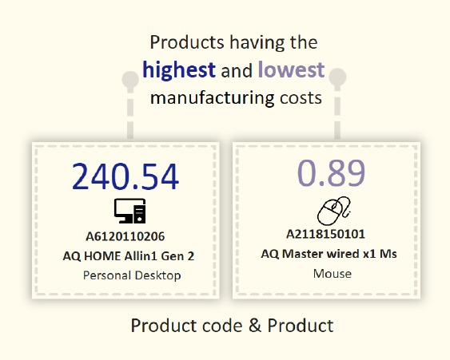
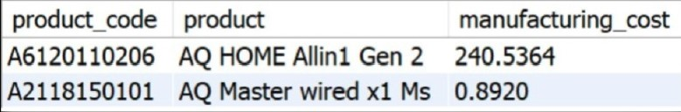
5. Get the product that have the highest and lowest manufacturing costs. The final output should contain these fields,
Mouse: AQ Master wired x1 Ms (Variant: Standard 1) has the lowest manufacturing cost.
Personal Desktop: AQ Home Allin1 Gen2 (Variant: Plus 3) has the highest manufacturing cost.

Slide 12
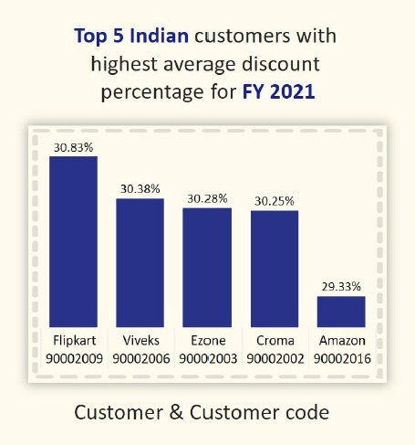
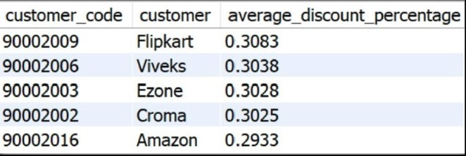
6. Generate a report which contains the top 5 customer who received an average high pre-invoice-discount-pct for the fiscal year2021 and in the Indian market. The final output contains these fields ,
Insights:
The largest average pre-invoice discount was given to Flipkart.
The least average pre-invoice discount was given to Amazon.

Slide 13
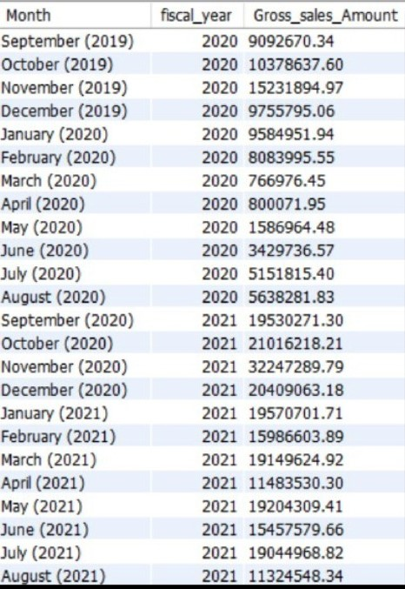
7. Get the complete report of the gross sales amount for the customer ‘Atli q exclusive’ for each month, this analysis helps to get an idea of low and high-performing months and take strategic decisions. the final report contains these columns:
FY 2020
79.5 M
FY2021
224.4 M
Insights:
The lowest Gross sales total for both fiscal years is in March (2020).
The highest Gross sales total for both fiscal years is in November (2020). 73.8% of the total Gross sales figure is in FY 2021.

Slide 14
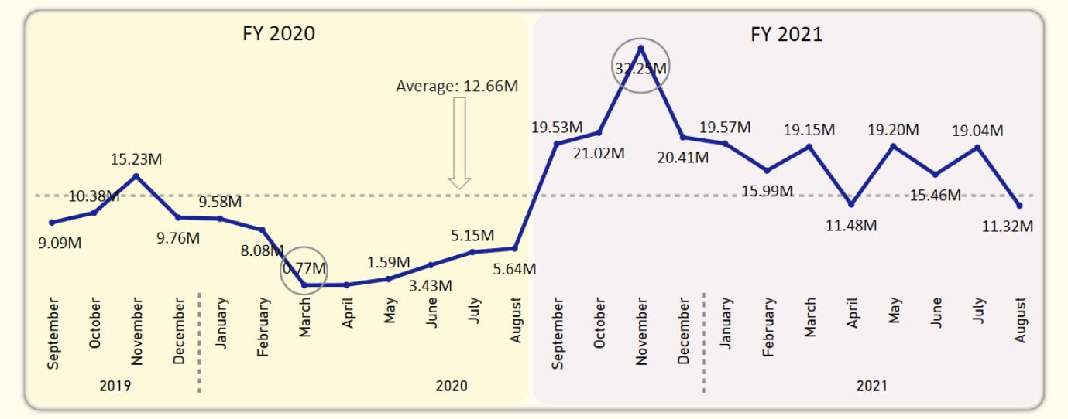
Reasons:
Covid- 19
Global chip shortage

Slide 15
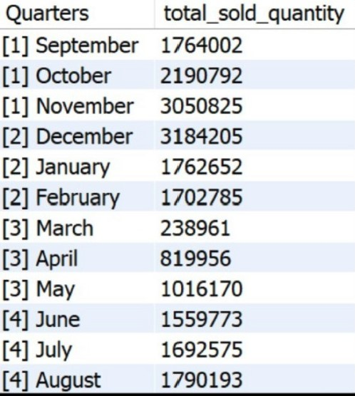
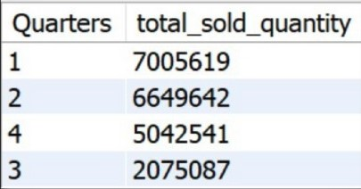
8.In which quarter of 2020, got the maximum total-sold-quantity, the final output contains these fields sorted by the total-sold-quantity,
Insights:
Quarter 1 of FY2020 saw the most units sold overall, while Quarter 3 had the fewest.
The highest and lowest overall sold quantity is in December and March.
Quarter 1 accounts for approximately 34% of the total sold quantity for FY2020.

Slide 16
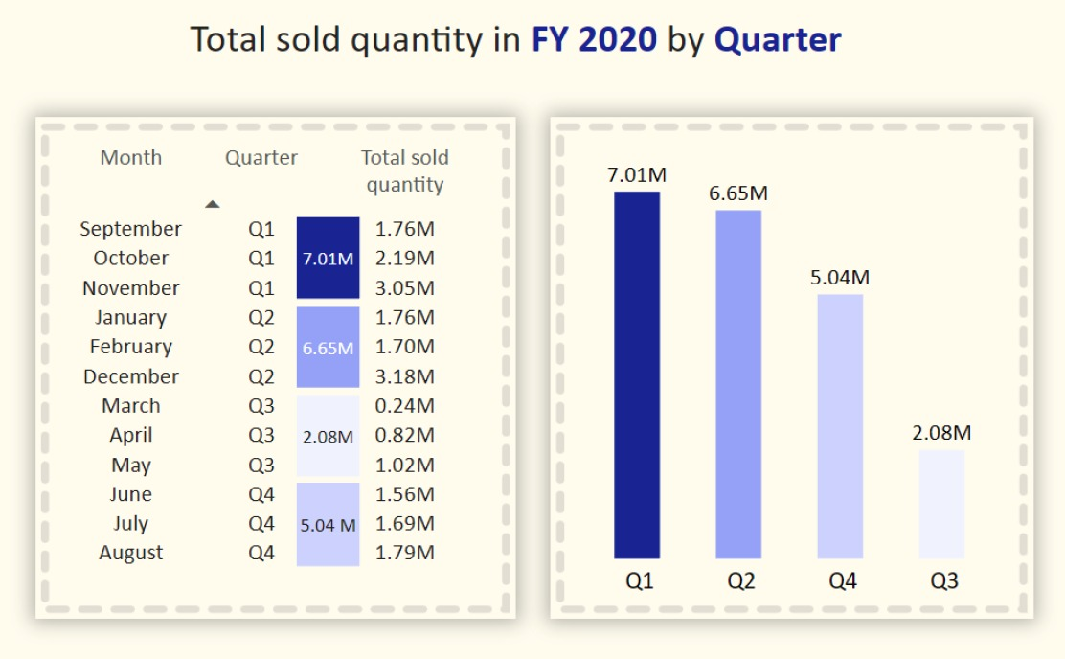

Slide 17
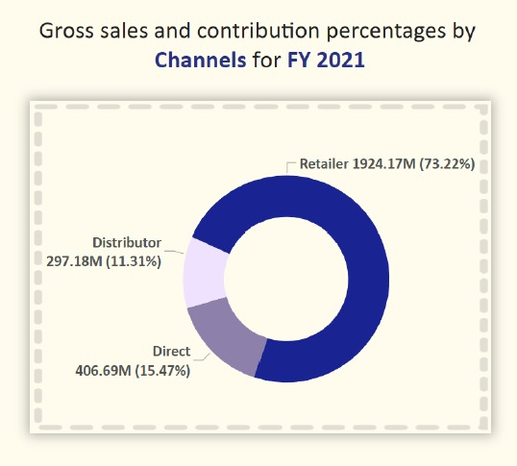
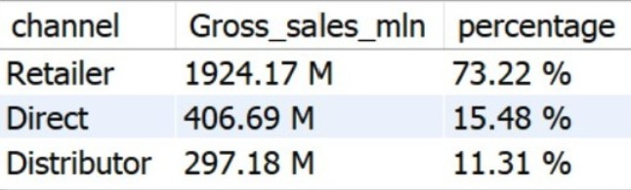
9. Which channel helped to bring more gross sales in the fiscal year 2021 and the percentage of contribution. The final output contains these fields.
Insights:
Channel: "Retailer" helped bring maximum sales to the company with 73.22% as the contribution percentage.
Channel: "Distributor" makes the least contribution at a percentage of 11.31%.

Slide 18
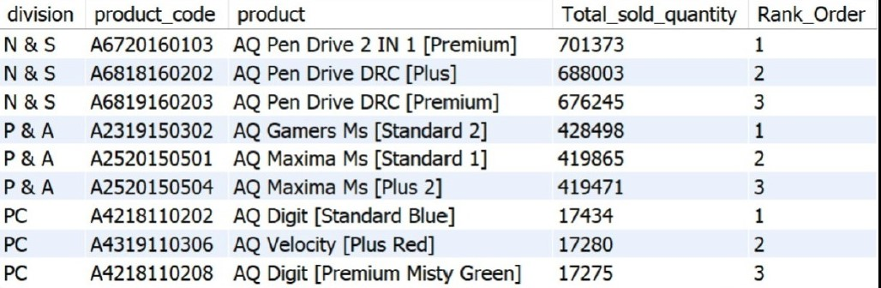
10. Get the top 3 products in each division that have a high total-sold-quantity in the fiscal-year 2021 , the final output contains these fields.
Insights:
Every division has a product with different variants that appears twice in the top three products by division list.

Slide 19
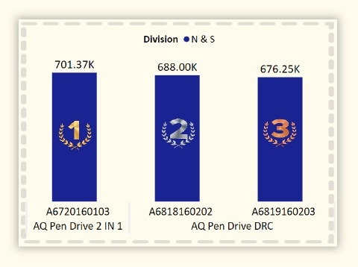
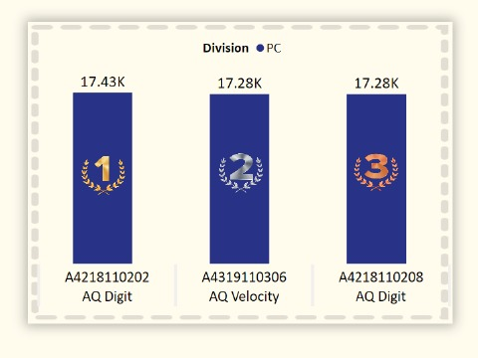
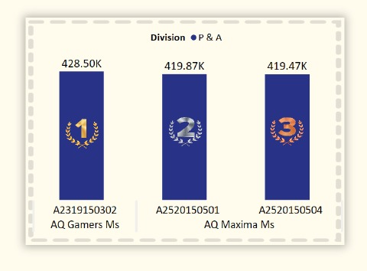

Slide 20
Thank you
Tools used – MYSQL,
Power bi

