Slide 1
US Working Visa Applications Status Visualization and Prediction
Data Analytics Boot camp – Monash University
Presented by Group 8: Hussam Goda, Kashif Bashir, Yoshie Hara

Slide 2

Agenda
Introduction and Overview
Data Information and Preparation
Data Analysis and Visualization
Machine Learning Modelling
Strategy
Logistic Regression
Artificial Neural Network
a. Traditional Modelling
b. Cross Validation Modelling
c. Model Deployment
Conclusions

Slide 3
Introduction and Overview
Goals of the project, to:
Understand the visa award program using data analysis and visualizations in Tableau.
Develop machine learning models that predict the status of visa applications results, with the aim to provide valuable insights for both applicants and immigration authorities, contributing to more efficient and informed decision-making.

Slide 4
Data Information
Dataset: US working visa status
Sources: https://www.kaggle.com/datasets/moro23/easyvisa-dataset
Target: Visa Status (Certified, Denied)
Numerical features:
Number of Employees
Wage
Year Company Established
Categorical features:
Continents of Origin (6)
Regions of Employment (5)
Level of Education (4)
Require experience (2)
Require Training (2)
Full Time Position (2)

Slide 5
Data Information and Preparation
Check for missing values
Investigate if any unexpected data exist
Confirm data types, change any if required
Add columns for latitude and longitude (for Tableau)
Drop unnecessary columns, i.e. case id
Remove outliers (using quantiles)
Data Statistic (describe())
Encode categorical features and target
Split the dataset into training and testing sets

Slide 6
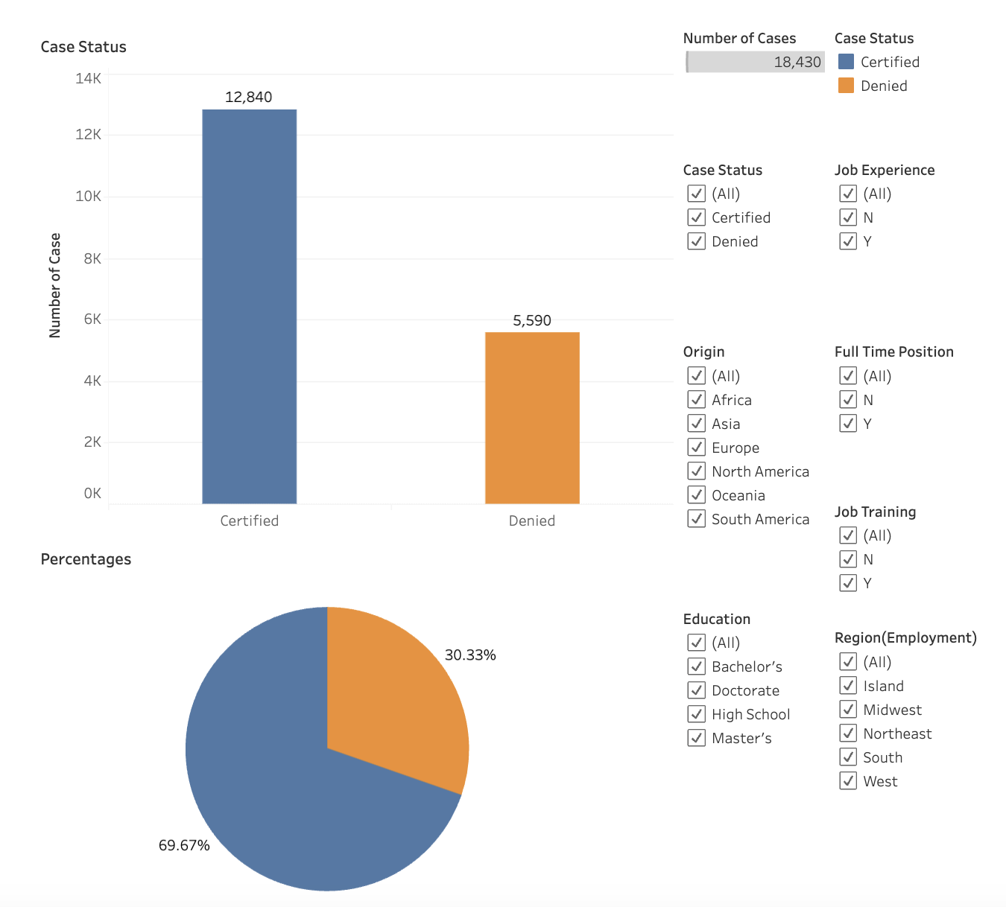
Data Analysis and Visualization Tableau Visualizations
Preforming exploratory analysis on the dataset in order to gain a better understanding of general themes associated with US visa approvals.
Tableau

Slide 7
Data Analysis and Visualization General Observations
Asia is the leading source of visa applications.
Europe boasts the highest certification rate at 81%. Meanwhile, South America has the lowest certification rate at 64%.
Doctorate holders having an 89% success rate, compared to high school degree holders only records34%. We can tell that Education level strongly influences certification.
Midwest employers have a high certification rate of 77%.
Salary expectations show a common range of 40k to 80k. Higher income doesn't guarantee the higher chance of approval.

Slide 8
Machine Learning Modelling Strategy
Data Preparation, as discussed
A couple of approaches
Logistic Regression
Neural Networks
Compare models in terms accuracy, precision, recall….etc
Deploy best model

Slide 9
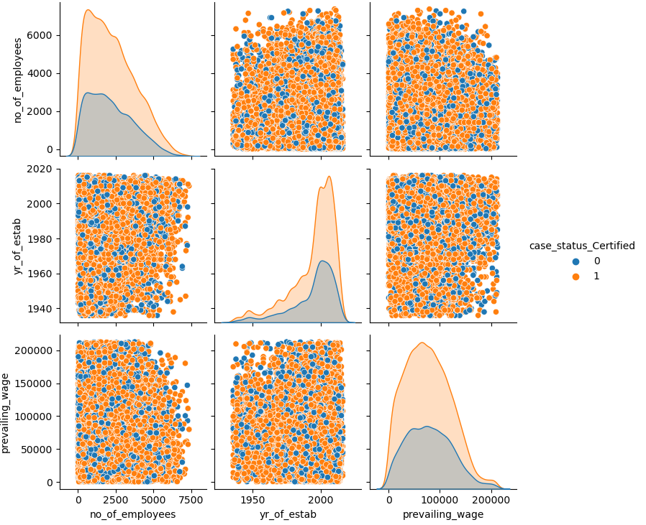
Machine Learning Modelling Data Preparation
Pair plots to check degree of linearity/no-linearity

Slide 10
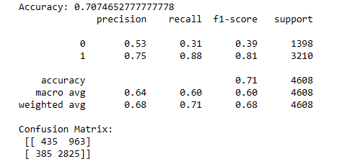
Machine Learning Modelling Logistic Regression
Input features and output target, as discussed in the Introduction
Accuracy score: 0.70
Better performance when predicting “Certified” visa status
Less impressive performance predicting “Denied” visa status

Slide 11

Machine Learning Modelling Artificial Neural Network – Traditional Modelling
Similar input features and output target
Two hidden layers with 80 neurons and 50 neurons respectively
Sigmoid activation function
Accuracy: 0.73
Better performance when predicting “Certified” visa status

Slide 12
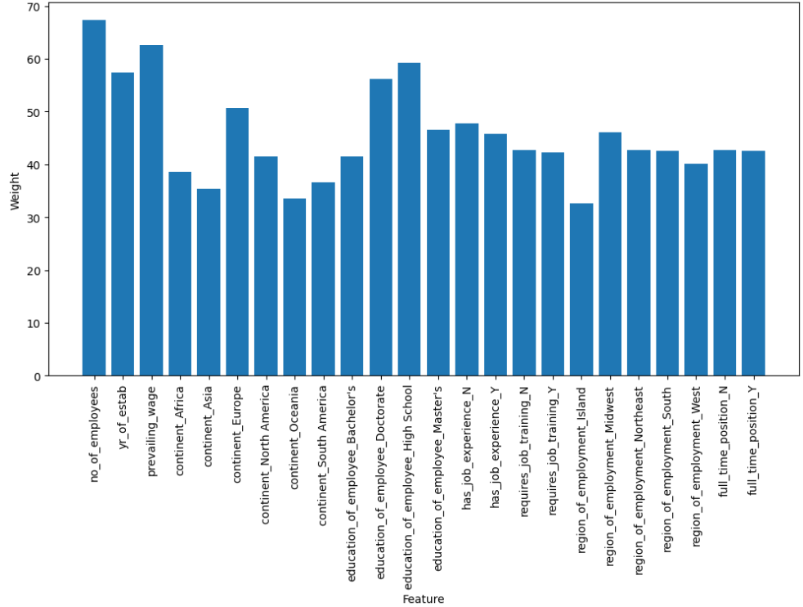
Machine Learning Modelling Artificial Neural Network – Traditional Modelling
Input features relative importance using weights
Numerical features (6%, 5.2% and 5.7%)
Full time position – both features (3.8%)
Require Job training – both features (3.8%)
Require Experience – both features (4.23%)
Categorical features split into more than two features carry more variation

Slide 13


Machine Learning Modelling Artificial Neural Network – Cross Validation Modelling
Similar input features and output target
Two hidden layers with 80 neurons and 50 neurons respectively
Sigmoid activation function
Cross Validation using KFold
Average Accuracy = 0.78 (min = 0.71, max=0.84)
Improved prediction for both visa status (Certified and Denied)
Better performance when predicting “Certified” visa status

Slide 14
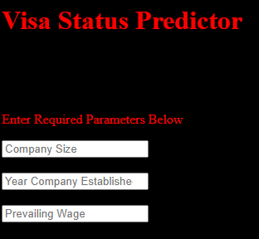
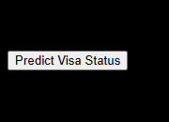
Machine Learning Modelling Artificial Neural Network – Model Deployment
Python Flask
HTML and JavaScript (in one file)
Three entry boxes for the numerical features
Six dropdown lists for the categorical features
Predict Visa Status

Slide 15

Conclusions
Data Analysis using Tableau – See slide 6 for General Observation
Logistic Regression Modelling shows:
Accuracy of about 0.70,
Precision of 0.75 (for “Certified”) and 0.53 (for “Denied”)
Neural networks Modelling shows
Accuracy of about 0.73 (single model) and 0.78-0.79 (cross validation)
Precision of about 0.78 (for “Certified”) and 0.57 (for “Denied”) – single model
Precision of about 0.82 (for “Certified”) and 0.65 for (“Denied) – cross validation model
All models perform better in predicting “Certified” status
Deploy Neural Network model using cross validation

Slide 16
Thank you!

