Slide 1
Why We Need Private Web Archives
Hussam Hallak
WSDL Research Group
Ph.D. student

Slide 2
Types of web pages
Publicly Archivable:
No paywall (mainly)
Not Publicly Archivable:
SERPs
Maps
Social Media: Facebook, Linkedin, etc
Commerce: Amazon
Email sites: Yahoo, Gmail, Hotmail, etc
Bank statements

Slide 3
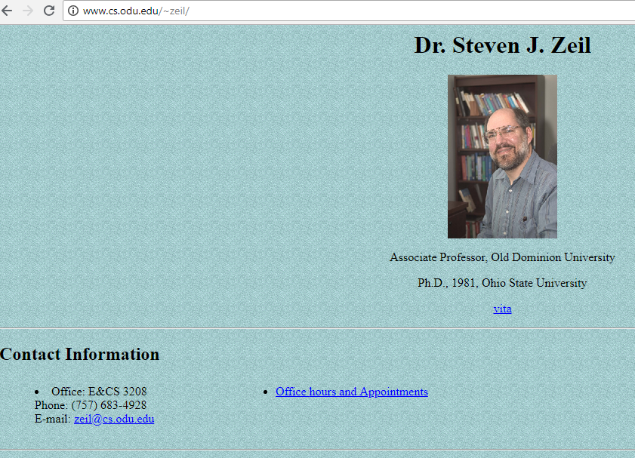

Slide 4
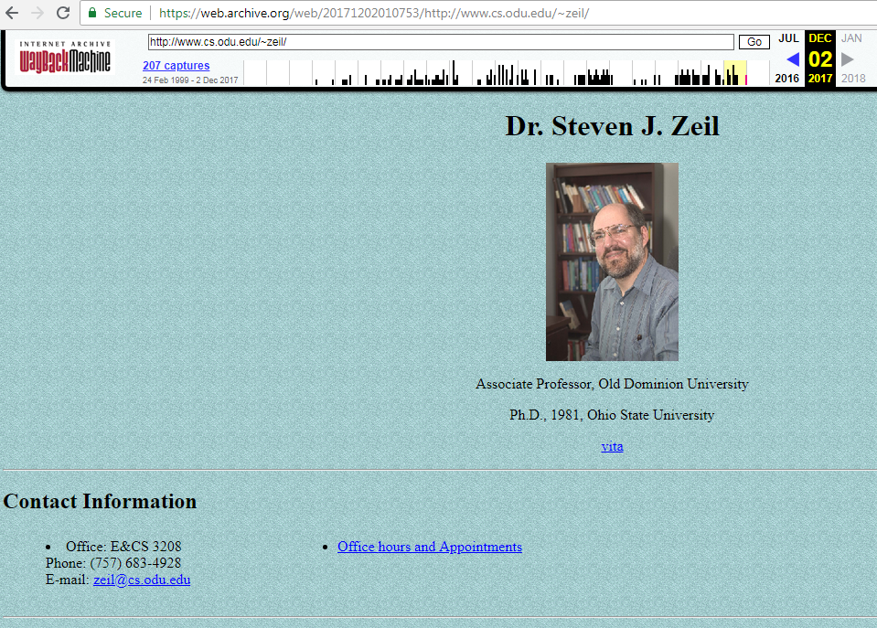

Slide 5
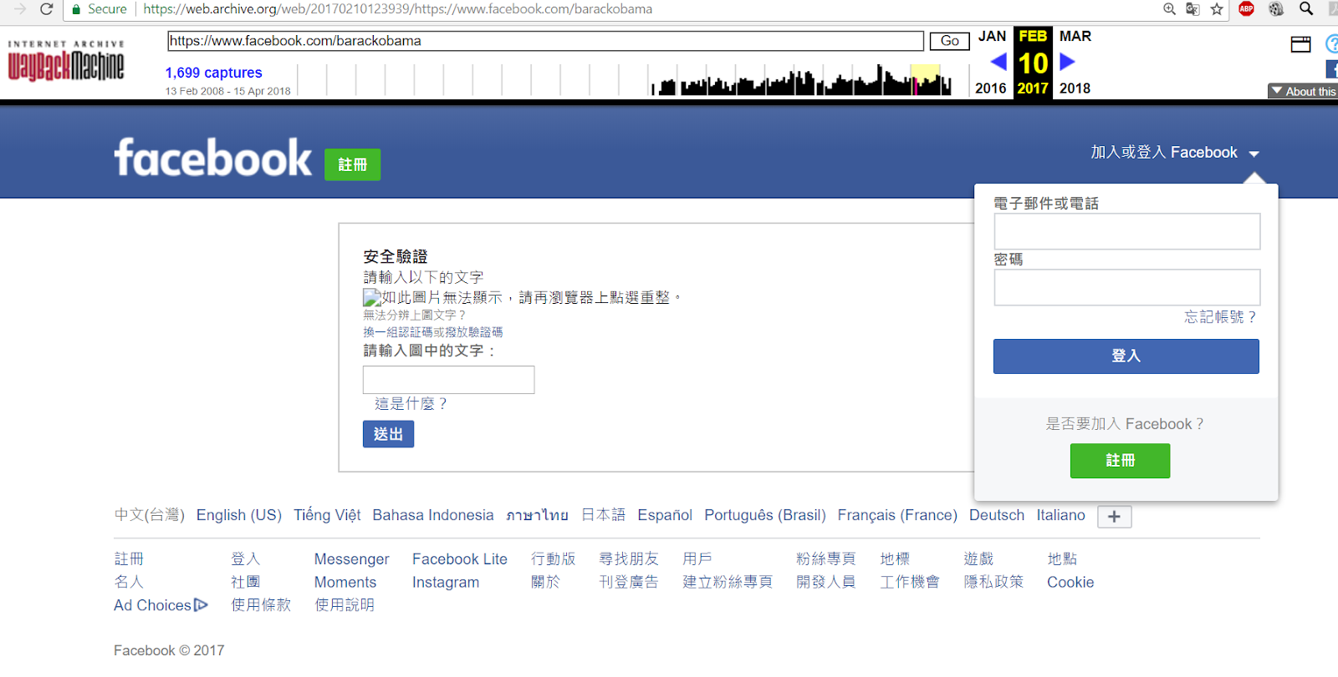

Slide 6
Problem
Estimating the amount of archivable web traffic

Slide 7
Few websites get most of the traffic
Top 100 websites receive %49 of the entire traffic on the web.
Fact is consistent with a Pareto distribution.

Slide 8
Web Traffic Measures
Total visits is the total number of non-unique visits from last month.
Unique visits is the number of unique visits from last month.
Pages/visit is the average number of visited pages per user's visit.

Slide 9
Approach
Collect all three web traffic measures for the top 100 websites (Alexa Ranking) from 2 different web traffic analysis services (SimilarWeb, Semrush). (Feb 23rd 2018)
Classify the top 100 websites:
Publicly Archivable or Not Publicly Archivable
Calculate the percentage of publicly archivable web traffic using six different formulas that use some or all traffic measures and their combinations in different ways

Slide 10
65% of Web Traffic is NOT publicly archivable
Using all measures, 65.30% of the traffic of the top 100 sites is not archivable by public web archives
What about the remaining 1.8 billion live websites?
Best case: If all are publicly archivable,
31% of web traffic is NOT publicly archivable
Worst Case: If all are Not publicly archivable,
83% of web traffic is NOT publicly archivable
Most Likely: The bottom half is similar to the top half
65% of web traffic is NOT publicly archivable

Slide 11
Take Away Message
Personalized web pages are on the rise. Therefore, personal web archiving is crucial.
There will always be pages that public archives cannot capture no matter how good they get.
We need personal web archiving tools
Available tools:
Web Recorder, Warcreate, WAIL

