Slide 1
CS834 Introduction to Information Retrieval Presentation 2
Hussam Aldeen Hallak

Slide 2
The Two Papers:
An Algorithm for Suffix Stripping
M.F.Porter
1980
An Evaluation Method for Stemming Algorithms
Chris D. Paice
1994
0

Slide 3
The First Paper:
An Algorithm for Suffix Stripping
M.F.Porter 1980
1

Slide 4
Porter Stemmer: Definitions
CONSONANT: A letter other than A, E, I, O, U, and Y preceded by consonant
VOWEL: Any other letter
The measure of a word is an indication of the number of syllables in it
C: string of one or more consonants
V: string of one or more vowels
The initial C and the final V are optional
Each word is represented as:
[C]VCVC ... [V], or [C](VC){m}[V], where m is its measure
2

Slide 5
Examples:
C O M P U T E R
C V C V C V C = [VC]{3}
C O M P U T A T I O N A L
C V C V C V C V C V C = [VC]{5}
m=0: I, AAA, CNN, TO, GLEE
m=1: OR, EAST, BRICK, STREET, DOGMA
m=2: OPAL, EASTERN, DOGMAS
m=3: EASTERNMOST, DOGMATIC
3

Slide 6
Porter Stemmer Rule Format:
(condition) S1 → S2
Where S1 and S2 are suffixes
Conditions:
m | The measure of the stem
*S | The stem ends with S
*v* | The stem contains a vowel
*d | The stem ends with a double consonant
*o | The stem ends in CVC (second C not W, X, or Y)
4

Slide 7
Porter Stemmer Algorithm:
Step 1: Manipulating words ending with S
Step 2a: Handling Past tense, Progressive
Step 2b: Cleanup
Step 3: Y Elimination
Step 4: Derivational Morphology 1
Step 5: Derivational Morphology 2
Step 6: Derivational Morphology 3
Step 7a: Cleanup
Step 7b: Cleanup
5

Slide 8
Step 1: Manipulating words ending with S
SSES -> SS
caresses -> caress
IES -> I
ponies -> poni
ties -> ti
SS -> SS
caress -> caress
S -> NULL
cats -> cat
6

Slide 9
Step 2a: Handling Past tense, Progressive
(m>1) EED -> EE
Condition verified: agreed -> agree
Condition not verified: feed -> feed
(*V*) ED -> NULL
Condition verified: plastered -> plaster
Condition not verified: bled -> bled
(*V*) ING -> NULL
Condition verified: motoring -> motor
Condition not verified: sing -> sing
7

Slide 10
Step 2b: Cleanup
(These rules are ran if second or third rule in 2a apply)
AT-> ATE
conflat(ed) -> conflate
BL -> BLE
Troubl(ing) -> trouble
(*d & ! (*L or *S or *Z)) -> single letter
Condition verified: hopp(ing) -> hop, tann(ed) -> tan
Condition not verified: fall(ing) -> fall
(m=1 & *o) -> E
Condition verified: fil(ing) -> file
Condition not verified: fail -> fail
8

Slide 11
Step 3: Y Elimination
(*V*) Y -> I
Condition verified: happy -> happi
Condition not verified: sky -> sky
9

Slide 12
Step 4: Derivational Morphology 1
(m>0) ATIONAL -> ATE
Relational -> relate
(m>0) IZATION -> IZE
generalization-> generalize
(m>0) BILITI -> BLE
sensibiliti -> sensible
10

Slide 13
Step 5: Derivational Morphology 2
(m>0) ICATE -> IC
triplicate -> triplic
(m>0) FUL -> NULL
hopeful -> hope
(m>0) NESS -> NULL
goodness -> good
11

Slide 14
Step 6: Derivational Morphology 3
(m>0) ANCE -> NULL
allowance-> allow
(m>0) ENT -> NULL
dependent-> depend
(m>0) IVE -> NULL
effective -> effect
12

Slide 15
Step 7: Two cleanup steps
Step 7a:
(m>1) E -> NULL
probate -> probat
(m=1 & !*o) NESS -> NULL
goodness -> good
Step 7b:
(m>1 & *d & *L) -> single letter
Condition verified: controll -> control
Condition not verified: roll -> roll
13

Slide 16
Examples:
controlling
Step 2a, Rule 3: -> controll
Step 7b : -> control
generalizations
Step 1, Rule 4: -> generalization
Step 4, Rule 11: -> generalize
Step 6, last rule: -> general
14

Slide 17
Input/Output:
construction construct
increasing increas
unexplained unexplain
differentiable differenti
15

Slide 18
The Second Paper:
An Evaluation Method for Stemming Algorithms
Chris D. Paice
1994
Correct Citation of Porter(1980):
This paper is builds upon Porter (1980) because it provided a method for evaluating stemming algorithm presented in Porter (1980).
16

Slide 19
Goal of the paper:
Providing a method in which stemming performance is assessed against predefined concept groups in samples of words.
Only suffix stemming is tested
Prefix stemming is not helpful except in domains like medicine and chemistry
17

Slide 20
Stemming Challenges:
Similar words with different meanings:
Author
Authoritarian
Irregularities:
Go
Went
18

Slide 21
Stemming Errors:
Understemming Errors:
Words referring to the same concept are not reduced to the same stem.
Overstemming Errors:
Words referring to distinct concepts are reduced to the same stem.
19

Slide 22
Stemmers’ Types:
Light Stemmers:
Play safe
Avoid overstemming
Leave many understemming errors
Heavy Stemmers:
Aggressive suffixes removal
Avoid understemming
Commit many overstemming errors
20

Slide 23
Paper’s Contributions:
Giving an approach for evaluating stemmers based on detecting and counting actual under/overstemming errors for word samples from actual texts.
Applying the approach on three different stemmers.
Computing “Stemming Weight”, SW for each stemmer.
Computing under/overstemming error rates.
Computing general accuracy for each stemmer.
21

Slide 24
Approach: Computing Desired Merge Total (DMTg)
Divide “distinct words sample”, W,into concept groups
A perfect stemmer should merge every member of a group with another
Desired Merge Total: DMTg = 0.5 ng (ng – 1) ng: Number of words in the group
22

Slide 25
Approach: Computing Desired non-Merge Total (DNTg)
A perfect stemmer should merge members if-and-only-if they belong to the same concept group
Desired non-Merge Total: DNTg = 0.5 ng (W – ng) W: Number of words in the sample ng: Number of words in the group
23

Slide 26
Approach: Computing the Globals of both Totals!
The sum of all DMTg totals over all groups gives GDMT, the Global Desired Merge Total
The sum of all DNTg totals over all groups gives GDNT, the Global Desired non-Merge Total
24

Slide 27
Approach: Computing Understemming Index (UI)
If a group has more than one stem left, let: ng: Group size, the number of words originally in the group s: The number of stems left in the group U1, U2, …, Us: The number of instances of these stems
The number of understemming errors in the group is the Unachieved Merge Total UMTg:
UMTg = 0.5 ∑^{s}_{i=1} Ui(ng-Ui)
The sum for all groups gives the Global Unachieved Merge Total GUMT.
Understemming Index: UI = GUMT/GDMT
25

Slide 28
Approach: Computing Overstemming Index (OI)
If two or more groups share a common stem, gather all cases for a particular stem into a “stem group”.
Any stem group whose members are derived from two or more different groups contains overstemming errors, count them!
Consider a stem group s containing ns items derived from t distinct concept groups. V1, V2, …, Vt: The number of representative of these concept groups
The number of overstemming errors for this stem group is the Wrongly Merged Total WMTs:
WMTs = 0.5 ∑^{t}_{i=1} Vi(ns-Vi)
The sum over all stem groups gives the Global Wrongly Merged Total GWMT.
Overstemming Index: OI = GWMT/GDNT
26

Slide 29
Approach: Computing Stemmers’ Weight (SW)
Heavy Stemmers: High OI Low UI
Light Stemmers: Low OI High UI
The ratio OI/UI is taken as a measure of stemming weight. SW = OI/UI
27

Slide 30
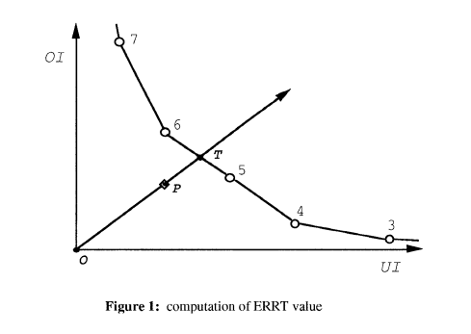
Approach: Evaluating General accuracy of a stemmer
Truncation: Reducing every word to the first q letters. Make use of truncation line, TL
Find UI, OI for q = 3, 4, 5, 6, and 7
The points p(UI,OI) define TL
Assess stemmers against TL
A reasonable stemmer: Gives p(UI,OI) between (0,0) and TL
The further p from TL and closer to the origin, the better the stemmer
28
Figure 1: Paice (1994)

Slide 31
Performance Measure: Error Rate Relative to Truncation (ERRT)
Found by extending a line from (0,0) through p(UI,OI) until intersecting with TL at T
ERRT = Len(OP)/Len(OT)
29
Figure 1: Paice (1994)

Slide 32
Evaluating Stemmers: Lovins, Porter, Paice/Husk
Truncation Length used: q = 4, 5, 6, 7, and 8 q values are appropriate for IR
Samples’ sizes: Three samples were used: 184,659 words → 9,757 distinct words 8,947 words → 1,527 distinct words 32,098 words → 3,559 distinct words
30

Slide 33
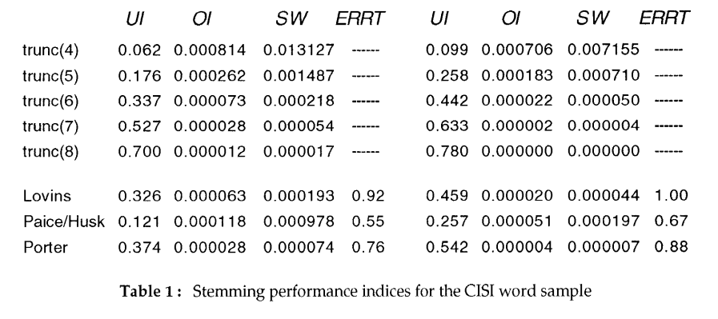
Stemming Performance Indices
31
Table 1: Paice (1994)

Slide 34
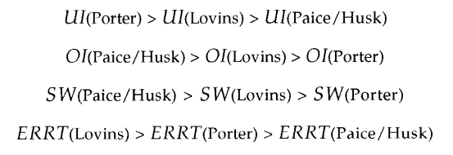
Comparing Lovins, Porter, and Paice/Husk Stemmers
These inequalities held for all word samples tested
ERRT is taken as a general indicator of accuracy performance
32

Slide 35
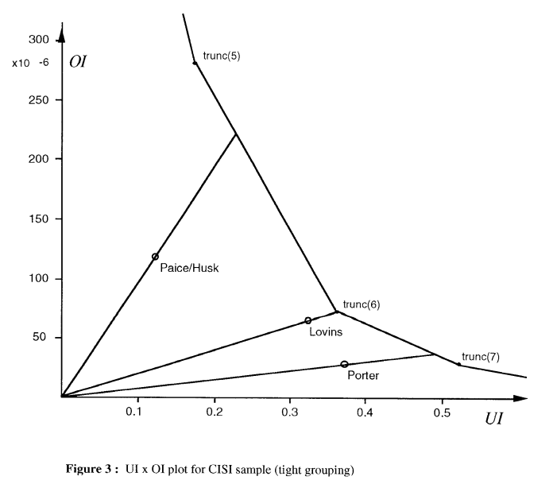
Comparing Lovins, Porter, and Paice/Husk Stemmers
Stemmers Ranking: Paice/Husk Porter Lovins
The further p from TL and closer to the origin, the better the stemmer
33
Figure 3: Paice (1994)

Slide 36
Take Away Message:
. Source text significantly affected performance indices
. Sample size increase caused a sharp decrease in OI & SW
. Sample size increase showed no significant effect on UI
. In terms of SW, Porter is a light stemmer
. In terms of SW, Paice/Husk is a heavy stemmer
. It might be meaningless to compare Porter to Paice/Husk stemmer (large difference in SW)
. Lovins is less accurate than the other two stemmers
. Porter stemmer is significantly lighter than Lovins and several other stemming algorithms (Earlier research found the same result)
34

Slide 37
References
[1] M.F.Porter, An Algorithm for Suffix Stripping (1980)
[2] Chris D. Paice, An Evaluation Method for Stemming Algorithms (1994)
35

