Slide 1
CS834 - Introduction to Information Retrieval
Presentation #3
Hussam Aldeen Hallak
1

Slide 2
The Two Papers:
Fast generation of result snippets in web search
SIGIR '07 Proceedings of the 30th annual international ACM SIGIR conference on Research and development in information retrieval
Pages 127-134
Good Abandonment in Mobile and PC Internet Search
Jane Li, Scott B. Huffman, Akihito Tokuda, Google Inc - Proc. SIGIR ’09 , 2009
2

Slide 3
The First Paper:
Fast generation of result snippets in web search
SIGIR '07 Proceedings of the 30th annual international ACM SIGIR conference on Research and development in information retrieval
Pages 127-134
http://citeseerx.ist.psu.edu/viewdoc/download?doi=10.1.1.72.4357&rep=rep1&type=pdf
3

Slide 4
Snippets
Sentences or fragments extracted from a document
Gives a preview of the document content
Allows the user to get an idea of what’s inside the document
Sometimes, it contains the answer to the search query
4

Slide 5
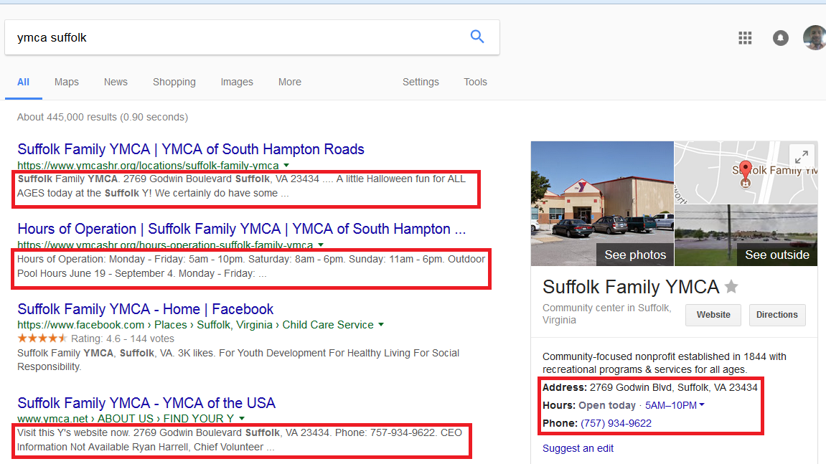
Google Snippets
5

Slide 6
Results Page Construction
Lexicon Engine: Maps query terms to integers
Ranking Engine: Generates inverted lists and uses them to rank documents
Snippet Engine: Generates snippets from query term numbers and document numbers
Meta Data Engine: Fetches other information to construct results page. Information include URI, pages’ titles, document type, size, ...etc.
6

Slide 7
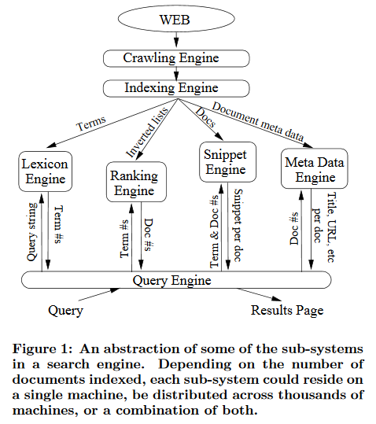
Search Engine Architecture
7
Turpin et al.(2007)

Slide 8
Two types of snippets:
Static:
- Generated from a document and stored
- Fixed for each document
- Query independent
- The same snippet is displayed for a document regardless of search query)
Dynamic:
- Generated on the fly (after search query is submitted)
- Query-biased
- Different snippets are generated for the same document based on the query.
8

Slide 9
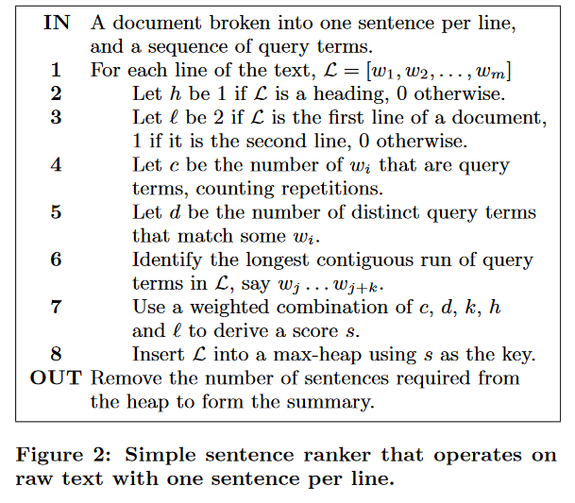
Simple Sentence Ranker
9
Turpin et al.(2007)

Slide 10
Dynamic Snippets: Challenges & Solutions
Challenges:
- The time taken to generate dynamic snippets while the user is waiting.
- Billions of web pages to store and access their files on the disk to generate dynamic snippets.
- Hundreds of millions of search queries
Solutions:
- Disk access reduction: Cache frequently accessed documents and precomputed result pages for popular queries.
- Compression: Smaller document size allows more documents to be cached.
- Compaction: Only cache the important part of the document.
10

Slide 11
Baseline Snippet Engine:
Uses a well-known adaptive compressor to compress each document and then decompress it as needed.
Implemented using zlib
Each document is stored in a single file
Snippet Generation:
- The required documents are decompressed one at a time.
- Linear search for provided query terms matching whole words.
11

Slide 12
Compressed Token System (CTS) Snippet Engine:
Uses a semi-static compression, which allows faster decompression with minimal compression loss.
Mapping words and non-words to single integer tokens. Frequent symbols receiving small integers.
Uses vbyte coding scheme that assigns small numbers a small number of bits.
Words and non-words strictly alternate in the compressed file, which always begins with a word.
Stores all documents contiguously in one file, and an auxiliary table indicating the start offset of each document in the file.
12

Slide 13
Advantages of CTS over Baseline:
Faster decompression
Sentences can be scored without having to decompress the document
Only the sentences returned as part of a snippet need to be decoded.
13

Slide 14
Experiments on CTS and Baseline:
Data:
WT10G, WT50G, WT100G
Search Queries:
Exite Log files from 1997 http://msxml.excite.com/
Search Engine:
Zettair
Document Ranker:
Okapi BM25 (Simulating PageRank)
14

Slide 15
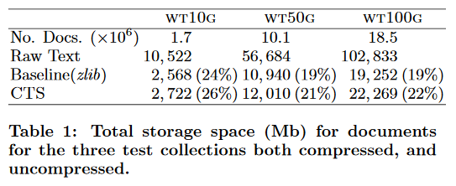
Storage: CTS vs Baseline
Zlib wins by about 2% in disk space saving
15
Turpin et al.(2007)

Slide 16
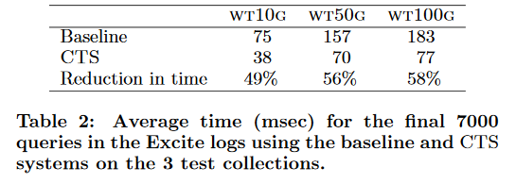
Reduction in time using CTS:
CTS wins by about 50% in snippet generation time
16
Turpin et al.(2007)

Slide 17
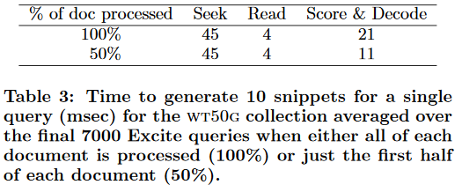
How CTS spends time?
Majority of the time is spent locating the document on disk.
Even when the collection size is cut in half, only 14% time reduction is observed!
It seems logical to try and reduce its impact through caching.
17
Turpin et al.(2007)

Slide 18
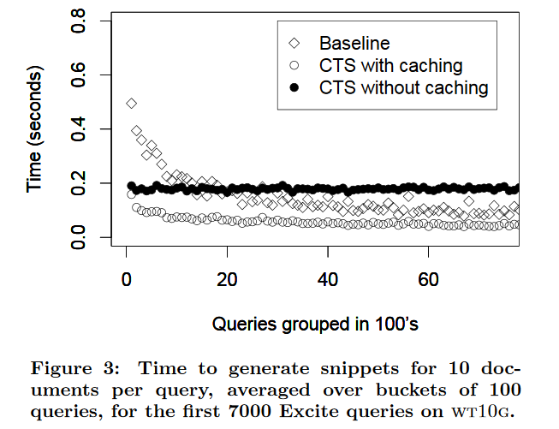
Snippet Generation Time: CTS vs Baseline
18
Turpin et al.(2007)

Slide 19
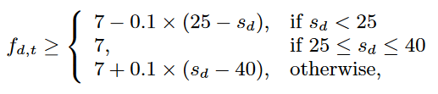
Document Compaction:
Only the important sentences count
Natural order: 1st sentence is the most important.
Does not work for poorly written documents.
Query Log Based (QLT):
Sentences containing past query terms are the most important.
Query Log Based (QLU):
Same as QLT, but only counts unique terms.
Significant Terms (ST):
Score based on term frequency
19
Turpin et al.(2007)

Slide 20
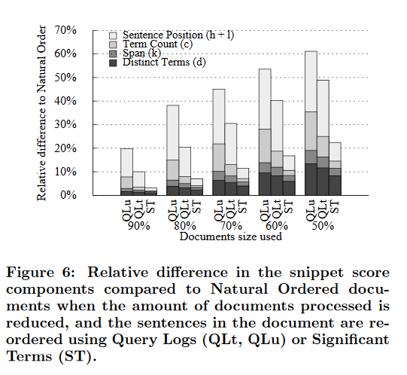
Natural Order vs (QLT vs QLU vs ST)
Significant Terms method wins since it leads to the smallest change in the sentence scoring components.
The greatest change over all methods is in sentence position (h+l) component of the score.
20
Turpin et al.(2007)

Slide 21
The Second Paper:
Good Abandonment in Mobile and PC Internet Search
Jane Li, Scott B. Huffman, Akihito Tokuda, Google Inc - Proc. SIGIR ’09 , 2009
http://static.googleusercontent.com/media/research.google.com/en/us/pubs/archive/35486.pdf
21

Slide 22
What is a Good Abandonment?
An Abandoned query for which user`s information need was successfully addressed by search result page with no need to click on a result or refine the query.
The snippets under the search results were good enough to provide what the user wanted.
This user won’t be clicking on any of the results, but that doesn’t mean that the search has failed.
22

Slide 23
Example of Good Abandonment
23

Slide 24
The Goal:
To approximate the prevalence of good abandonment and the types of information need that may lead to one.
Study is conducted across two modalities PC, Mobile devices for three countries USA, CHINA, JAPAN because results for mobile and desktop queries are different based on local results.
Google's aim is to give the results that are most relevant to the person searching. Google uses your searching history and location, where possible, to personalize the results.
24

Slide 25
Findings:
Queries potentially indicating good abandonment are a significant portion of all abandoned queries. How to find potential queries?
Good Abandonment rate for Mobile is higher than PC across all countries.
Why?
Good Abandonment vary by both, locale and modality.
Why?
Hold on to your questions, coz they are about to be answered
25

Slide 26
Why is Good Abandonment so important?
Abandoning is usually considered an indicator of user dissatisfaction because the user did not click on any result or did not make an refinement to the query. Which no search engine wants.
Mobile devices are clunky, slow, have formatting, content omission issues.
Mobile users need quicker responses.
Mobile devices are inherently local to find local address, phone numbers, ... etc.
Search Engines want to accurately answer your query as quick as possible.
25

Slide 27
Definitions:
Potential Good Abandonment:
- User’s query should mostly be answered by a search engine result page.
- It is judged by looking at the query to generate an upper bound of good abandonment.
Likely Good Abandonment:
- Subset of potentially good abandonment.
- Information need expressed by the query was clearly met on the results page.
- Determined by examining the actual results provided by Google.
25

Slide 28
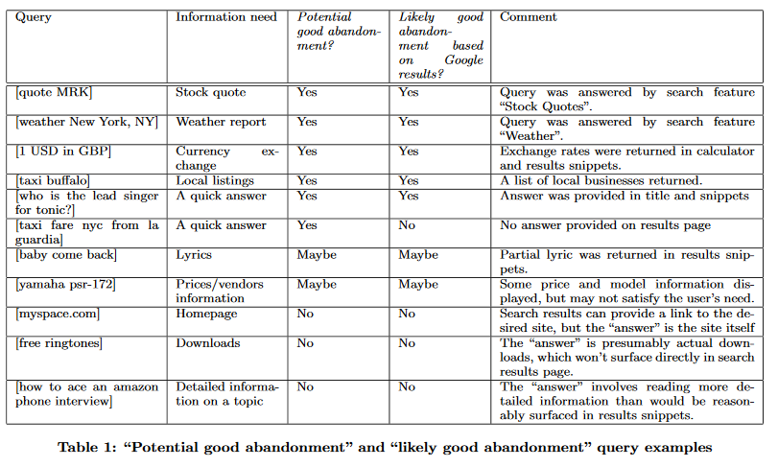
PGA and LGA Query Examples:
Jane Li (2007)

Slide 29
Experiment Data Source & Size:
Google’s PC and Mobile search log from a week in Sep-Oct 2008
Sampled 400 abandoned queries from Japan, US, and 1000 from China for both mobile and PC.

Slide 30
Upper Bound Estimate of Good Abandonment:
The proportion of abandoned queries classified as ‘YES’ or ‘MAYBE’ a potential good abandonment out of all abandoned queries.

Slide 31
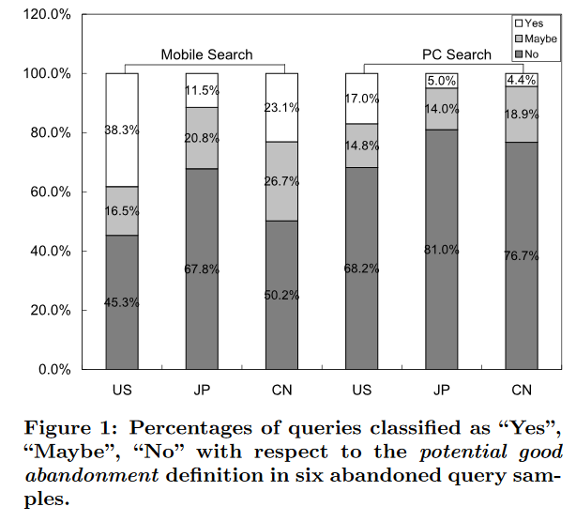
Percentage of PGA Queries:
Jane Li (2007)

Slide 32
Observations:
Japan has lowest potential abandonment for mobile search.
Higher potential good abandonment rate in mobile search.
Retrieving web pages on mobile devices is a clumsy experience, hence users mostly have simple searches, and they expect to find what they need without clicking on any result.
Mobile searches are dependent on activity at the time, current location, etc.

Slide 33
Likely Abandonment Rates:
It measures how often does the user actually will get the desired result out of all queries that could potentially lead to good abandonment.
YES: queries that actually turned out to be good abandonment queries.
MAYBE: authors were not sure if the result pages would have satisfied the user
NO: authors thought it would be good abandonment but turns out it is not.

Slide 34
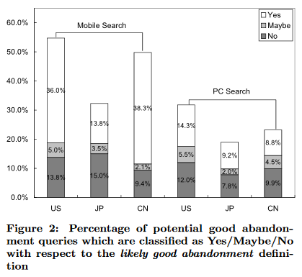
Percentage of LGA Queries:
Jane Li (2007)

Slide 35
Observations:
For mobile search 70% of the potential good abandonment queries were met on the result page compared to 56% for PC.
Over 80% potential good abandonment queries are answered in Chinese mobile searches.

Slide 36
Classification by Information Need:
The authors coded each potential or likely good query on the basis of information need
They compiled a list and found that the prevalence and likelihood of good abandonment across the different categories varied significantly both by locale and modality.

Slide 37
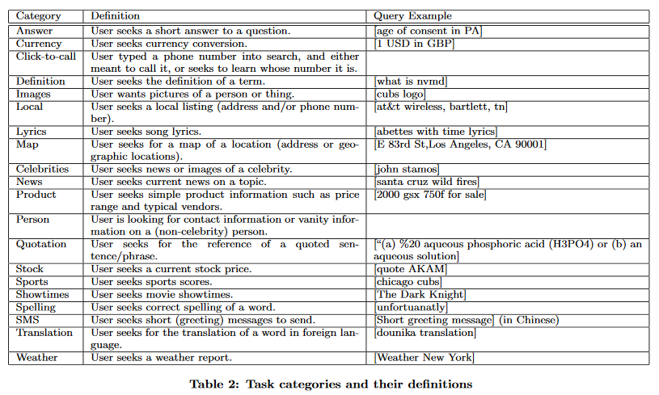
Task Categories Example:
Jane Li (2007)

Slide 38
Findings:
The distribution of good abandonment information needs varies enormously across search modalities and locales.
Queries seeking local information or short answers are the top classes leading to good abandonment in PC search, consistently across locales.
Significant portion of entertainment related searches in Japan and China, especially in mobile search.

Slide 39
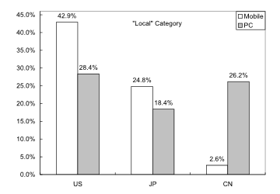
Surprise!
Figure 4:
Jane Li (2009)
Less than 3% “Local” potential good abandonment queries for Chinese mobile search. By contrast, it is the top class for Chinese PC search.
the actual search results were poorly addressed on the results page.
On mobile devices where text entry is difficult and loading takes longer people may usually give up.

Slide 40
Some Interesting Results:
US users click more often when searching celebrities.
Japanese mobile users browse images or news outlines (satisfied by the snippets).
For Stocks, more good abandonment in mobile because users look for stock quotes in the snippets, whereas in PC user may seek more information and graphs.
China has most simple mobile searches for weather.

Slide 41
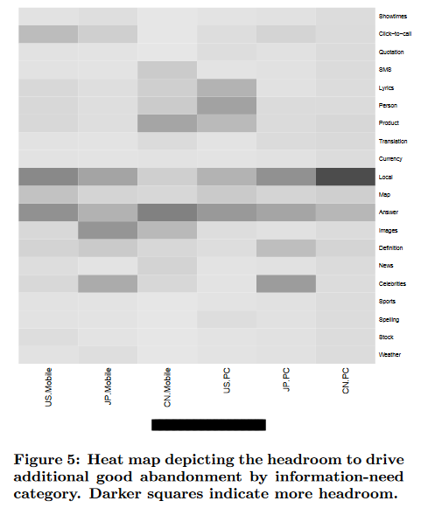
In the figure the darker the cell, the more headroom/scope it has for improvement.
Categories like Celebrities, Local, Answer have scope for improvement.
The search engines should give directly address “Local”, “Image” information needs by adding more features like “Shortcut Insertions”.
The “Answer” category requires more intelligent snippets and for mobile users it should be longer since loading a webpage is a hasseel.

Slide 42
Conclusion and future work
The authors used their judgement to classify queries into potential or likely good abandonment buckets, but It would be ideal to conduct a study with real users to understand the real information needs.
Query abandonment should not be considered as a negative signal as seen.
Evaluation models derived from CLICKS should be improved by taking Good abandonment in account.
Search engines still have headroom for good abandonment.
Can be improved by providing right information on the result page especially for mobile users because user wants the result in the snippets.
Hence, the snippet length and quality should be increased.

Slide 43
