Slide 1
CS834 - Introduction to Information Retrieval
Presentation #4
Hussam Aldeen Hallak

Slide 2
The Two Papers:
A semantic approach to contextual advertising
SIGIR '07 Proceedings of the 30th annual international ACM SIGIR conference on Research and development in information retrieval
Pages 559-566
How much can behavioral targeting help online advertising?
WWW '09 Proceedings of the 18th international conference on World wide web
Pages 261-270

Slide 3
The First Paper:
A semantic approach to contextual advertising
SIGIR '07 Proceedings of the 30th annual international ACM SIGIR conference on Research and development in information retrieval
Pages 559-566
http://clair.si.umich.edu/~radev/767w10/papers/Week12/ca/semantic.pdf

Slide 4
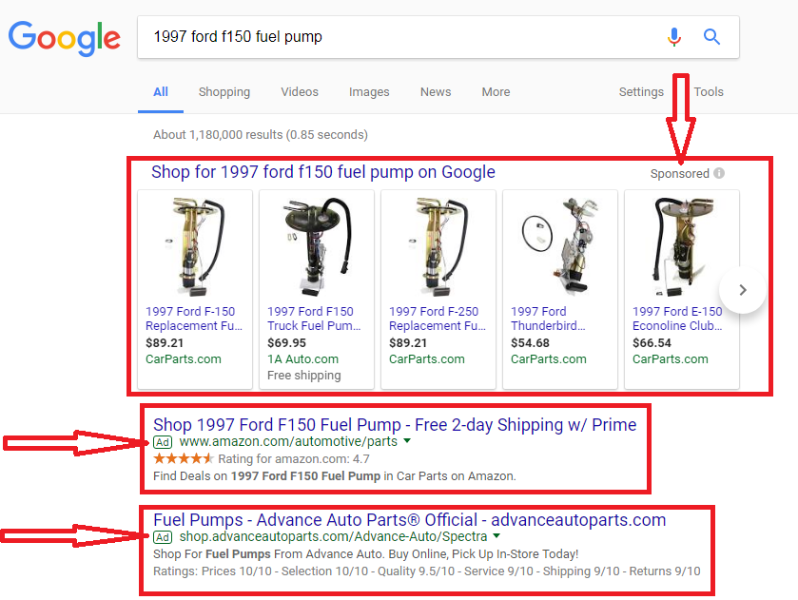
1st Type of Advertising: Sponsored Search (SS)
Placing ads on the result pages from a search engine

Slide 5
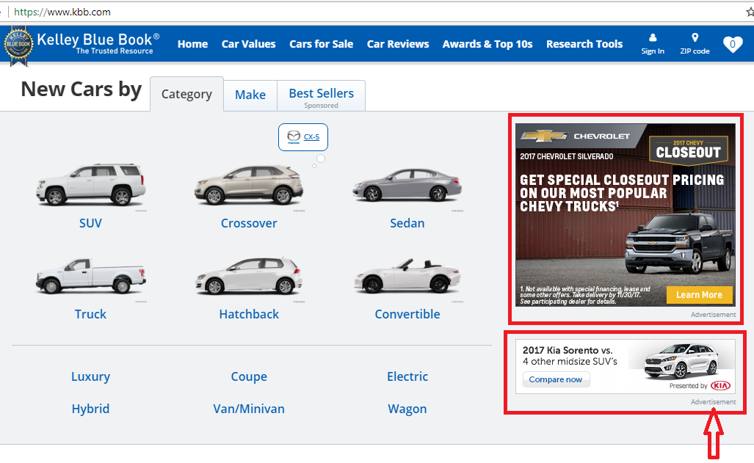
2nd Type of Advertising: Context Match (CM)
Commercial ads within the content of a web page.

Slide 6
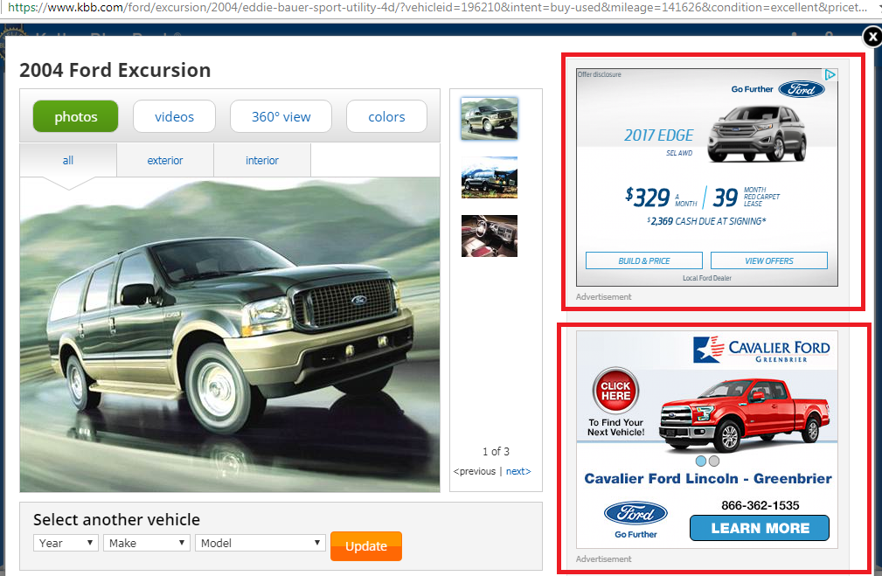
Why ads and page content should be related?
Improve user experience → increase clicks → increase revenue

Slide 7
Matching ads with pages
Syntactic Approach:
Match words found in the page with words in ads.
Problems: Leads to irrelevant ads
A page about the golfer “John Maytag” might trigger an ad for “Maytag dishwashers”
Solution:
Combining Semantic (topical) and syntactic matching
The semantic phase:
1. Classify the page and the ads into a taxonomy of topics
2. Use the proximity of the ad and page classes as a factor in the ad ranking formula

Slide 8
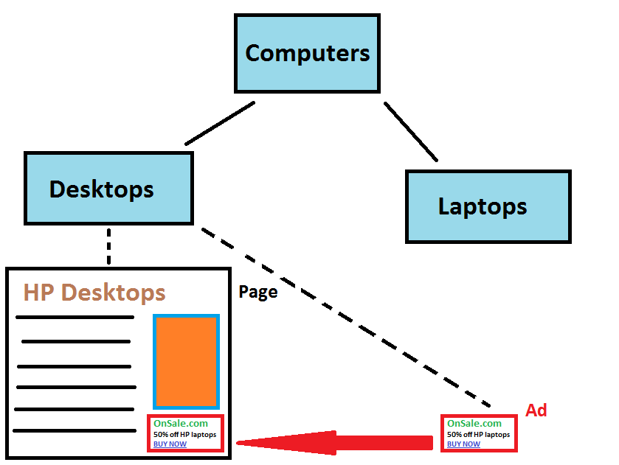
Advantages of Using a hierarchical taxonomy
Classes Set of applicable ads
keywords Narrow down the search.

Slide 9
Taxonomy Choice
Built by a large web search engine in the US
100 queries for each node
Contains 6000 nodes
Used for classifying both pages and ads

Slide 10
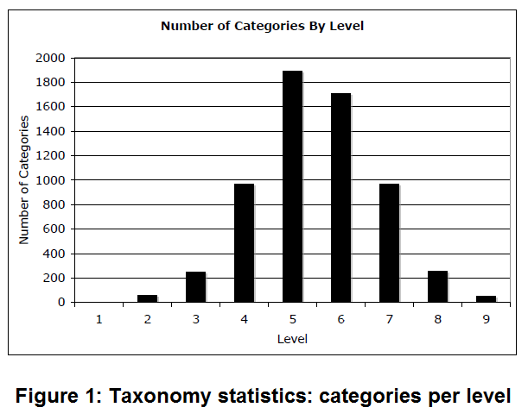
Categories per level
Broder et al.(2007)

Slide 11
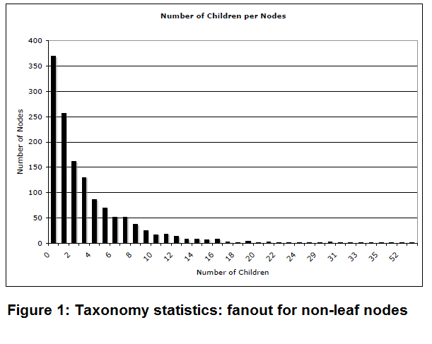
Number of children per node
Broder et al.(2007)

Slide 12
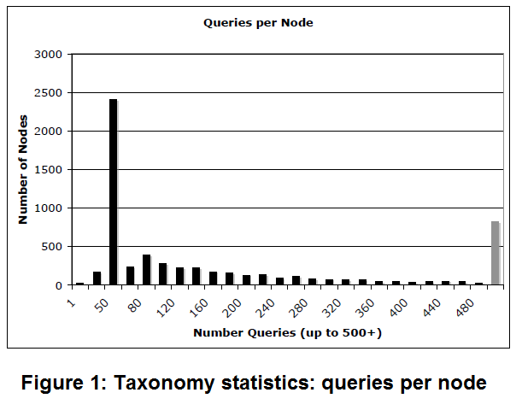
Queries per node
Broder et al.(2007)

Slide 13
Training data
Pages: Select top 10 results of Web search index for each class in the taxonomy
Ads: Select ads with a bid-phrase assigned to the class

Slide 14
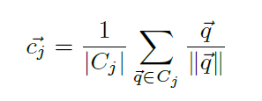
Classifiers:
SVM and log-regression classifiers were slow!
Rocchio’s (nearest-neighbor) gave best performance!
Each taxonomy node: a single meta-document (concatenation of all the example queries), represented as a centroid for the class.
A centroid is the sum of the TF.IDF values of each term.
Classification is based on the cosine of the angle between the document and the centroid.
where c_{j} is the centroid for class C_{j} q iterates over the queries in a particular class.

Slide 15
Semantic-Syntactic Matching
Process the content of the page
Extract features
Search the ad space to find the best matching ads.

Slide 16
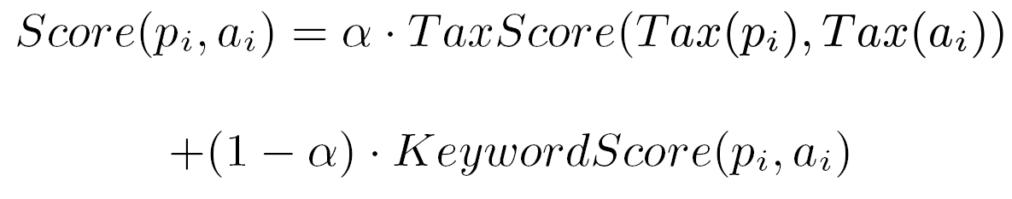
Relevance score
Convex combination of the keyword (syntactic) and classification (semantic) score:
𝝰 determines the relative weight of the taxonomy score and the keyword score.
𝝰 = TaxScore / KeywordScore

Slide 17
KeywordScore (syntactic relevance score)
Uses Vector Space Model
Pages and ads are vectors in n-dimensional space (one dimension for each distinct term)
KeywordScore is the cosine of the angle between the page and the ad vectors

Slide 18
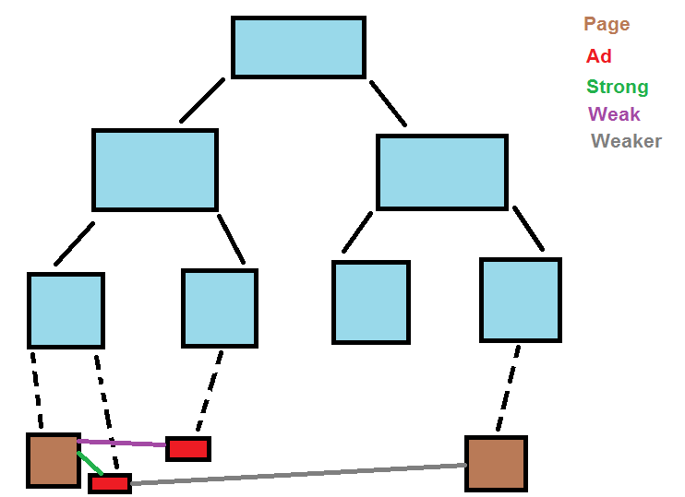
TaxonomyScore (semantic relevance score)
(page-ad topical match score)
Purpose:
1. Match ads and pages based on the topic
2. Generalization within a taxonomy
3. Efficient search of the ad space (user is waiting)
Ideally:
The match is stronger when both the ad and the page are classified into the same node and weaker when the distance between the nodes in the taxonomy gets larger.

Slide 19
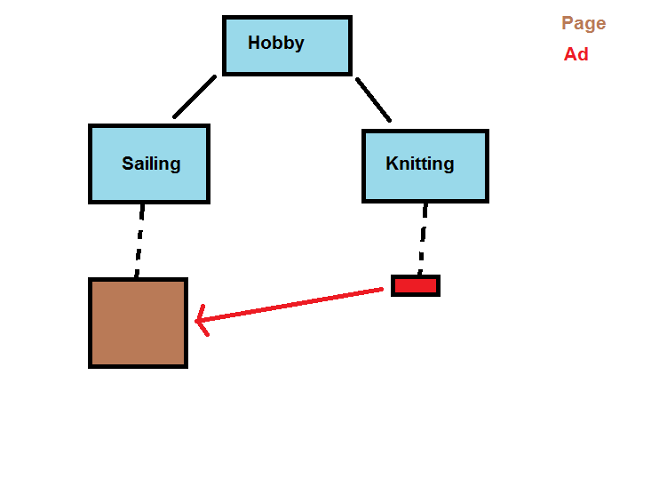
Generalization Challenge

Slide 20
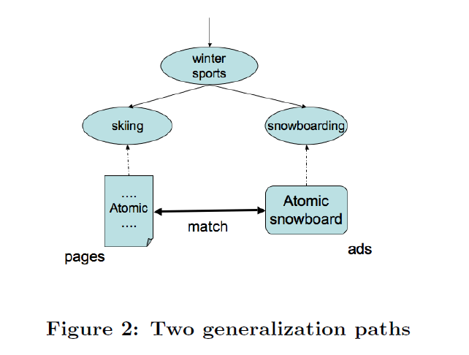
Generalization Advantage
Broder et al.(2007)

Slide 21

Generalization cost
Density: The probability of an ad belonging to the parent topic being suitable for the child topic.
Where:
c is the child node.
p is the parent node.
n_{c} is the number of document classified into the subtree rooted at c.
n_{p} is the number of document classified into the subtree rooted at p.
0 ≤ idist ≤ 1
idist = 1 (the page and ad belong to the same class/node)
idist = 0 (the least common ancestor of page and ad is the root)

Slide 22
Searching the ad space
Using inverted index
The ads are parsed into terms
Each term has a weight based on a section where it appears
Challenge: Preserving class information in the index
Solution: Annotate ads with a unique meta-term for each class
Cons: Generalization is lost!
Instead: Also annotate each ad with one meta-term for each ancestor of the assigned class; utilize weights!
Weights of the meta-terms: the value of idist() function

Slide 23
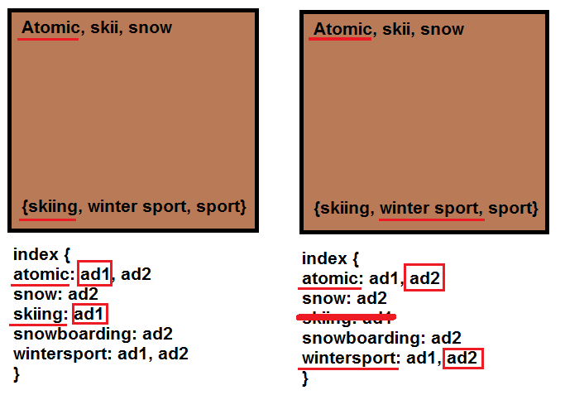
Example:

Slide 24
Data and Methodology
Data: 105 pages randomly selected from 20 million pages with contextual advertising
Tens of millions of ads from advertising network in the US
Human judges for each page-ad pair on a 1 to 3 scale:
1. Relevant
Page: The National Football League
Ad: Tickets for NFL games
2. Somewhat Relevant
Page: The National Football League
Ad: NFL branded products
3. Irrelevant:
Page: The National Football League
Ad: NFL player “John Maytag” triggers “Maytag” dishwasher ads on NFL page.

Slide 25
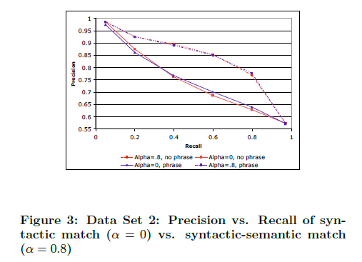
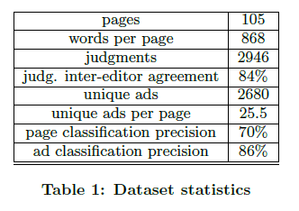
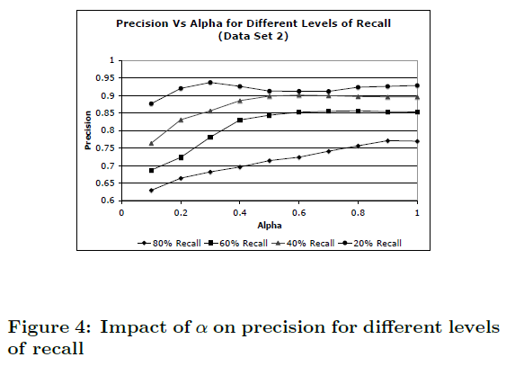
Results
In most cases, precision grows or is flat when Alpha is increased, except at the low level of recall where due to
small number of data points there is a bit of jitter in the results.
Broder et al.(2007)

Slide 26
What to take away?
Syntactic (keyword) matching between pages and ads leads to irrelevant ads.
Semantic (topical) matching relies on the matching between pages and ads in topic
Semantic matching complemented with syntactic matching leads to better results.

Slide 27
The Second Paper:
How much can behavioral targeting help online advertising?
WWW '09 Proceedings of the 18th international conference on World wide web
Pages 261-270
http://citeseerx.ist.psu.edu/viewdoc/download?doi=10.1.1.215.1473&rep=rep1&type=pdf

Slide 28
What is Behavioral Targeting BT Ads?
The delivery of ads to targeted users based on their web search and browsing history.
How much can BT help online advertising?
Strategies to represent the users’ behavior:
1. Web browsing history
2. Search queries
Which BT strategy is better for user segmentation?
The performance of online advertising is measured by ads Click-Through Rate (CTR)
Calculate & compare ads click entropy, precision, recall, and F-measure for different BT strategies.
Short window (1 day) vs long window (7 days)

Slide 29
Modeling User Browsing History
Users are represented by a matrix U_{gxl}
g: number of users
l: number of urls
TF.IDF:
Users are the documents
URLs are the terms
Each entry in the matrix is given the value:
 | Lnk₁ | Lnk₂ | ... | Lnk_{l}
usr₁
usr₂
...
usr_{g}

Slide 30
Modeling User Search History
Query history uses Bag-of-Words (BOW) model to populate TF.IDF matrix.
Stop words are removed and Porter stemming is used
Terms that only appear once are removed. (why?)
Number of terms is reduced from 765k to 294k

Slide 31
Examined BT Strategies:
Two BT strategies (pages visited, queries searched)
Two window sizes (long term: 7 days, short term: 1 day)
Lead to four possible BT strategies to assess:
1. Long term behavior based on page views (LP)
2. Long term behavior based on query terms (LQ)
3. Short term behavior based on page views (SP)
4. Short term behavior based on query terms (SQ)

Slide 32
Raw Data Clean-Up!
Source: A commercial search engine (Bing?)
log dataset records all users’ search click behavior: 1. Web page clicking
2. Ad clicking
Period: 7 days’ click-through log data ranging from June 1st to 7th 2008
Users removed if they clicked on more than 100 ads in one day (robots)
Ads removed if they have fewer than 30 clicks over seven days (cannot be used to draw a reliable statistical conclusions)
Only English queries are considered!

Slide 33
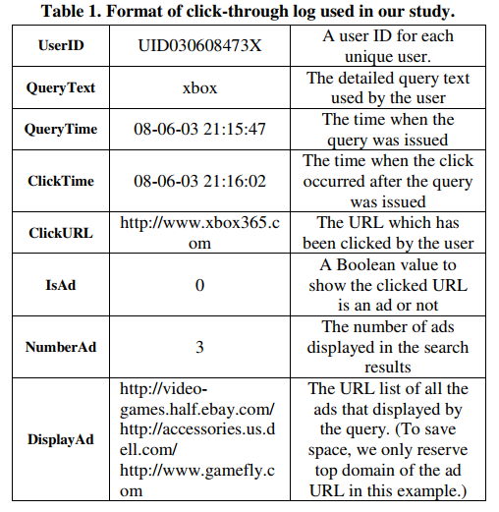
Click-Through Log Format
Yan et al.(2009)

Slide 34

Definitions:
A = {a₁, a₂, …, a_{n}} is the set of ads
Q_{i} = {q_{i1}, q_{i2}, …, q_{imi}} queries which have displayed or clicked a_{i}
U_{i} = {U_{i1}, U_{i2}, …, U_{imi}} users who have displayed or clicked a_{i}
δ(u_{ij}) is used to show whether the user u_{ij} has clicked the ad a_{i}
K-means and and CLUTO (a clustering software package) cluster users into groups: g_{k}(U_{i}) is all users in U_{i}

Slide 35



Calculating Similarity Between Users
Cosine similarity is used:
Within-ad similarity: Users who clicked the same ad
Between-ad similarity: Users who clicked different ads

Slide 36

Similarity Ratio
Ratio between within-ad and between-ad similarity
The larger the ratio, the more confident we are on the basic assumption of BT for a pair of ads a_{i} and a_{s}

Slide 37

Ad Click-Through Rate (CTR)
The CTR of ad a_{i} is defined as the number of users who clicked it over the number of users who either clicked it or only displayed it.

Slide 38
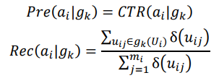

F-measure
CTR can be used to calculate precision and recall
Positive instance: Users displayed and clicked a_{i}
Negative instance: Users displayed a_{i} but didn’t click it
Precision: CTR of segment
Recall: clicks of segment/total clicks
F-measure:
The larger the F measure is, the better the achieved performance is by user segmentation for BT

Slide 39


Ads-Click Entropy
For ad a_{i}, the probability of users in segment g_{k}, who will click this ad, is estimated by:
Ads-Click Entropy (mathematically):
Smaller Entropy => Better user segmentation

Slide 40
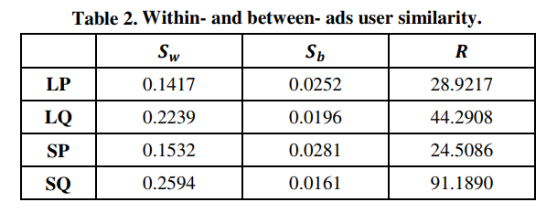
Within- and between- ads user similarity
Scores are average across all ads or query terms
- Users who clicked the same ad are up to 91 times more similar
- For all ad pairs, 99.37% had higher within-ad user similarity than between-ad similarity.
- Search queries are more effective than pages clicked in BT
Yan et al.(2009)

Slide 41
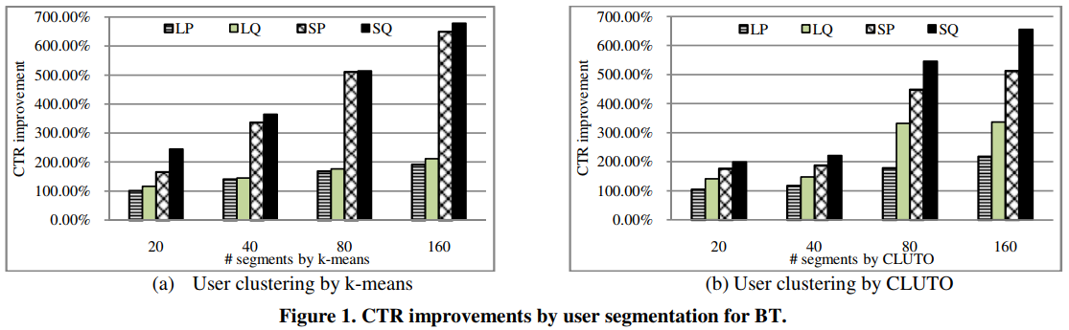
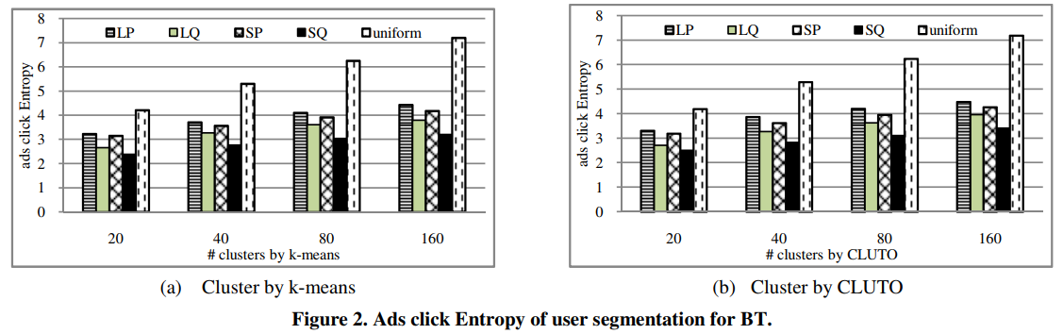
User segmentation improves CTR by 670%:
CTR was improved by up to 670% off of the non segmented CTR
Yan et al.(2009)

Slide 42
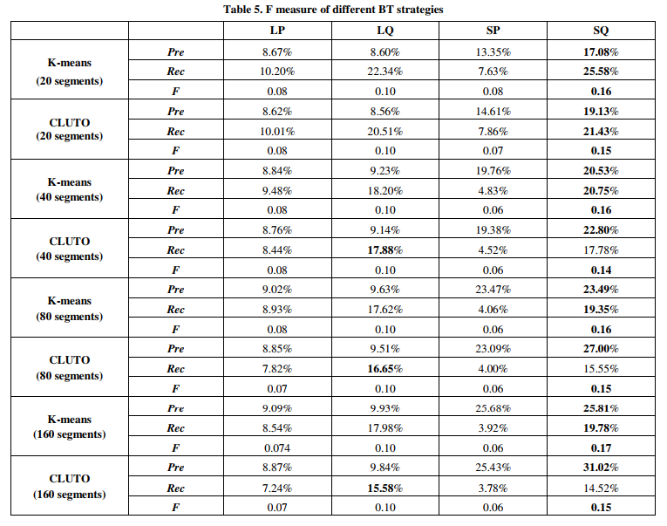
Overall Performance by different methods:
Yan et al.(2009)

Slide 43
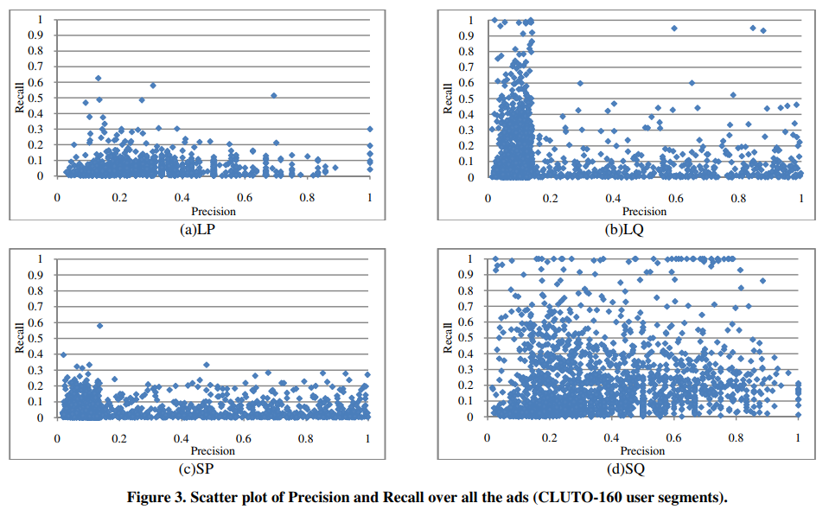
Precision vs Recall for 160 user segments
Yan et al.(2009)

Slide 44
Take away message:
Behavioral targeting can help online advertisement
Users who click the same ads have similar behavior and they are 91 times more similar than those who don’t
User segmentation based on search queries gives better results than pages visited
It is better to use short window to segment users
Increasing the number of segments provides better targeting.
CTR can be improved by 670% using user segmentation

Slide 45
Referrences:
A semantic approach to contextual advertising
SIGIR '07 Proceedings of the 30th annual international ACM SIGIR conference on Research and development in information retrieval
Pages 559-566
http://clair.si.umich.edu/~radev/767w10/papers/Week12/ca/semantic.pdf
How much can behavioral targeting help online advertising?
WWW '09 Proceedings of the 18th international conference on World wide web
Pages 261-270
http://citeseerx.ist.psu.edu/viewdoc/download?doi=10.1.1.215.1473&rep=rep1&type=pdf

Slide 46
Why did the 2nd paper cite the 1st paper?
Both papers introduce methods to deliver ads related to users’ interests
Page content indicates visitor’s interest
User’s internet behavior determines interest
Similar behavior indicates similar interest
Visited web page
Search query
Ad

