Slide 1
CS834 - Introduction to Information Retrieval Presentation #3
Hussam Aldeen Hallak
1

Slide 2
The Two Papers:
Fast generation of result snippets in web search SIGIR '07 Proceedings of the 30th annual international ACM SIGIR conference on Research and development in information retrieval Pages 127-134
Good Abandonment in Mobile and PC Internet Search Jane Li, Scott B. Huffman, Akihito Tokuda, Google Inc - Proc. SIGIR ’09 , 2009
2

Slide 3
The First Paper: Seminal paper from the book
Fast generation of result snippets in web search SIGIR '07 Proceedings of the 30th annual international ACM SIGIR conference on Research and development in information retrieval Pages 127-134
http://citeseerx.ist.psu.edu/viewdoc/download?doi=10.1.1.72.4357&rep=rep1&type=pdf
3

Slide 4
Snippets
Sentences or fragments extracted from a document
Gives a content preview
Allows the user to get an idea of what’s inside the document
Sometimes, it contains the answer to the search query
4

Slide 5
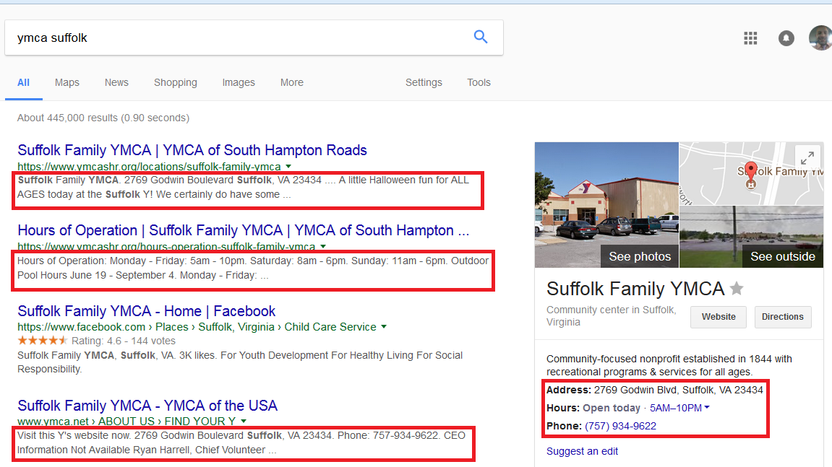
Google Snippets
5

Slide 6
Results Page Construction
Lexicon Engine: Maps query terms to integers
Ranking Engine: Generates inverted lists and ranks documents
Snippet Engine: Generates snippets from query term numbers and document numbers
Meta Data Engine: Fetches other information to construct results page (e.g., URI, page title, document type, size, ...etc.)
6

Slide 7
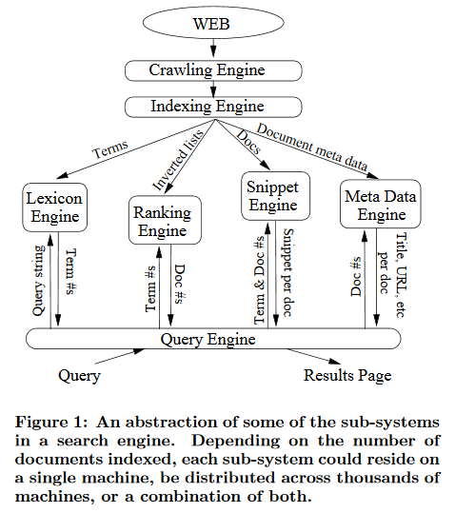
Search Engine Architecture
7
Turpin (2007)

Slide 8
Two types of snippets:
Static: - Generated from a document and stored - Fixed for each document - Query independent
Dynamic: - Generated from the query and the document - Query-biased - Different snippets are generated for the same document based on the query.
8

Slide 9
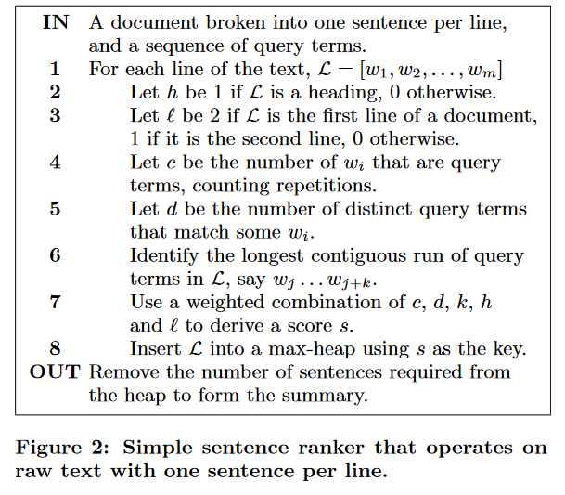
Simple Sentence Ranker
9
Turpin (2007)

Slide 10
Dynamic Snippets: Challenges & Solutions
Challenges: - Generating dynamic snippets takes time. - Billions of web pages to store and access their files on the disk to generate dynamic snippets. - Hundreds of millions of search queries.
Solutions: - Disk access reduction: Cache: 1- Frequently accessed documents 2- pre-computed result pages for popular queries - Compression: Smaller documents size → more can be cached. - Compaction: Only cache the important part of the document.
10

Slide 11
Baseline Snippet Engine:
Uses a well-known adaptive compressor: Compress all documents Decompress as needed.
Implemented using zlib
Each document is stored in a single file
Snippet Generation: - Documents are decompressed one at a time. - Linear search for provided query terms.
11

Slide 12
Compressed Token System (CTS) & CTS Snippet Engine
Uses a semi-static compression: 1- Fast decompression 2- Minimal compression loss
Mapping words and non-words to single integer tokens.
Uses vbyte coding scheme.
Words and non-words alternate in compressed files.
Stores all documents contiguously in one file.
Auxiliary table saves documents’ start offsets.
12

Slide 13
Advantages of CTS over Baseline:
Faster decompression
Scoring sentences without document decompression
Only decode the sentences returned as part of a snippet.
13

Slide 14
Experiments on CTS and Baseline:
Data Collections: WT10G, WT50G, WT100G
Search Queries: Exite Log files from 1997 http://msxml.excite.com/
Search Engine: Zettair
Document Ranker: Okapi BM25 (Simulating PageRank)
14

Slide 15
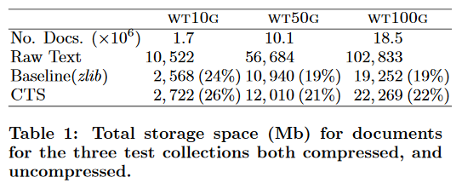
Storage: CTS vs Baseline
Zlib wins by about 2% in disk space saving
15
Turpin (2007)

Slide 16
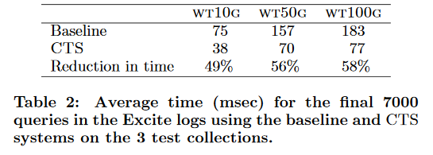
Reduction in time using CTS:
CTS wins by about 50% in snippet generation time
16
Turpin (2007)

Slide 17
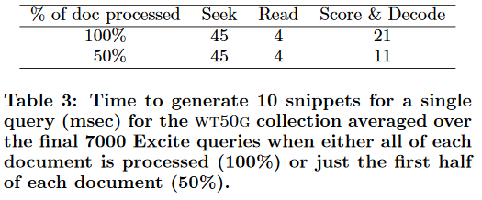
How CTS spends time?
Majority of the time is spent locating the document on disk.
Even when the collection size is cut in half, only 14% time reduction is observed!
It seems logical to try and reduce its impact through caching.
17
Turpin (2007)

Slide 18
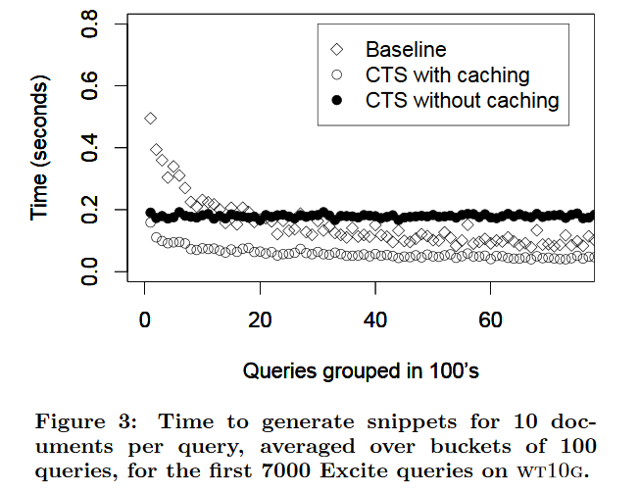
Snippet Generation Time: CTS vs Baseline
18
Turpin (2007)

Slide 19
Document Compaction: Only the important sentences count
Natural order: 1st sentence is the most important. Does not work for poorly written documents.
Query Log Based (QLT): Sentences containing past query terms are the most important.
Query Log Based (QLU): Same as QLT, but only counts unique terms.
Significant Terms (ST): Score based on term frequency (threshold)
19
Turpin (2007)

Slide 20
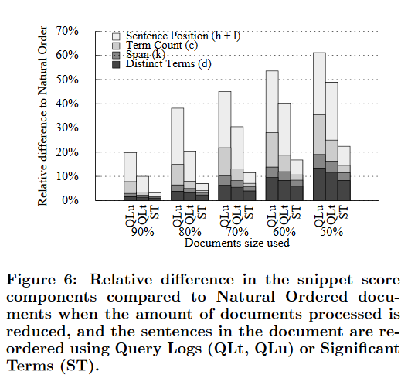
Natural Order vs (QLT vs QLU vs ST)
Significant Terms method wins since it leads to the smallest change in the sentence scoring components.
The greatest change over all methods is in sentence position (h+l) component of the score.
20
Turpin (2007)

Slide 21
The Second Paper:
Good Abandonment in Mobile and PC Internet Search Jane Li, Scott B. Huffman, Akihito Tokuda, Google Inc - Proc. SIGIR ’09 , 2009
http://static.googleusercontent.com/media/research.google.com/en/us/pubs/archive/35486.pdf
21

Slide 22
What is a Good Abandonment?
The user`s information need was successfully addressed by search result page with no need to click on a result or refine the query.
The snippets under the search results were good enough to provide what the user wanted.
This user won’t be clicking on any of the results, but that doesn’t mean that the search has failed.
22

Slide 23
Example of Good Abandonment
23

Slide 24
The Goal:
To approximate the prevalence of good abandonment.
Identify the types of information need that may lead to good abandonment.
24

Slide 25
Why is Good Abandonment so important?
Abandoning usually indicates user dissatisfaction: 1- The user did not click on any result 2- The user did not refine the query
No search engine wants that? NOT TRUE because: 1- Mobile devices are clunky, slow, have formatting and content omission issues. 2- Mobile users need quicker responses. 3- Search engines use mobile user’s location to find local addresses, phone numbers, ... etc. 4- Search Engines want to accurately answer your query as quick as possible.
25

Slide 26
Definitions:
Potential Good Abandonment: - User’s query should mostly be answered by the result page. - It is judged by looking at the query to generate an upper bound of good abandonment.
Likely Good Abandonment: - Subset of potentially good abandonment. - Information need was clearly met on the results page. - Determined by examining the actual results provided by Google.
26

Slide 27
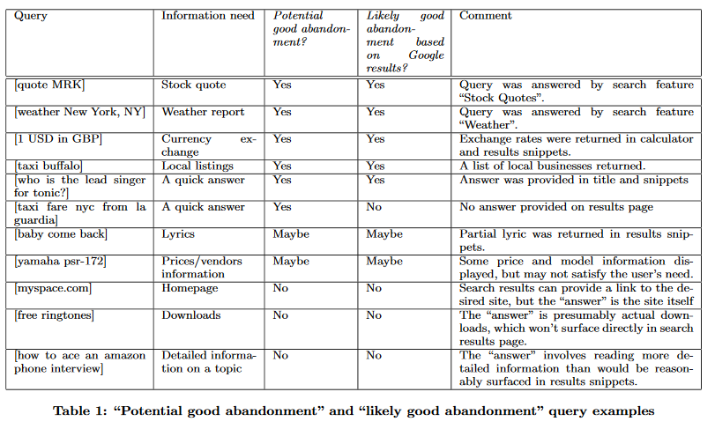
PGA and LGA Query Examples:
27
Jane Li (2007)

Slide 28
Experiment:
Study was conducted on: Two modalities: PC, Mobile devices For Three countries: USA, CHINA, JAPAN
Google’s PC and Mobile search log from a week in Sep-Oct 2008
Sampled 400 abandoned queries from Japan, US, and 1000 from China for both mobile and PC.
28

Slide 29
Upper Bound Estimate of Good Abandonment:
The proportion of abandoned queries classified as ‘YES’ or ‘MAYBE’ a potential good abandonment out of all abandoned queries.
29

Slide 30
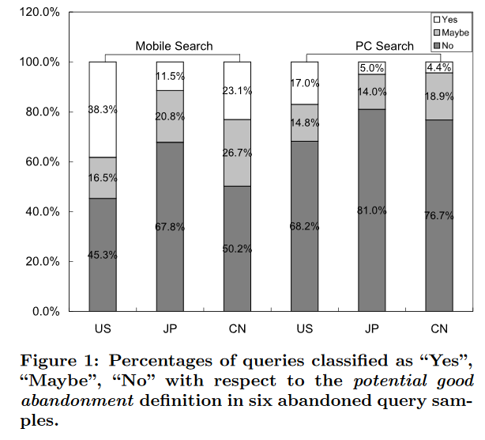
Percentage of PGA Queries:
30
Jane Li (2007)

Slide 31
Observations:
Japan has lowest potential abandonment for mobile search.
Higher potential good abandonment rate in mobile search because: 1- Retrieving web pages on mobile devices is a clumsy experience. 2- Mobile users perform simple searches 3- Mobile users expect to find what they need without clicking on any result. 4- Mobile searches are dependent on activity at the time, current location, … etc.
31

Slide 32
Likely Abandonment Rates:
It measures how often does the user actually get the desired result out of all queries that could potentially lead to good abandonment.
YES: queries that turned out to be good abandonment queries.
MAYBE: authors were not sure if the result page would have satisfied the user
NO: authors thought it would be good abandonment but turns out it is not.
32

Slide 33
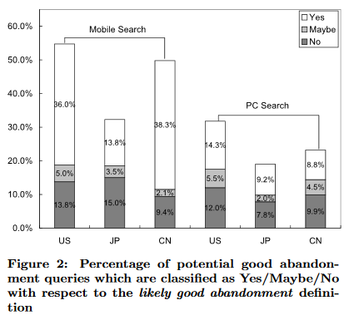
Percentage of LGA Queries:
33
Jane Li (2007)

Slide 34
Observations:
For mobile search 70% of the potential good abandonment queries were met on the result page.
56% for PC.
Over 80% potential good abandonment queries are answered in Chinese mobile searches.
34

Slide 35
Classification by Information Need:
The authors categorized potential or likely good abandonment queries based on information need.
35

Slide 36
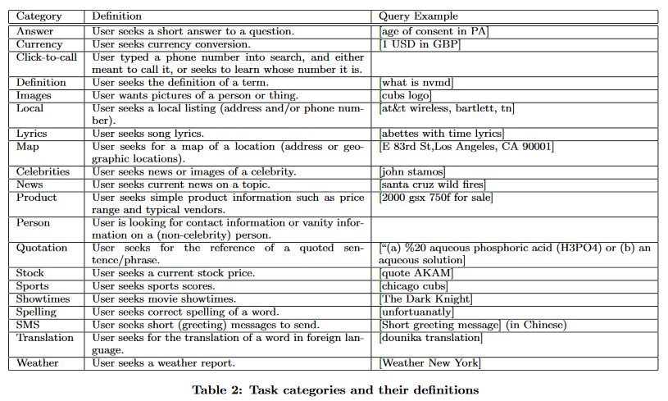
Task Categories Example:
36
Jane Li (2007)

Slide 37
Findings:
The distribution of good abandonment based on information needs varies enormously across search modalities and locales.
Queries seeking local information or short answers are the top classes leading to good abandonment in PC search, consistently across locales.
Significant portion of entertainment related searches in Japan and China, especially in mobile search.
37

Slide 38
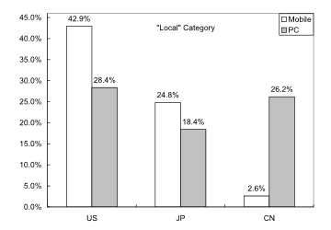
Surprise!
Figure 4:
Jane Li (2009)
Less than 3% “Local” potential good abandonment queries for Chinese mobile search. By contrast, it is the top class for Chinese PC search.
The actual search results were poorly addressed on the results page.
On mobile devices, where text entry is difficult and loading takes longer, people may usually give up.
38

Slide 39
Some Interesting Results:
US users click more often when searching celebrities.
Japanese mobile users browse images or news outlines (satisfied by the snippets).
For Stocks, more good abandonment in mobile because: 1- Mobile users look for stock quotes in the snippets. 2- PC users may seek more information and graphs.
China has most simple mobile searches for weather.
39

Slide 40
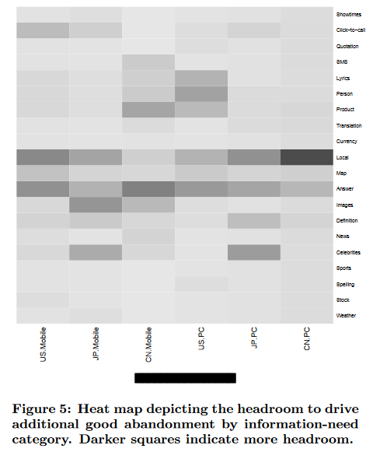
What to improve?
Categories like Celebrities, Local, Answer have scope for improvement.
search engines should address “Local”, “Image” information needs by adding features like “Shortcut Insertions”.
The “Answer” category requires more intelligent snippets.
Longer snippets is better for mobile users since loading a web page is a hassle.
40
Jane Li (2007)

Slide 41
Findings:
Queries leading to good abandonment are a significant portion of all abandoned queries.
Good abandonment rate for Mobile is higher than PC across all locales.
Good abandonment vary by both, locale and modality.
41

Slide 42
Take Away Message:
Query abandonment is not a negative signal.
Evaluation models derived from CLICKS should be improved by taking good abandonment into account.
Search engines still have headroom for good abandonment especially for mobile users.
42

Slide 43
Good Citation?
The first paper introduces a method for fast dynamic and smart snippet generation which leads to higher good abandonment rate, the subject of the second paper.
43

Slide 44
References:
[1] Fast generation of result snippets in web search SIGIR '07 Proceedings of the 30th annual international ACM SIGIR conference on Research and development in information retrieval Pages 127-134
[2] Good Abandonment in Mobile and PC Internet Search Jane Li, Scott B. Huffman, Akihito Tokuda, Google Inc - Proc. SIGIR ’09 , 2009
44

