Slide 1
CS834 - Introduction to Information Retrieval Presentation #1
Hussam Aldeen Hallak

Slide 2
The Two Papers:
The Anatomy of a Large-Scale Hypertextual Web Search Engine (the original Google paper 1998)
Sergey Brin and Lawrence Page
The Anatomy of a Large-Scale Social Search Engine (2010)
Damon Horowitz and Sepandar D. Kamvar

Slide 3
First Paper
The Anatomy of a Large-Scale Hypertextual Web Search Engine (the original Google paper 1998)
Sergey Brin and Lawrence Page

Slide 4
Design Goals: Scalability
The web is growing rapidly. Search engines didn’t scale well.

Slide 5
Design Goals: Improve Search Quality
Web pages are increasing, but user’s ability to look at them is behind.
In 1998, search engines returned so much junk and spam documents.
Early search engines could not find themselves!

Slide 6
Design Goals: Academic Search Engine Research
Push more development and understanding into the academic realm.
Develop Systems that reasonable number of people can use (user friendly).
Build an architecture to support novel research activities in large-scale web data.

Slide 7
PageRank: Bringing Order to the Web!
Using link structure of the Web to calculate a quality ranking for each page. (citation like)
Page quality/ranking depends not only on the number of pages that point to it, but also the ranking/importance of these pages.
Example: If Amazon.com put a link to my website (cited it), my page rank will increase because Amazon.com is so important (has a high PageRank). Also if a large number of unpopular websites link to mine, my PageRank will increase, but not so much.

Slide 8
Calculating PageRank
PR(A): PageRank of a webpage A
PR(T_{i}): PageRank of a webpage T_{i} pointing to A
C(T_{i}): Number of outbound links for webpage T_{i}
L(A): Set of webpages linking to A
d: Damping factor, a value between 0 and 1, is the probability that a random surfer will stop clicking.
Note that PageRanks form a probability distribution of webpages, so the summation of all webpages will be 1

Slide 9
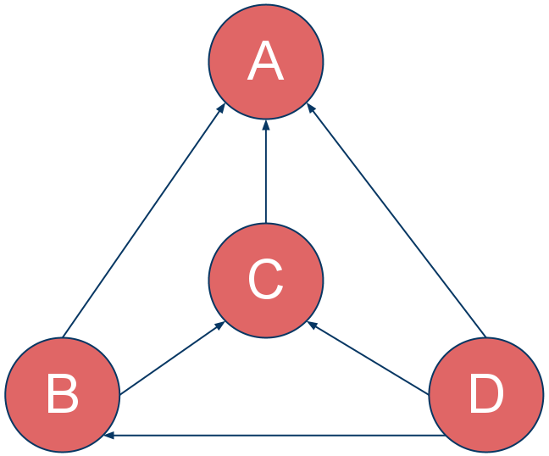
PageRank Calculation Example
Assume a universe of 4 webpages: A, B, C, and D
d is a damping factor. Generally assumed to be 0.85
Repeating the process leads PR to converge!

Slide 10
Search quality: Anchor Text
Using Anchor text of links on webpages.
What is Anchor text? <a href=‘www.example.com’> ANCHOR TEXT </a> <a href=‘www.hussam.us’>Hussam Hallak</a>
Anchor Text of a link is not only associated with the webpage it is on, it also gives information (sometimes more relevant) to the webpage it points to.
Anchors may exist for “un-indexable” documents by text-based search engines, such as images, sound files, programs, databases, etc.

Slide 11
Other Features
Using location information for all hits and thus making extensive use of proximity in search.
Keeping track of visual presentation of text on webpages such as font sizes and styles. Words with bolder/larger font are given more importance.
Storing complete raw HTML of webpages in a repository.

Slide 12

Major Data Structure: BigFiles and Repository
BigFiles: Virtual files spanning multiple file systems and addressable by 64 bit integers.
Repository: Contains full compressed HTML of all pages stored one after another prefixed with docID, length, and URL. They are compressed using high speed compression technique (zlib).

Slide 13


Major Data Structure: Document Index and Lexicon
Document Index: Keeps information about each document.
Lexicon: Contains a list of null separated words (about 14 million) and hash table of pointers.

Slide 14
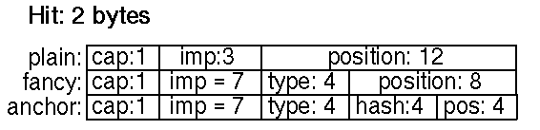
Major Data Structure: Hit Lists
Hit Lists: A list of occurrences of a particular word in a particular document including position, font, and capitalization information.

Slide 15
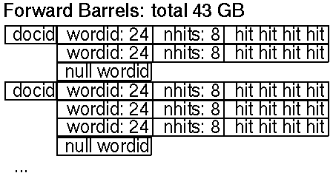
Major Data Structure: Forward Index
Forward Index: Stored in a number of barrels. If a document contains words that fall into a particular barrel, the docID is recorded into the barrel followed by a list of wordIDs with their hit lists.

Slide 16
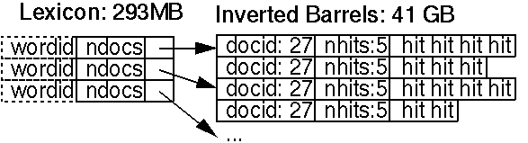
Major Data Structure: Inverted Index
Inverted Index: The inverted index consists of the same barrels as the forward index, except that they have been processed by the sorter.

Slide 17
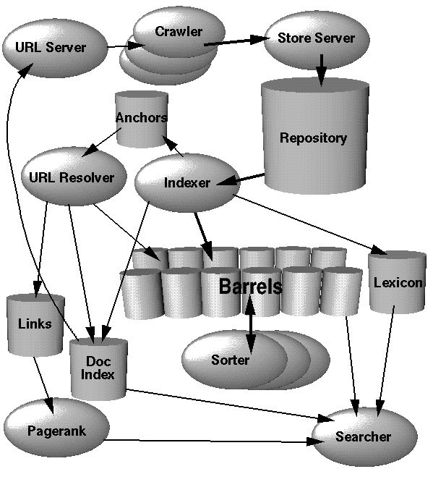
System Anatomy
URL Server
- sends lists of URLs to crawlers
Crawler
- downloads web pages
Store Server
- compresses & stores web pages
into the repository
Indexer
- reads the repository &
uncompresses the documents
- parses the documents
- creates forward index
- parses out the links
URL Resolver
- converts relative URLs to
absolute URLs and then to docIDs
- generates a database of links
- puts the anchor text into the barrels
Sorter
- generates the inverted index
Searcher
- answers queries

Slide 18
Google Query Evaluation
Parse the query.
Convert words into wordIDs.
Seek to the start of the doclist in the short barrel for every word.
Scan through the doclists until there is a document that matches all the search terms.
Compute the rank of that document for the query.
If we are in the short barrels and at the end of any doclist, seek to the start of the doclist in the full barrel for every word and go to step 4.
If we are not at the end of any doclist go to step 4.
Sort the documents that have matched by rank and return the top k.

Slide 19
Second Paper
The Anatomy of a Large-Scale Social Search Engine (2010)
Damon Horowitz and Sepandar D. Kamvar

Slide 20
Social Information Retrieval
Aardvark: Social search engine.
Information Retrieval in a village with no library
Users ask question by: 1. IM 2. Email 3. Web input 4. Text messages 5. Voice
System routes the question to user’s extended social network most likely to be able to answer.

Slide 21
Main components
Crawler & Indexer: Find users, not documents
Query analyzer: Understands user’s information need
Ranking function: Selects the best resource to provide information
User interface: Presents information

Slide 22
How it works
A new user joins Aardvark: 1. Use existing social networks to import and index friendships and affiliation information 2. Add it to social graph 3. Users are connected through common groups reflecting real world affiliations. 4. Index topics the user knows about (manually entered by user, extraction, endorsements, user’s behavior).

Slide 23
How it works Cont’d.
Forward index: Stores topics, userID, user’s behavior (e.g., answers quality, responsiveness)
Inverted index: Topic ID, list of user IDs who know about that topic, scored lists of user ID’s for quality, responsiveness, etc.

Slide 24
The life of the query
A user asks a question
Send question to transfer layer
Normalize to message data structure
Send to conversation manager
Find if it is a question
If it is, send to question analyzer
Determine the topic
Inform the asker of the topic and allow editing

Slide 25
The life of the query Cont’d.
Issue a request to routing engine
Routing engine accesses the inverted index and social graph for a list of candidates to answer
Rank candidates by quality and topic match
Return a list of routing suggestions to conversation manager
Conversation manager contacts candidates and asks if they would like to answer
Repeat until a satisfactory answer is found

Slide 26
The life of the query Cont’d.
Conversation manager forwards the answer to the asker.
Allows follow up between the asker and the answerer

Slide 27
The model
A. Identify the probability of the answerer giving a satisfactory answer to a question based on topic.
B. Identify the probability of the answerer being trusted by the asker based on connectedness and profile similarity.
Scoring function is defined as the composition of A and B.
Goal: Maximize scoring function!

Slide 28
Social crawling
More active users lead to more potential answerers.
The denser a user’s network is, the larger the effective knowledge base.
Creating good experience for users motivates them to remain active and invite their friends.

Slide 29
Indexing people
Two things to know about a user: 1. Topics he/she knows about 2. People he/she is connected to

Slide 30
Topics to include
Entered manually by the user
Endorsements (e.g., Linkedin)
Parsed from status updates (e.g., Twitter, FB)
Parsed from profiles (e.g., FB, Linkedin, etc.)
Extracted from websites and blogs

Slide 31
Topics to exclude
Exclude a topic if the user: 1. Manually muted the topic 2. Tends to decline to answer questions about it 3. Recieves negative feedbacks on his/her answers

Slide 32
Computing connectedness
Connectedness is stored in the social graph
Continuously updated based on: 1. Social connectedness (mutual friends) 2. Demographic similarity 3. Profile similarity 4. Vocabulary match (e.g., IM shortcuts) 5. Chattiness match (e.g., IM frequency) 6. Verbosity match 7. Politeness match (e.g., thanks, yw, etc) 8. Speed match (responsiveness to other users)

Slide 33
Analyzing questions
Simple factual questions answered automatically using existing common services (e.g., what time is it now? What is the temperature in Norfolk?)
Location sensitive classifier: See if the question is related to a certain location (e.g., what is a great automotive shop in Suffolk, VA?)

Slide 34
Topic Mapping
89% Precision
84% Recall
9 times out of 10, the system is able to route a question to someone with relevant topic in their profile.
5 out of every 6 possibly relevant answerers for each question based on their topics are identified.

Slide 35
Candidates ranking
Routing engine is in charge of ranking candidates. It provides a sorted list of candidate answerers to a question based on topic expertise P(u_{i}|q), connectedness P(u_{i}|u_{j}) and availability.
Topic expertise is also location-sensitive for location-sensitive questions. It eliminates all users in a different location.
Connectedness: Independently calculated, not related to topic expertise.
Availability: Online candidates go to the top. Distributing questions evenly. Historical behavior.

Slide 36
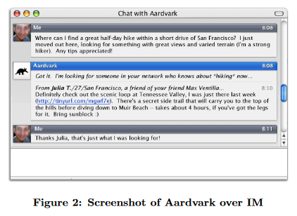
User Interface

Slide 37
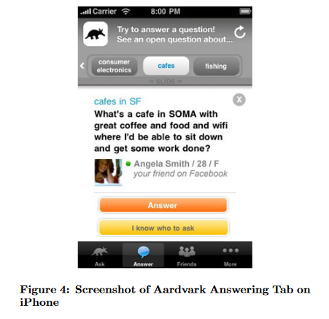
iPhone Aardvark tab

Slide 38
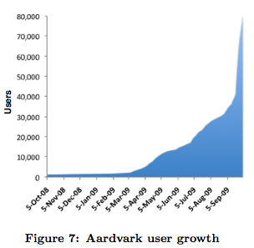
User growth

Slide 39
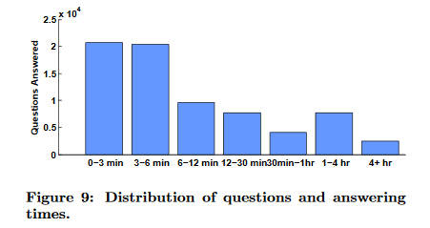
Distribution of questions and answering times

Slide 40
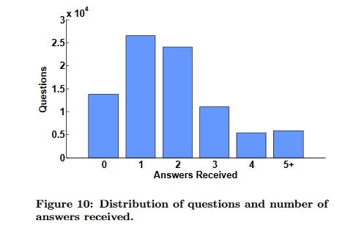
Distribution of questions and # of answers

Slide 41
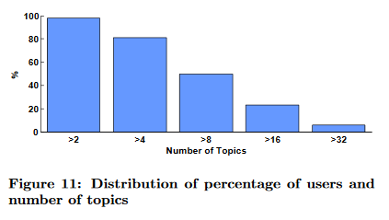
Distribution of percentage of users and # of topics

Slide 42
Aardvark Result Analysis
Aardvark is actively used.
Mobile users are particularly active.
Questions are contextualized (unique Qs and As).
Questions often have a subjective element.
Questions get answered quickly.
High quality answers: 70% good 14% ok 16% bad
Social Proximity Matters!
People are indexable: 98% of users had at least 3 topics. Median is 9 topics.

Slide 43
Evaluation: Compare to Google
Questions were taken from Aardvark users
Discard questions that took > 10 mins to answer
70% of questions answered by Google
71% of questions answered by Aardvark
Time to answer: 1. Google: 2 mins of active searching 2. Aardvark: 5 mins of passive waiting
Reverse experiment was not possible.

Slide 44
Take away message: Comparison
Web Search Engine Google | Social Search Engine Aardvark
Finds documents to answer a question | Finds people to answer a question
Challenge: Finding the right document | Challenge: Finding the right person
Trust: Based on authority | Trust: Based on intimacy
Library like model | Village like model
Effective objective search | Effective subjective search
Query: Short, objective | Query: Long, contextualized, subjective

Slide 45
Referrences
http://video.google.com/videoplay?docid=-1400721382961784115
http://google.stanford.edu
http://en.wikipedia.org/wiki/List_of_search_engines
The Anatomy of a Large-Scale Hyper textual Web Search Engine (1998) Sergey Brin and Lawrence Page.
The Anatomy of a Large-Scale Social Search Engine (2010) Damon Horowitz and Sepandar D. Kamva

