Slide 1
CS834 - Introduction to Information Retrieval
Presentation #5
Hussam Aldeen Hallak

Slide 2
The Two Papers:
Finding high-quality content in social media
WSDM '08 Proceedings of the 2008 International Conference on Web Search and Data Mining
Pages 183-194
How opinions are received by online communities: a case study on amazon.com helpfulness votes
WWW '09 Proceedings of the 18th international conference on World wide web
Pages 141-150

Slide 3
The First Paper:
Finding high-quality content in social media
WSDM '08 Proceedings of the 2008 International Conference on Web Search and Data Mining
Pages 183-194
http://www.mathcs.emory.edu/~eugene/papers/wsdm2008quality.pdf

Slide 4
Web Transformation
1990s
Traditional published material
Content created by publishers
Web users are consumers
2000s
User generated content became popular
Examples:
Blogs
Forums
Photo and video sharing communities: Youtube
Social networks: Facebook
Question / Answer communities: Yahoo! Answers

Slide 5
Yahoo! Answers
Users ask/answer questions on any topic
Users regulate the system through voting:
1. Mark a question as “Interesting”
2. Mark an answer as “Best answer”
3. Vote on Answers “Thumbs up/down”
4. Report abusive content/behavior
Users have threefold role:
1. Asker
2. Answerer
3. Evaluator
Users are forming a social network characterized by heterogeneous interactions

Slide 6
Question Lifecycle
Open: The question is asked by the user
Other users answer the question
Closed: The question gets closed because:
1. Time limit has been reached (4 days by default)
2. Asker closed the question
Resolved: The question gets marked as resolved because:
1. Asker selected the best answer
2. Other users voted on the best answer

Slide 7
Goal
Identify high quality content in community-driven question/answering sites
Examine quality range in user-generated content, which is much wider than traditional content
Utilizing additional sources in the content
1. Link analysis
2. User-to-document relations
3. User-to-User relations

Slide 8
Content Quality Analysis in Social Media
Intrinsic content quality: Mostly text-related
1. Punctuation and typos
2. Syntactic and semantic complexity
3. Grammaticality
User relationships:
1. Nodes: Entities
users, questions, answers, ...etc
2. Edges: Actions & relationships
answers, votes to, asks, ...etc
Usage statistics
1. Number of clicks
2. Dwell time
Binary Classification
High quality vs the rest
Asker
Asks
Q
Answered
Rates
to
A
Gave
Answerer

Slide 9
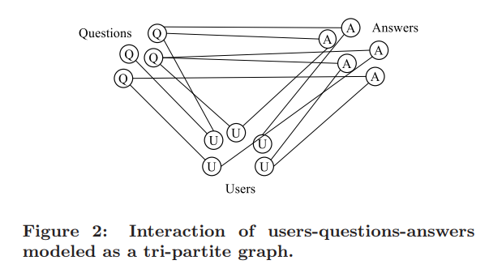
Interaction of users-questions-answers
No triangles
Cycle length >= 6
Agichtein et al. 2008

Slide 10
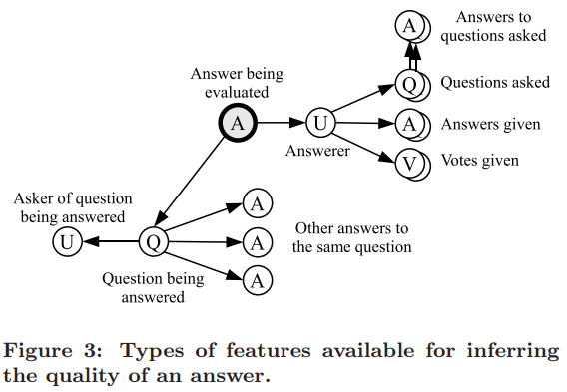
Answer Features’ Types
Example: QU
Agichtein et al. 2008

Slide 11
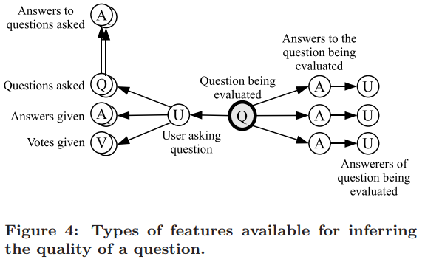
Question Features’ Types
Example: AU
Agichtein et al. 2008

Slide 12
Implicit User-User Relationships
Represented by the graph G = (V, E)
Vertices V = users
Edges E = { E_{a} U E_{b} U E_{v} U E_{s} U E₊ U E₋ } represents relationships between users u and v:
E_{a} represents the answers: (u, v) ∈ E_{a} iff user u has answered at least one question asked by user v
E_{b} represents the best answers: (u, v) ∈ E_{b} iff user u has provided at least one best answer to a question asked by user v.
E_{v} represents the votes for best answer: (u, v) ∈ E_{v} iff user u has voted for best answer at least one answer given by user v.
E_{s} represents the stars given to questions: (u, v) ∈ E_{s} iff user u has given a star to at least one question asked by user v.
E_{+/-} represents the thumbs up/down: (u, v) ∈ E_{+/-} iff user u has given a “thumbs up/down” to an answer by user v.

Slide 13
Experimental Setting
Dataset:
6,665 Questions
8,366 Questions-Answer pairs
Labeled for quality by human editors for:
Well-formedness
Readability
Utility
Interestingness
Answers labeled for correctness
Questions are assigned a high-level type: informational, advice, poll, etc

Slide 14
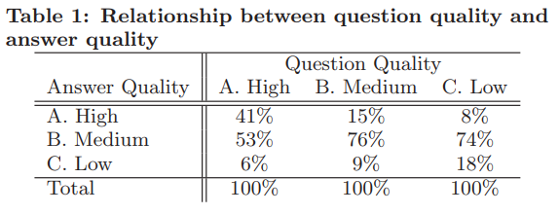
Good questions get good answers
Good answers are written in response to good questions
Bad questions are the ones that attract bad answers
Agichtein et al. 2008

Slide 15
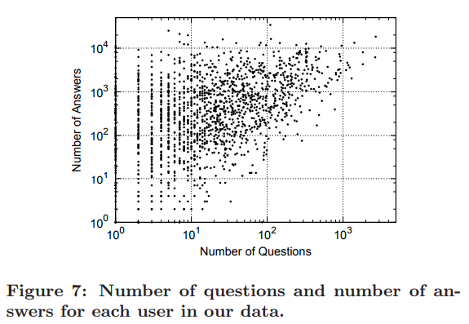
Question/Answers per user
Heatmap?
No clear roles of “asker” and“answerer”
Only users with many questions also have many answers is a by-product of the incentive mechanism of the system (points)
Agichtein et al. 2008

Slide 16
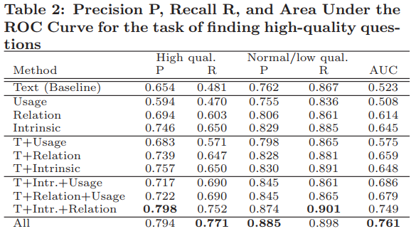
Question Quality Identification Results
Agichtein et al. 2008

Slide 17
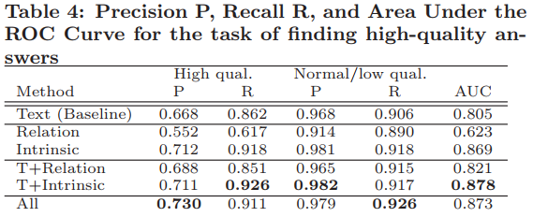
Finding High Quality Answers Measures
Agichtein et al. 2008

Slide 18
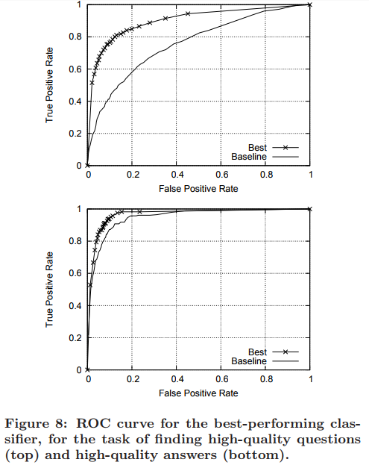
ROC Curve for Best Performing Classifier
Agichtein et al. 2008

Slide 19
Contributions of the paper:
The paper investigates methods for exploiting community feedback to automatically identify high quality content.
Develops a comprehensive graph-based model of user relationships, content, and usage features.

Slide 20
The Second Paper:
How opinions are received by online communities: a case study on amazon.com helpfulness votes
WWW '09 Proceedings of the 18th international conference on World wide web
Pages 141-150
https://www.cs.cornell.edu/home/kleinber/www09-helpfulness.pdf

Slide 21
Study Outline
Helpfulness votes:
Examining users’ evaluation on online reviews
1. Make hypothesis
2. Proving their validity
3. Coming up with a mathematical model that explains these behaviors

Slide 22

Amazon Product Star Rating
Average star rating

Slide 23
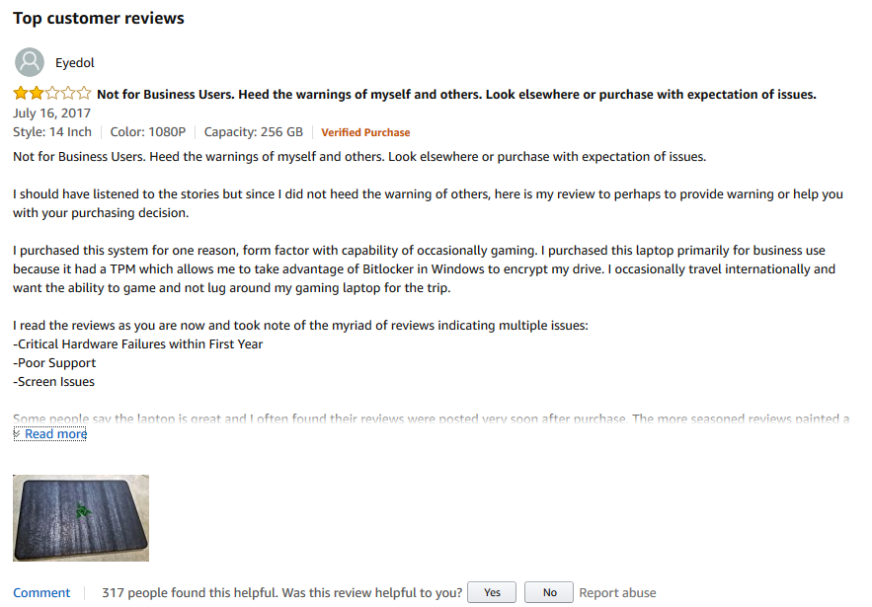
Review Helpfulness Rating
Reviewer rating for the product
Helpfulness rating (used to be ratio)

Slide 24
Product Rating vs Review Rating
Product Rating: Opinion
What did Y think of X?
Review Helpfulness Rating: Opinion²
What did Z think of Y’s opinion of X?
X: Product
Y: User
Z: User

Slide 25
Hypotheses: Social Mechanisms
Well-studied hypotheses for how social effects influence group’s reaction to an opinion
The conformity hypothesis
The individual-bias hypothesis
The brilliant-but-cruel hypothesis
The quality-only straw-man hypothesis

Slide 26
The Conformity Hypothesis
Review is evaluated as more helpful when its star rating is closer to the consensus star rating
Helpfulness ratio will be the highest of which reviews have star rating equal to the overall average

Slide 27
The Individual-Bias Hypothesis
When a user considers a review, he or she will rate it more highly if it expresses an opinion that he or she agrees with

Slide 28
The Brilliant-But-Cruel Hypothesis
Negative reviewers are perceived as more intelligent, competent, and expert than positive reviewers

Slide 29
The Quality-only Straw-man Hypothesis
Helpfulness is being evaluated purely based on the textual content of reviews
Non-textual factors are simply correlates of textual quality

Slide 30
Verifying Hypotheses
Absolute deviation of helpfulness ratio
Signed deviation of helpfulness ratio
Variance of star rating and helpfulness ratio
Making use of plagiarism

Slide 31
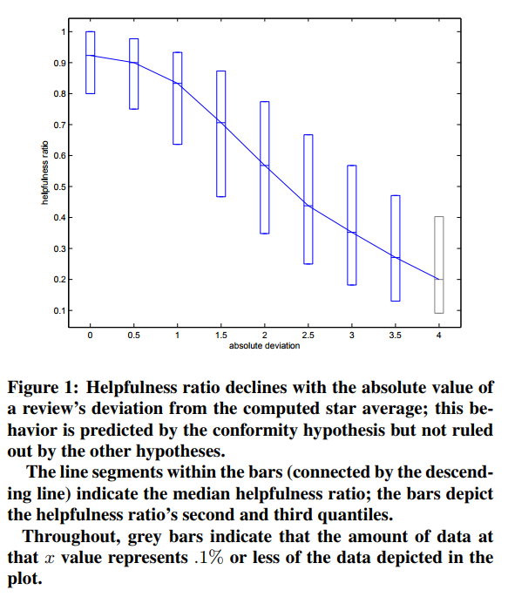
Absolute Deviation from Average
Consistent with Conformity hypothesis
Reviews with star rating close to the average get higher helpfulness ratio
Danescu-Niculescu-Mizil et al. 2009

Slide 32
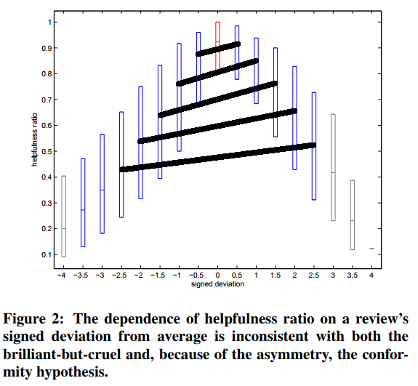
Signed Deviation from Average
Not consistent with brilliant-but-cruel hypothesis
There is tendency towards positivity
Black lines should not be sloped that way if it is a valid hypothesis
Danescu-Niculescu-Mizil et al. 2009

Slide 33
Addressing Individual-Bias Effects
It is hard to distinguish between the conformity and the individual-bias hypothesis
We need to examine cases in which individual people’s opinions do not come from exactly the same distribution
Cases in which there is high variance in star ratings
Otherwise conformity and individual-bias are indistinguishable
Everyone has the same opinion

Slide 34
Addressing Individual-Bias Effects
Helpfulness ratio is the highest when star ratings of reviews have average value
Helpfulness ratio is the highest with reviews of which rating is slightly-above the average
Two-humped camel plots: local minimum around average
Danescu-Niculescu-Mizil et al. 2009

Slide 35
The Quality-only Straw-man Hypothesis
Helpfulness is purely based on the textual content of reviews
Using plagiarized reviews is helpful!
Challenges:
1. Almost (no exact) same text
2. Same exact text could be considered as spam reviews
If the quality-only straw-man hypothesis holds, helpfulness ratio of “same text” reviews should be the same

Slide 36
Plagiarism
Using plagiarism is an effective way to control for the effect of review text
Definition of plagiarized pair(s) of reviews:
Two or more reviews of different products with near-complete textual overlap
Authors consider %70 of textual overlap as plagiarism.

Slide 37
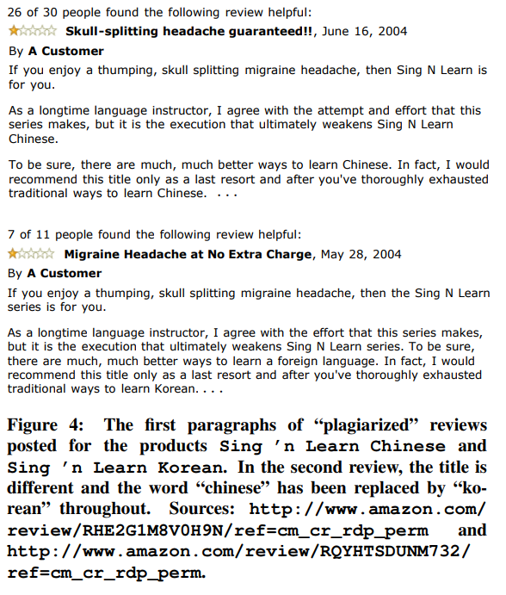
Plagiarism Example
Danescu-Niculescu-Mizil et al. 2009

Slide 38
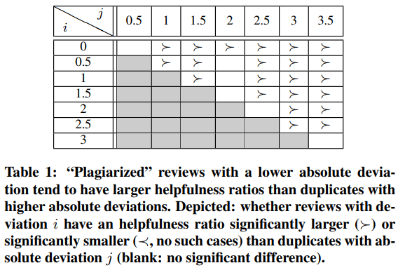
Experiments with Plagiarism
Text quality is not the only explanatory factor
Statistically significant difference between the helpfulness ratios of plagiarized pairs
The plagiarized reviews with deviation 1 is significantly more helpful than those with deviation 1.5
Danescu-Niculescu-Mizil et al. 2009

Slide 39
What to Take Away?
A review’s perceived helpfulness depends not just on its content, but also the relation of its score to other scores
The dependence of the score is consistent with a simple and natural model of individual-bias in the presence of a mixture of opinion distributions

Slide 40
References:
Finding high-quality content in social media
WSDM '08 Proceedings of the 2008 International Conference on Web Search and Data Mining
Pages 183-194
http://www.mathcs.emory.edu/~eugene/papers/wsdm2008quality.pdf
How opinions are received by online communities: a case study on amazon.com helpfulness votes
WWW '09 Proceedings of the 18th international conference on World wide web
Pages 141-150
https://www.cs.cornell.edu/home/kleinber/www09-helpfulness.pdf

Slide 41
Why did the 2nd paper cite the 1st paper?
The second paper studied elements that affect the helpfulness/quality of reviews which took advantage of some of the methods studied in the first paper for identifying high quality content on social media.

