Slide 1

Distributed Programming and Networking
Online Eye Care Clinic
Authors: Husam Nujaim, Anastasiia Rozhyna, Tewele Weletnsea Tareke
Professor: Mario Molinara

Slide 2
1
Problem Statement
2
General and Specific Objective
3
Functional and Non-functional Requirements
4
Project development and Implementation tools

Slide 3
Nearly 1 out of 3 people with diabetes has retinopathy -- damage to the blood vessels in the retina.
34%
42%
Diabetic retinopathy is the most frequent cause of new cases of blindness among adults aged 20–74 years. During the first two decades of disease, nearly all patients with type 1 diabetes and >60% of patients with type 2 diabetes have retinopathy.

Slide 4

Abstract
MAIA EyeCare system provides a computerized platform to manage the online booking of eye clinics.
The system has three main actors.
1
Admin adds ophthalmologists' details and allocate
their appointments on the platform.
2
Patient: registers in the platform and books an available appointment with the desired doctor.
3
Ophthalmologist uploads the retinal images of the patient to the platform and uses deep learning to diagnose the retinal image of the patient and submit the report.

Slide 5
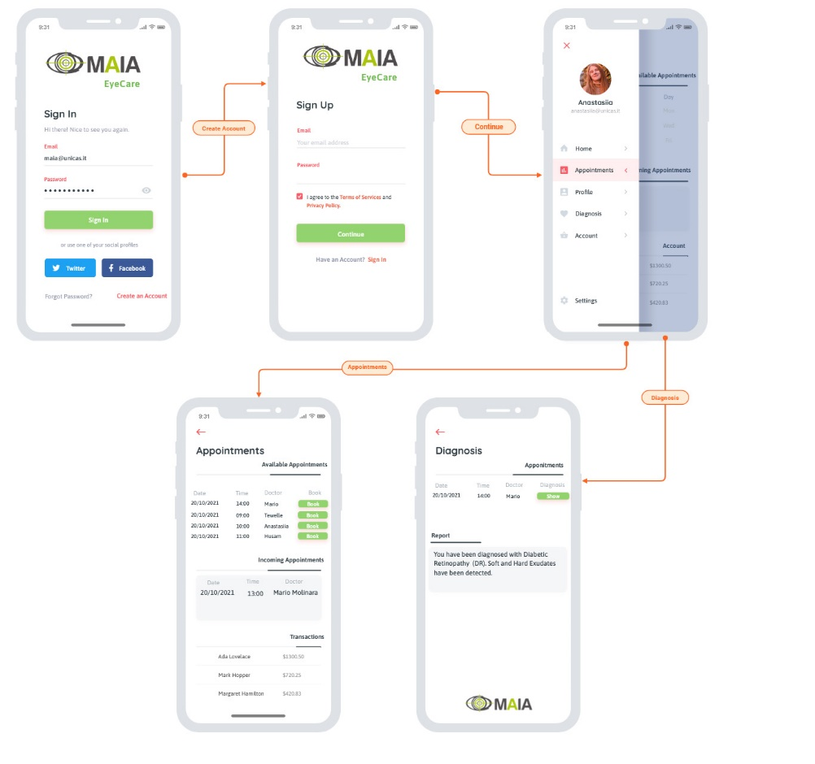
MOCK UP

Slide 6
Problem Statement
The problem of data accuracy, ambiguity, costly and not being able to collect the required data in time.
1
2
Manual systems.
3
4
Existing systems are time consuming, complex and ineffective.
Patient can not check the results of the examination online

Slide 7
General and Specific Objective
Specific
General
1
1
To develop an online booking system for patients and ophthalmologist.
To analyze the existed booking system and design a convenient and flexible online EyeCare clinic system.
2
2
The patient can book an appointment with preferred doctor and view the result after diagnosed and uploaded by the ophthalmologist.
To implement the online EyeCare clinic, test and validate the system.

Slide 8
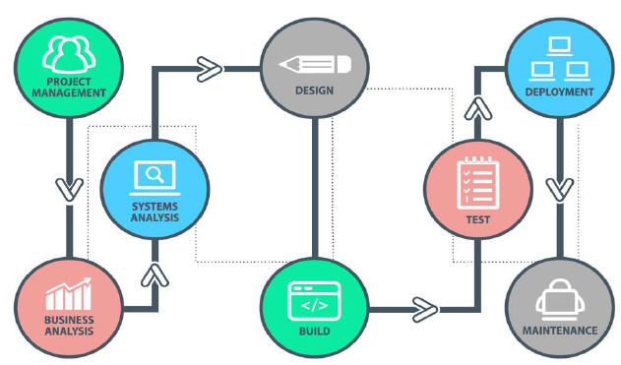
Software development life cycle

Slide 9
Functional requirements
The admin is responsible for adding ophthalmologists' details, allocate their appointments on the platform and updating the system with time. The patient is responsible for registration and booking an appointment with available doctors. The ophthalmologist and his/her role is to diagnosed the image with deep Learning and upload the result to system so that the patient can see it directly.

Slide 10

Non-functional requirements
Security
Availability and Manageability
Performance

Slide 11
Project development
This platform used as web application services and for that we use MVC software design pattern that separates an application into three components that have communication among them to complete process.
In the MVC when we built the system as back-end and front-end that divide the view into external part it represents the same client/server architecture.

Slide 12
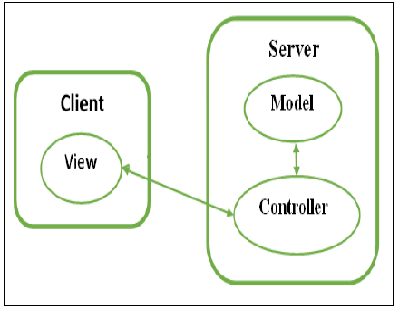
MVC as Client/Server Diagram

Slide 13
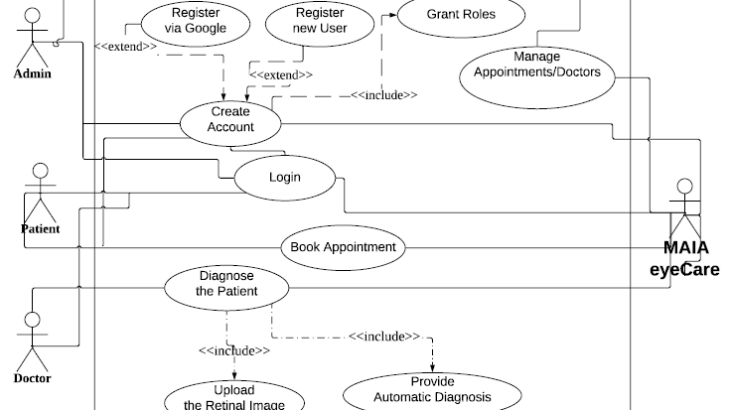
Use case Diagram

Slide 14








Implementation tools
System Technology
Framework

Slide 15
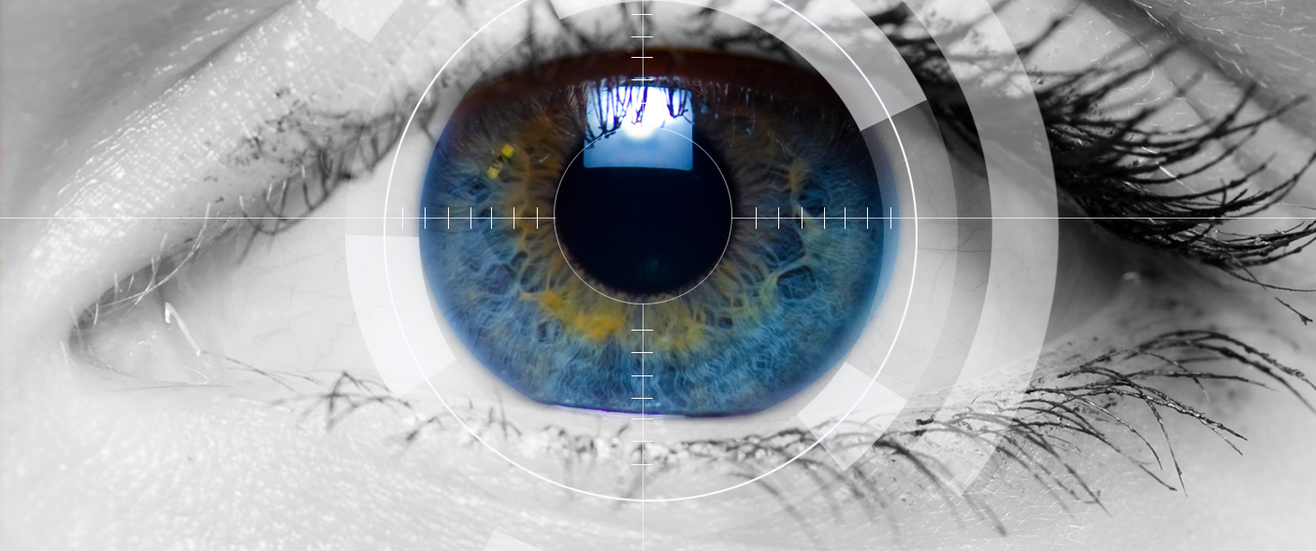
Thank you

