Slide 1



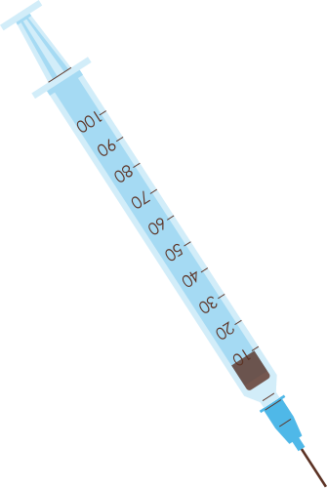

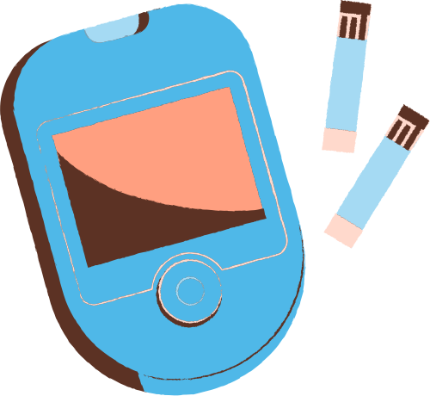

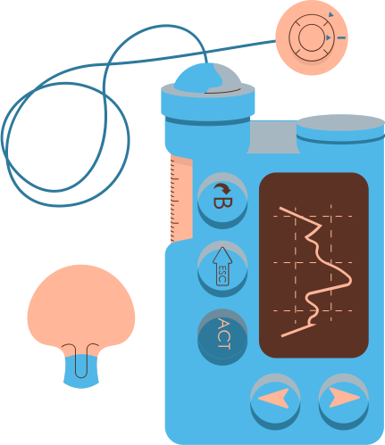
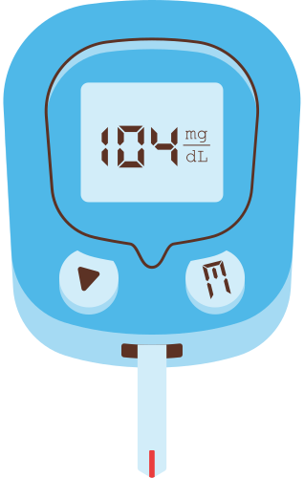

AN INTRODUCTION
TO DIABETES
Created by: Hussein Abbas

Slide 2

TODAY'S AGENDA
Help answer your questions about diabetes.
Explain different types of diabetes.
Explain high blood sugar levels.
Outline how you can manage your diabetes.

Slide 3

ABOUT OUR COMPANY
We are a non-profit diabetes clinic that helps people with diabetes access medical care and education.

Slide 4
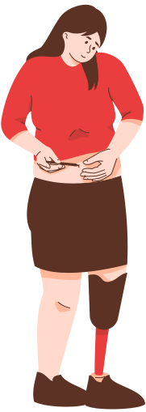
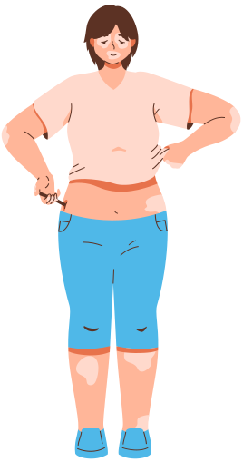
WHAT IS DIABETES?
Write a short background about diabetes.

Slide 5

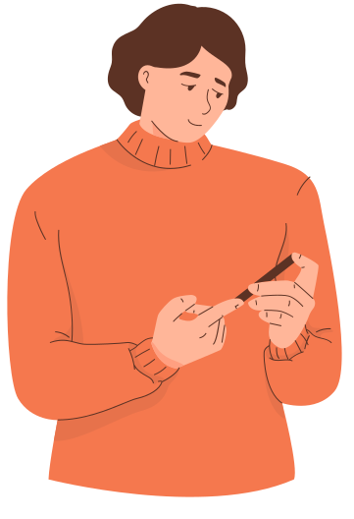

WHAT ARE THE SIGNS AND SYMPTOMS OF DIABETES?

Slide 6
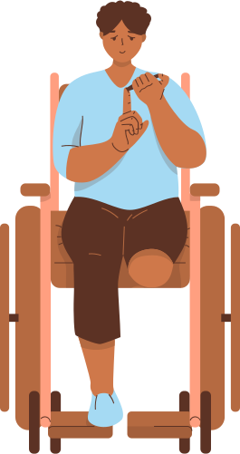
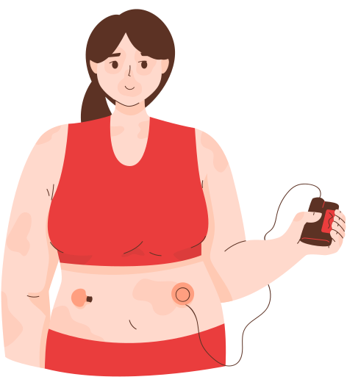
You may be diagnosed with diabetes after you go to your doctor because:
Write a symptom here.
Write a symptom here.
Write a symptom here.
Write a symptom here.
Write a symptom here.
Write a symptom here.
Write a symptom here.
Write a symptom here.
Write a symptom here.
Write a symptom here.

Slide 7
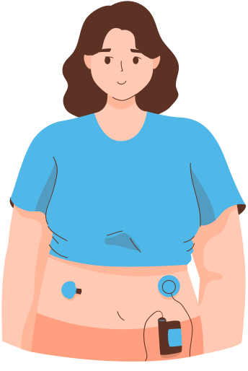
WHAT ARE THE DIFFERENT TYPES OF DIABETES?

Slide 8
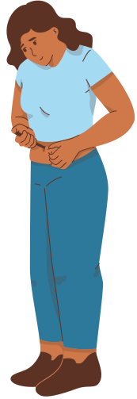
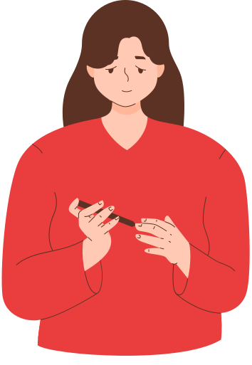
Type
1
Type
2
Gestational Diabetes
Describe Type 1 Diabetes.
Describe Type 2 Diabetes.
Describe Gestational Diabetes.

Slide 9
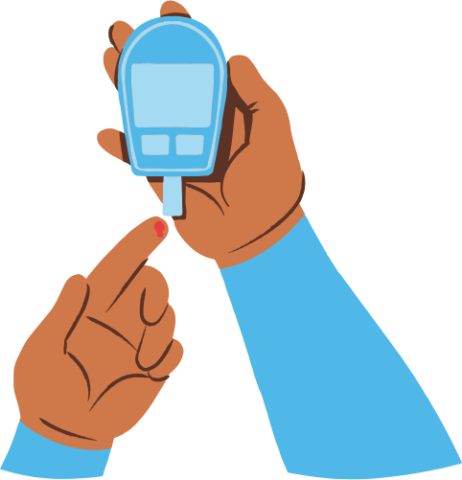
WHAT ARE HIGH BLOOD SUGAR LEVELS?
Explain high blood sugar levels.

Slide 10


WHAT CAUSES HIGH BLOOD SUGAR LEVELS?
Explain the causes of high blood sugar levels.

Slide 11
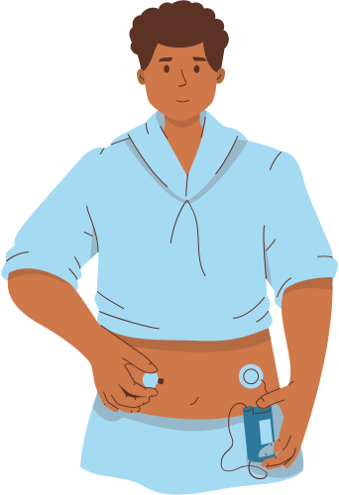
WHAT SHOULD BE YOUR IDEAL BLOOD SUGAR LEVEL?
Elaborate on the ideal blood sugar level.

Slide 12
WHEN SHOULD YOU DO YOUR BLOOD TESTS?
Explain when to take blood tests.

Slide 13



WHAT TYPE OF DIET SHOULD YOU EAT?
Explain the type of diet that people with diabetes should eat.

Slide 14


WHAT ABOUT SPORTS AND EXERCISE?
Explain how exercise can help manage diabetes.

Slide 15
WHAT TYPES OF MEDICATION WILL
YOU NEED?
Explain the type of medications people with diabetes should take.

Slide 16
THANK YOU!
Thank you so much for watching our presentation! Do you have any questions, comments, or suggestions?

